Slide 1


Lithofacies of Core 103
Will Wright
Gregor Eberli, Ralf Weger, & Paulina Manekas

Slide 2
Key Findings
Preliminary observations from Core 103 reveal a diverse array of coral reef lithofacies and microbialite types
Five lithofacies were defined, differentiated by depositional texture, fabric, and biotic components
Numerous microbialite classes were identified, highlighting extensive microbial influence throughout the core

Slide 3
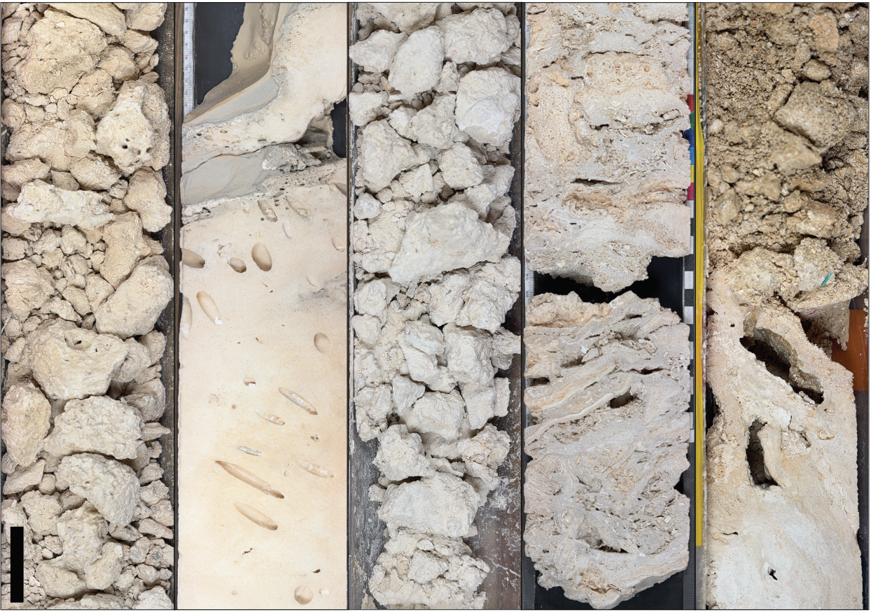
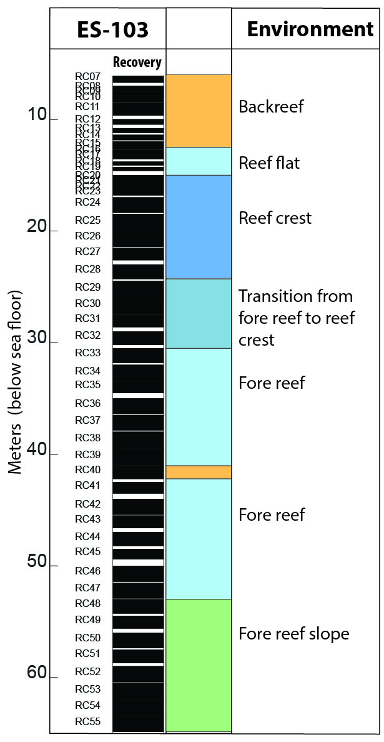
Lithofacies 1 – Coral & Microbialite
Rudstone
Description: Coral and microbialite rudstone with microbialite coating
Fossil Content: Coral, serpulid, Halimeda, bryozoa, bivalve
Notes:
  Numerous dark (possible phosphatic) surfaces; orange staining
  Muddy matrix
  Galaxea sp. > favors lower energy settings
  Backreef environment

Slide 4
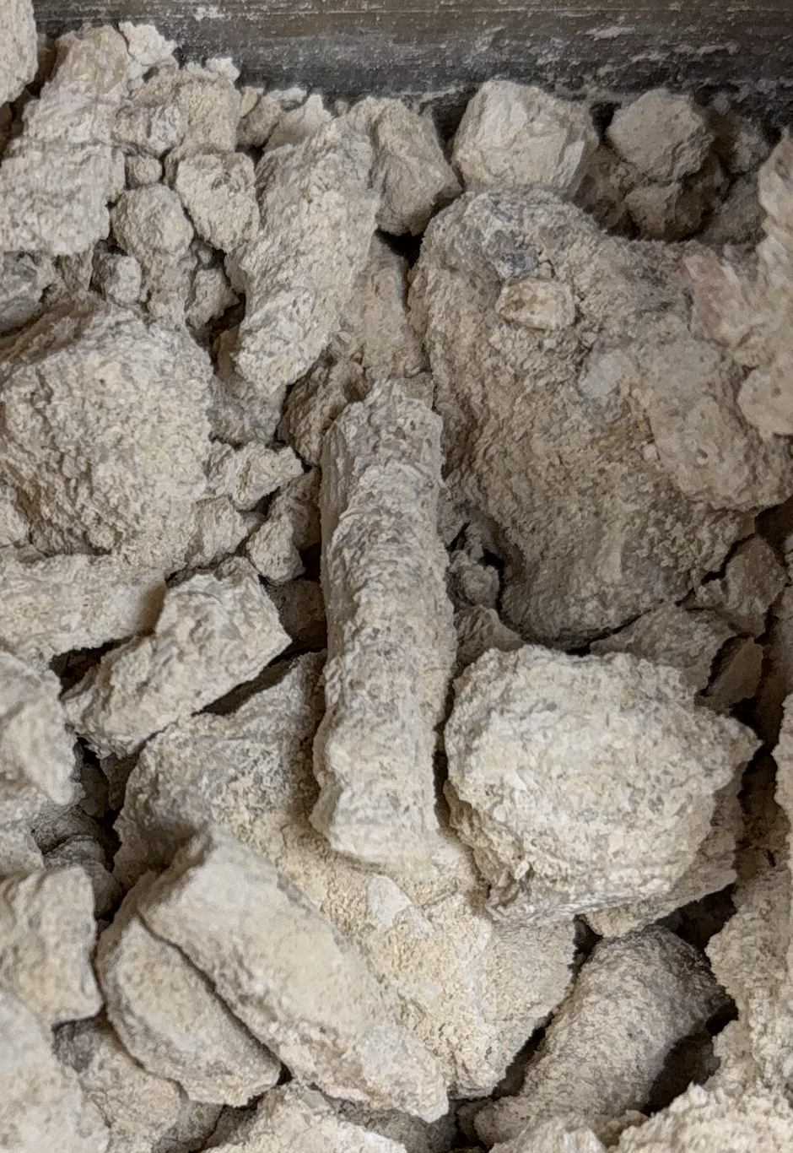
5mm

Slide 5
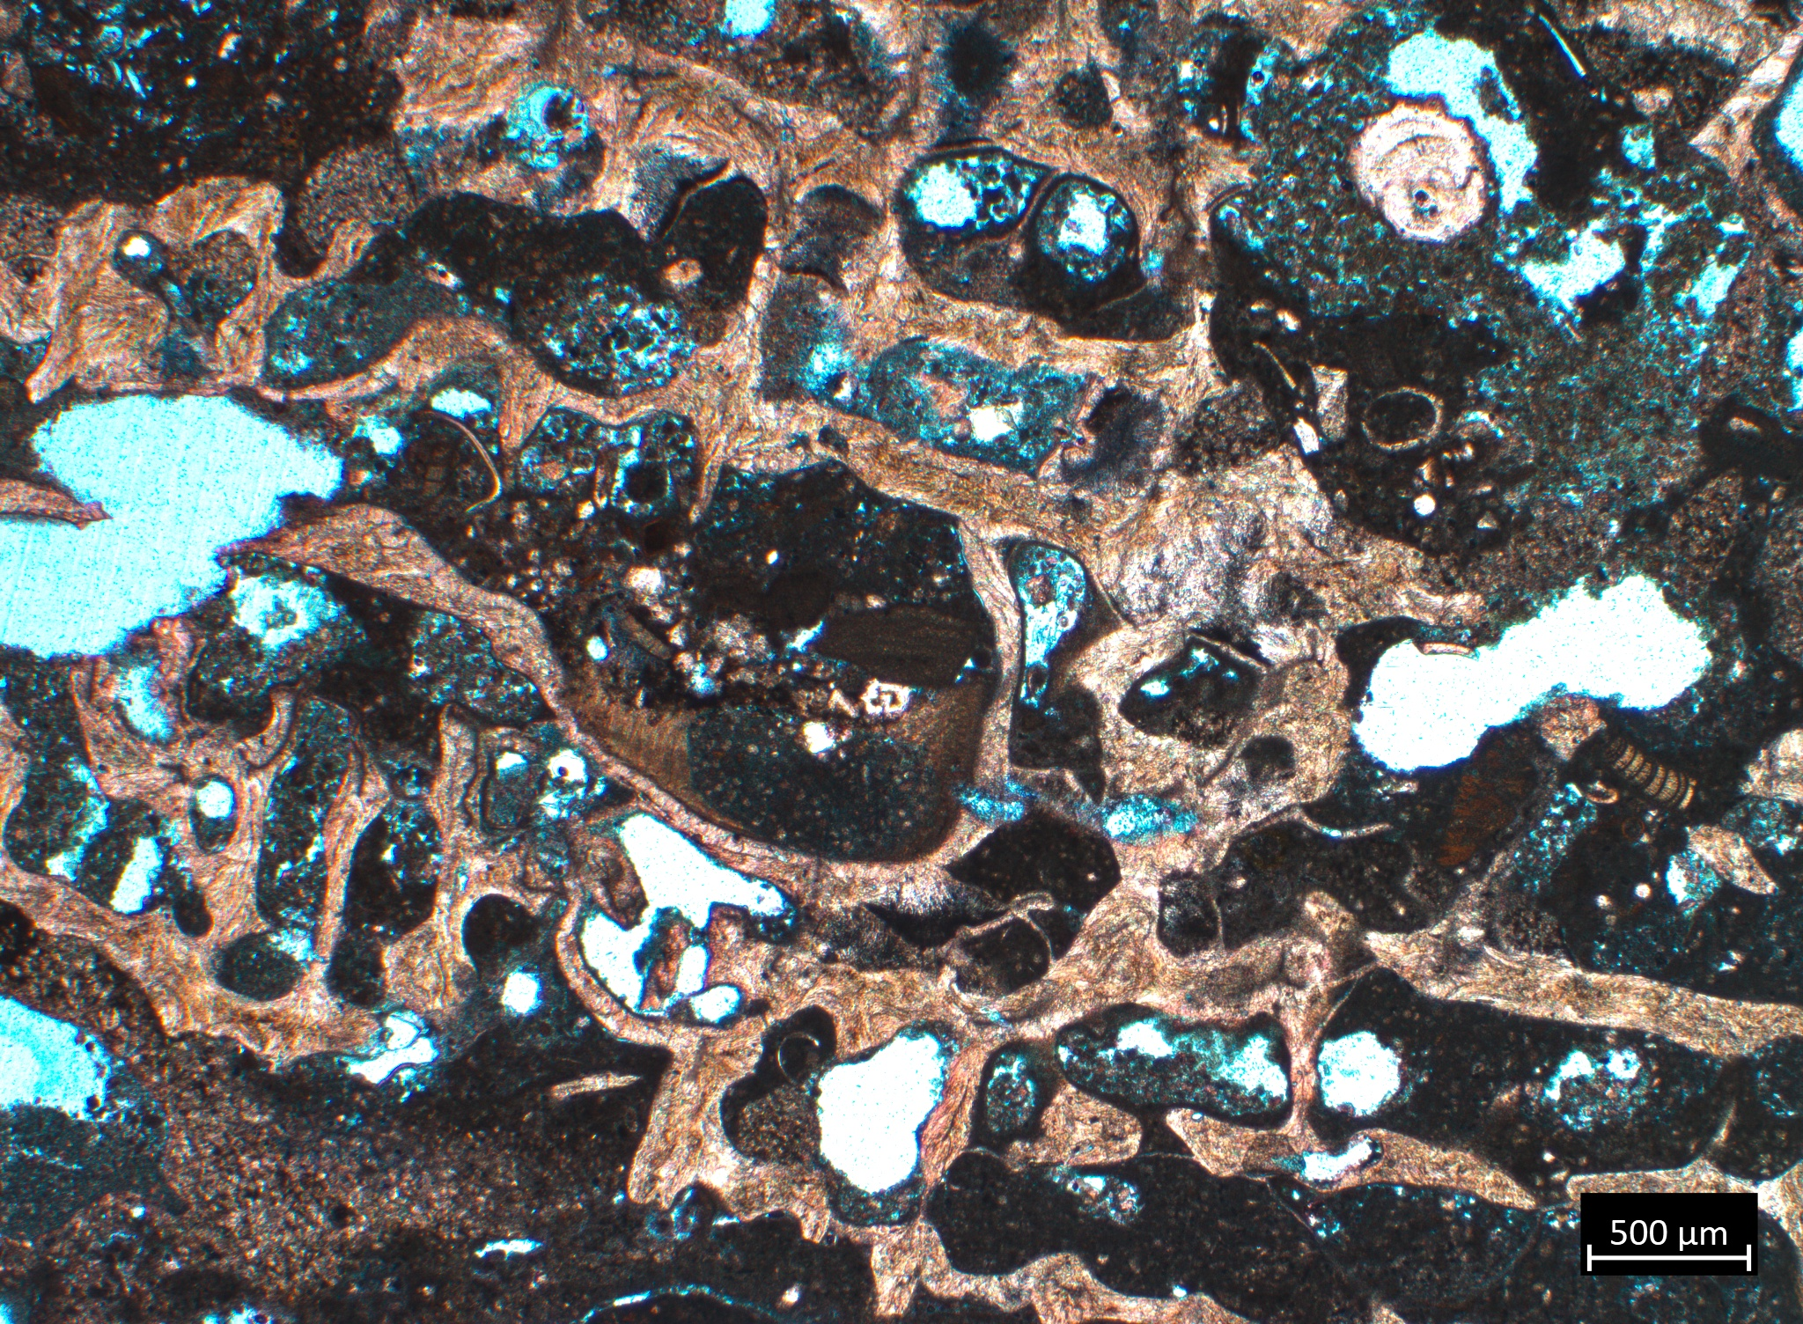
ES-103-RC-11 (8.78m)
Foram
Intraskeletal Microbialite
Skeletal fragment
Red algal thalli
Coral

Slide 6
Lithofacies 2 – Coralgal Framestone with Microbialite Crust
Description: Coral framestone with CCA and microbialite crust
Fossil Content: Coral, gastropod, Halimeda, Homotrema, serpulid, echinoid, bivalves
Notes:
  Dominated by robust branching coral, exceeding 1m
  Coral encrusted by CCA and microbialite
  Multiple microbialite morphologies
  Lithophaga common within coral
  Reef crest environment
Notes:
Add core photos

Slide 7
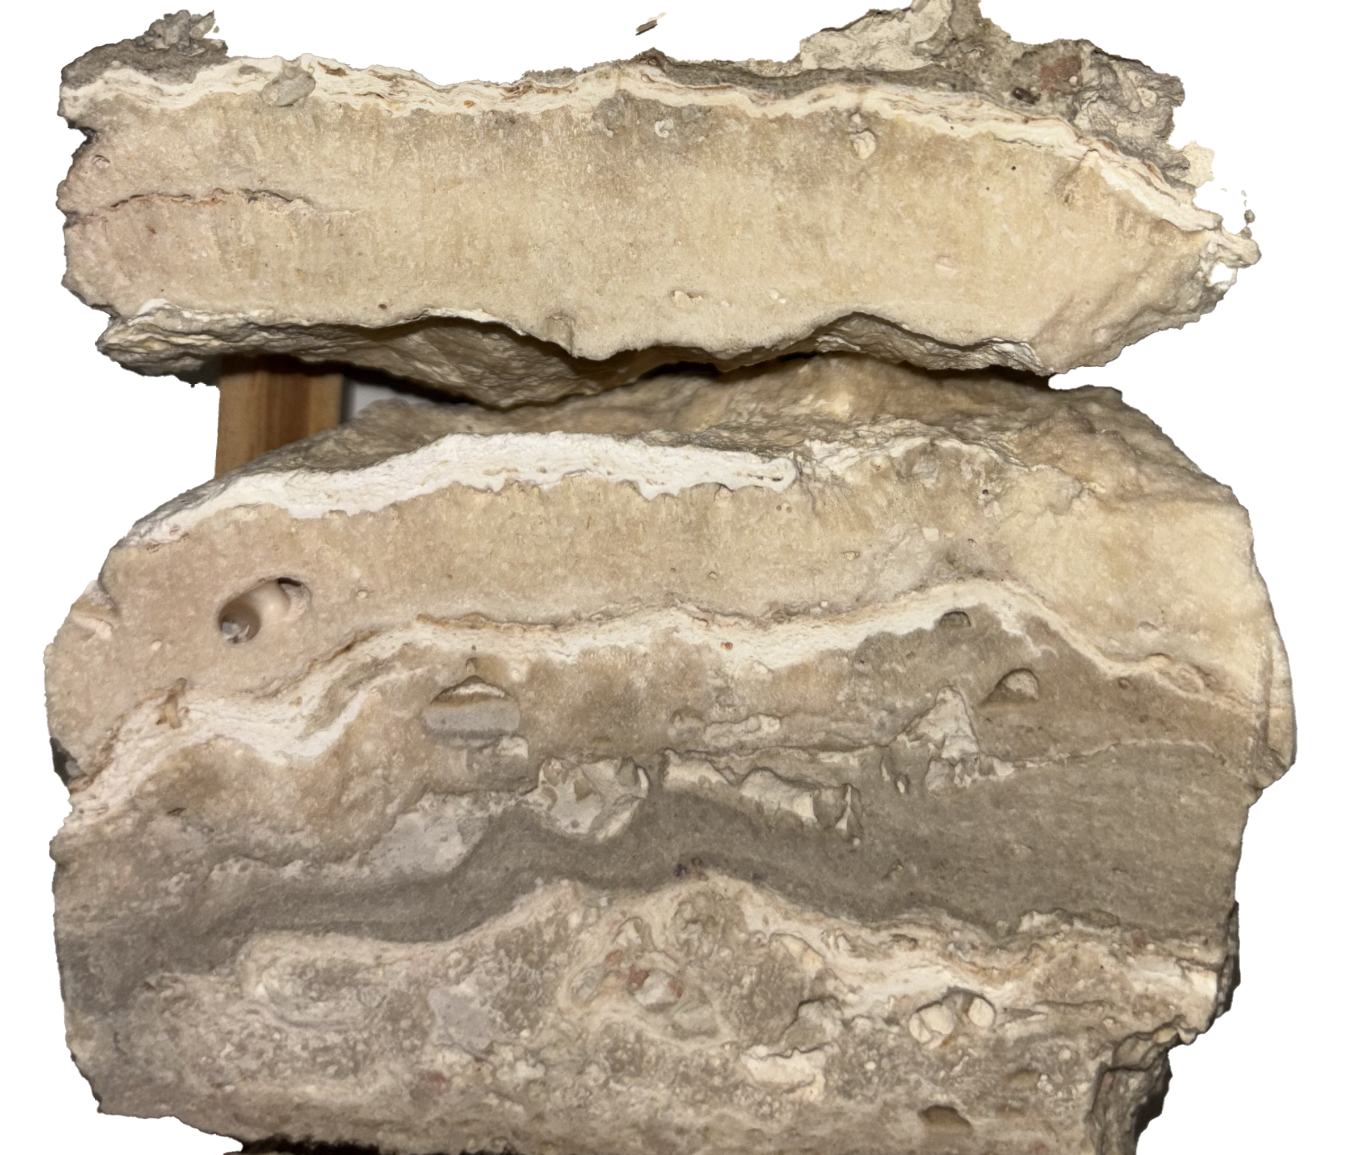
2 CM

Slide 8
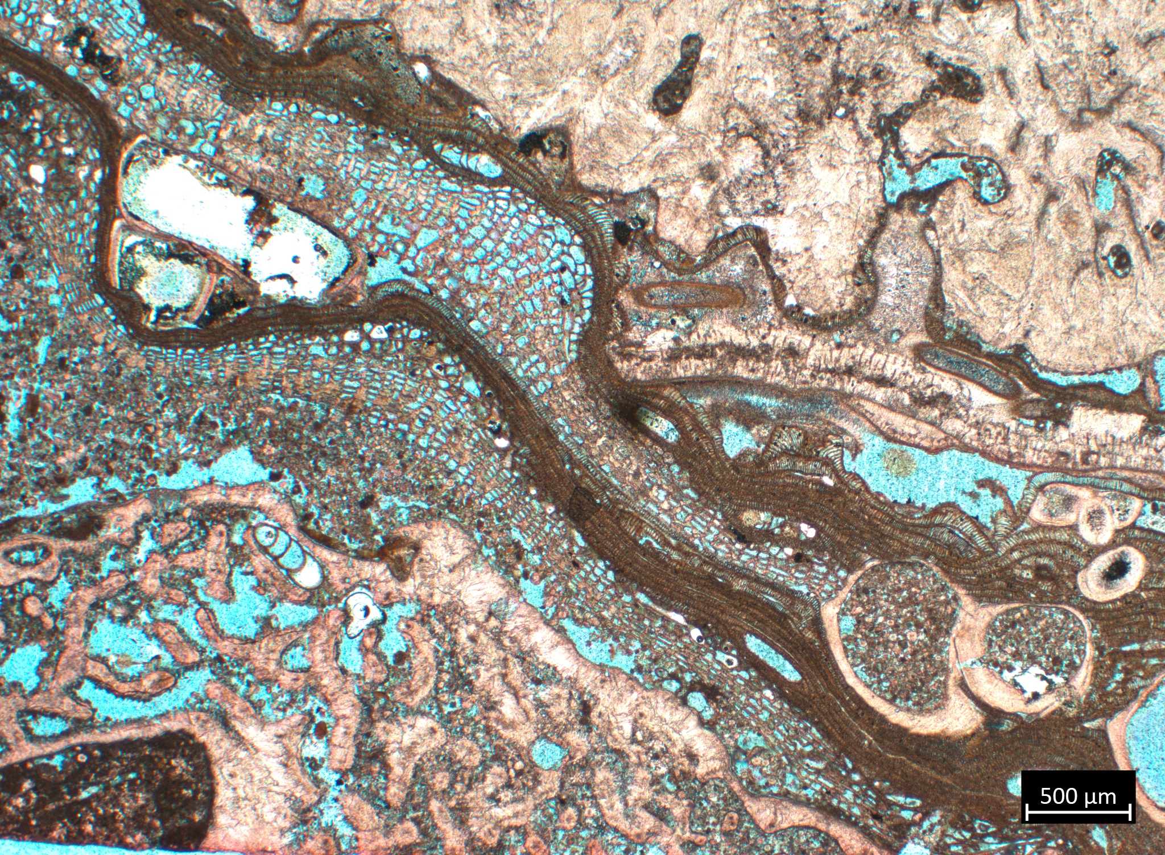
ES-103-RC-20 (15.1m)
Microbialite
Coral
CCA
(Sporolithon)
Bivalve bore
Notes:
acervulina

Slide 9
Lithofacies 3 – Coral Floatstone to Rudstone with Microbialite Encrustation
Description: Consists of large coral fragments that are encrusted by both CCA and microbialite
Fossil Content: Coral, gastropod, Homotrema, serpulid, bivalve, and echinoid
Notes:
  Sparse intervals of skeletal rudstone partially or fully cemented by microbialite
  NO MUD

Slide 10
5cm

Slide 11
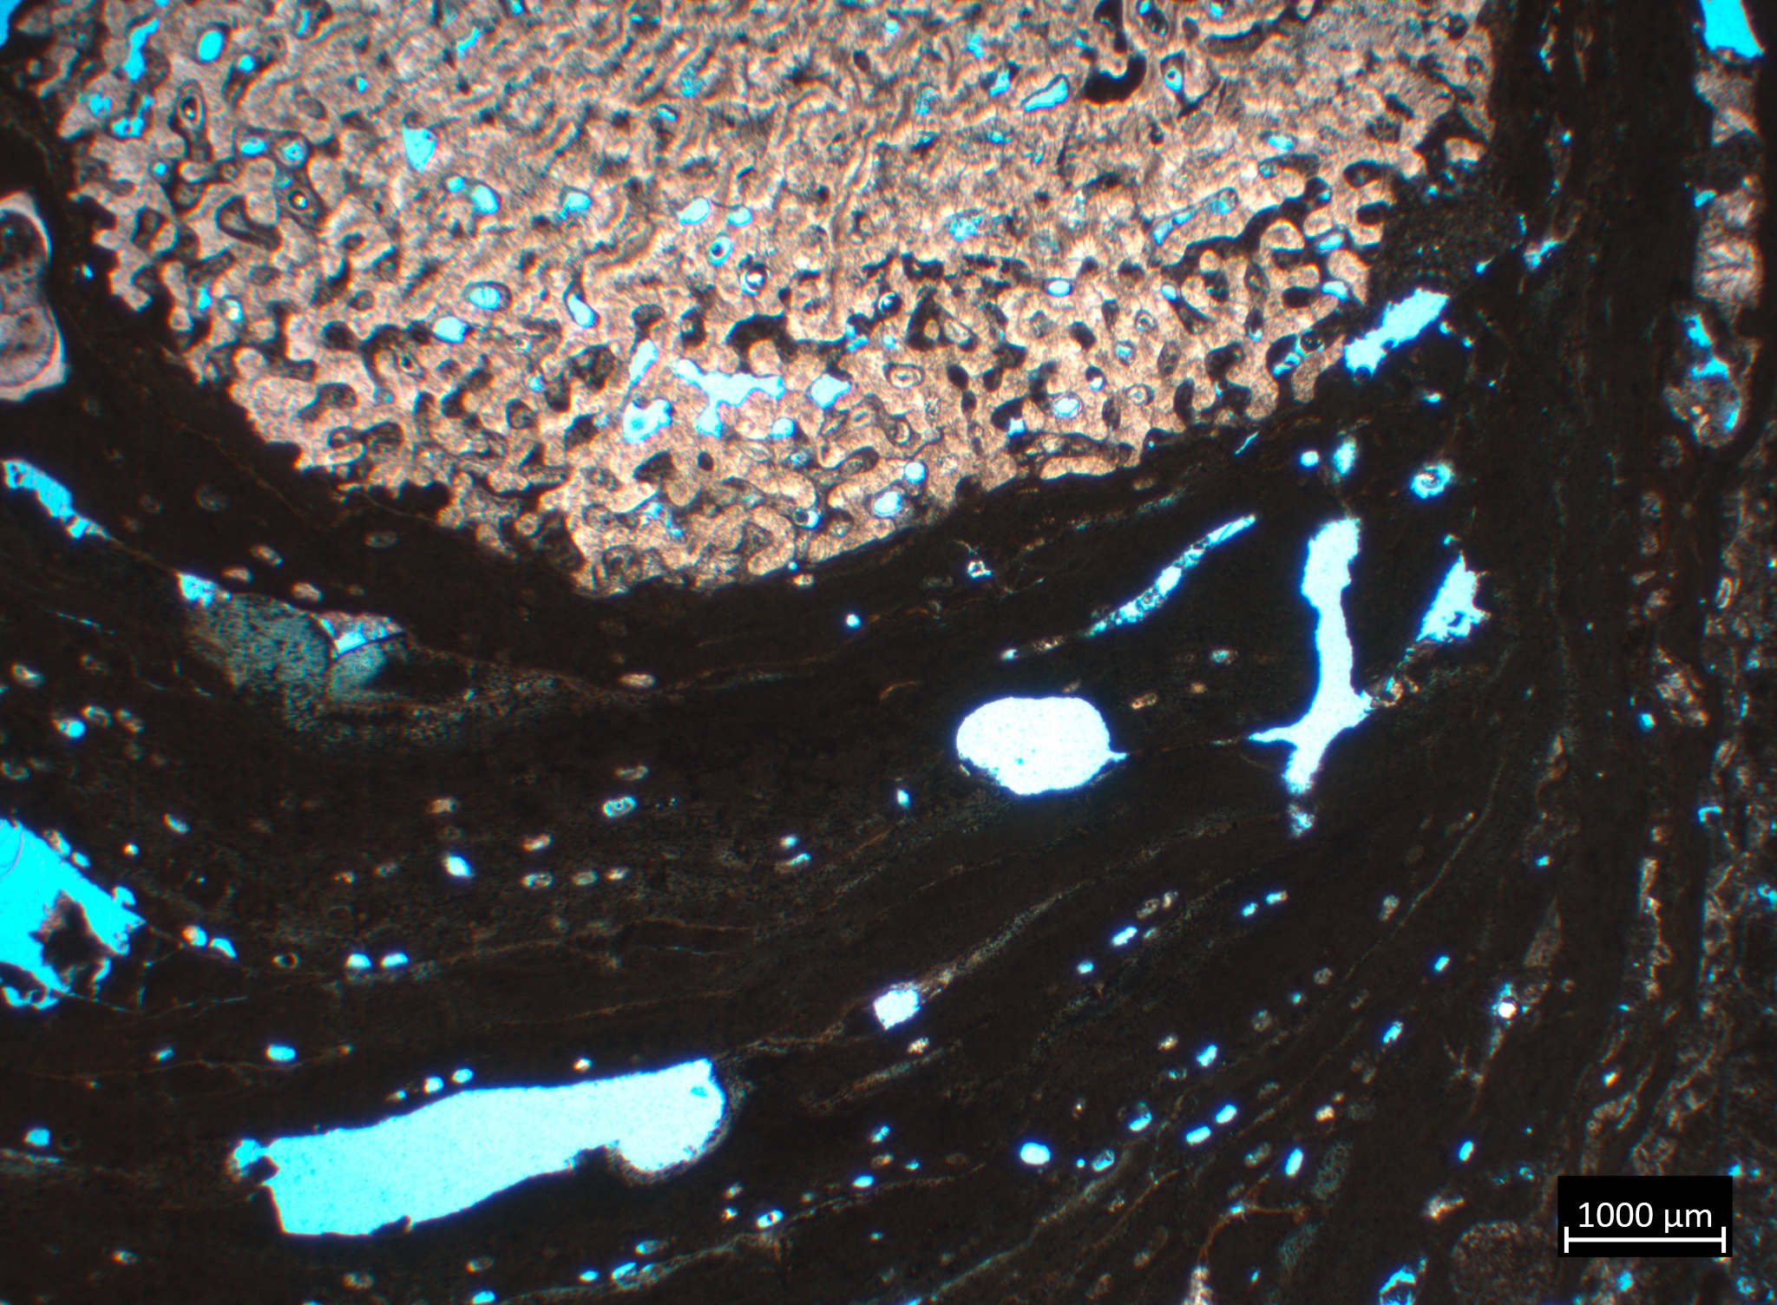
ES-103-RC-30 (27.3m)
Coral
CCA

Slide 12
Lithofacies 4 – Coralgal Framestone with Microbialite Crust to Skeletal Rudstone Cemented by Microbialite
Description: Coralgal rudstone to framestone with microbialite layers and crust
Fossil Content: Coral, echinoid, bivalve, gastropod, serpulid, Halimeda
Notes:
  Dominated by branching & platy corals forming rigid framework
  Framework voids filled with microbially cemented skeletal rudstone
  Rudstone is variably cemented by microbialite; MCD category
  Gradational coral species
  Forereef facies

Slide 13
2 CM

Slide 14
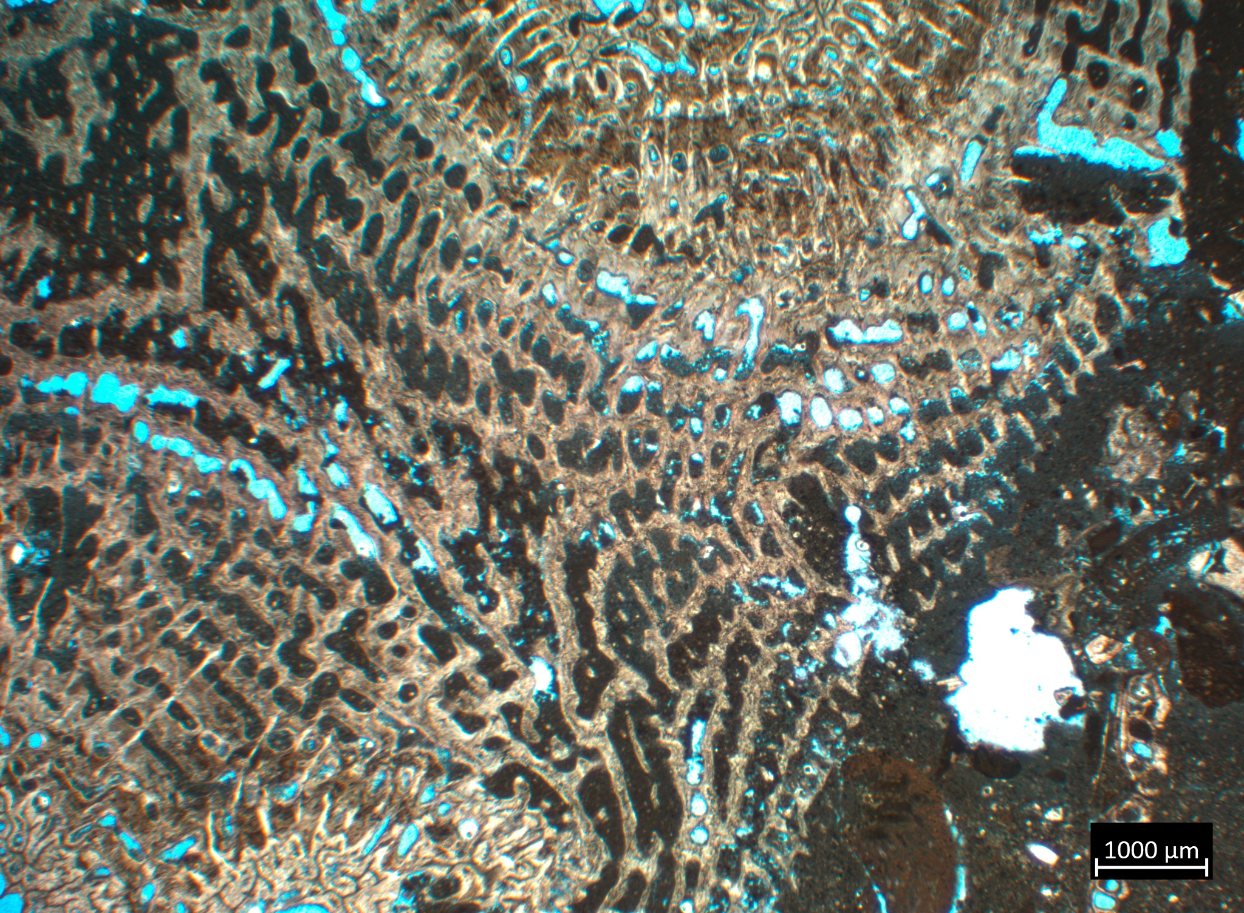
ES-103-RC-42 (45.35m)

Slide 15
Lithofacies 5 – Skeletal Rudstone with Irregular Coral Fragments
Description: Partially cemented to uncemented skeletal sand with sparse coral fragments
Fossil Content: coral, rhodoliths, bivalve, serpulid, Halimeda, echinoid, gastropod
Notes:
  Observed near the base of the core
  Rhodoliths are abundant
  Isolated coral fragments; most likely down slope shed from reef crest
  Forereef slope deposit

Slide 16
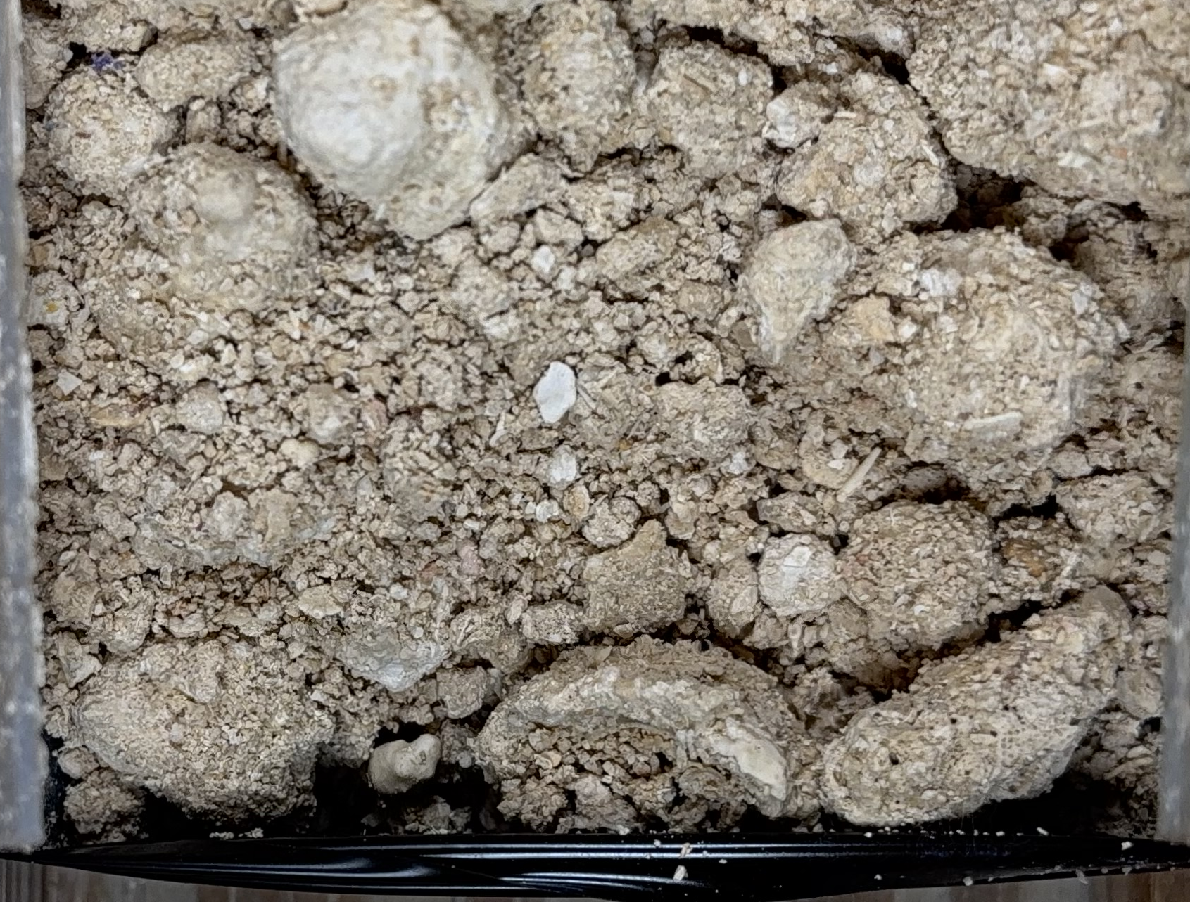
1cm

Slide 17
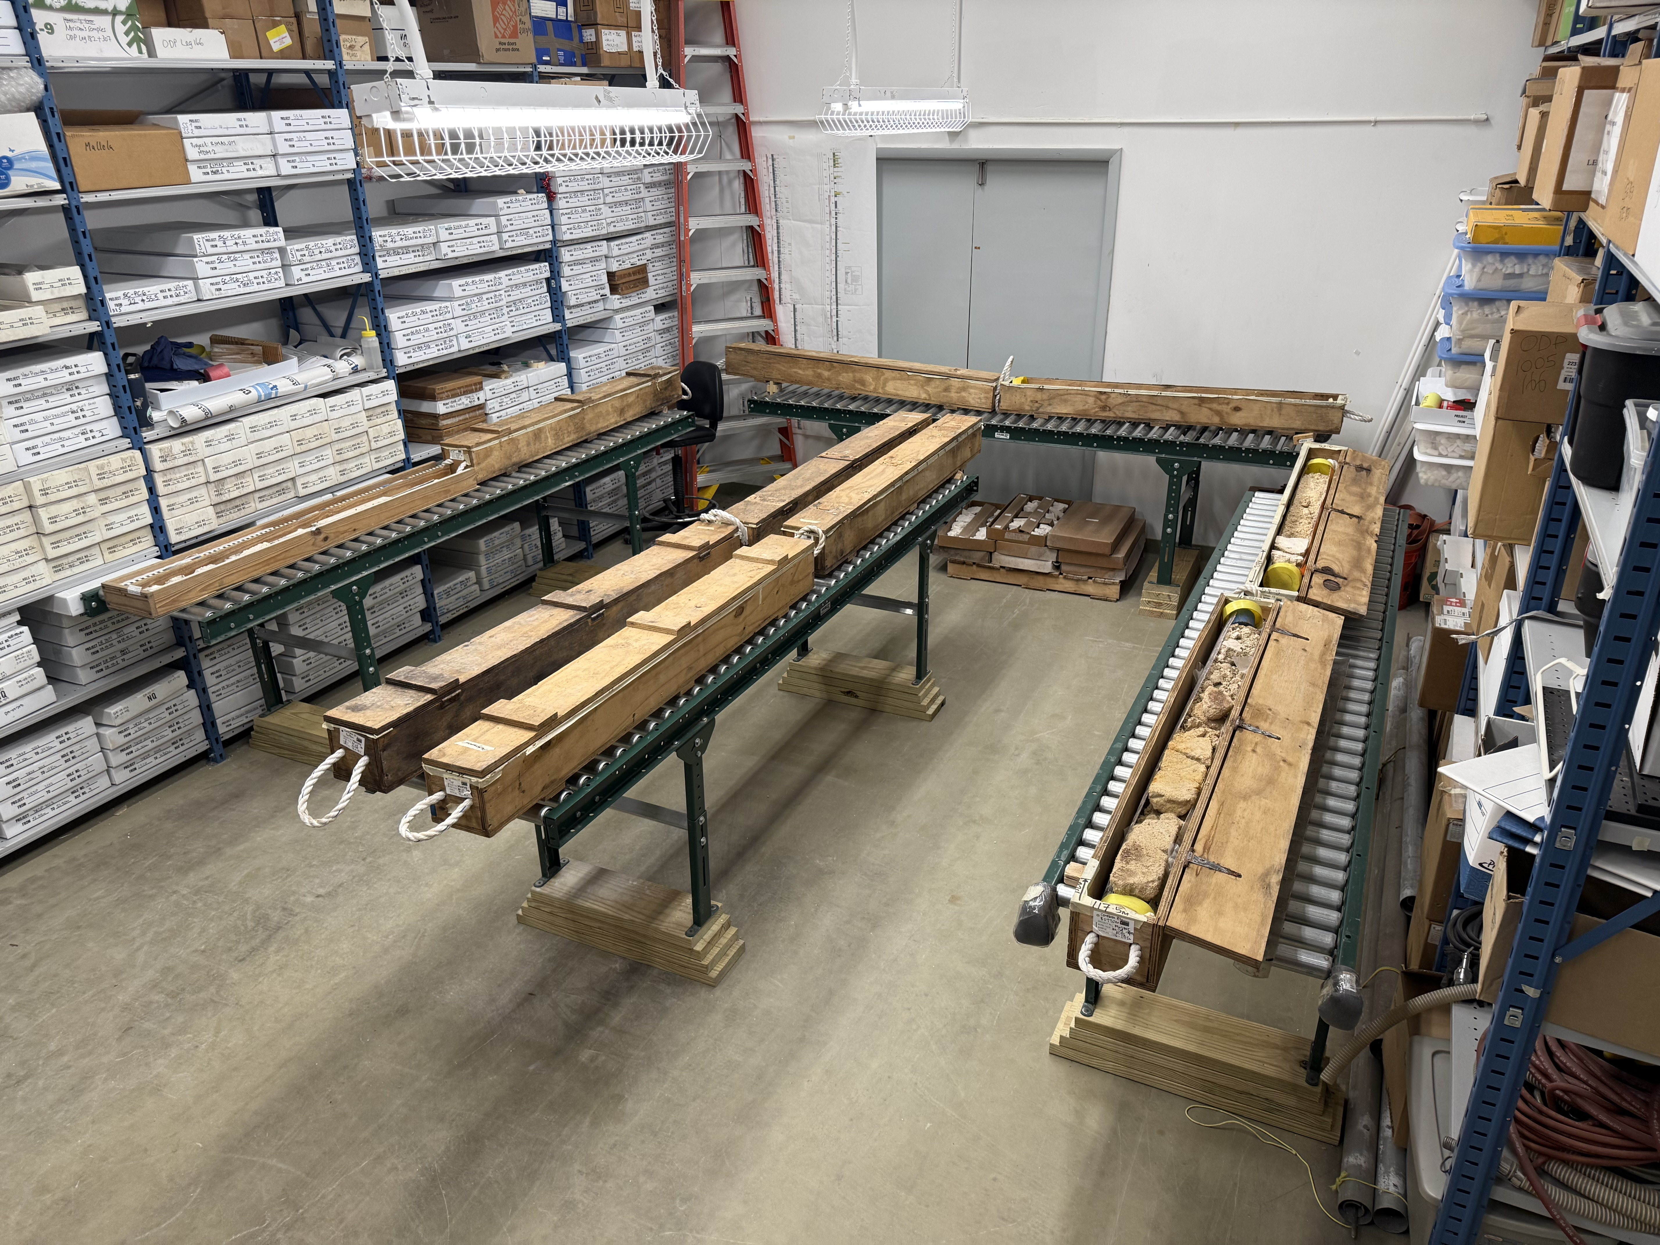
Summary
Core 103 contains a range of reefal lithofacies and microbialite textures
Five main lithofacies were identified using texture, fabric, and biotic components
Several microbialite types were observed

Slide 18
Backup

Slide 19
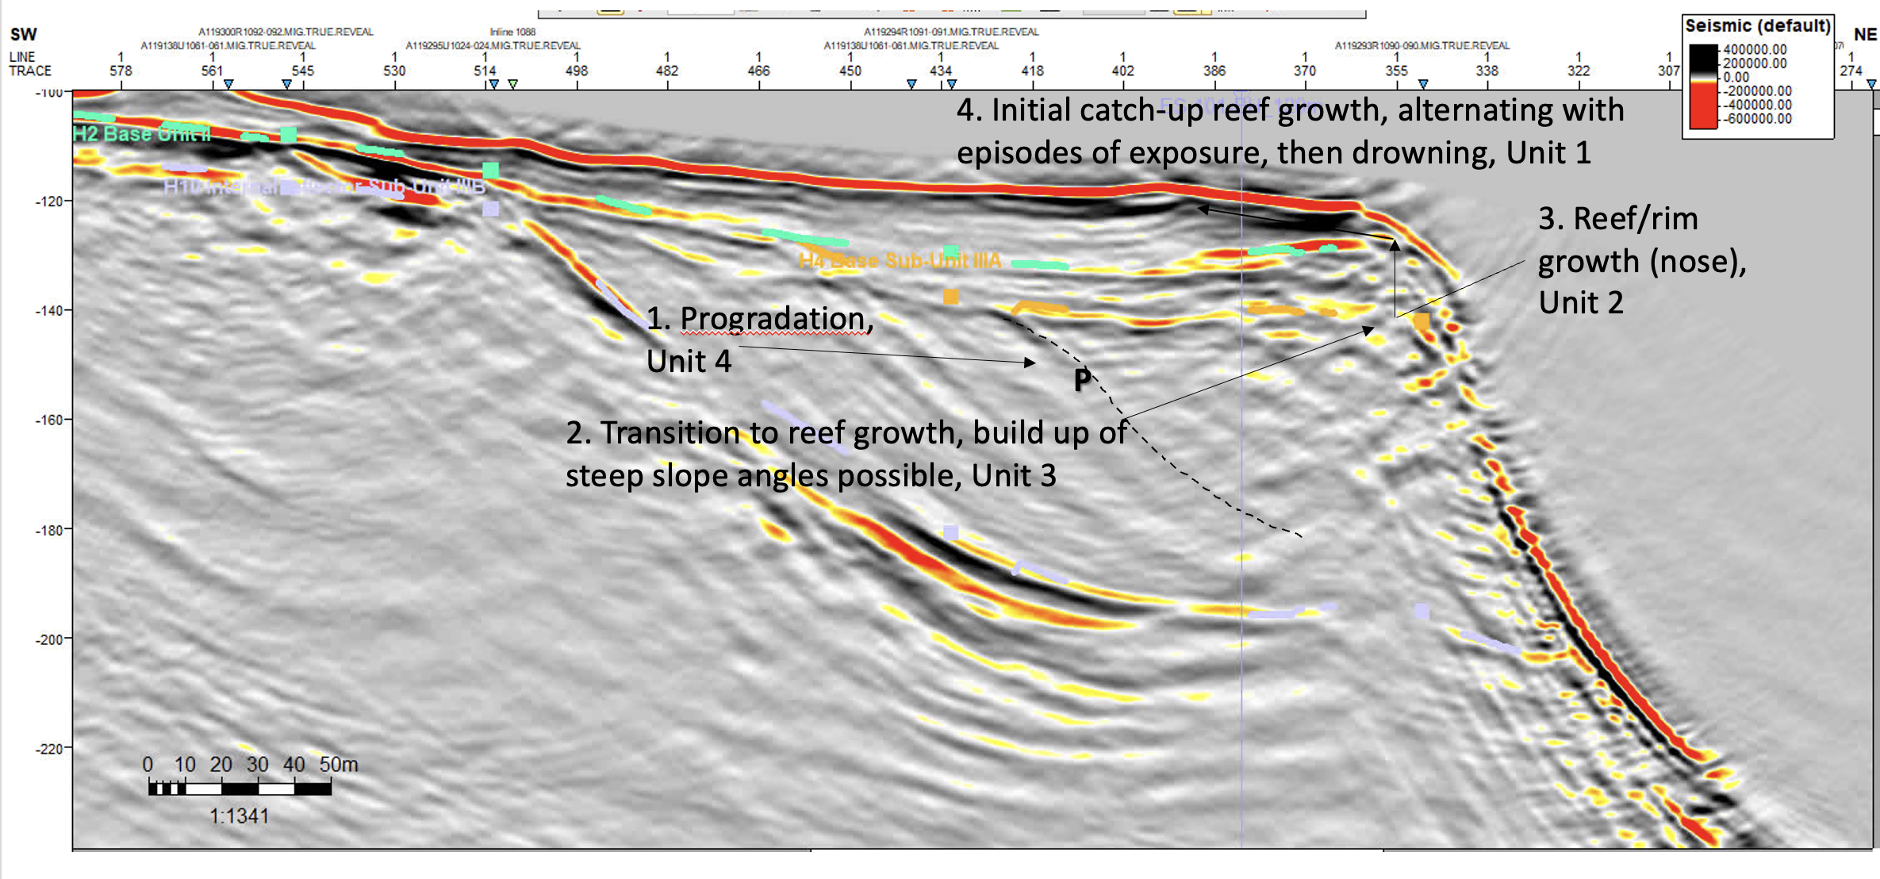

Slide 20
