Slide 1
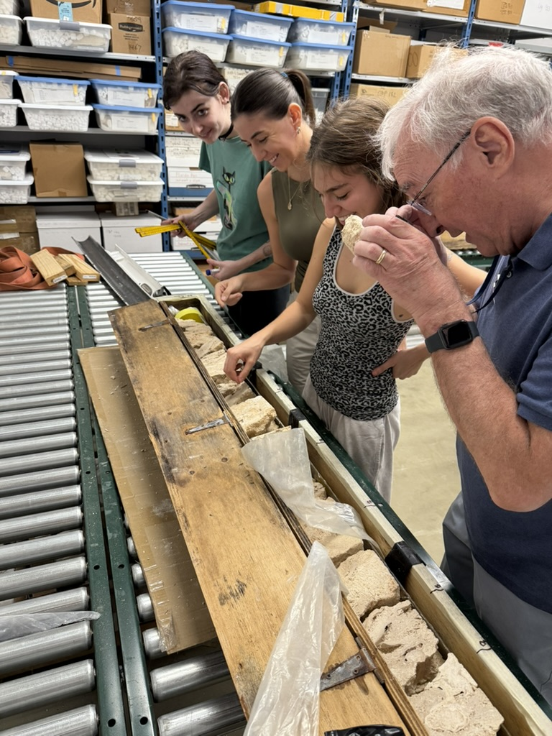
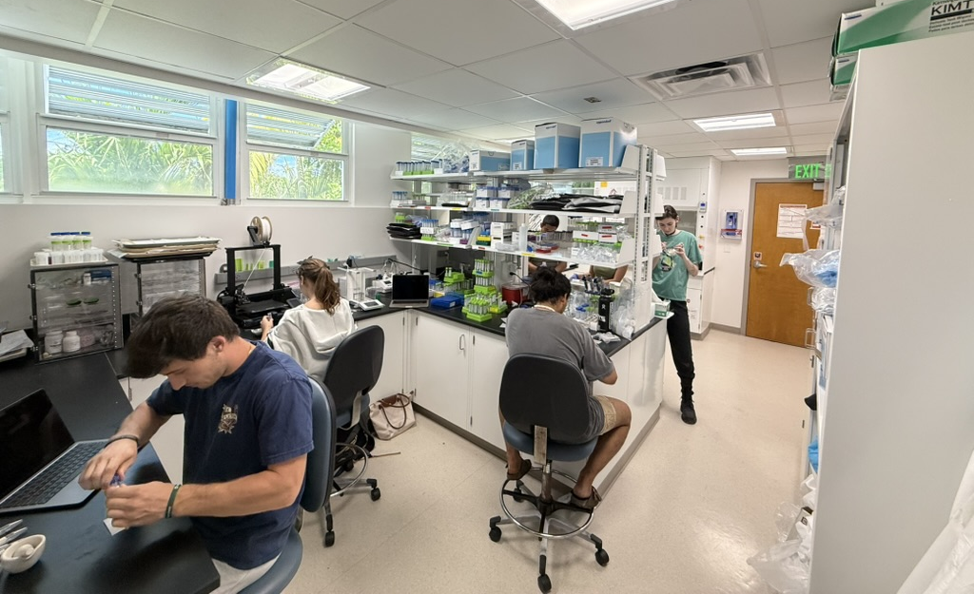

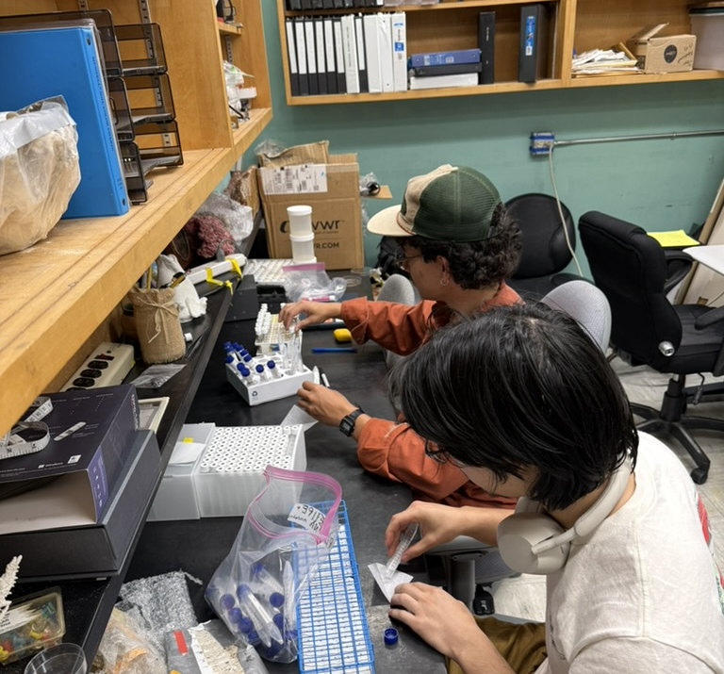
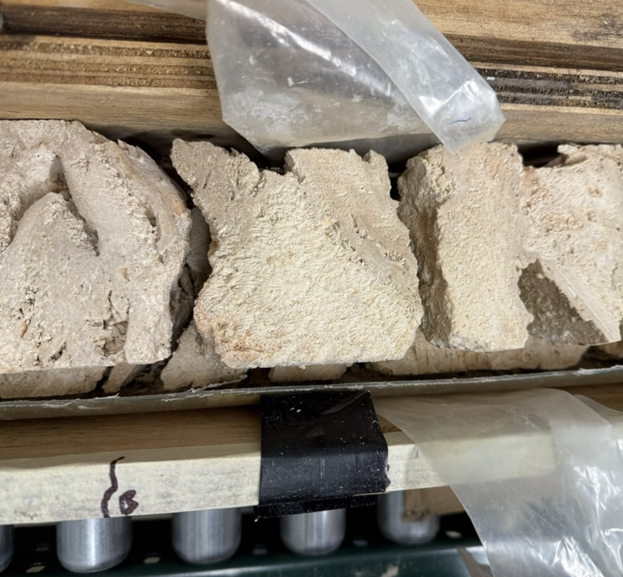
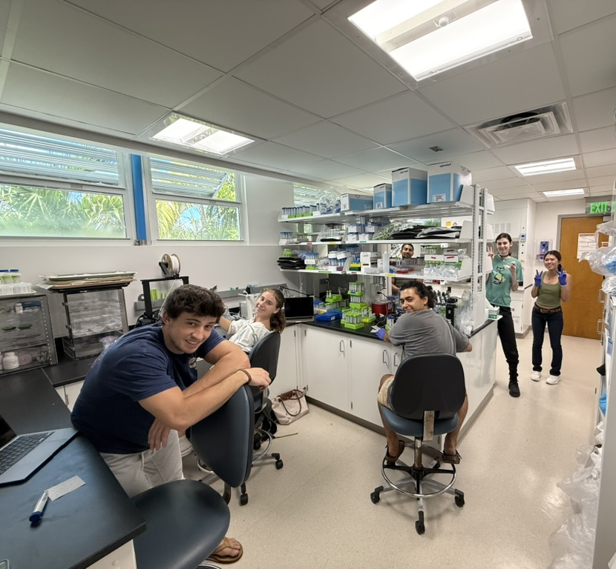
Initial Results on the Isotopic Composition of the Allochems in Core 103
Oehlert et al., 2025
Amanda Oehlert, Jazmin Garza, Becca Adlin, Flora Beleznay, Paulina Manekas, Brandon Mears, Kingshuk Mukherjee, Brian Mulvey, Felipe Muschel, Raymond Owens, Merrilee Rivers, Trina Rosing, Caroline Tran, Bernie Kaup and Iva Tomchovska
And Team Mozambique led by Gregor Eberli

Slide 2
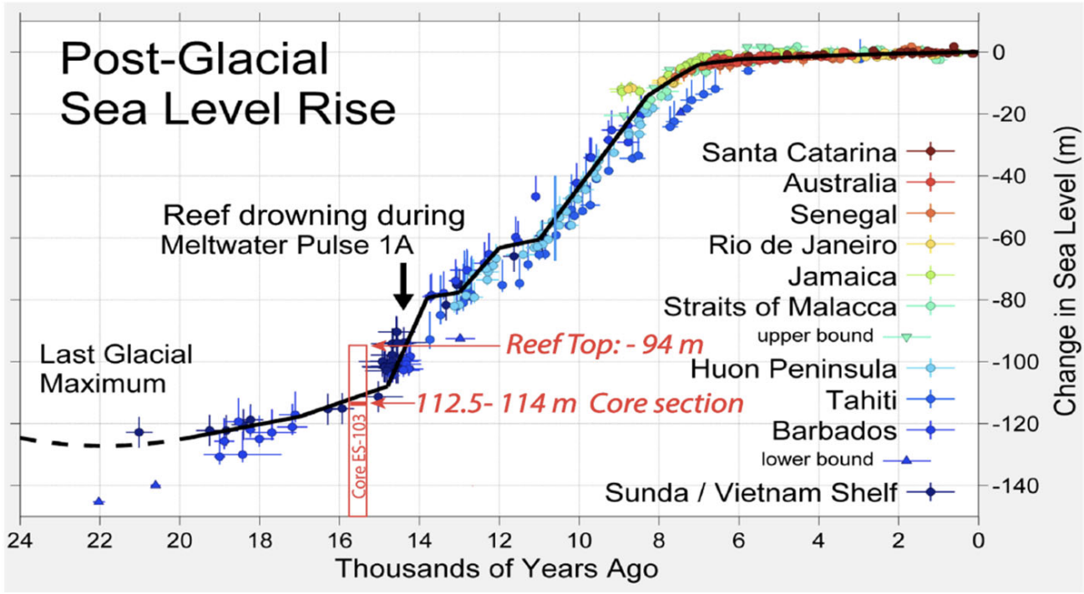
ES103: A geochemical archive of environmental changes during the last deglaciation?
Objective: Reconstruct changing environmental conditions during the last deglaciation
  Rule out changes in sediment composition
  Rule out changes in diagenesis
  Assess records of environmental changes
Oehlert et al., 2025
From Eberli et al., 2025; dates from Grammer et al., 1993

Slide 3
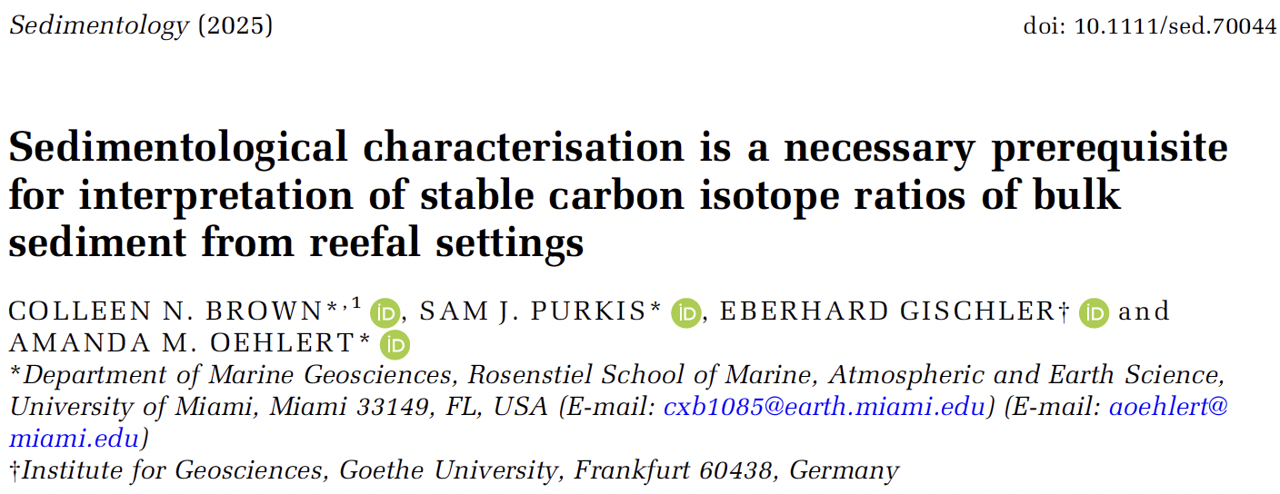
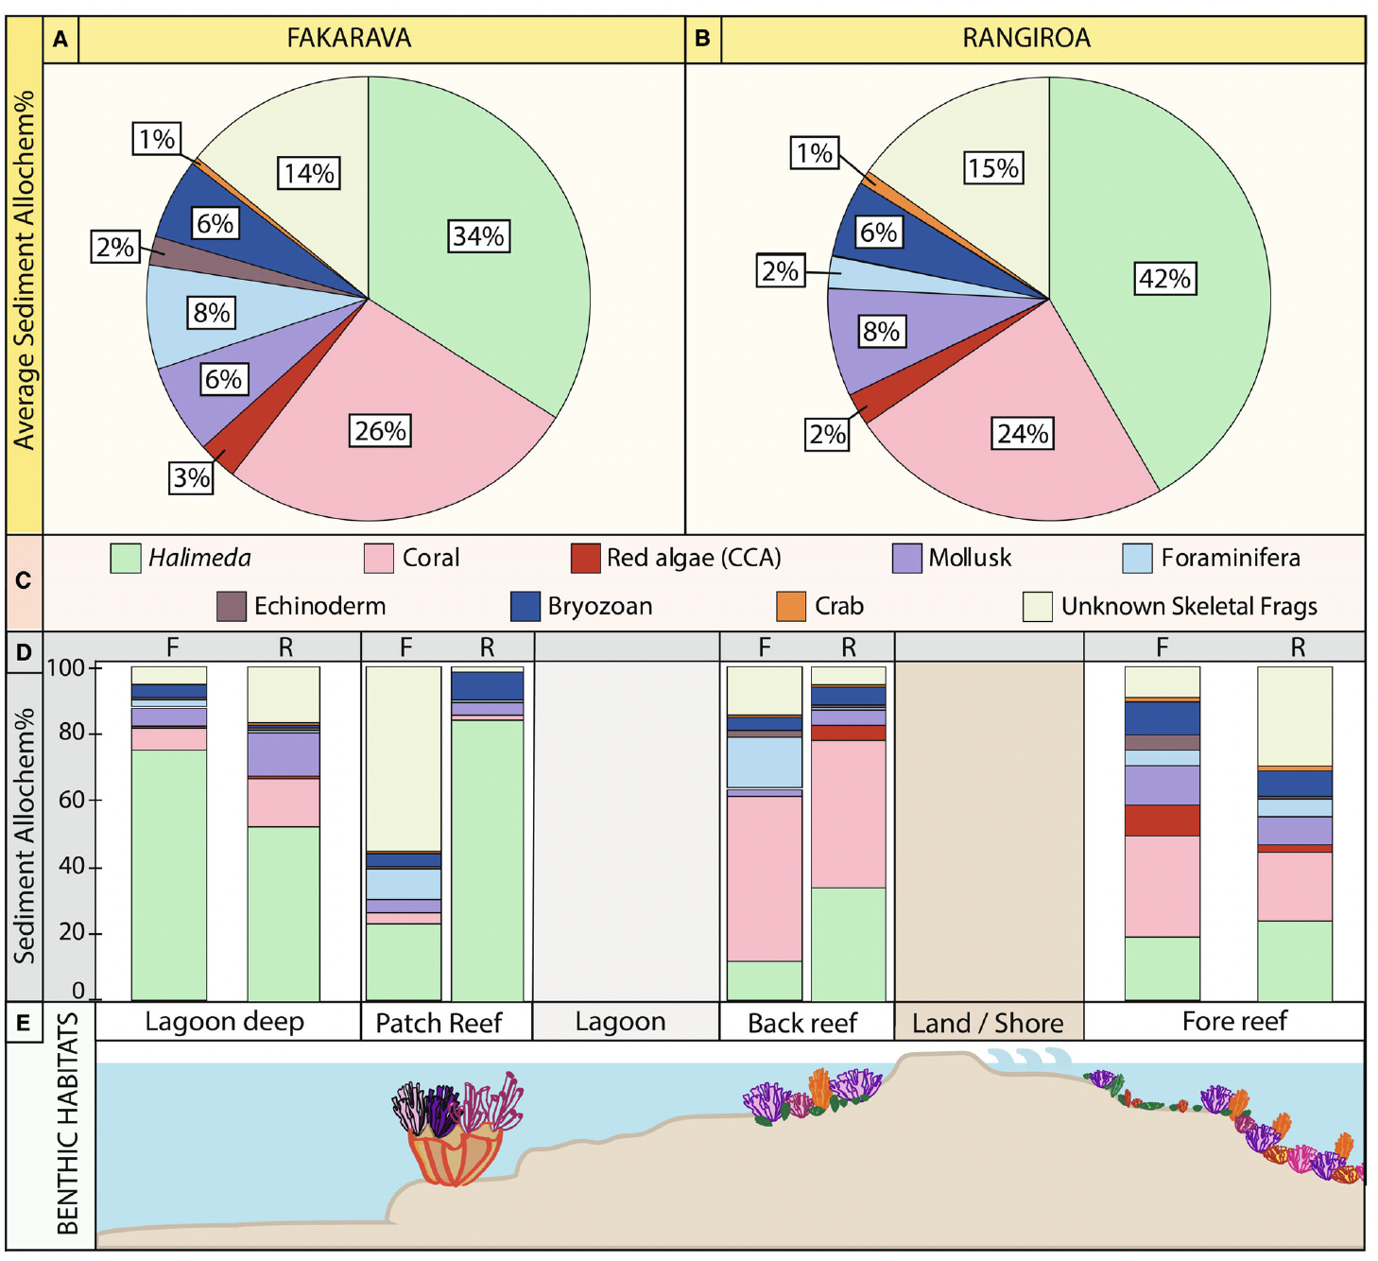
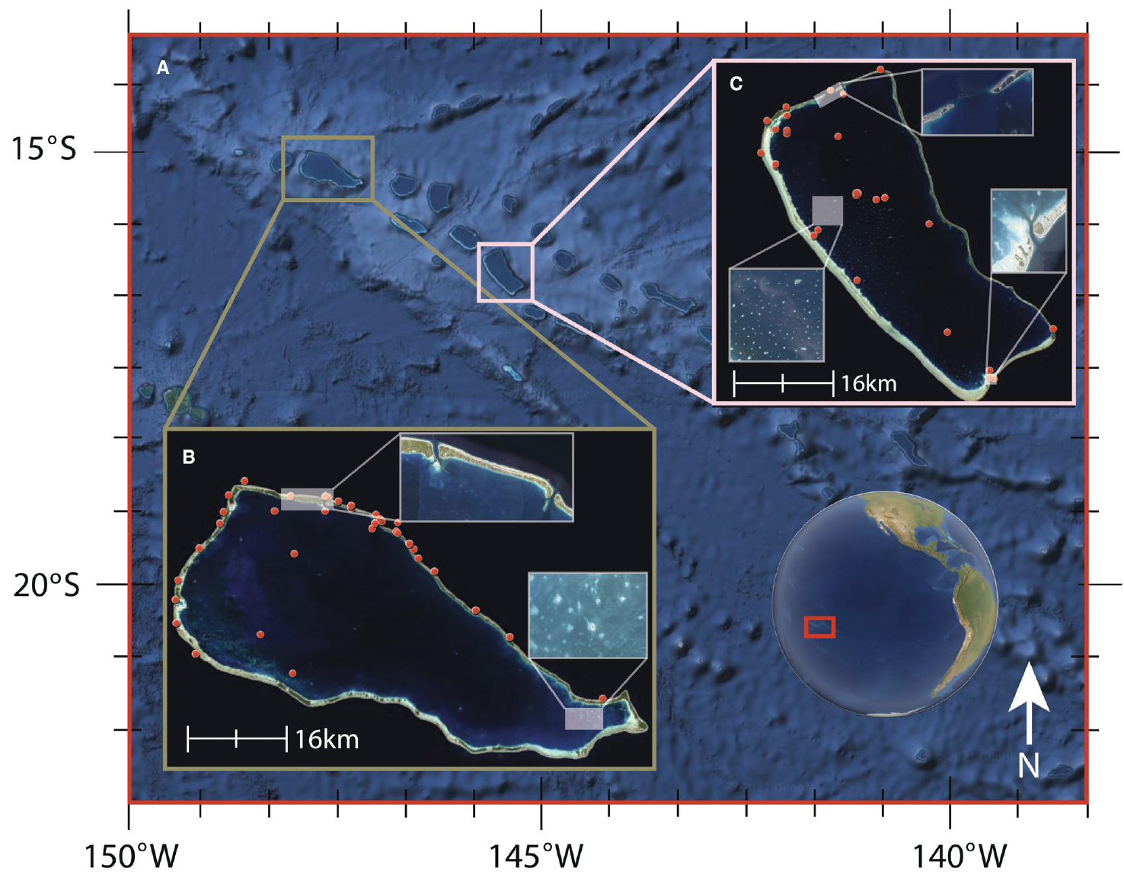
Oehlert et al., 2025
Brown et al., 2025
Notes:
Reefal sediment geochemistry is influenced by sediment composition

Slide 4
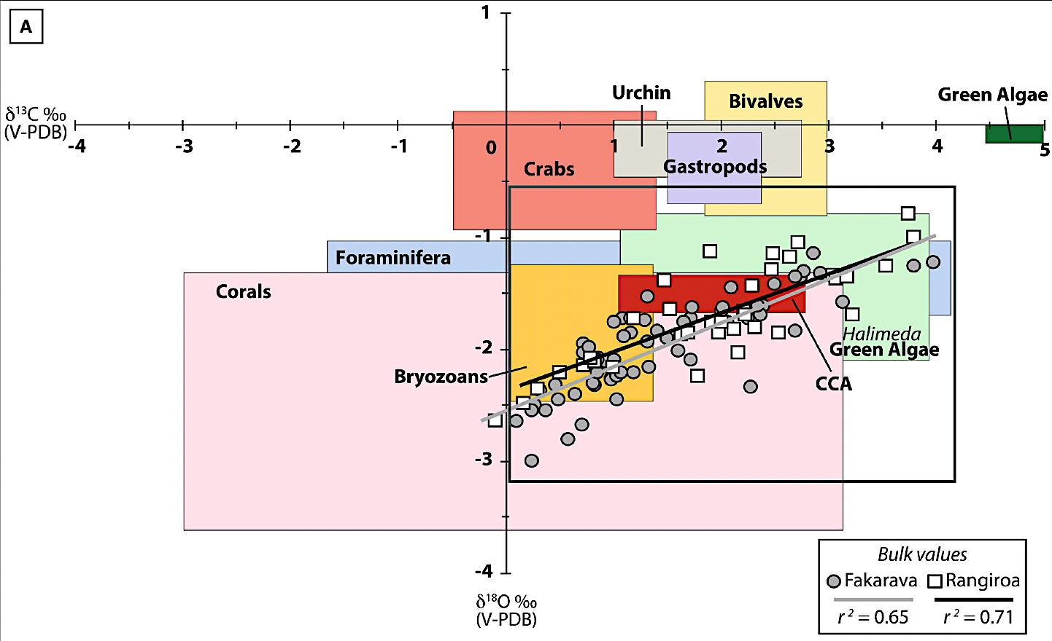
Variation in allochem δ¹³C and δ¹⁸O values
Allochem composition:
Mineralogy
Vital Effects
Salinity
Bulk sediments:
Dominant allochems?
Oehlert et al., 2025
Brown et al., 2025

Slide 5
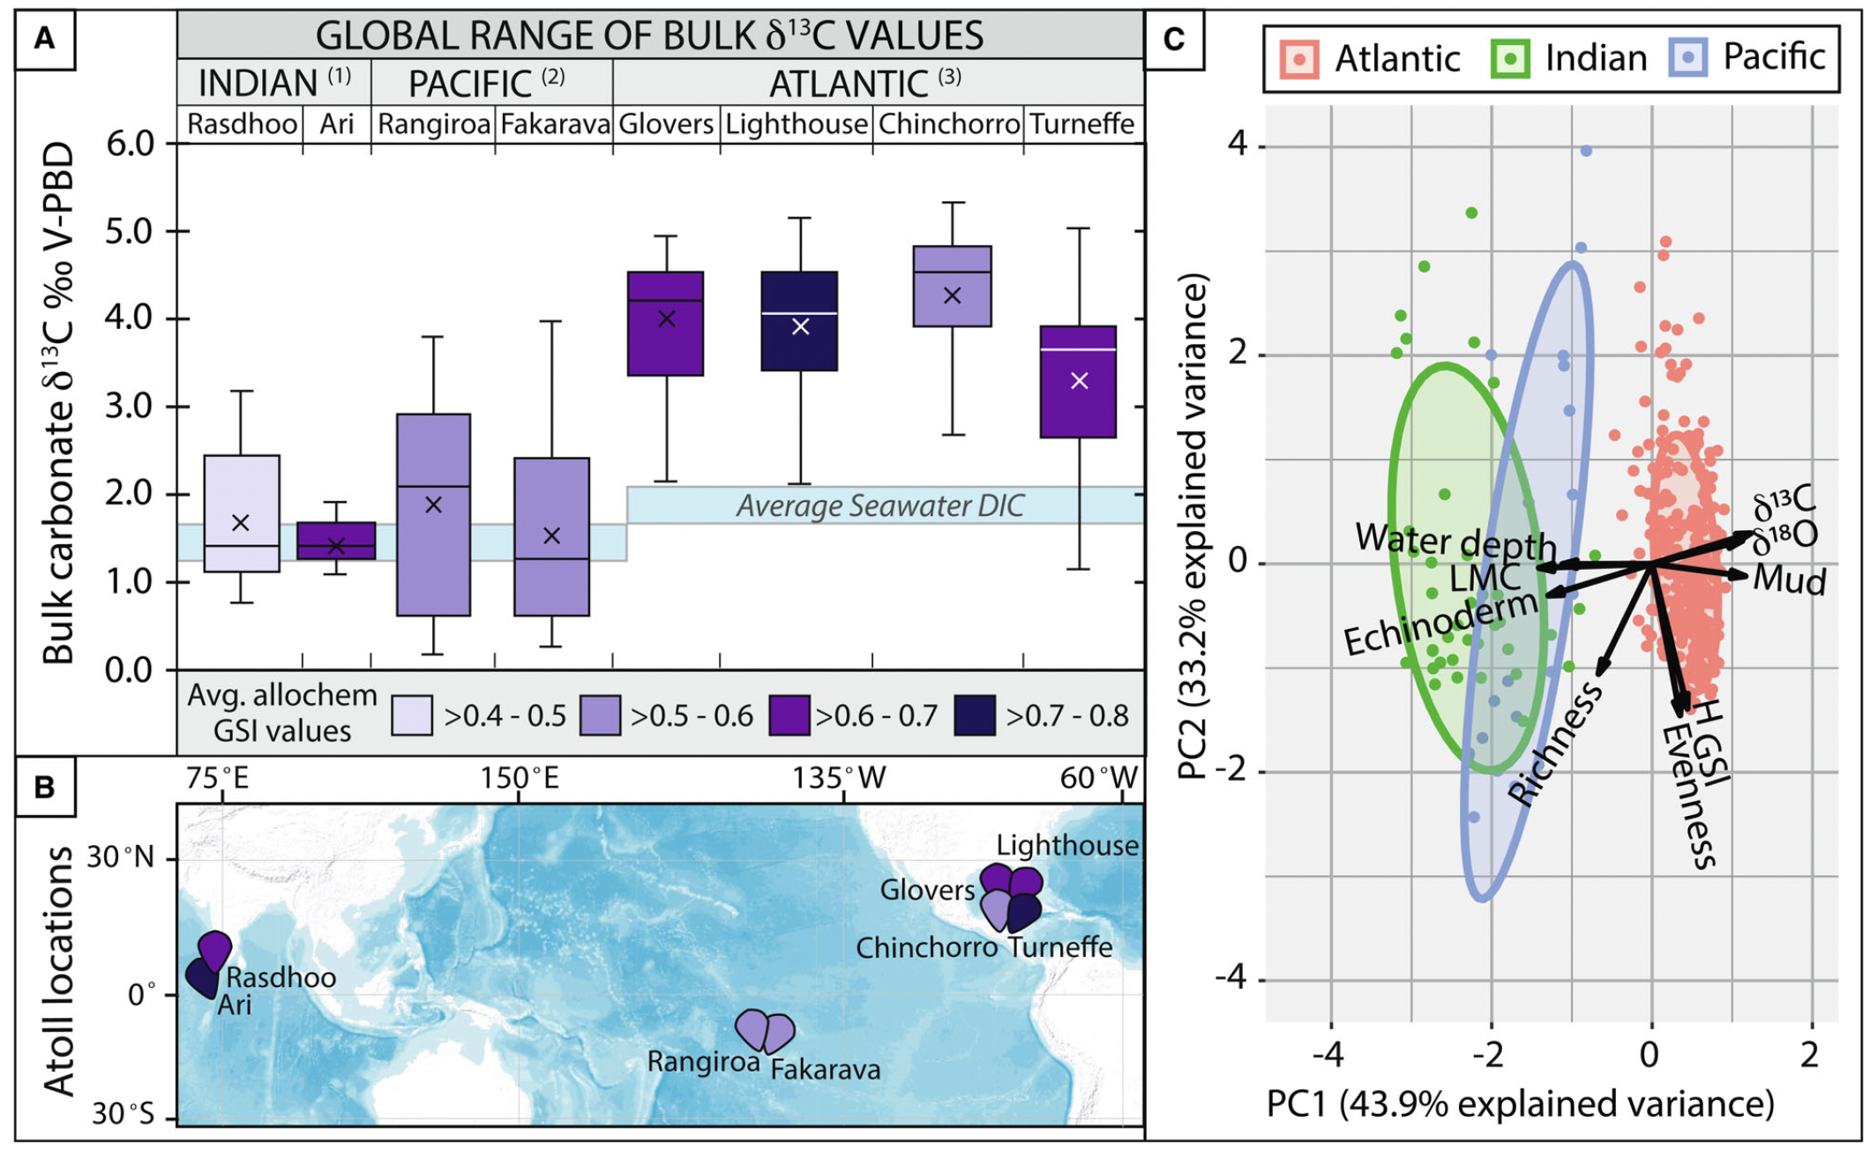
Global Comparison of Reefal Surface Sediments
Compared to 6 other atolls in Indian & Atlantic Ocean Basins
(Gischler 2006, Gischler et al., 2009)
> 5 ‰ range globally
Sediment allochem diversity indices
  Richness
  Evenness
  GSI
Oehlert et al., 2025
Brown et al., 2025

Slide 6
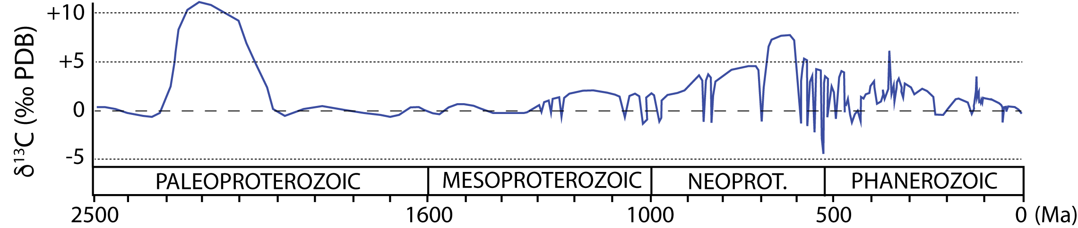
Marine carbonate δ¹³C records through time
x
Increased organic carbon burial
Increased weathering
Modified from Bartley and Kah, 2004; Barral et al., 2017; Zachos et al., 2001
Oehlert et al., 2025

Slide 7
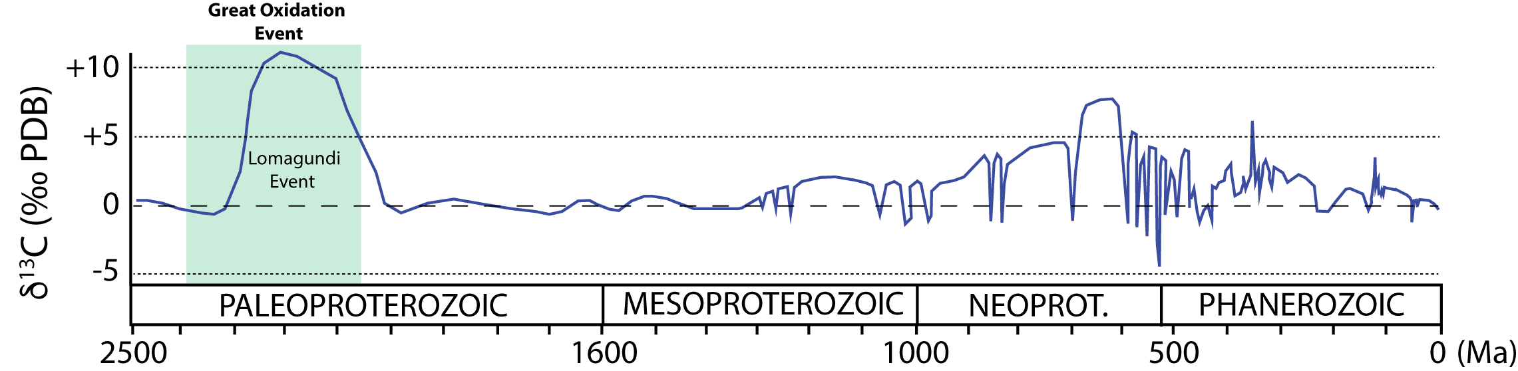
Marine carbonate δ¹³C records through time
Fraction of C buried as Organic Matter needs to be 3x higher!
Modified from Bartley and Kah, 2004; Barral et al., 2017; Zachos et al., 2001
Oehlert et al., 2025
Notes:
0 = 0.2
10= 0.6

Slide 8
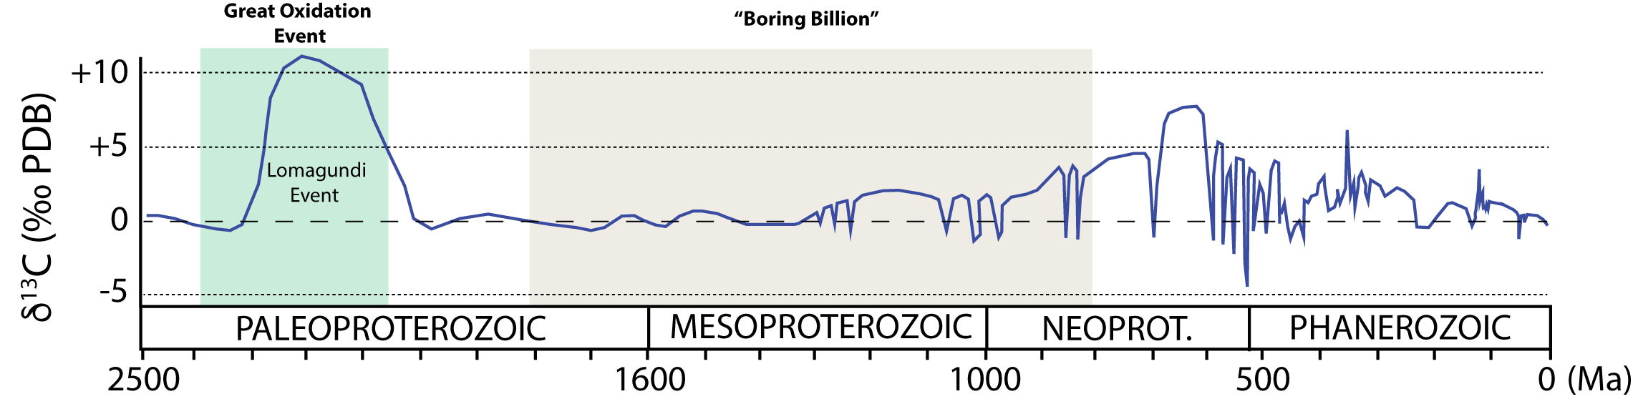
Marine carbonate δ¹³C records through time
Modified from Bartley and Kah, 2004; Barral et al., 2017; Zachos et al., 2001
Oehlert et al., 2025

Slide 9
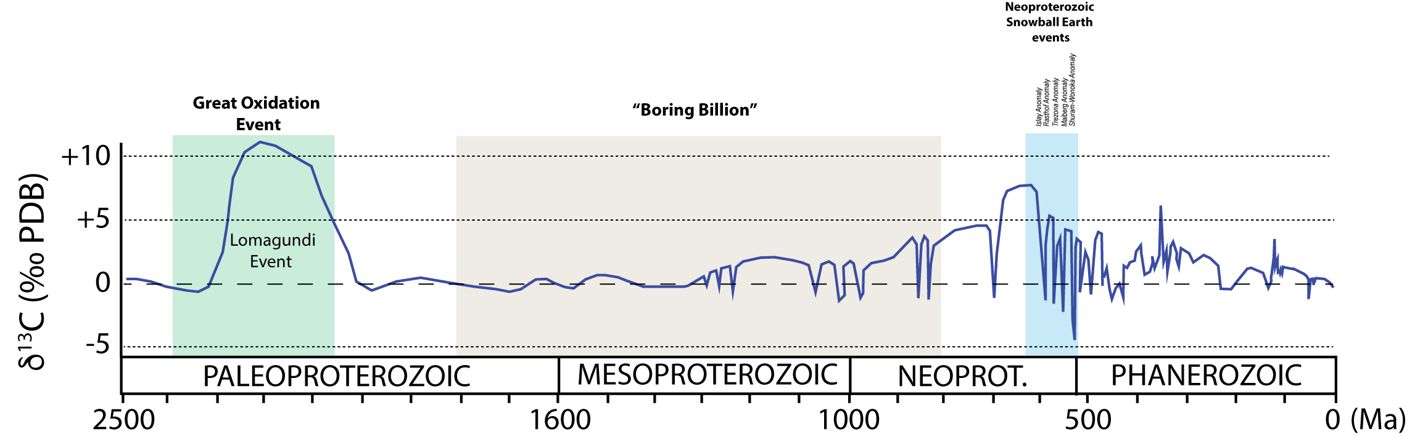
Marine carbonate δ¹³C records through time
Modified from Bartley and Kah, 2004; Barral et al., 2017; Zachos et al., 2001
Oehlert et al., 2025

Slide 10
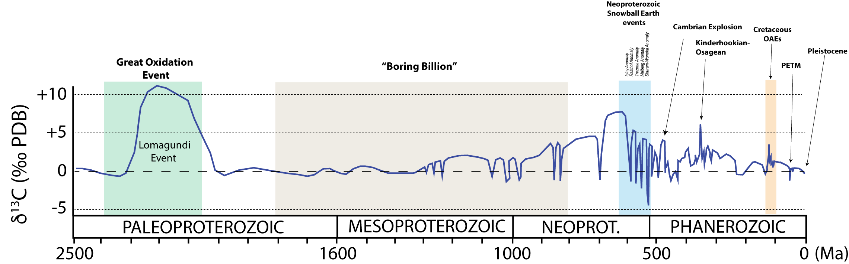
Marine carbonate δ¹³C records through time
Modified from Bartley and Kah, 2004; Barral et al., 2017; Zachos et al., 2001
Oehlert et al., 2025

Slide 11
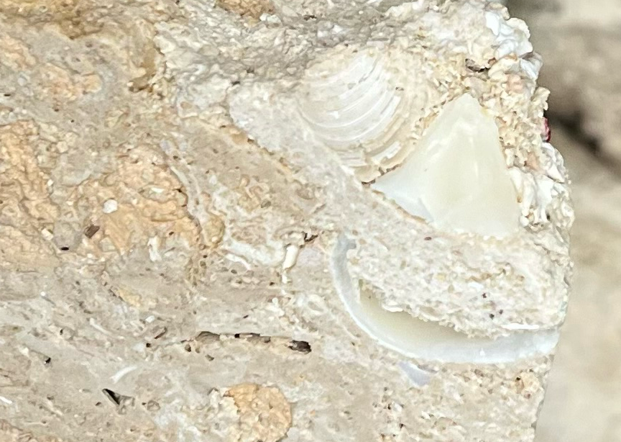
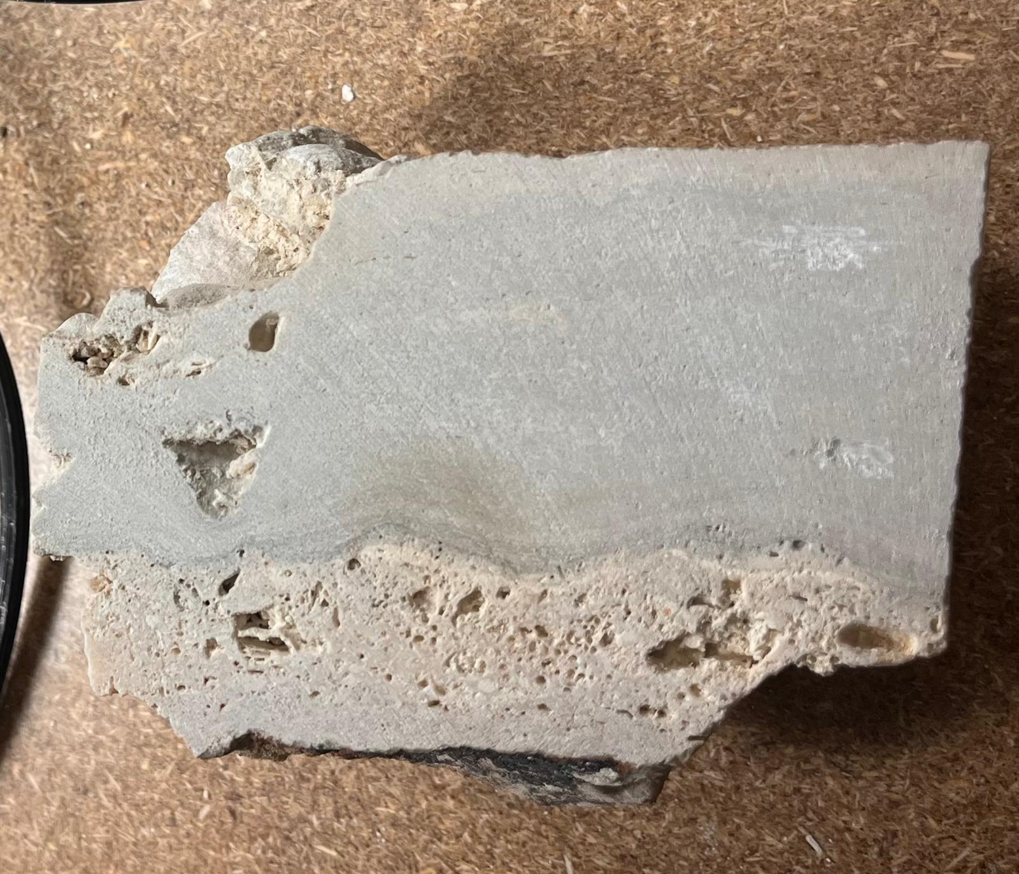
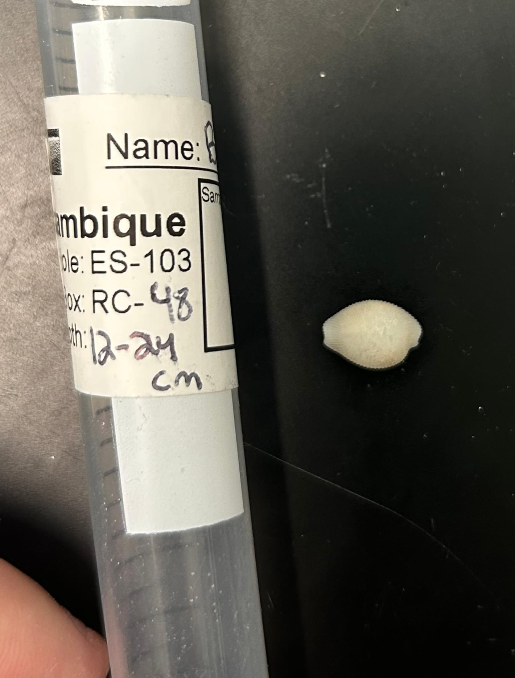
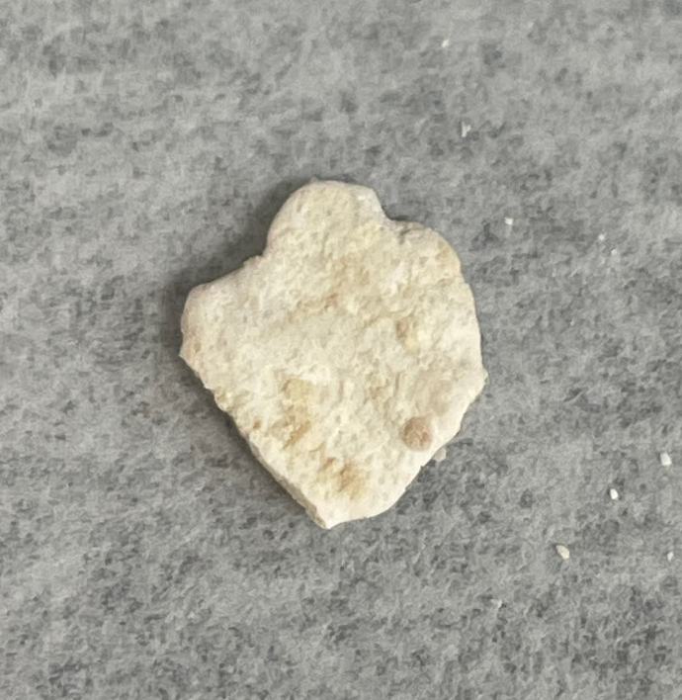
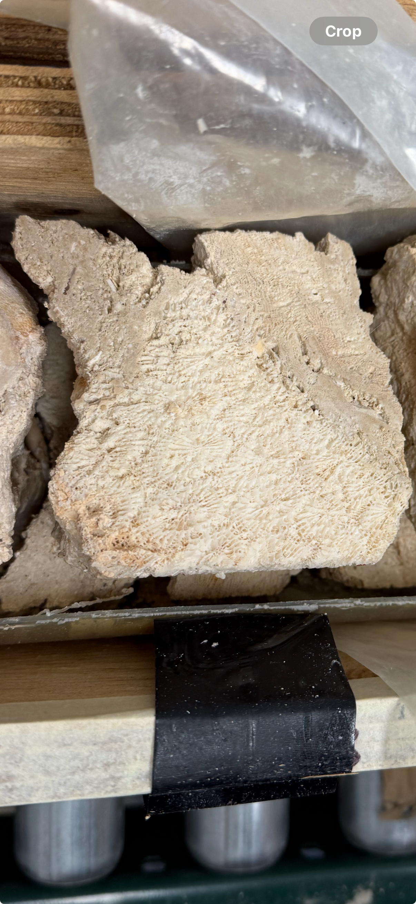
ES103: Initial Results
Oehlert et al., 2025
MGS 513/613 Intro to Geochemistry
~150 samples collected, spanning ~60 m core
CCA
Bulk
Halimeda
Top Coral
Bivalve (2)
Bivalves (1)
Gastropod
Microbialites

