Slide 1
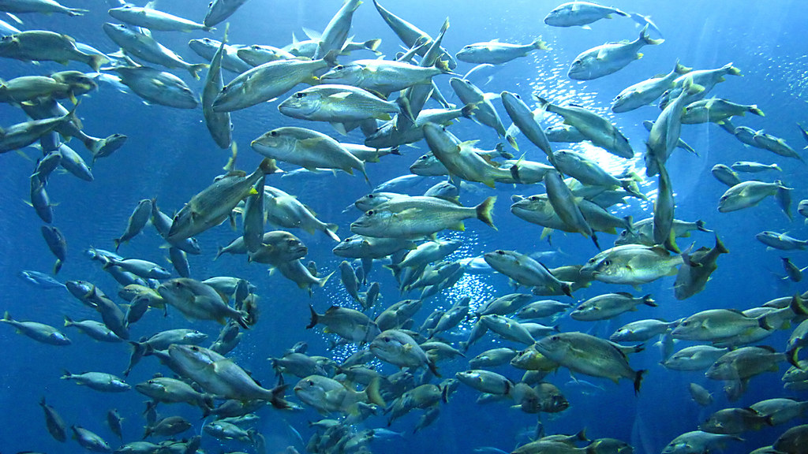

Inferring variations in ichthyocarbonate production rate, composition, and fate throughout
the Phanerozoic
Amanda M. Oehlert, Cameron Sam, Sarah Walls¹, Bret Marek¹, Caroline Tran, Roxanne Reed¹, Felipe Muschel, Sydney Cloutier, Jazmin Garza, Clément Pollier, Rachael M. Heuer¹, Martin Grosell¹
¹Marine Biology and Ecology, Rosenstiel School of Marine, Atmospheric and Earth Science, University of Miami

Slide 2

Oehlert et al., 2025
NSF-OCE-2319245

Slide 3
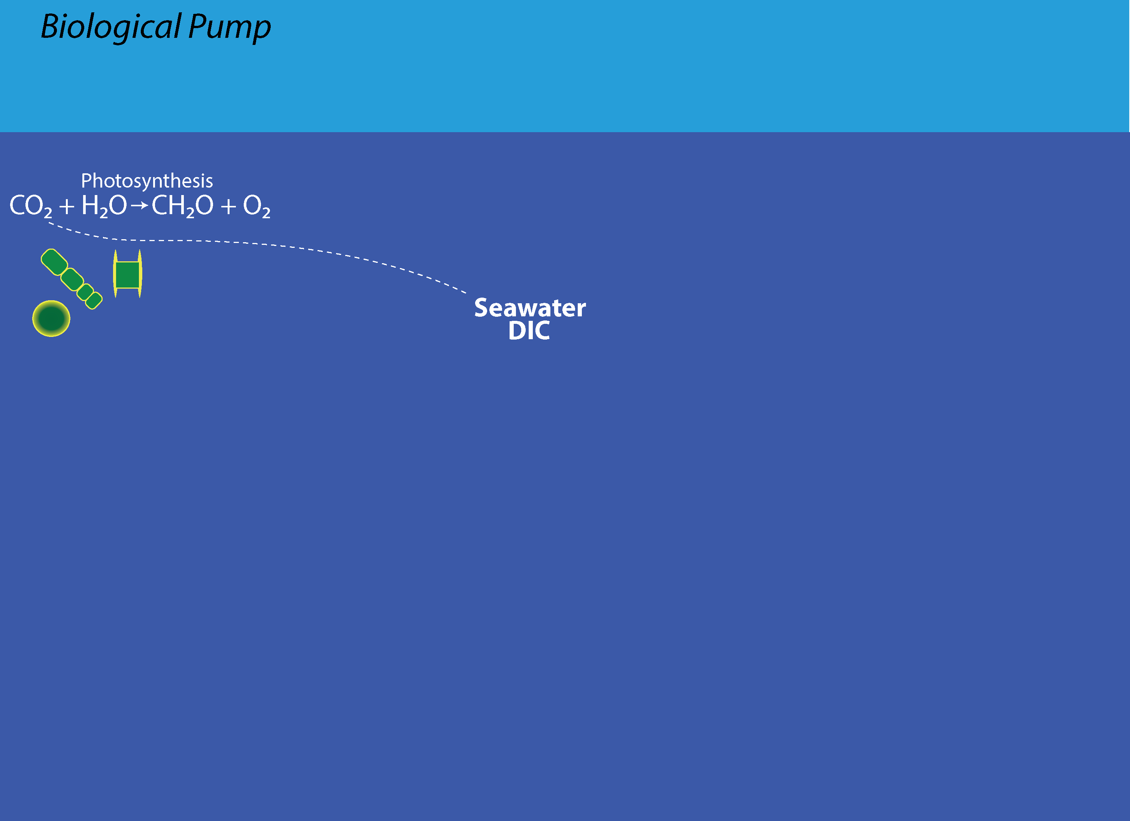
Oehlert et al., 2025
NSF-OCE-2319245

Slide 4
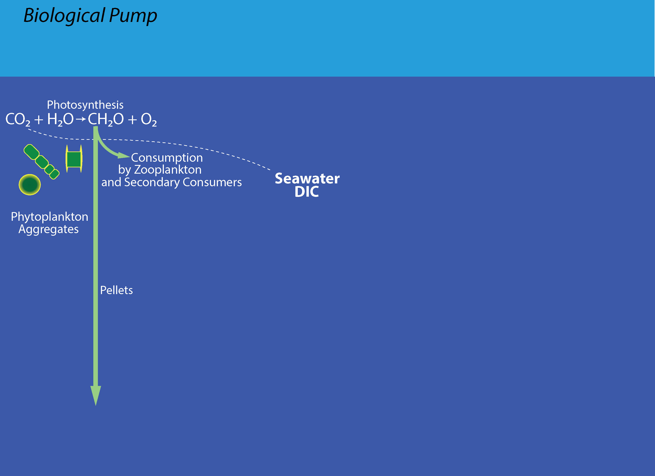
Oehlert et al., 2025
NSF-OCE-2319245

Slide 5
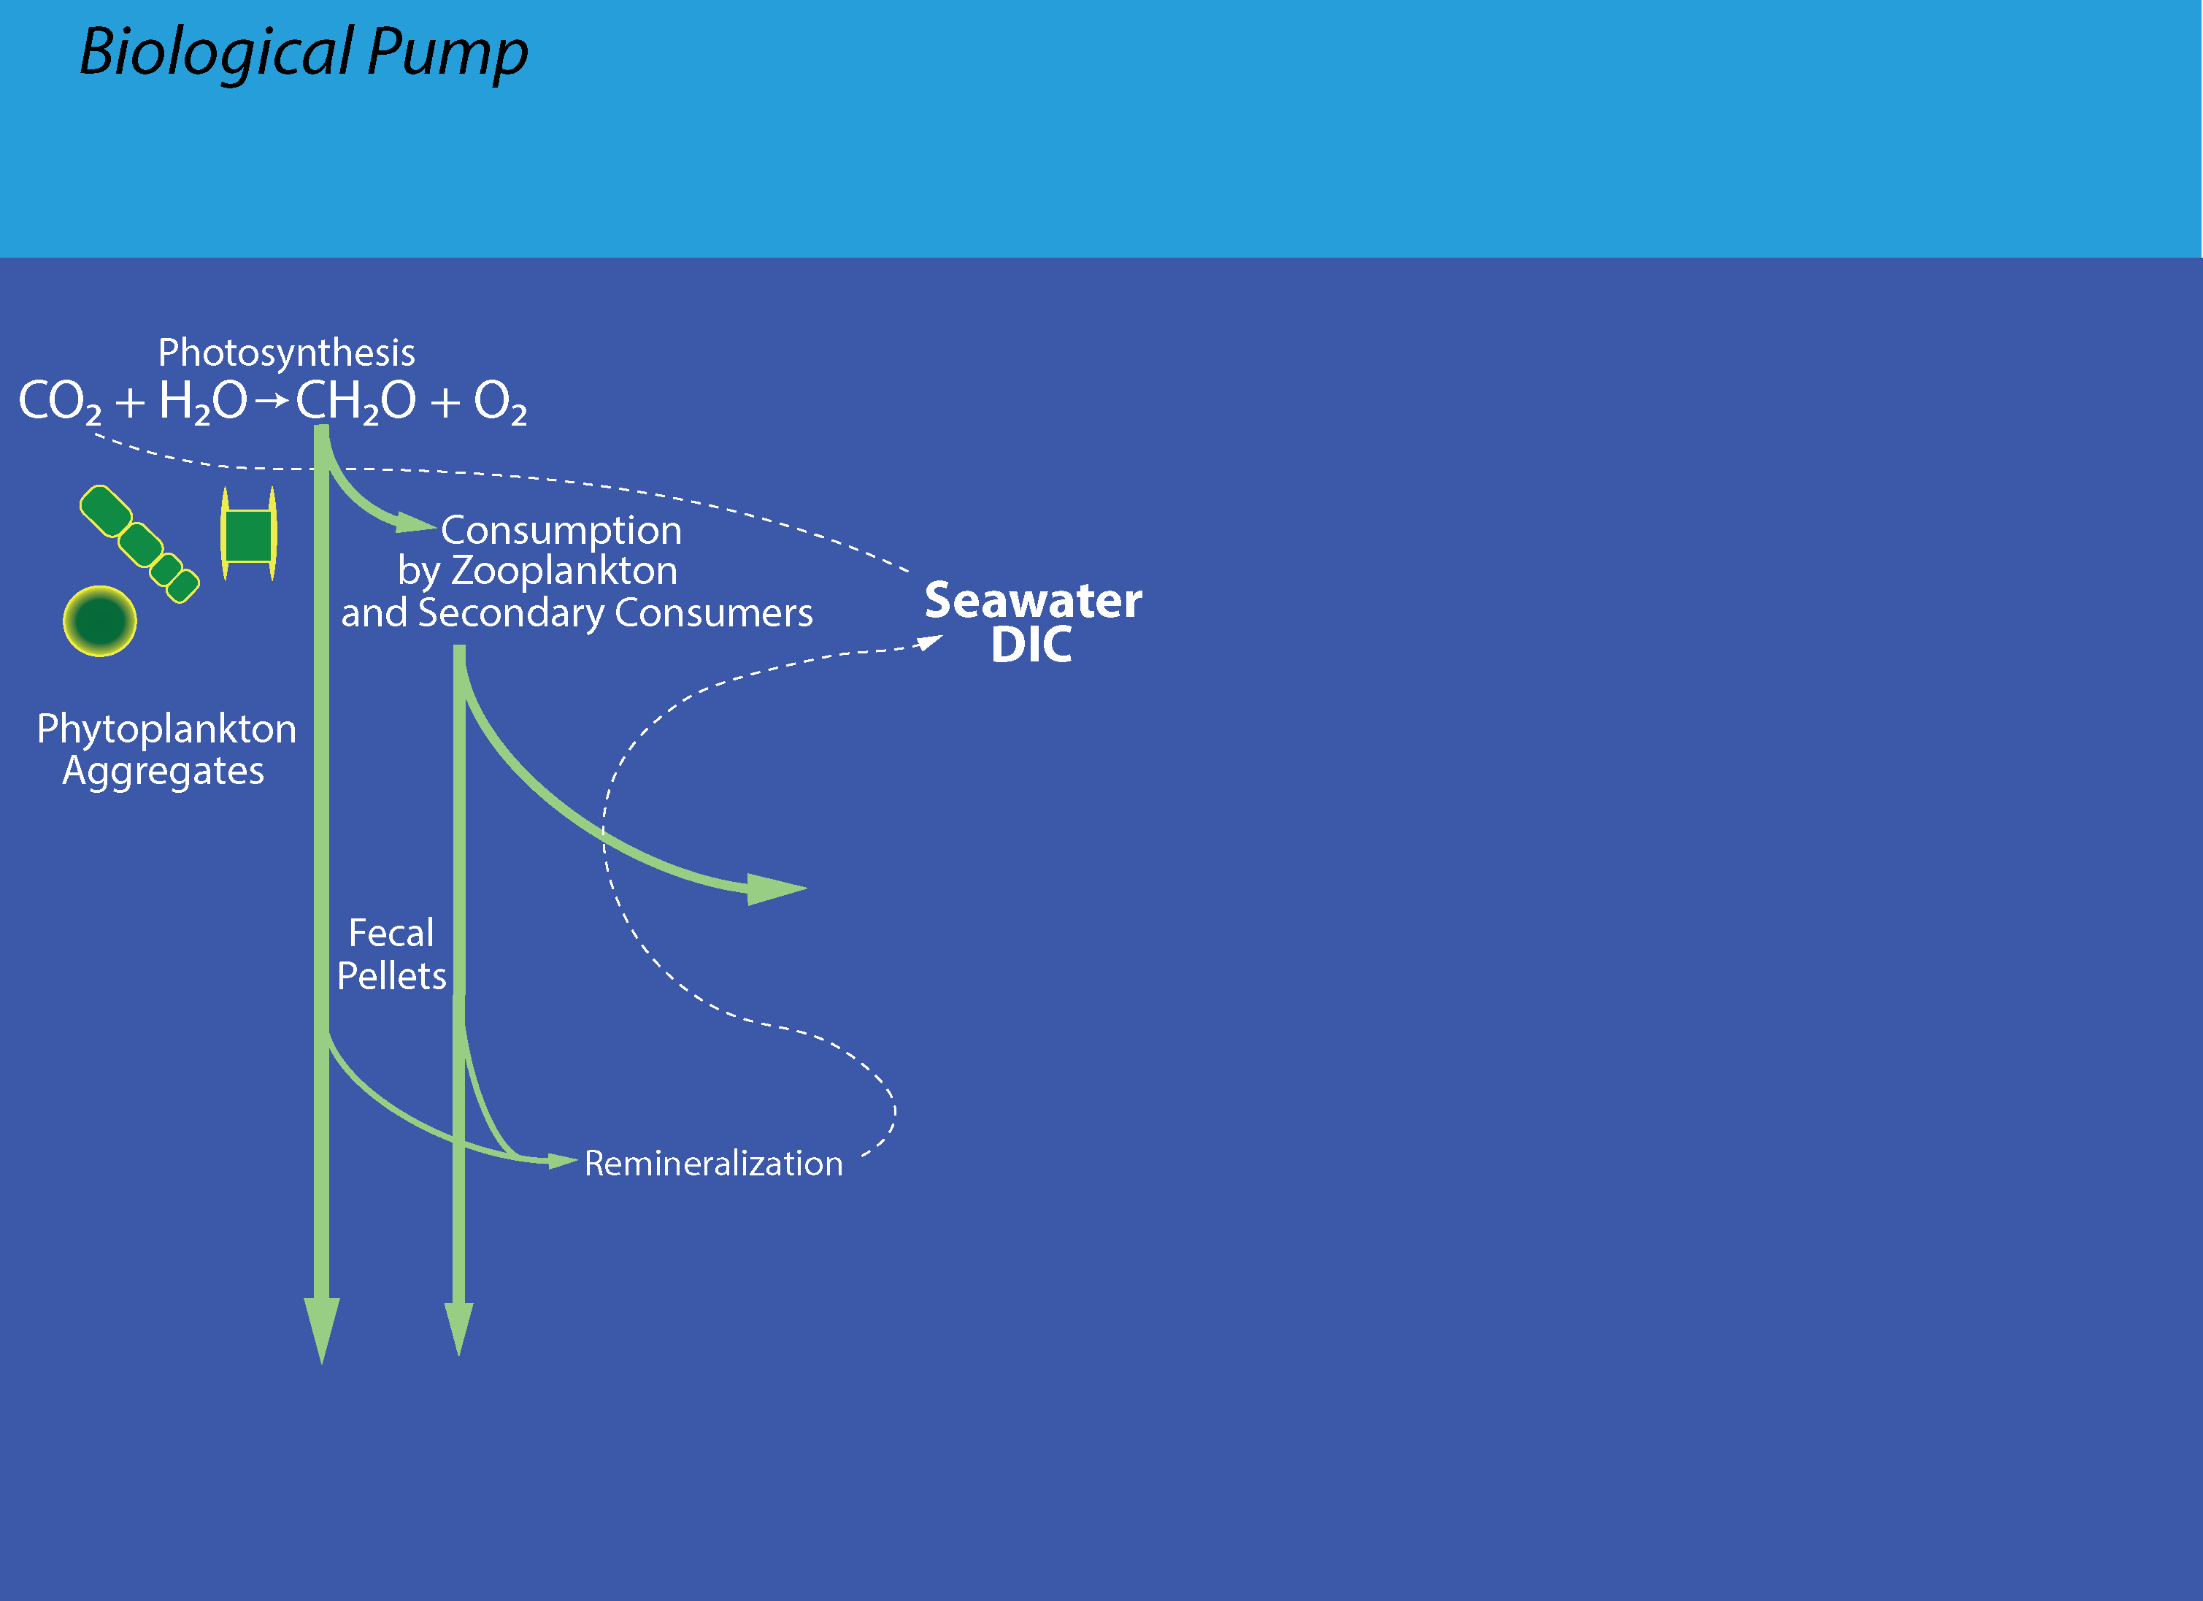
Oehlert et al., 2025
NSF-OCE-2319245

Slide 6
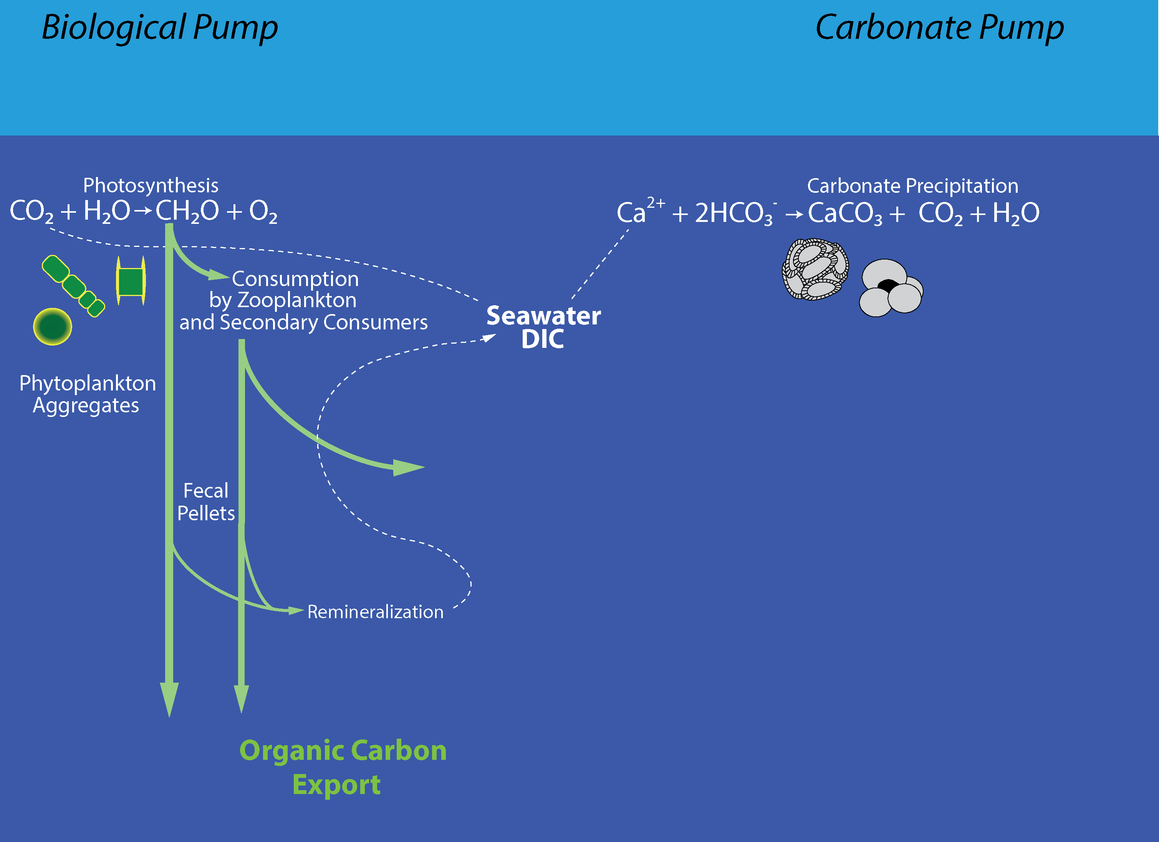
Oehlert et al., 2025
NSF-OCE-2319245

Slide 7
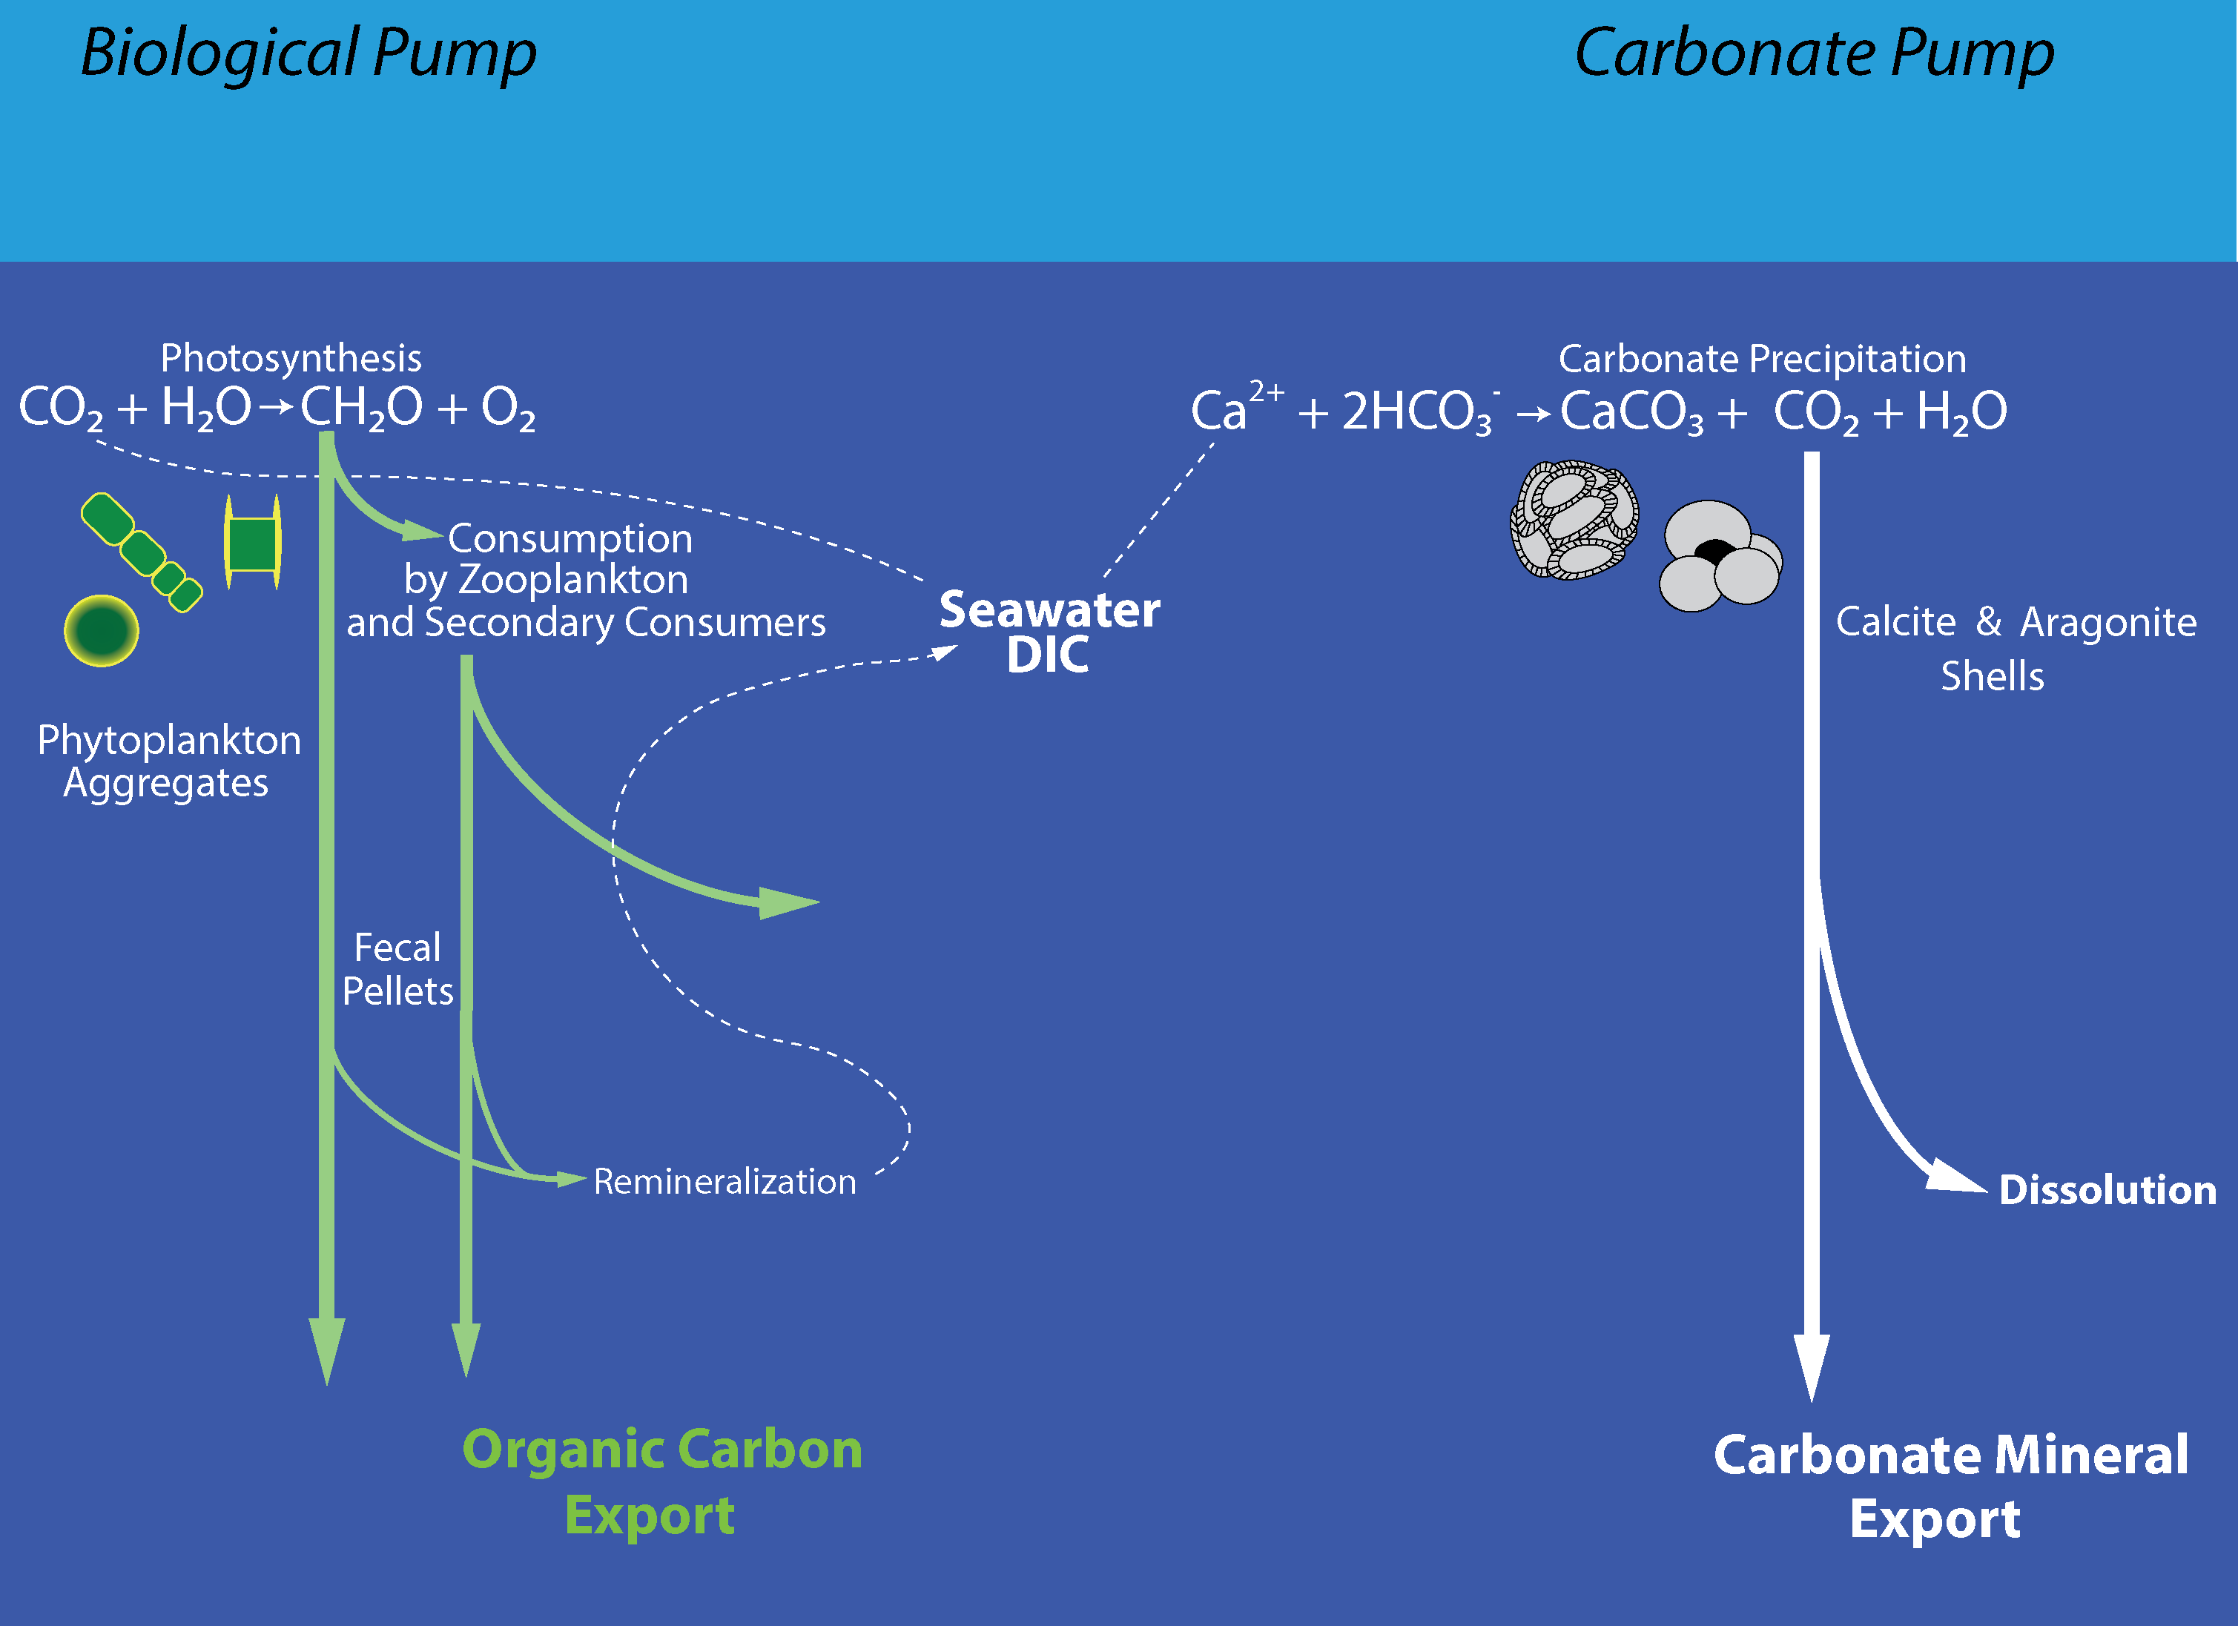
Oehlert et al., 2025
NSF-OCE-2319245

Slide 8
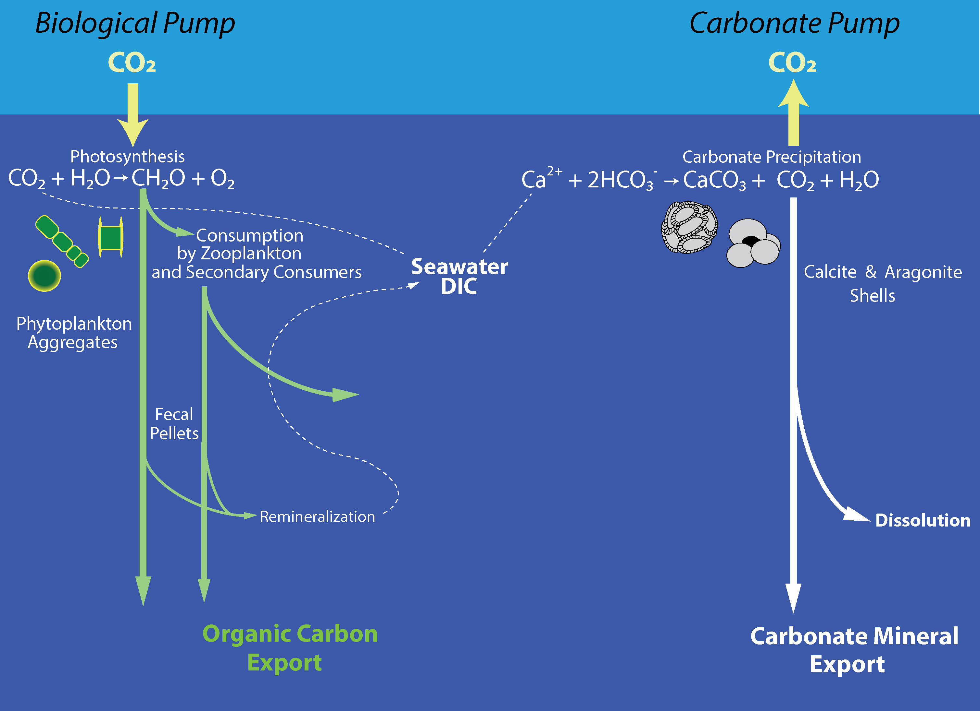
Oehlert et al., 2025
NSF-OCE-2319245

Slide 9
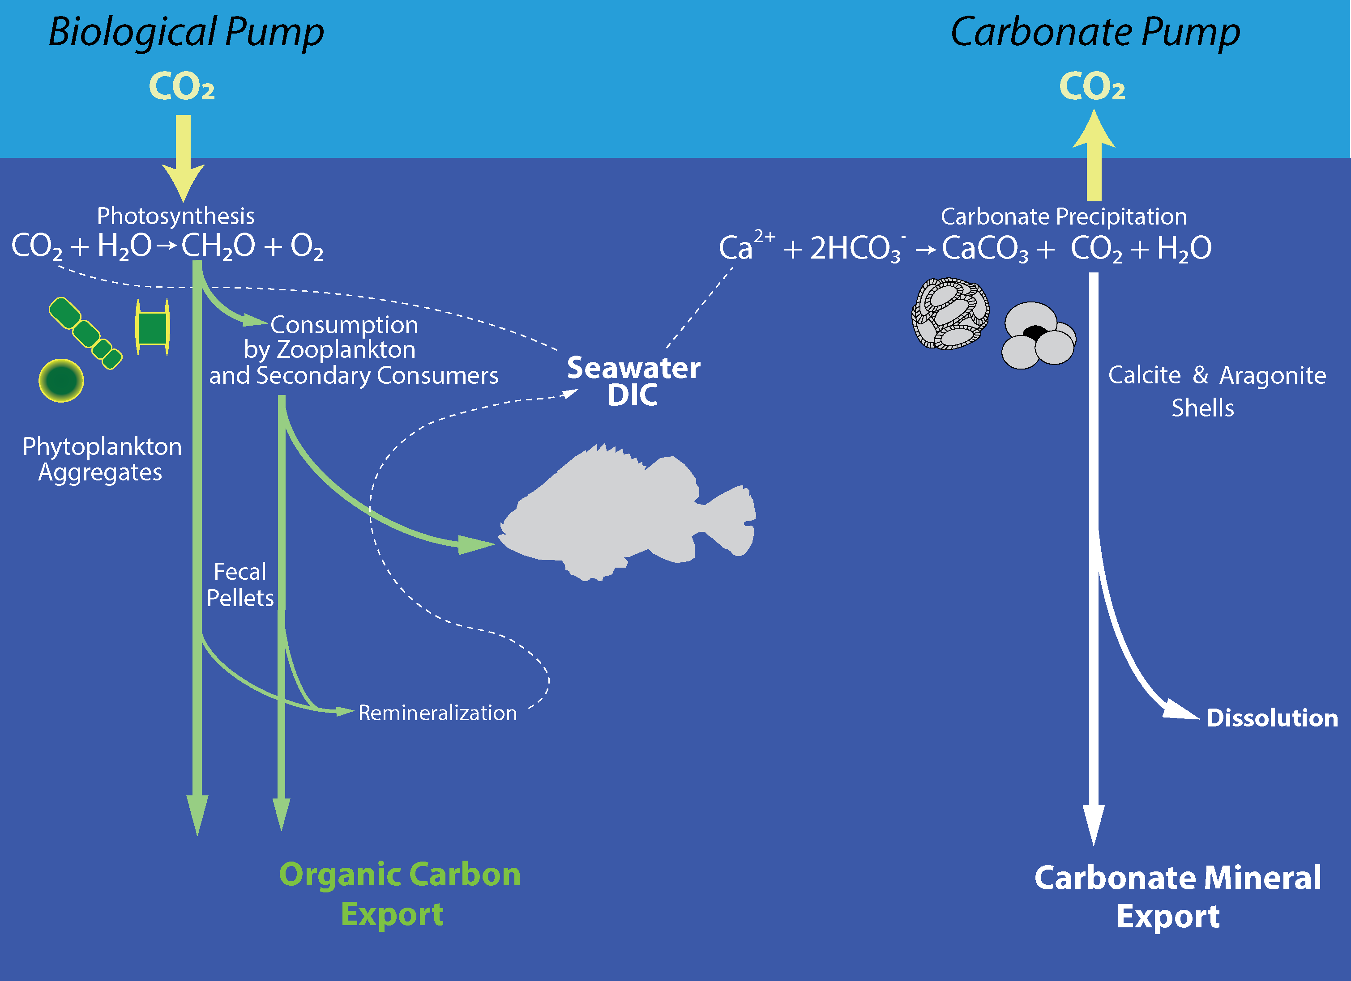
Oehlert et al., 2025
NSF-OCE-2319245

Slide 10

Oehlert et al., 2025
NSF-OCE-2319245

Slide 11
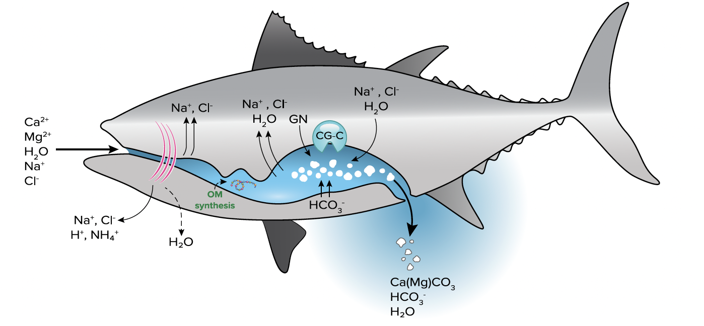
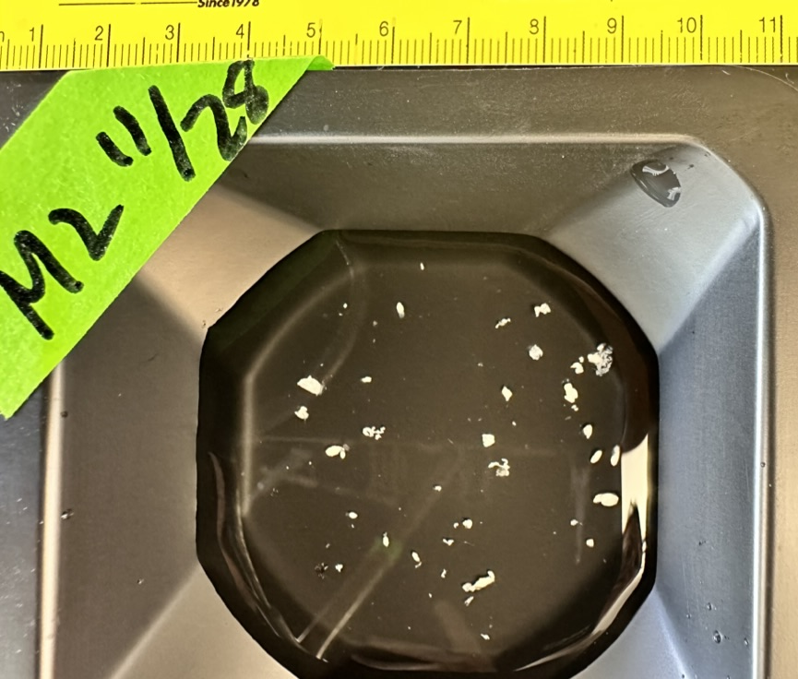
Drinking Seawater to Stay Hydrated…
Oehlert et al., 2025
R.M. Heuer
NSF-OCE-2319245
Grosell & Oehlert, 2023
Mg-rich carbonate precipitates formed in intestines and excreted continuously, necessary for fish survival in seawater (Wilson et al., 2009; Perry et al., 2011; Salter et al., 2012, 2017, 2018; Foran et al., 2013…)

Slide 12
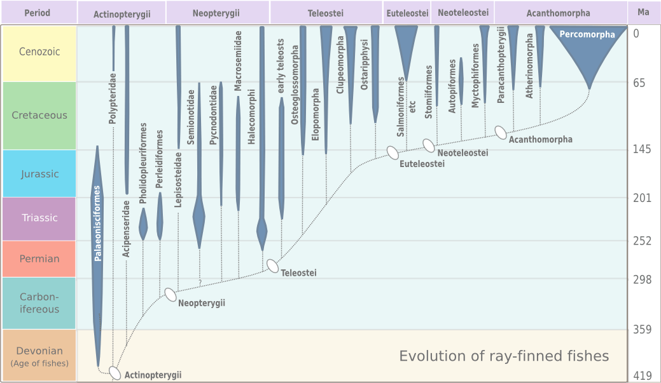
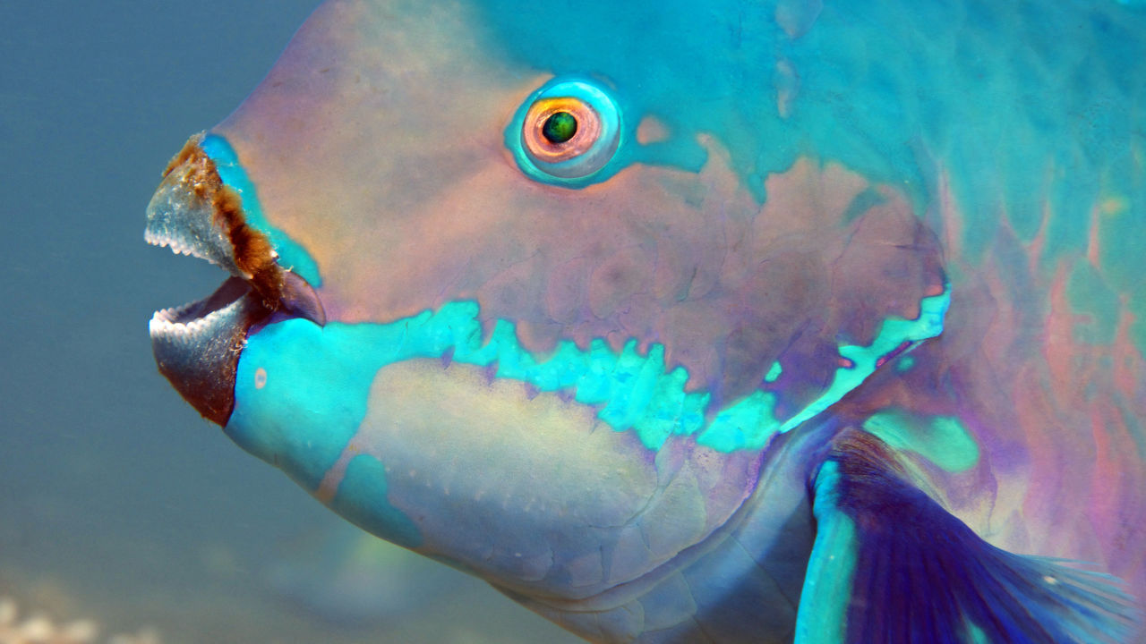
New, not recycled, minerals
Oehlert et al., 2025
X
Grosell & Oehlert, 2023
Great Barrier Reef Foundation
Benton, 2005
Not crushed carbonate produced by fish eating corals (i.e., Parrotfish)
Autochthonous intestinal precipitates, Mg-rich carbonate minerals (Walsh et al., 1991)
Evolutionary trait that arose ≥280 million years ago (Benton, 2005, Near 2012)

Slide 13
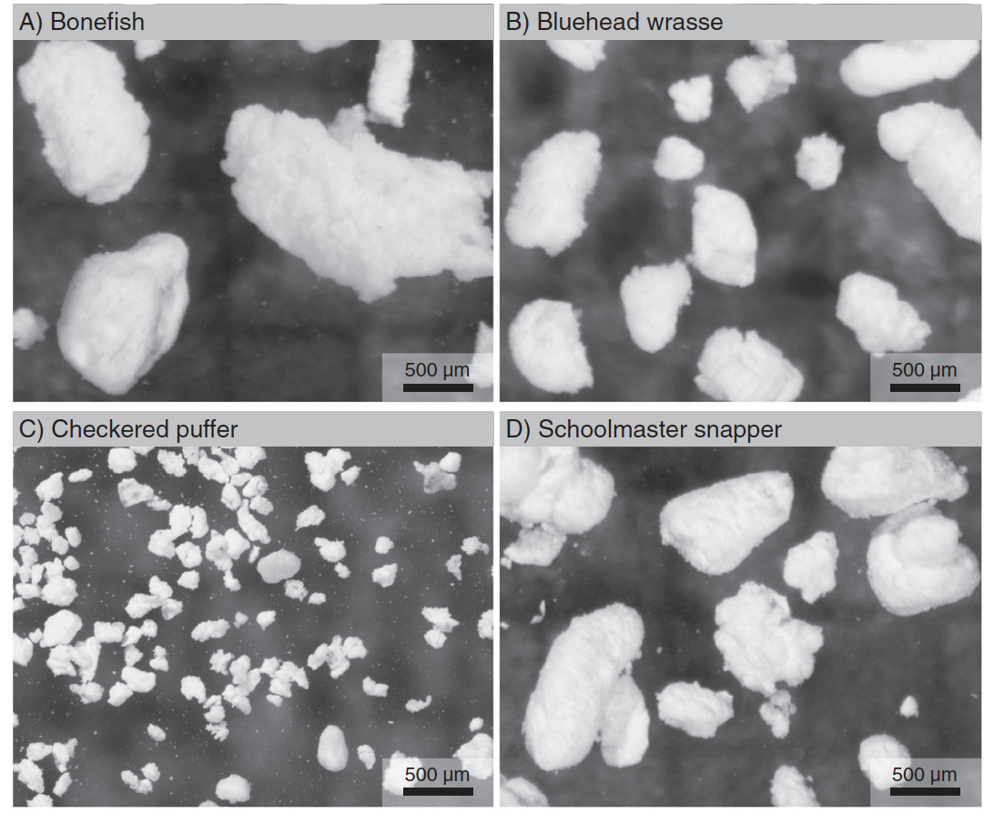
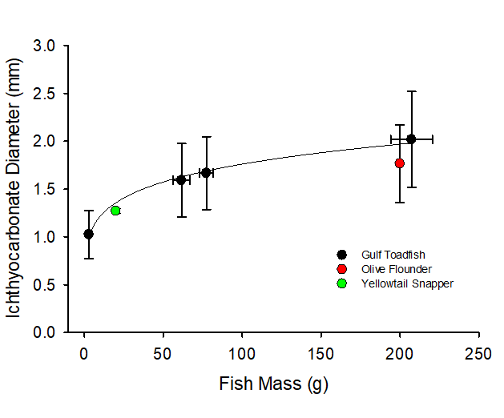
Ichthyocarbonate Morphology
NSF-OCE-2319245
Oehlert et al., 2025
Ichthyocarbonate: sand size particles
Depends on fish size
Grosell & Oehlert, 2023
Salter et al., 2014
Folkerts et al., 2024

Slide 14
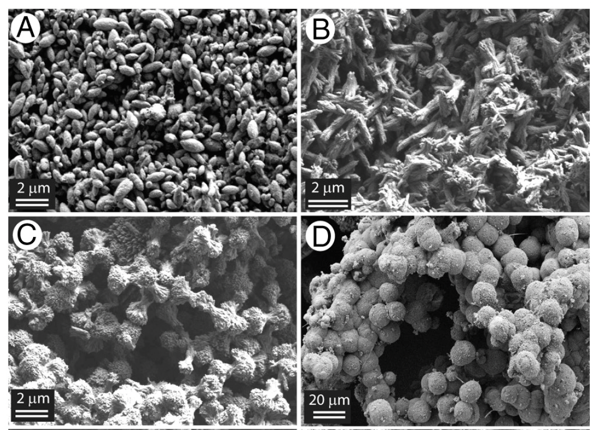
Ichthyocarbonate Morphology
Oehlert et al., 2025
Four dominant shapes
  Ellipsoidal (<0.25 -3 mm long)
  Straw bundles (1-3 mm long)
  Dumbbells (1-3 mm long, but 10-15 mm possible)
  Spheroids (<10-30 mm)
(Perry et al., 2011; Salter et al., 2018,
Ghilardi et al., 2023)
High Magnesium Calcite or
Amorphous Ca-Mg Carbonate
  Minor: Aragonite, Brucite, LMC
  (Perry et al., 2011; Foran et al., 2013;
  Salter et al., 2017, 2018)
Grosell & Oehlert, 2023
Perry et al., 2011

Slide 15
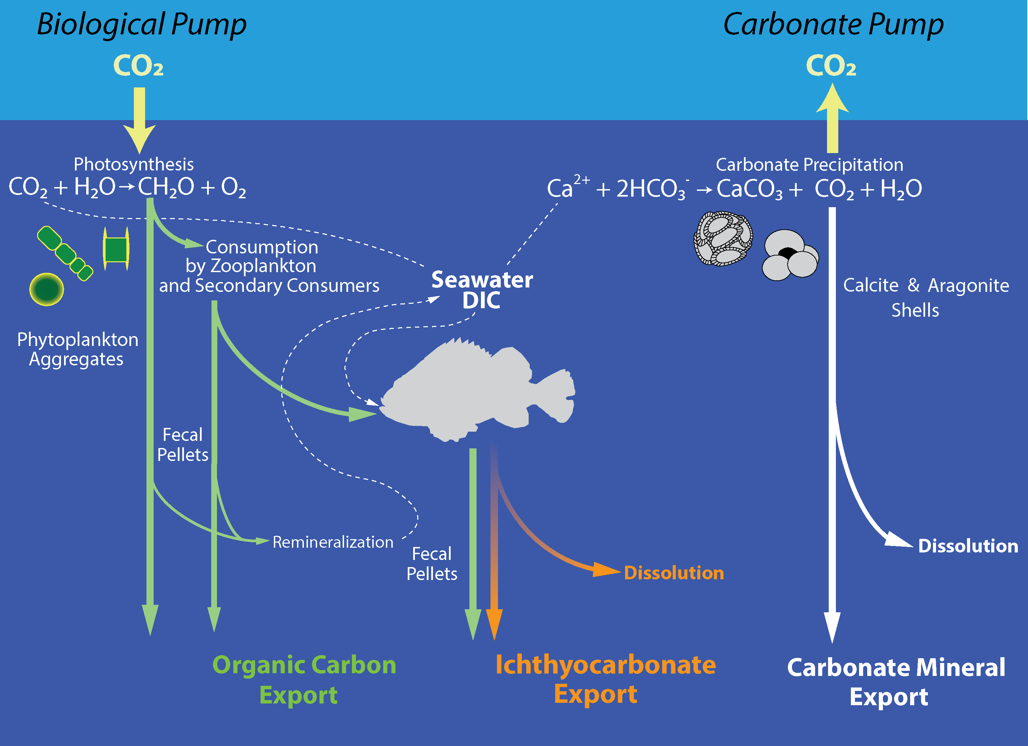
Fish & The Modern Carbon Cycle
NSF-OCE-2319245
Oehlert et al., 2025
Biological Pump
Saba et al., 2021
Fish-based carbon fluxes recently synthesized:
Fecal pellet sinking
Migratory fluxes (Respiration, excretion, defecation)
Deadfall
Contribute as much as 1.5 ± 1.2 Pg C yr⁻¹ or
16.1 ± 13% of global carbon export
similar to zooplankton migratory flux
(Archibald et al., 2019)

Slide 16
Fish & The Modern Carbon Cycle
NSF-OCE-2319245
Oehlert et al., 2025
Biological Pump
Saba et al., 2021
Fish-based carbon fluxes recently synthesized:
Fecal pellet sinking
Migratory fluxes (Respiration, excretion, defecation)
Deadfall
Contribute as much as 1.5 ± 1.2 Pg C yr⁻¹ or
16.1 ± 13% of global carbon export
similar to zooplankton migratory flux
(Archibald et al., 2019)
Carbonate Pump
Oehlert et al., 2024a, Wilson et al., 2009
Top three producer of marine carbonate in the oceans today
Median Estimate:
0.171 to 0.475 Pg CaCO₃-C yr⁻¹
Foraminifera:
0.12-0.14
(Langer, 2008)
Coccolithophores:
0.12-0.14
(Broecker and Clark, 2009; Godrijian et al., 2022)

Slide 17
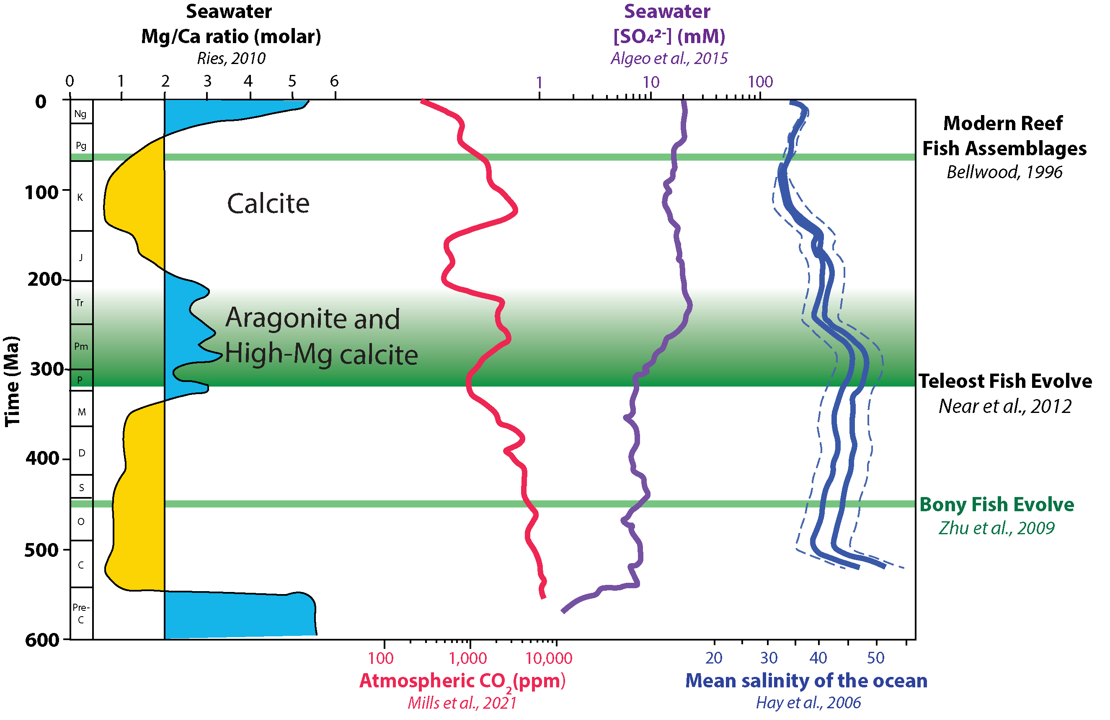
Phanerozoic & Fish Evolution
NSF-OCE-2319245
Oehlert et al., 2025
Geological Time
1) Marine fish evolution
2) Ocean and atmospheric chemistry
Could the role of marine fish have changed?
Oehlert et al., in prep

Slide 18
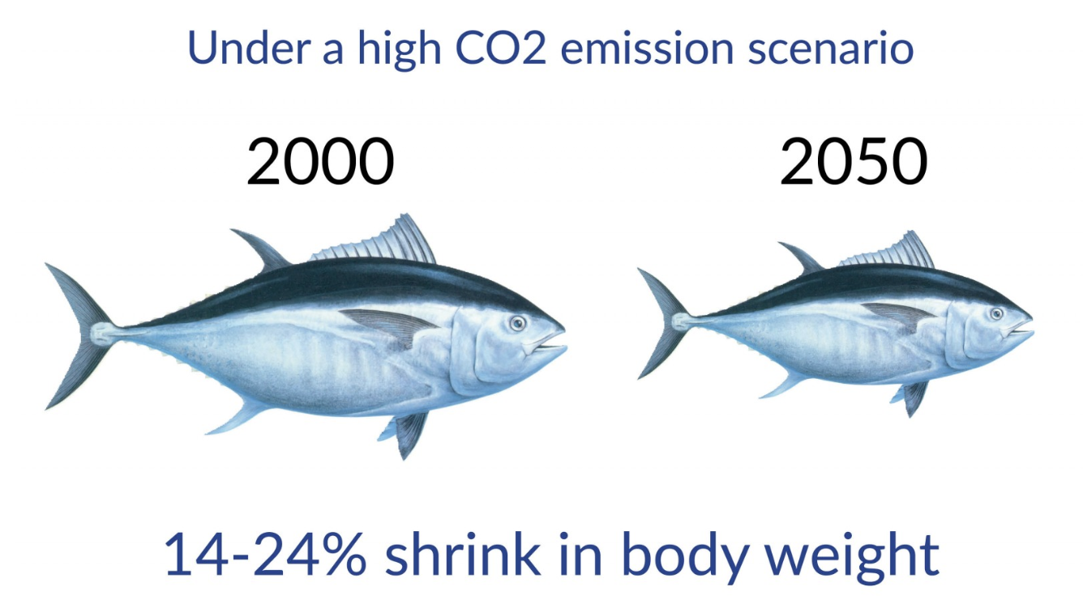
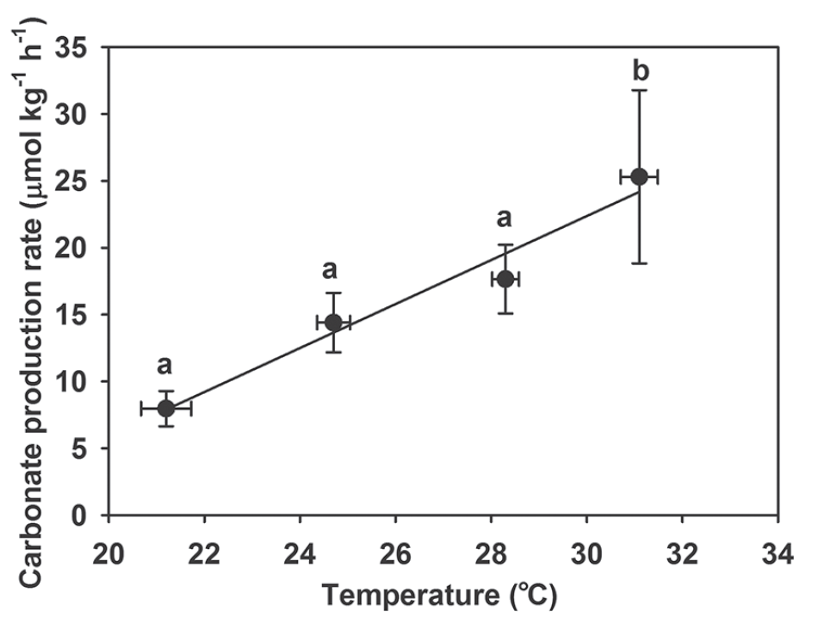
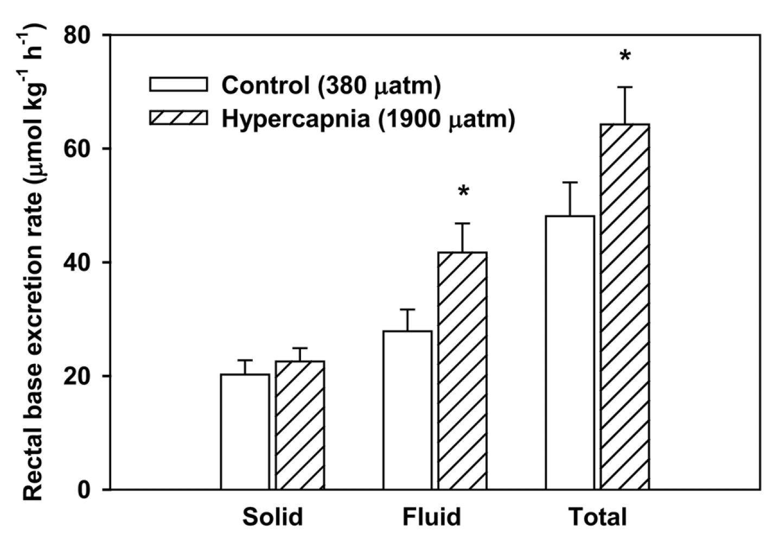
Temperature and pCO₂ effects
NSF-OCE-2319245
Oehlert et al., 2025
Increased temperature:
Distribution shifts polewards, and fish size to shrink
(Jennings et al., 2008, Cheung et al., 2012)
Increased metabolic rates (small, high T)
(Wilson et al., 2009; Cheung et al., 2012)
Increased production, by 50-133%
(Wilson et al., 2009; Heuer et al., 2016; Ghilardi et al., 2023)
Nereus Program, UBC
Increased pCO₂:
Enhanced base excretion by > 34%
(Heuer et al., 2012; Gregorio et al., 2019; Alves et al., 2019)
Heuer et al., 2016
Heuer et al., 2012

Slide 19
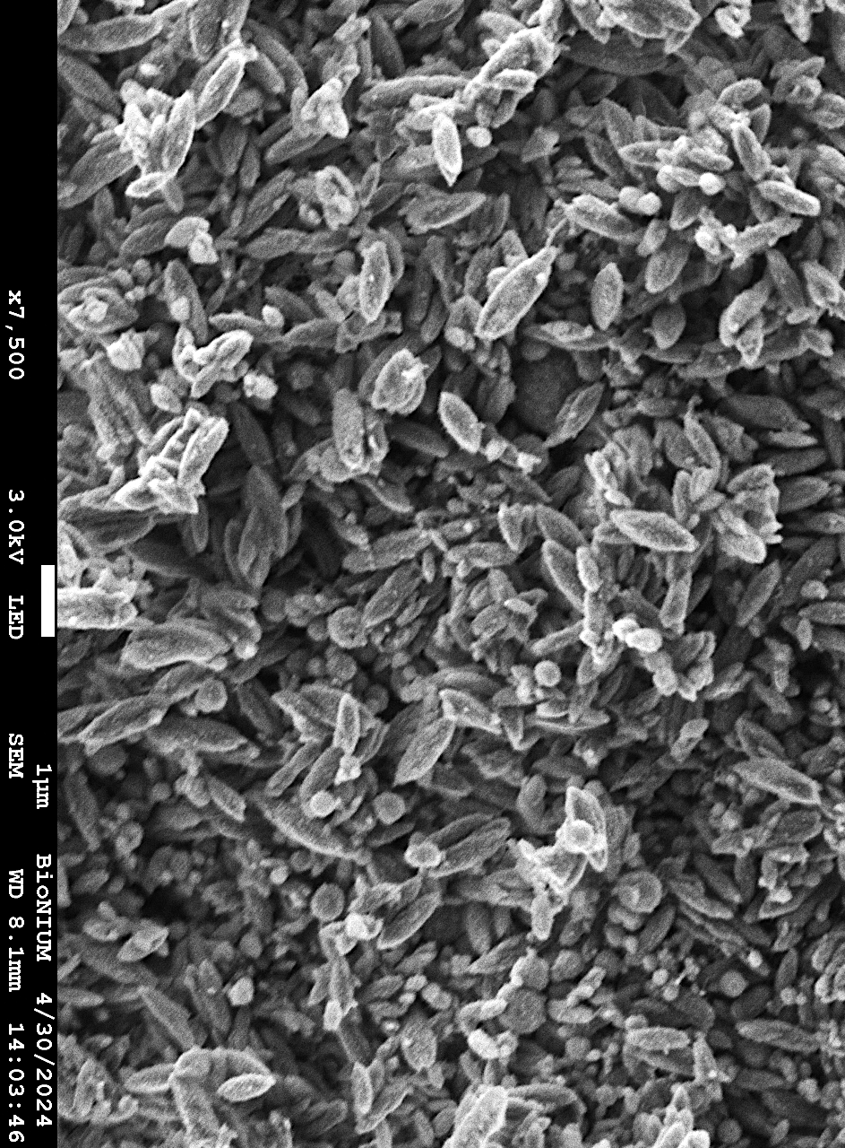
Key Findings…
NSF-OCE-2319245
Oehlert et al., 2025
During Greenhouse Periods,
carbonate production by marine fishes
even more important than today…
      3.6x more ichthyocarbonate
      Increased proportion of sinking ichthyocarbonate
      Lower mol%MgCO₃ and TOC
      Slower dissolution rates

Slide 20
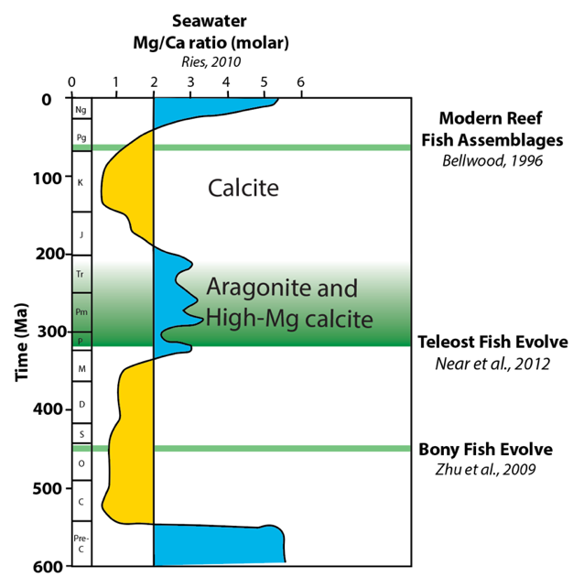
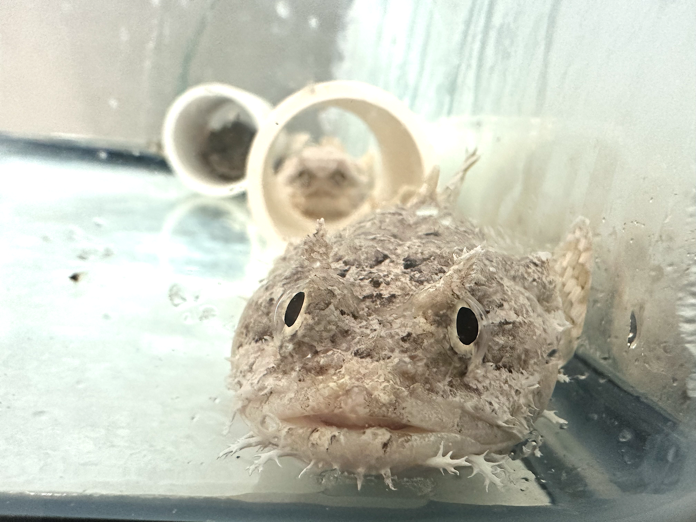
Experimental Approach
NSF-OCE-2319245
Oehlert et al., 2025
Oehlert et al., in prep
Seawater Mg/Ca ratios:
Sandberg, 1983; Lowenstein et al., 2001; Turchyn and DePaolo, 2017; Ries et al., 2008, 2010; Higgins and Schrag, 2015…
Acclimation experiments:
Modern (M)- acclimated
Cretaceous (K)- acclimated
Gulf toadfish (Opsanus beta)
Estuaries, regulatory scope
IACUC 22-150
Ionic Composition | M-acclimated | K-acclimated
Mg/Ca | 5 | 0.65
SO₄²⁻ (mM) | 28 | 9
alkalinity | Held constant at modern (2.2mM)

Slide 21
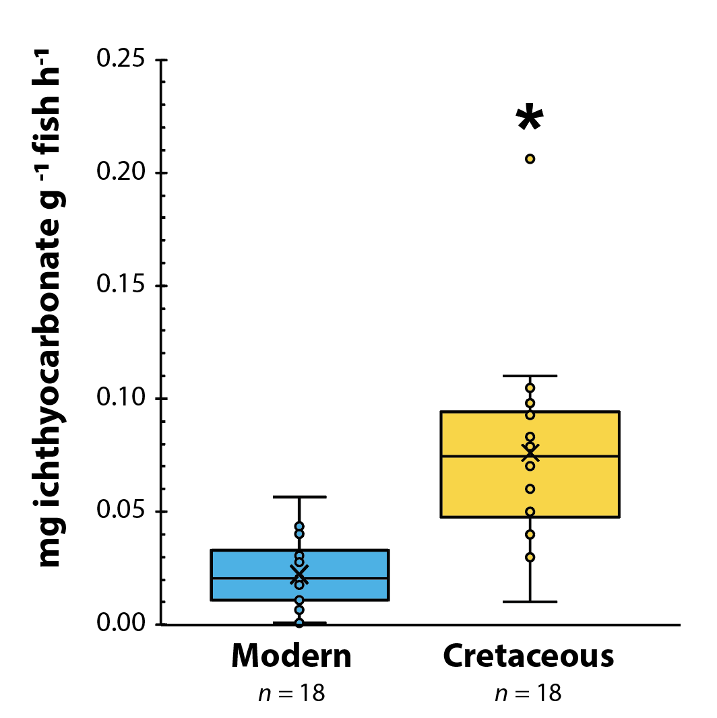
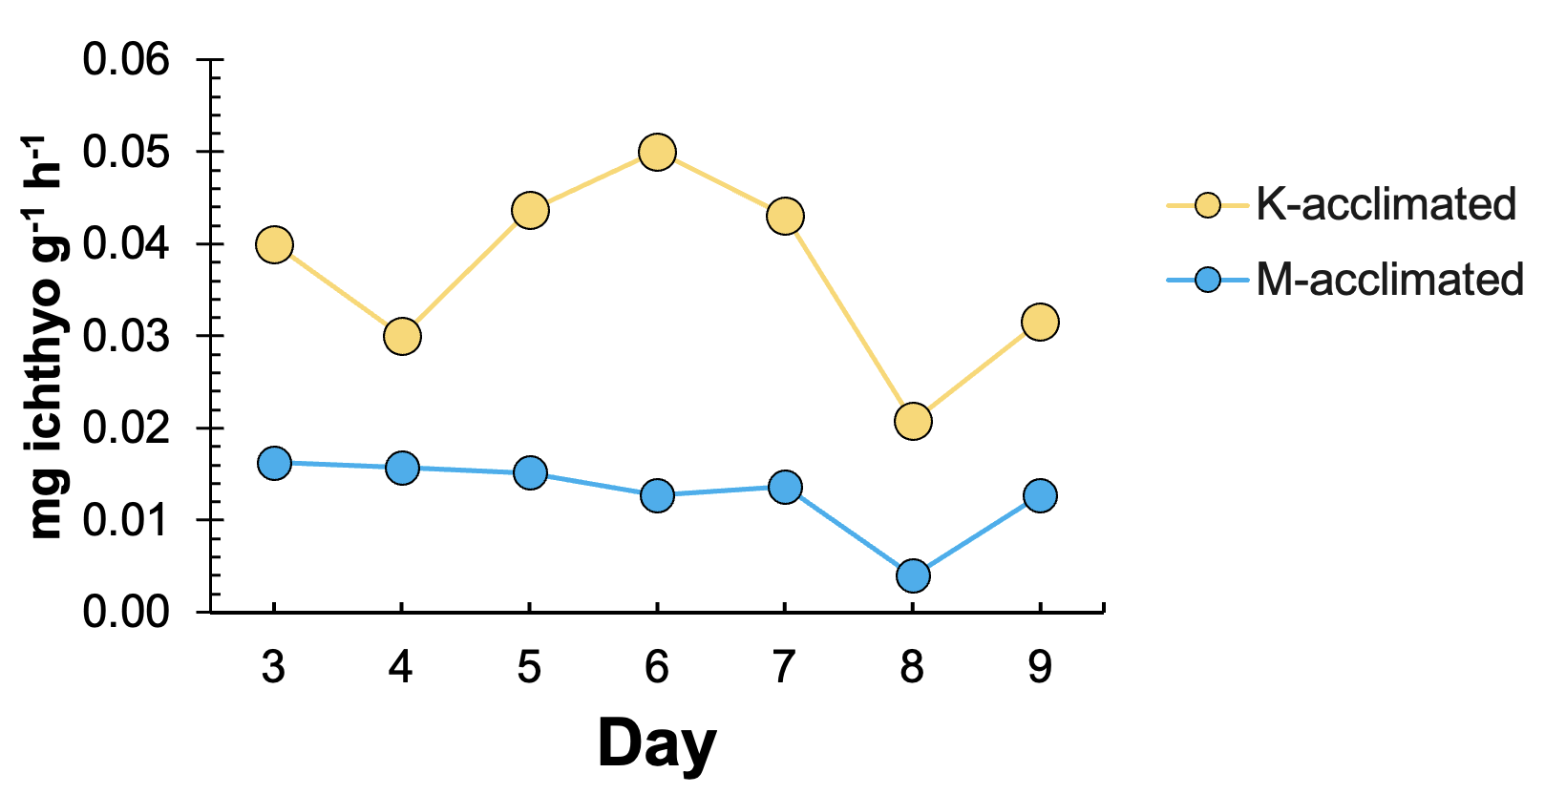

Production Rate
NSF-OCE-2319245
Oehlert et al., 2025
Oehlert et al., in prep
K-acclimated fish produce 3.6$×$ more ichthyocarbonate than M-acclimated fish (p <0.001)
  K-acclimated: 1.82 mg g⁻¹ d⁻¹
  M-acclimated: 0.51 mg g⁻¹ d⁻¹
Oehlert et al., in prep

Slide 22
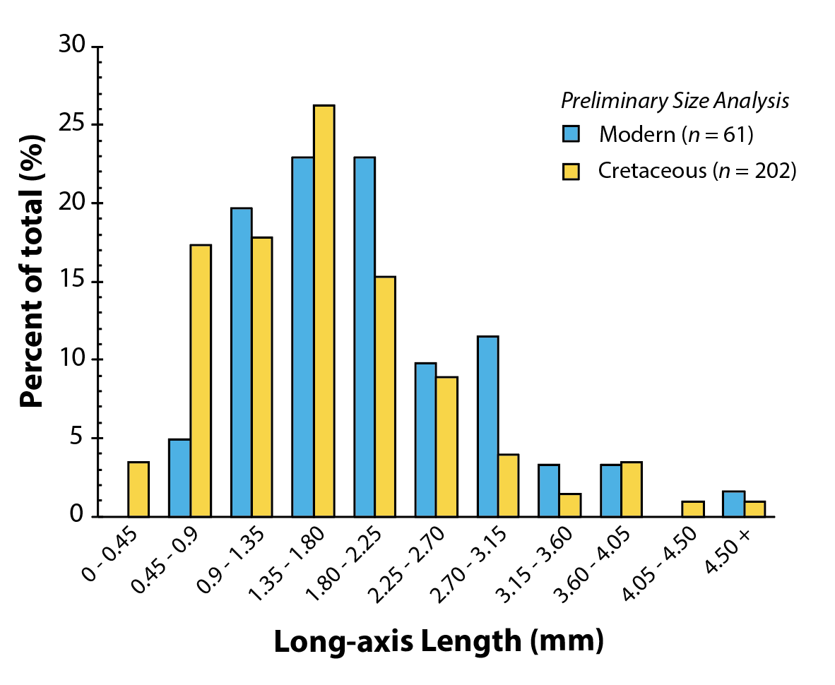
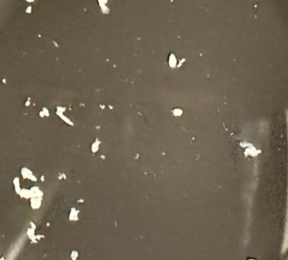
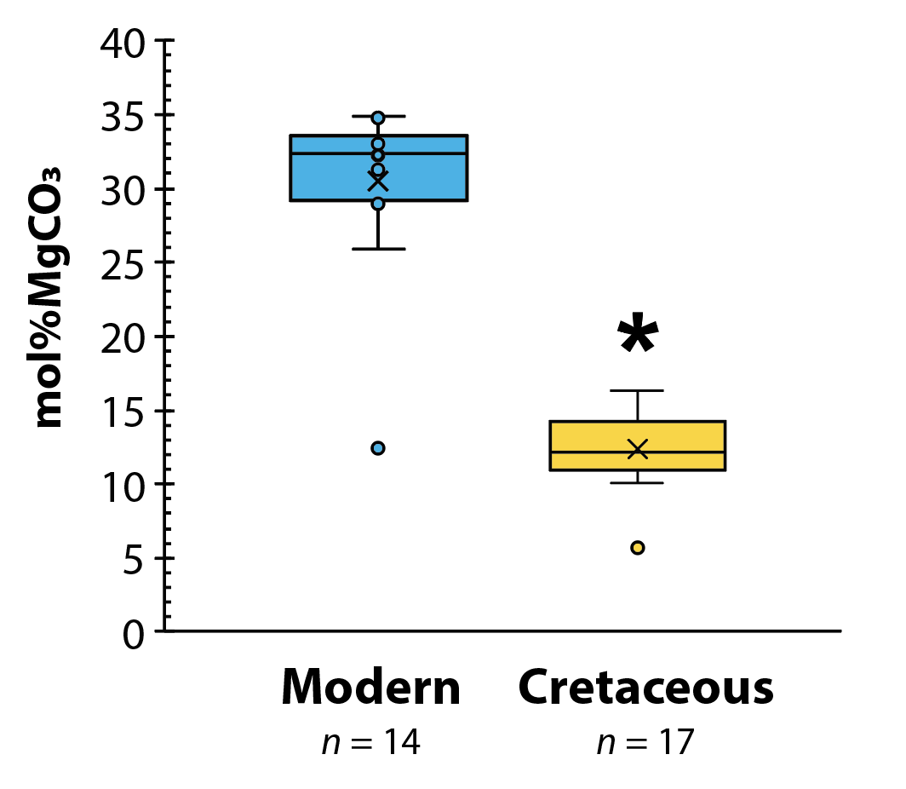
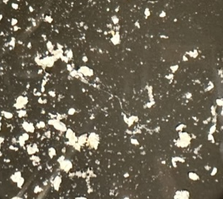
Composition: Mol%MgCO₃ and Size
NSF-OCE-2319245
Oehlert et al., 2025
Ichthyocarbonate produced by K-acclimated fish have:
Lower mol%MgCO₃ (12.4 ± 0.2%) than control (30.6 ± 0.4%, p <<0.001)
20% smaller long-axis diameters (1.66 mm) than control (1.98 mm, p = 0.011)
M-acclimated
K-acclimated
Oehlert et al., in prep
1 cm

Slide 23
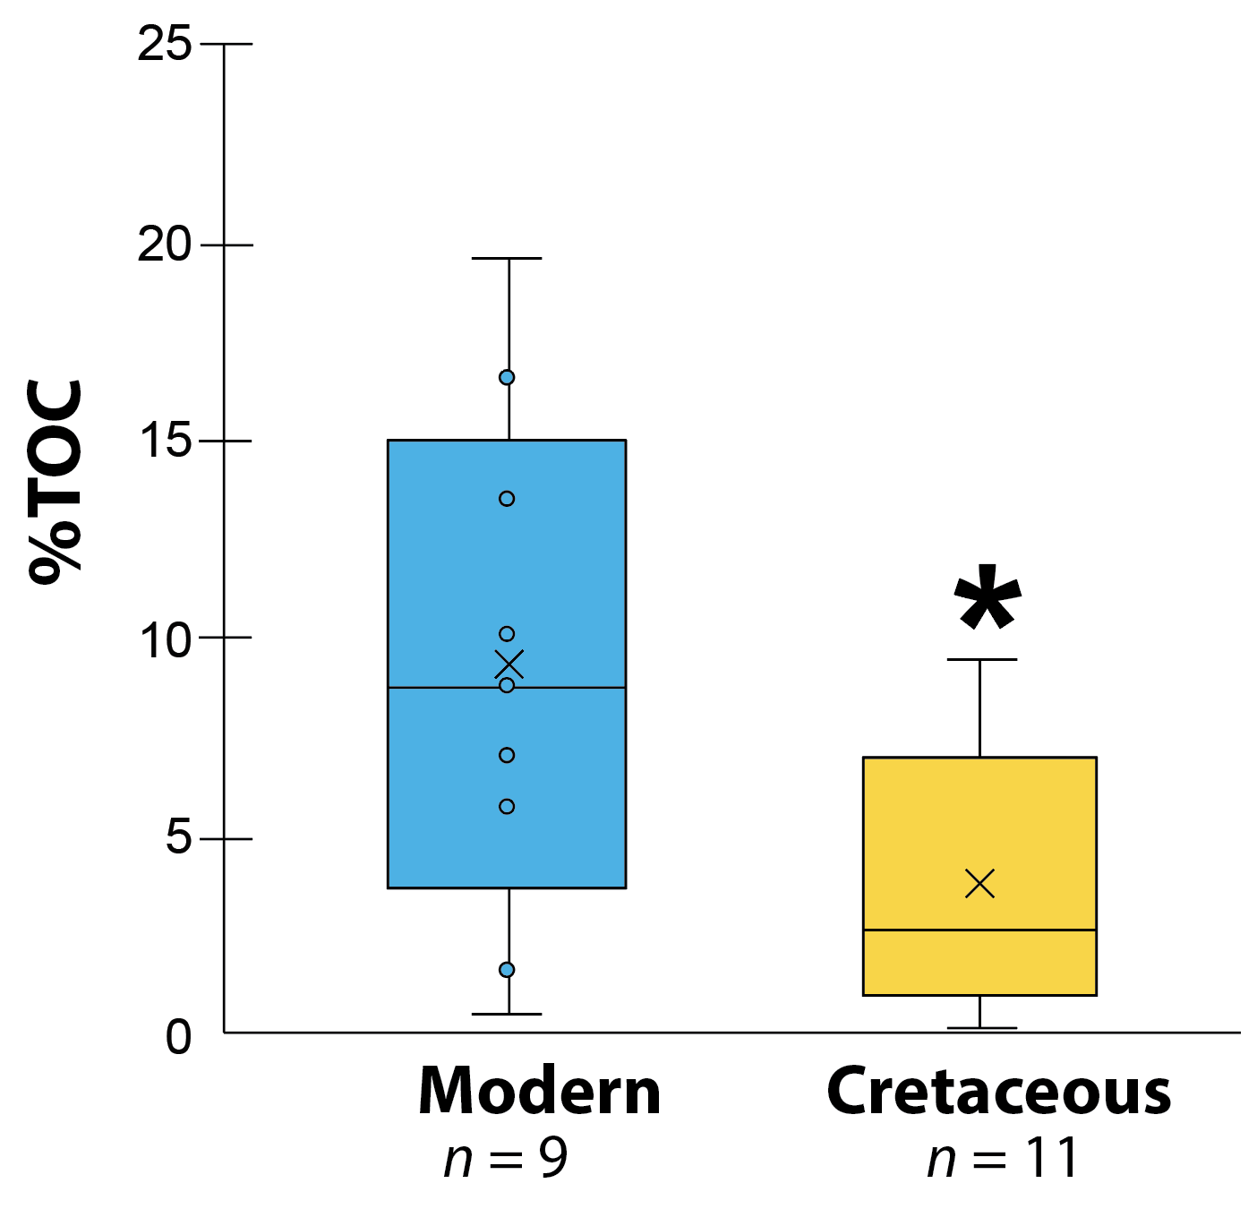
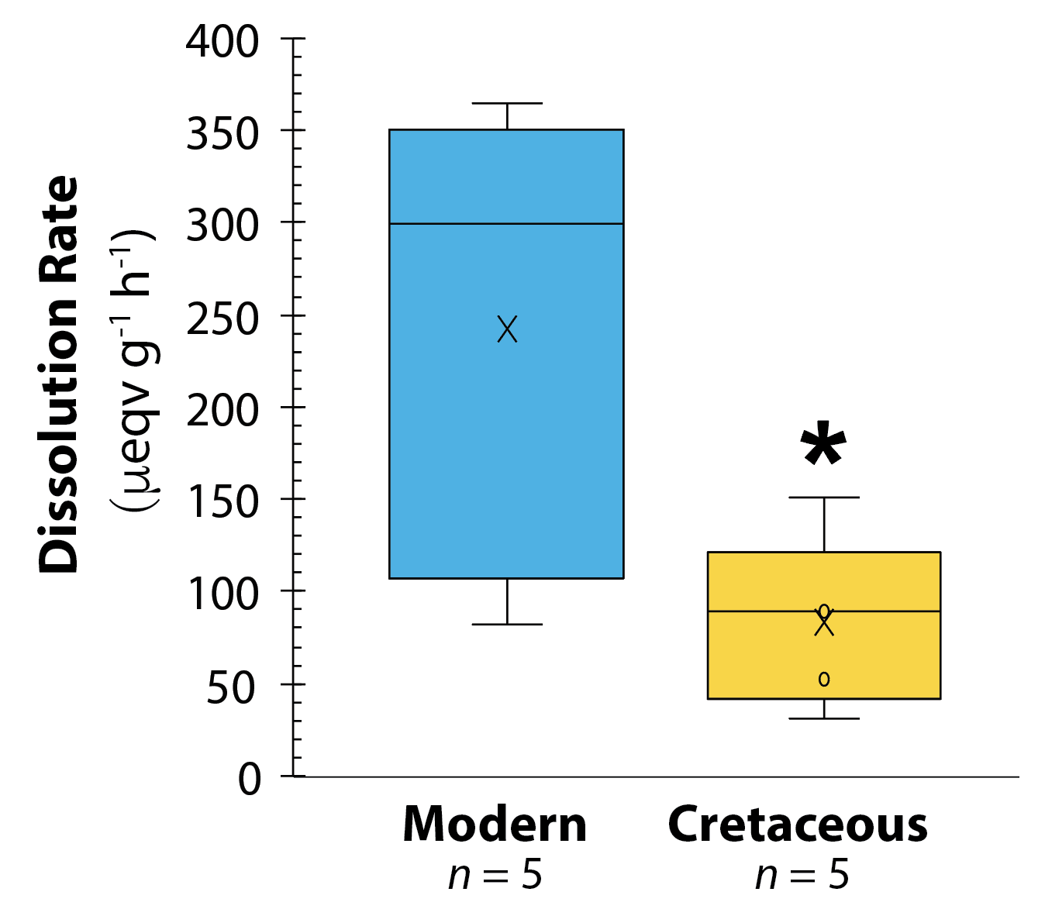
Fate: TOC and Dissolution Rate
NSF-OCE-2319245
Oehlert et al., 2025
Ichthyocarbonate produced by K-acclimated fish have:
lower %TOC (5.8 ± 3.3%) than modern counterparts (10.1 ± 6.5%, p = 0.04)
~3x slower dissolution rate compared to modern ichthyocarbonate (p = 0.045)
Average dissolution rates:
K-acclimated:
81.8 μeqv g⁻¹ h⁻¹
M-acclimated: 244.2 μeqv g⁻¹ h⁻¹
Oehlert et al., in prep

Slide 24
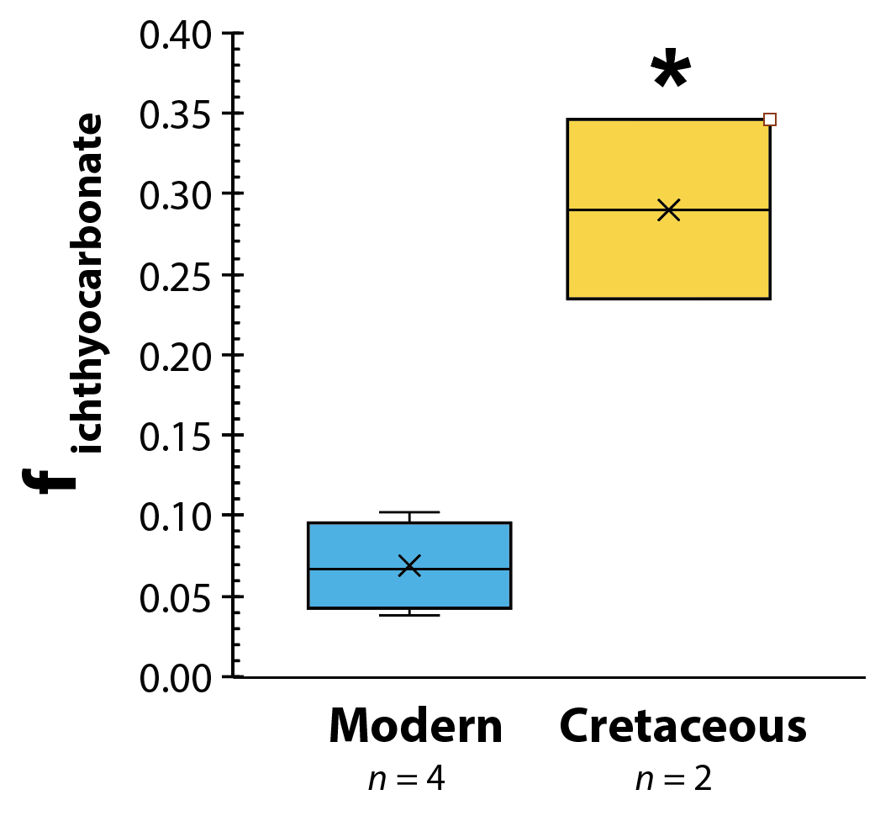
Fate: f_{ichthyo} vs f_{HCO3}
NSF-OCE-2319245
Oehlert et al., 2025
K-acclimated fish excrete more base as solid ichthyocarbonate
K-acclimated: 29 ± 8% vs M-acclimated: 7 ± 3% (p = 0.01)
HCO₃⁻
Oehlert et al., in prep
Modified from Grosell and Oehlert, 2023

Slide 25
Depth of Complete Dissolution
NSF-OCE-2319245
Oehlert et al., 2025
More ichthyocarbonate likely to reach sediments in Cretaceous
Application of fate model (Folkerts et al., 2024)
predicts K-acclimated ichthyocarbonate has:
2.4x greater lifespan
24% deeper depths of complete dissolution
HCO₃⁻
Modified from Grosell and Oehlert, 2023

Slide 26
Synthesis of Experimental Results
NSF-OCE-2319245
Oehlert et al., 2025
3.6$×$ ichthyocarbonate, but 20% smaller
3.6× ichthyocarbonate, but 20% smaller
Lower TOC and mol%MgCO₃, ~3$×$ slower dissolution rate
Lower TOC and mol%MgCO₃, ~3× slower dissolution rate
Higher f_{ichthyocarbonate}
Notes:
Nearly 1 Gt CaCO3 produced where does it end up?
Erik, Martin- dissolution rate, specific gravity, size, AO CO2sys- estimate omega Ar--model fate in open ocean

Slide 27
Key Findings…
NSF-OCE-2319245
Oehlert et al., 2025
During Greenhouse Periods,
carbonate production by marine fishes
even more important than today…
      3.6x more ichthyocarbonate
      Increased proportion of sinking ichthyocarbonate
      Lower mol%MgCO₃ and TOC
      Slower dissolution rates

Slide 28
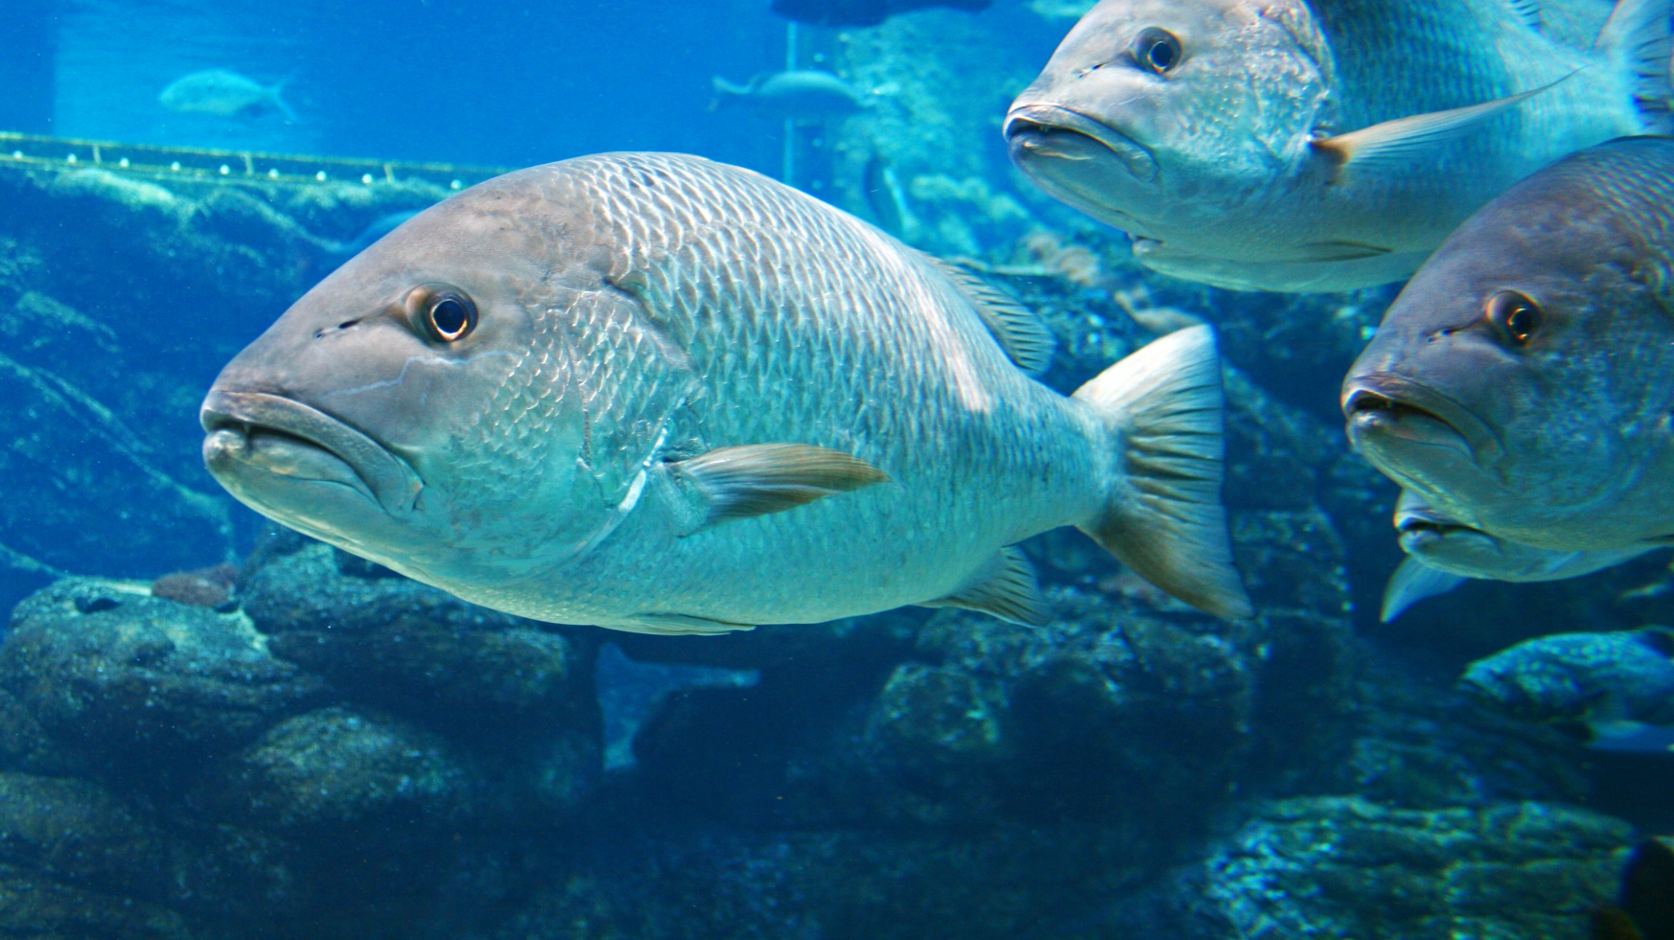
Oehlert et al., 2025
NSF-OCE-2319245
Thank you!
Notes:
Muscle water content higher in K acclimated fish (78.3%) than M acclimated fish (77.1%, p< 0.001), and likely reflects the lower osmotic pressure in K seawater (692.3 ± 28.2 mmol/kg) vs M seawater (944 ± 32.9 mmol/kg, p = 0.03). (Easier to stay hydrated, but makes the increased production even more impressive because they wouldn’t need to work as hard to fight the weaker osmotic imbalance in K seawater)
No significant difference in hematocrit between treatments K: avg. 21.9 ± 0.79 (SEM) vs M: 25.0 ± 0.1.60, p = 0.57)
No significant difference in plasma TCO₂ between K (5.80 ± 0.25 meqv L⁻¹) vs M (5.48 ± 0.14 meqv L⁻¹, p = 0.66)
No significant difference in plasma osmotic pressure between K (316.5 ± 3.86 mmol kg⁻¹) compared to M (351.9 ±8.85 mmol kg⁻¹, p = 0.18)

