Slide 1
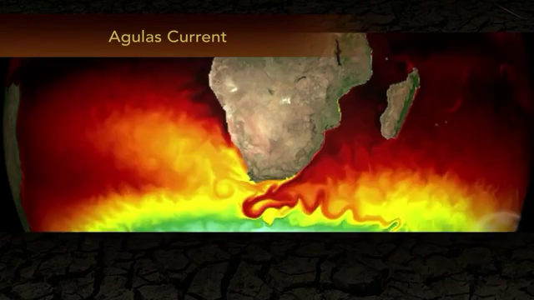

Mozambique Reef Cores
Research Initiative
Gregor P. Eberli

Slide 2
Sea Level Rise from LGM

Slide 3
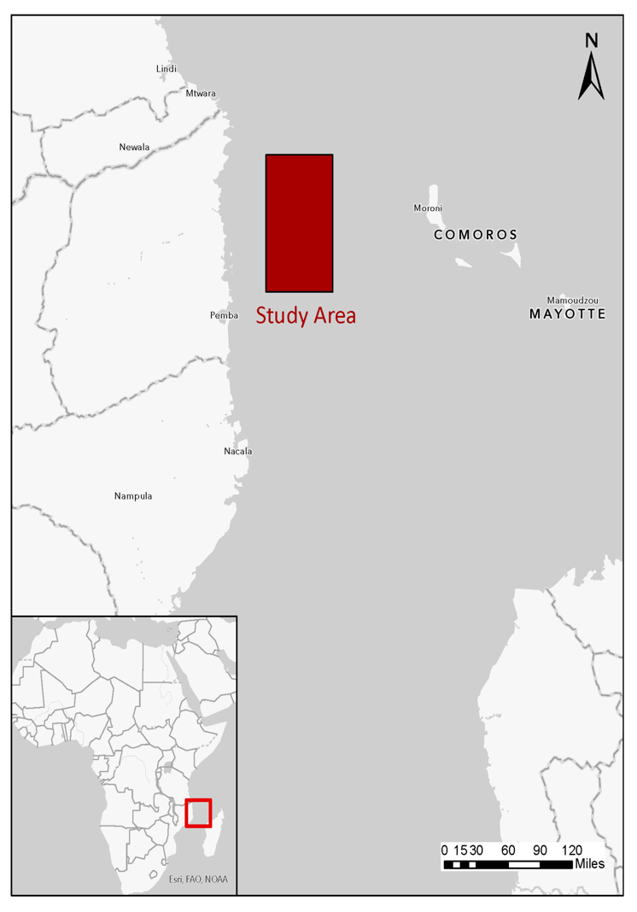
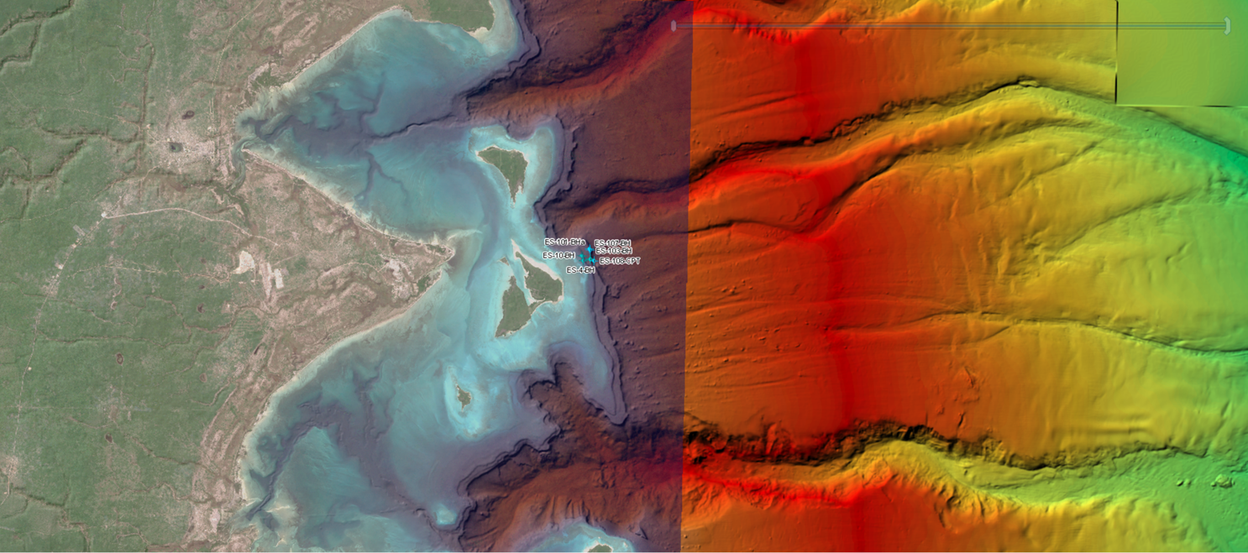
Core location on the slope

Slide 4
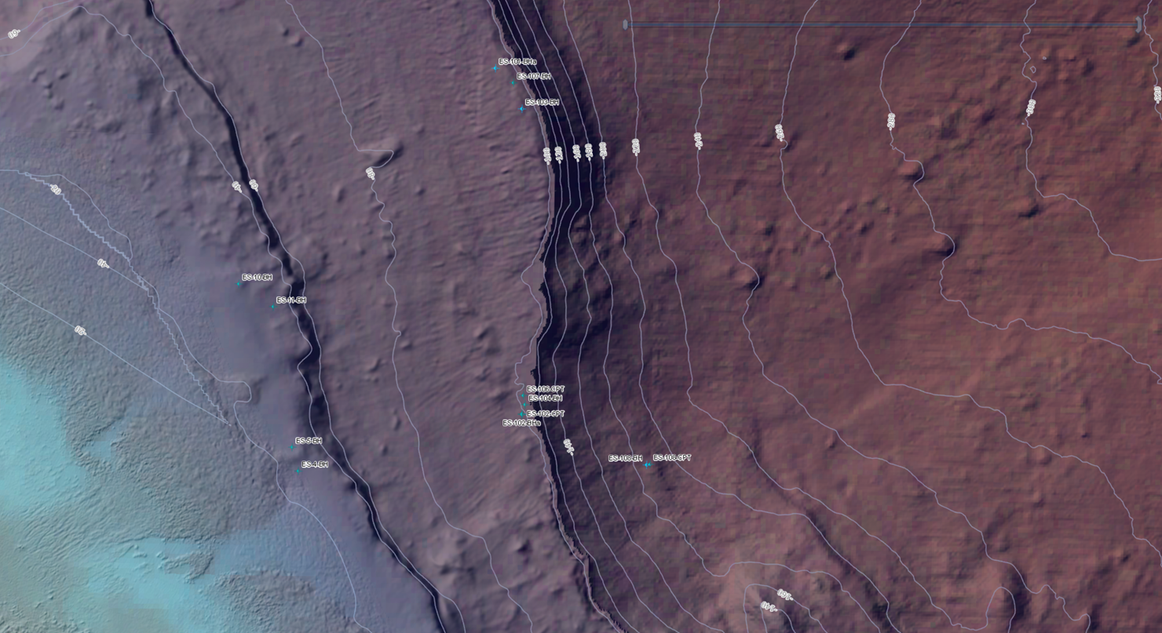
Core locations
-200
-100
-300
Upper Terrace
Lower Terrace
-60
-100
-200
-40

Slide 5
Multibeam Bathymetry

Slide 6
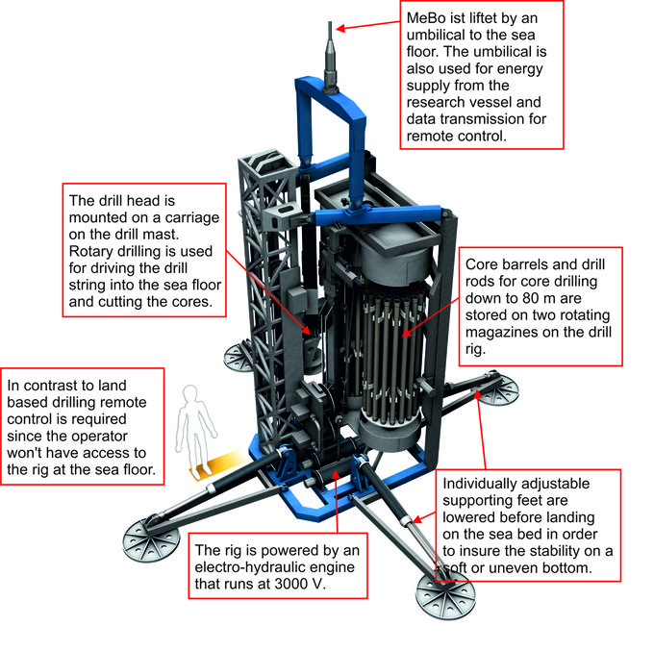
Mozambique Shelf Cores – Research Initiative
The cores were drilled using a drill rig that was positioned on the seafloor.
Each core section is 1.5m in length.
Total depth of the 103 core is 67m.

Slide 7
The long journey of the cores to Miami
The cores were stored in London and Fugro paid for storage. They were on the verge of disposing them.
Ricardo Argiolis from ENI started to explore the possibility of shipping the cores to Miami for further research.
I wrote a proposal and outlined the research that would be conducted on the core material.
The proposal received approval from the affiliates and the government of Mozambique but the “National Institute of Petroleum (INP)” wanted to review and evaluate the proposal.
After more than two years, INP approved the transfer of the cores to the University of Miami July 17, 2024.
The cores were shipped in December 2024 to Miami.

Slide 8
Core locations
-200
Core 103
-300
-100
Upper Terrace
Lower Terrace
-60
-200
-100
-40

Slide 9
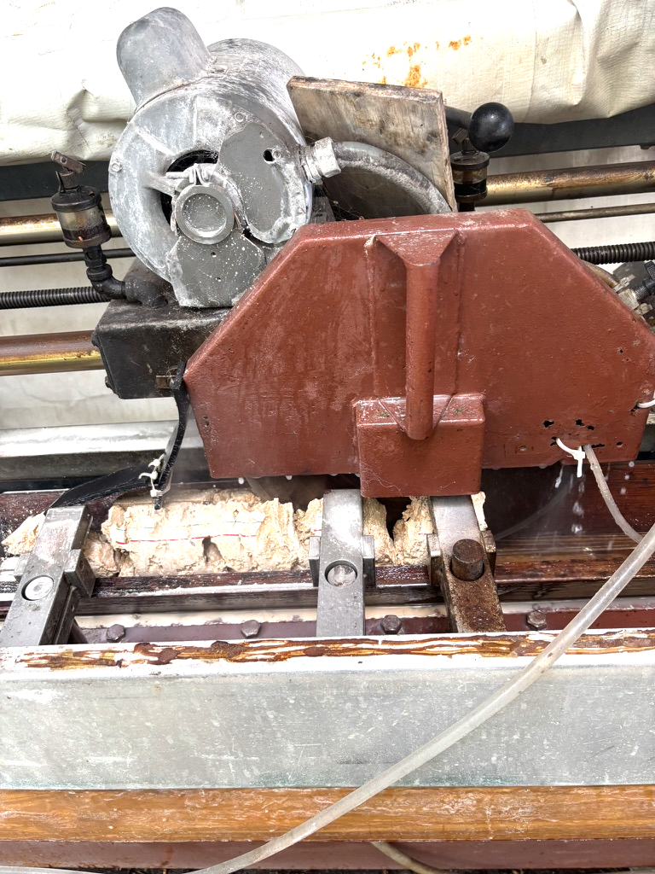
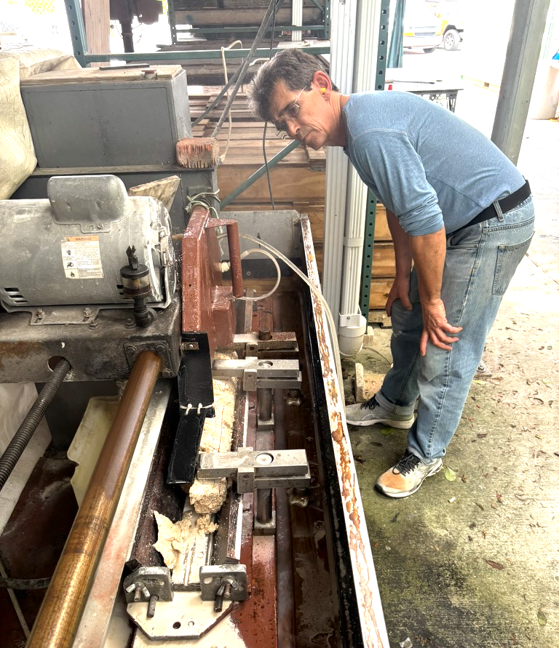
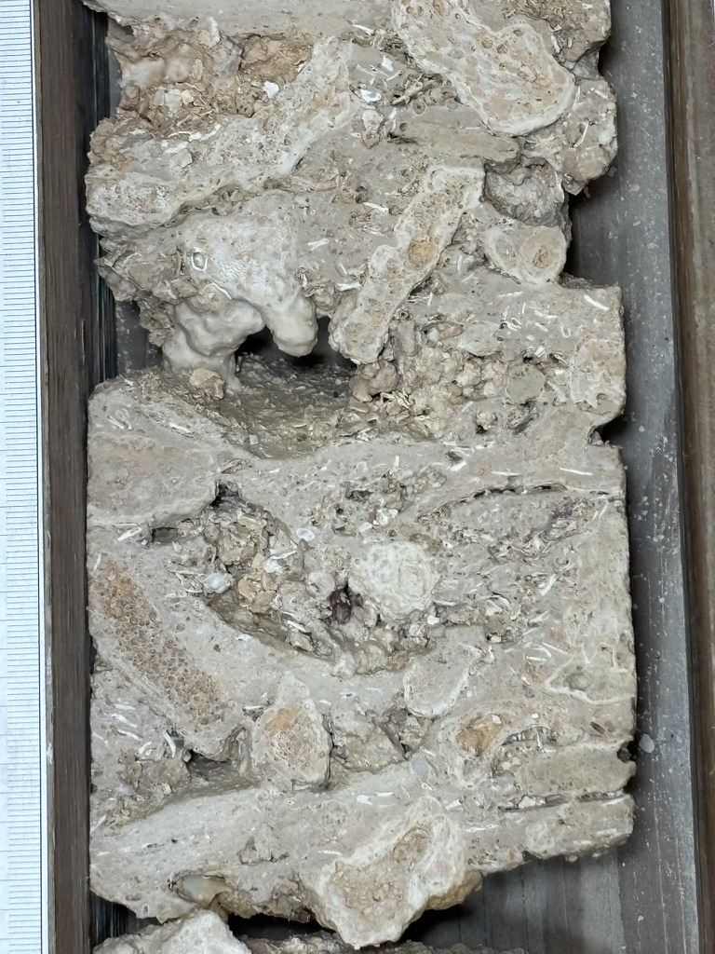
Core cutting

Slide 10
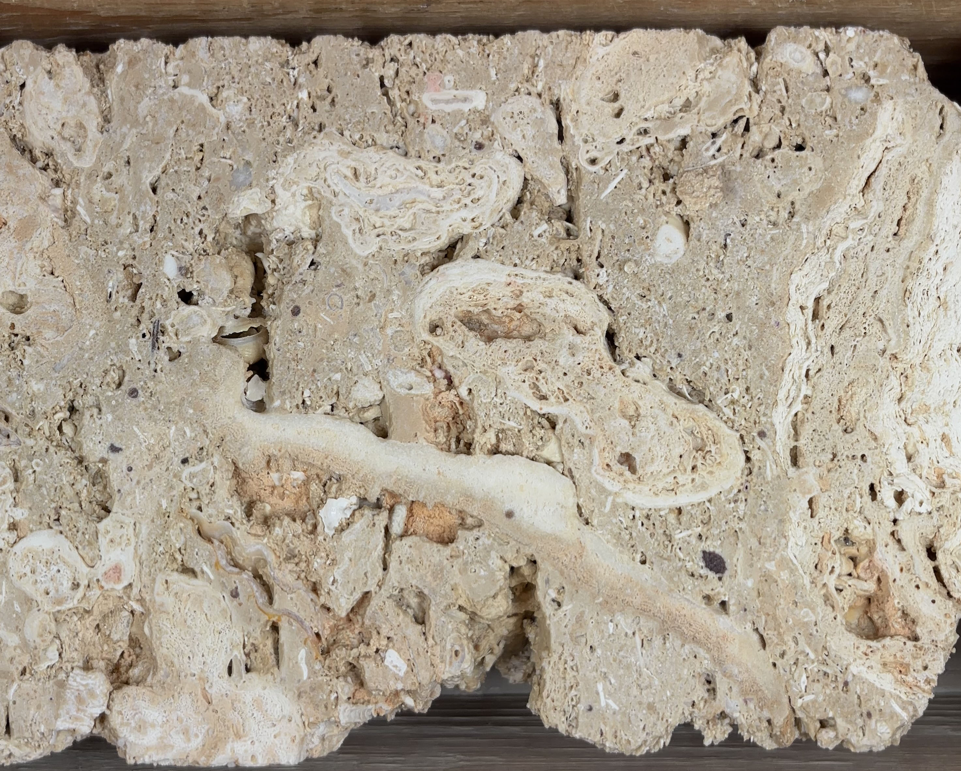
Core Photography – Core 44, 45, 47, 48

Slide 11
Core was drilled through the lower terrace of a fringing reef structure.
It captures the successive reef growth during the last deglaciation
Seismic Profile across the reef
The seismic profile reveals a prograding but downstepping pattern, followed by aggradation

Slide 12
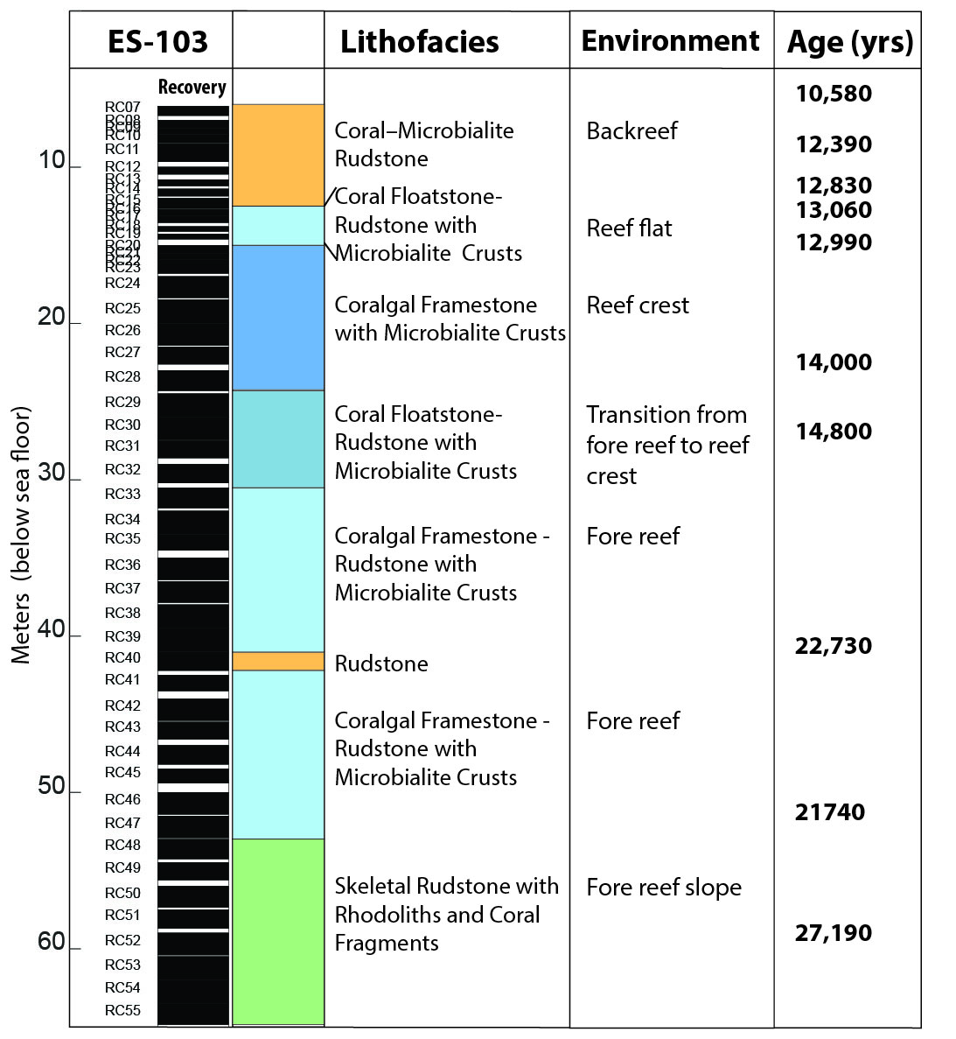
Core recovery, lithofacies and ages
Core recovery in ES-103 is 86%!
The lithofacies types recovered are all part of a reef system that is shallowing upward to a reef crest and backreef environment before drowning
The ¹⁴C ages indicate a record from 27.2ka to 10.5 ka., spanning the the last glacial maximum and the early sea level rise.

Slide 13
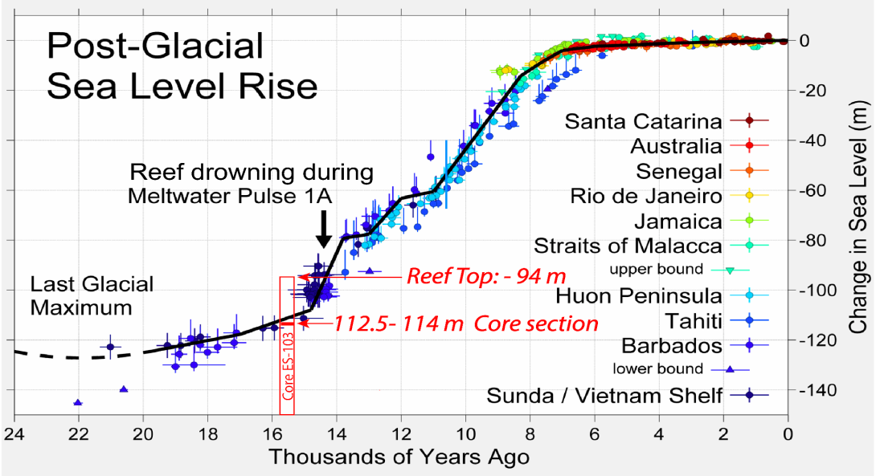
Core within sea level curve

Slide 14
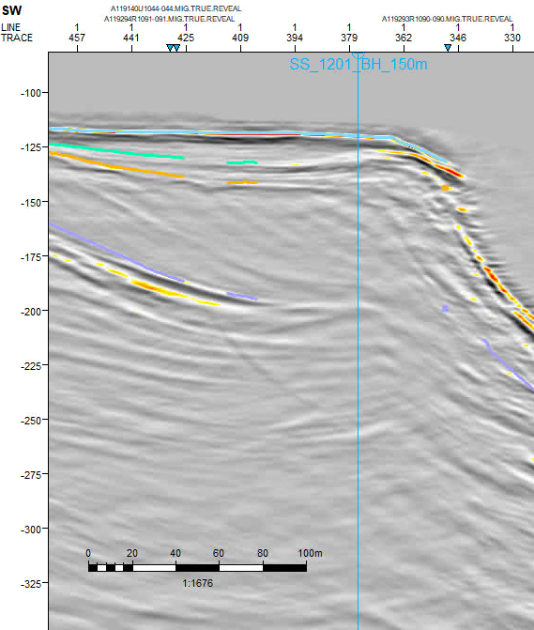
Core location and recovered lithofacies/environment

Slide 15
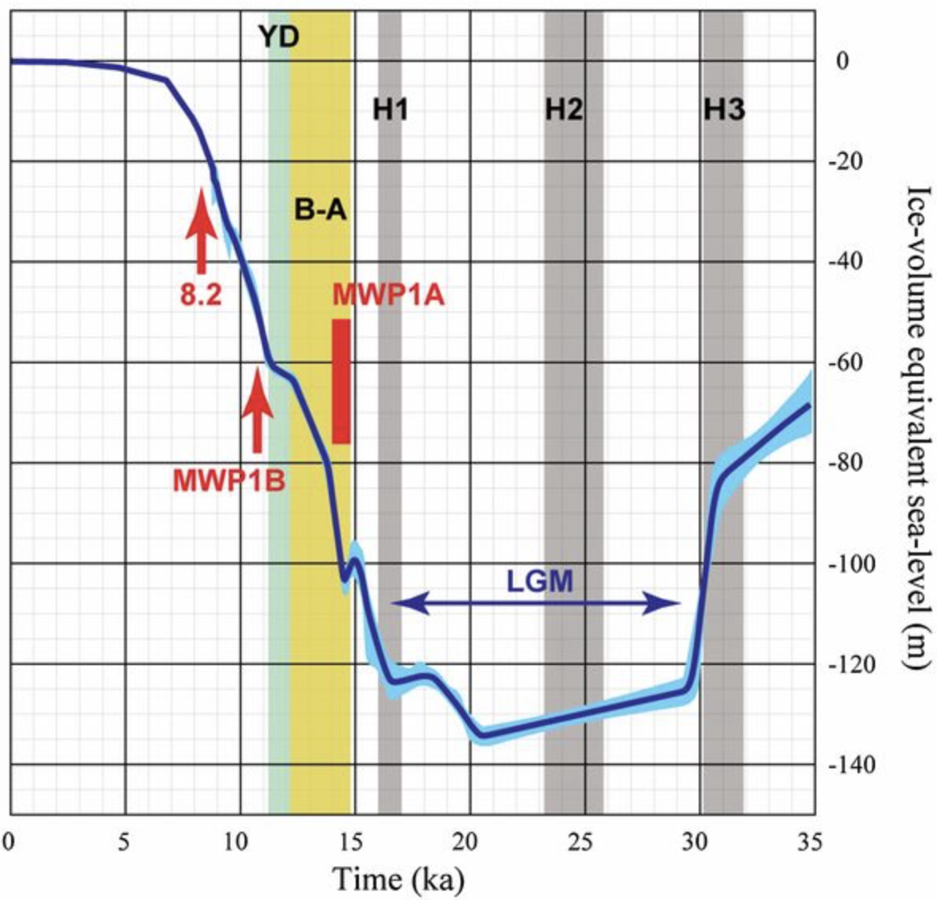
The record of the Last Glacial Maximum in core 103
Also shown are the major climate events in the interval [the Last Glacial Maximum (LGM), Heinrich events H1 to H3, the Bølling-Allerød warm period (B-A), and the Younger Dryas cold period (Y-D)] as well as the timing of MWP-1A, 1B, and the 8.2 ka BP cooling event.
Core ES-103

Slide 16
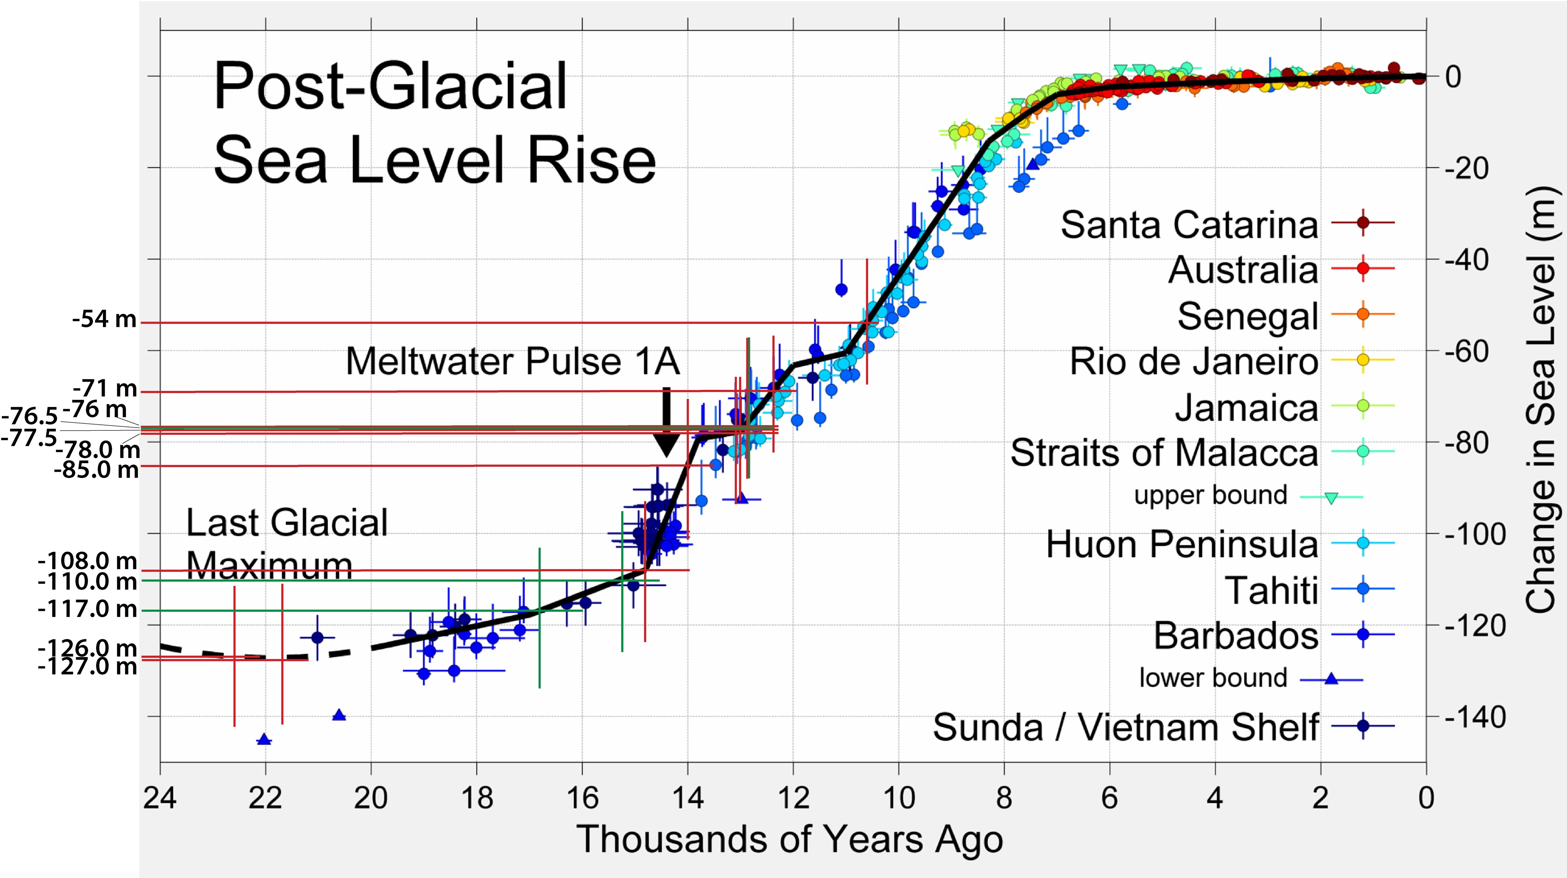
Ages of Cores in context of post glacial sea level rise
Core was drilled through the fringing reef captures the successive reef growth during the last deglaciation

