Slide 1
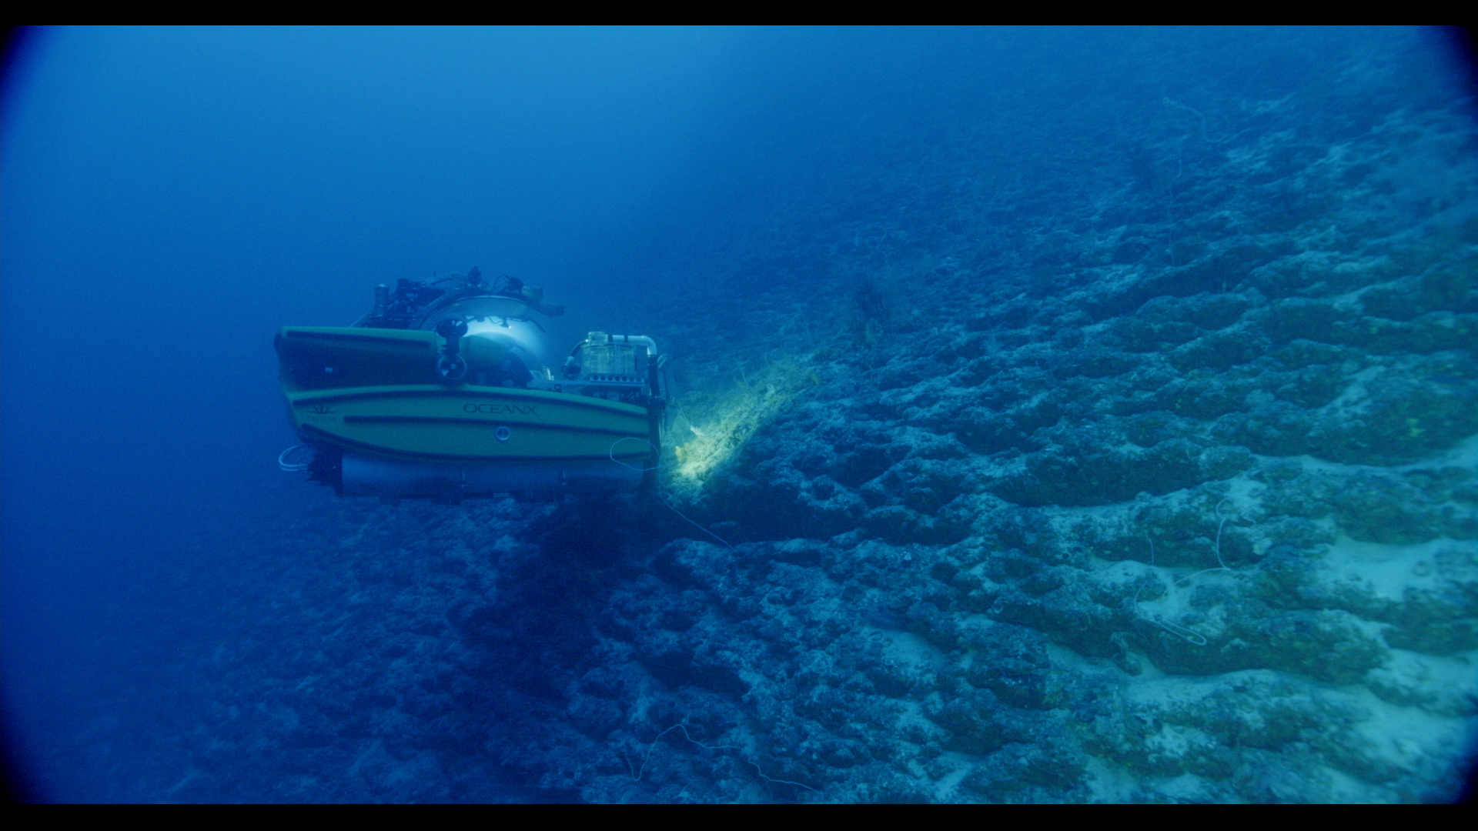


Unusual Carbonate Slopes in the Gulf of Aqaba
Ellie Barkyoumb, Gregor P. Eberli, Morgan I. Chakraborty, Mara R. Diaz, Amanda Oehlert, Peter K. Swart, and Sam Purkis

Slide 2
Key Points
Barkyoumb et al. 2025
The very steep slopes in the Gulf of Aqaba are unusual: they have a wide mesophotic reef zone down to -150m followed downslope by undulating ledges with a regular spacing.
These ledges consist of micritic limestone with fossils; with their hardness, their iron stained and borings by sponges and lithophaga they are reminiscent of hardgrounds.
SEM images reveal microbes, but no there is no evidence that these microbes induce the micritic cementation.

Slide 3
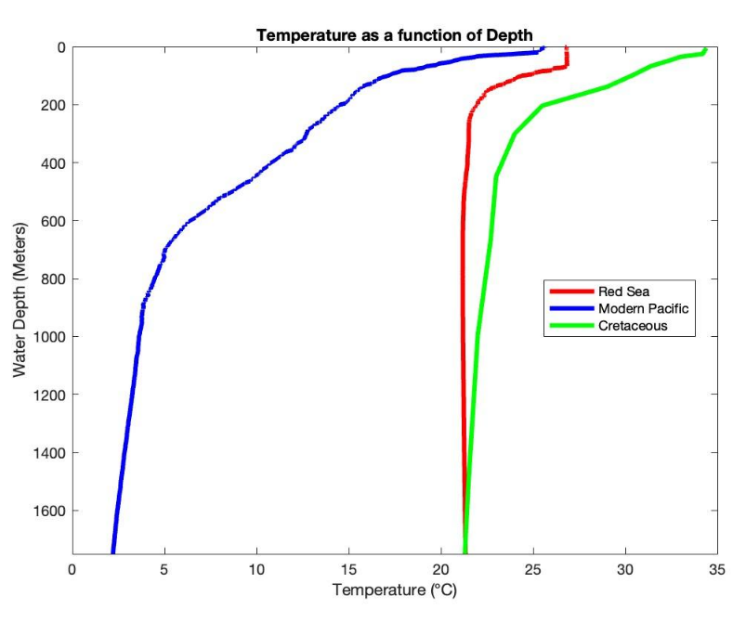
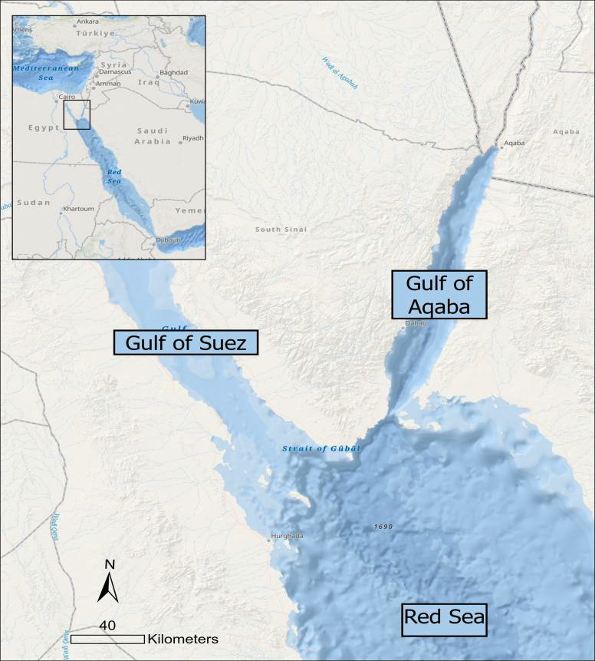
Slopes in the Gulf of Aqaba
Barkyoumb et al. 2025
Slope in a warm ocean, analogue to the Cretaceous oceans

Slide 4
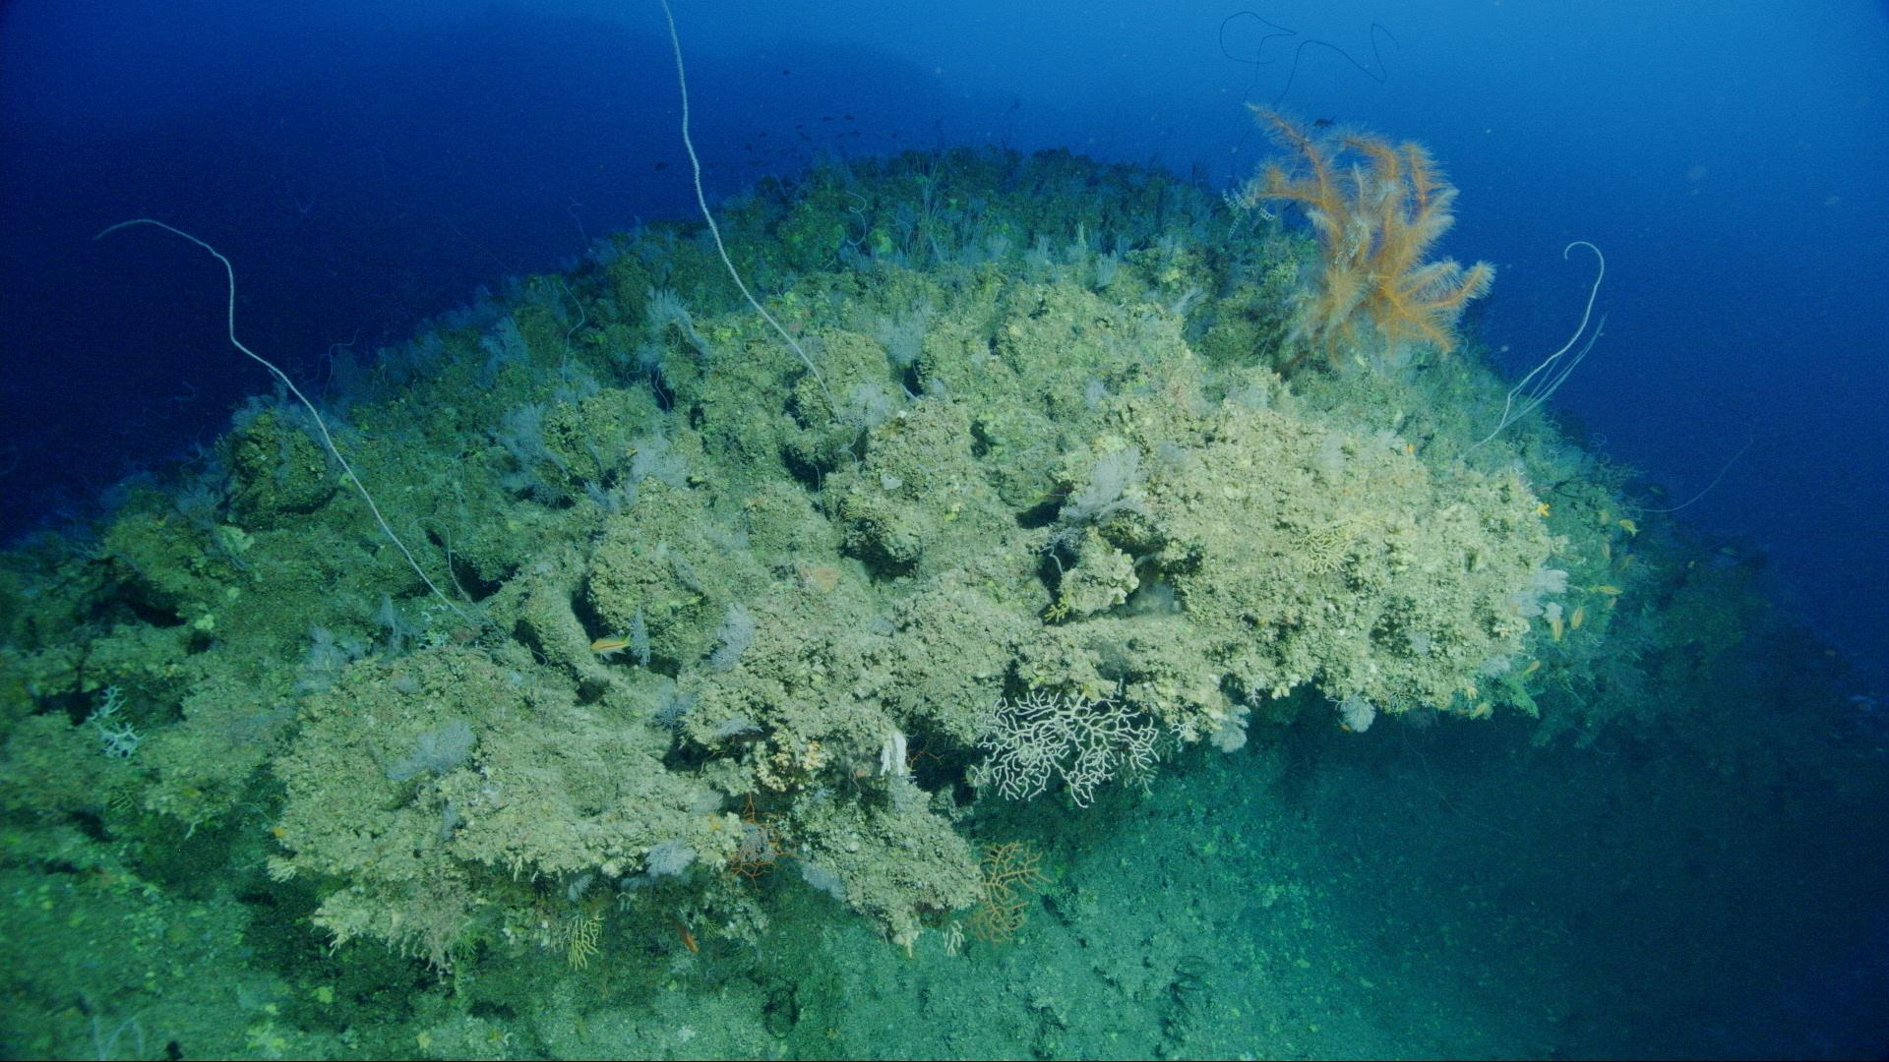
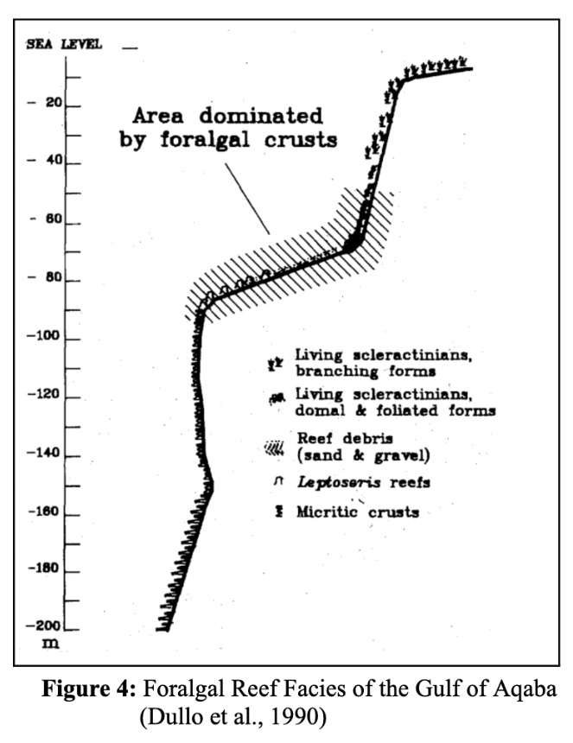
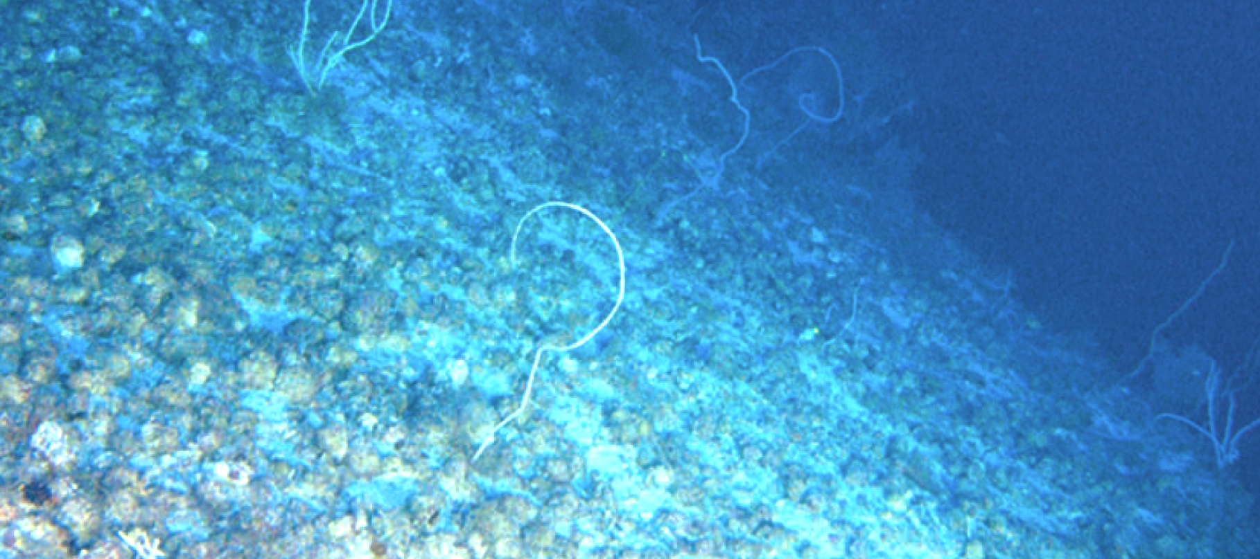
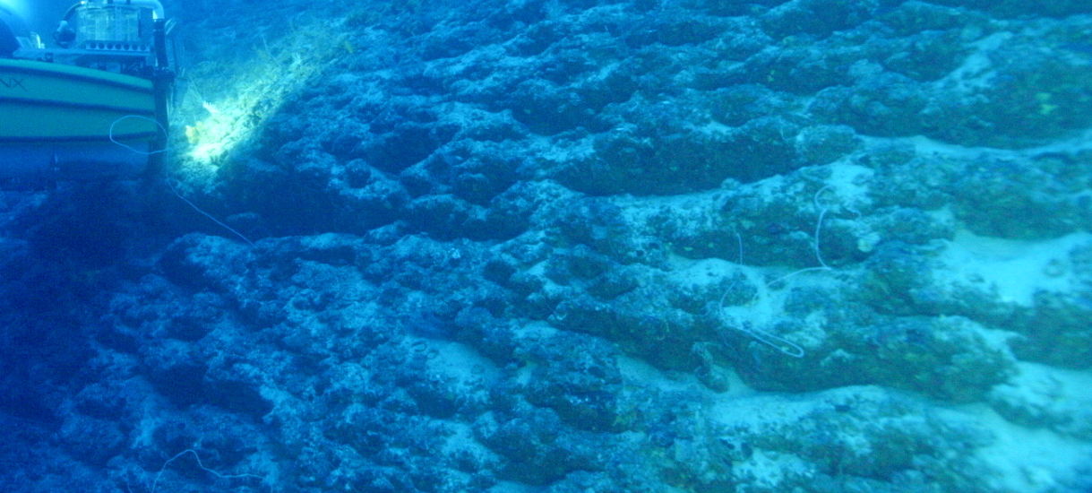
Top 200 m: Gulf of Aqaba
Barkyoumb et al. 2025

Slide 5
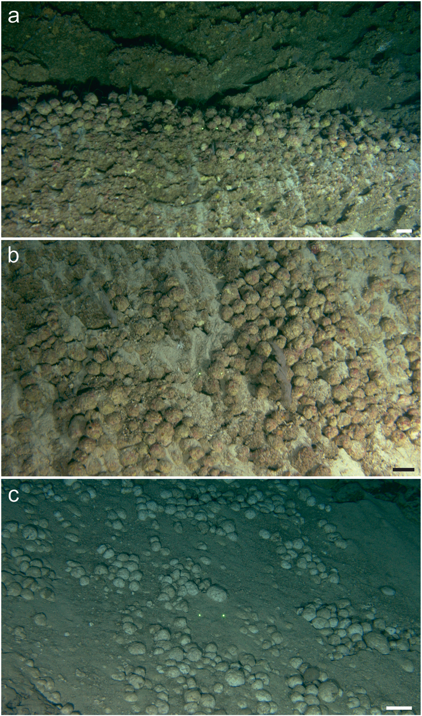
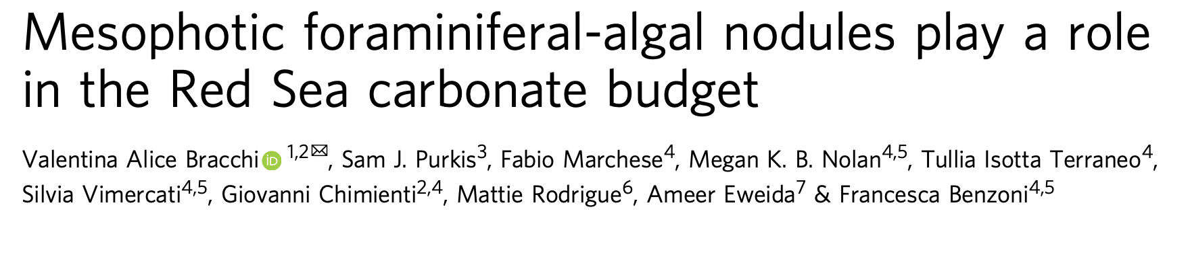
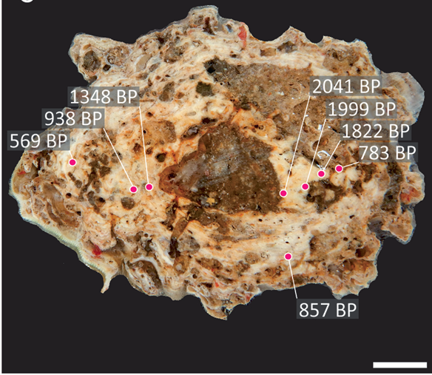
Foraminiferal-algal nodules (FAN)
94 m
Barkyoumb et al. 2025
140 m
Half of the FAN NTN0035-17A after the cutting. The evident nucleus is recognizable at the core. The layering structure is evident around the core. Radiocarbon dating as years BP are reported Scale bar = 1 cm.
425 m
Bracchi et al.,

Slide 6
Methods
Barkyoumb et al. 2025
Remotely Operated Vehicles (ROVs) as well as human-occupied submersibles were used to collect samples of the slope at a variety of depths, ranging from 30 to 700 meters water depth
32 slope samples were first organized & classified, followed by cutting & polishing of a subset of 14 samples for petrographic thin section analysis
Stable isotope analysis of oxygen & carbon was by done by Peter Swart
X-ray Diffraction (XRD) analysis was done by Oklahoma State (Mike Grammer)

Slide 7
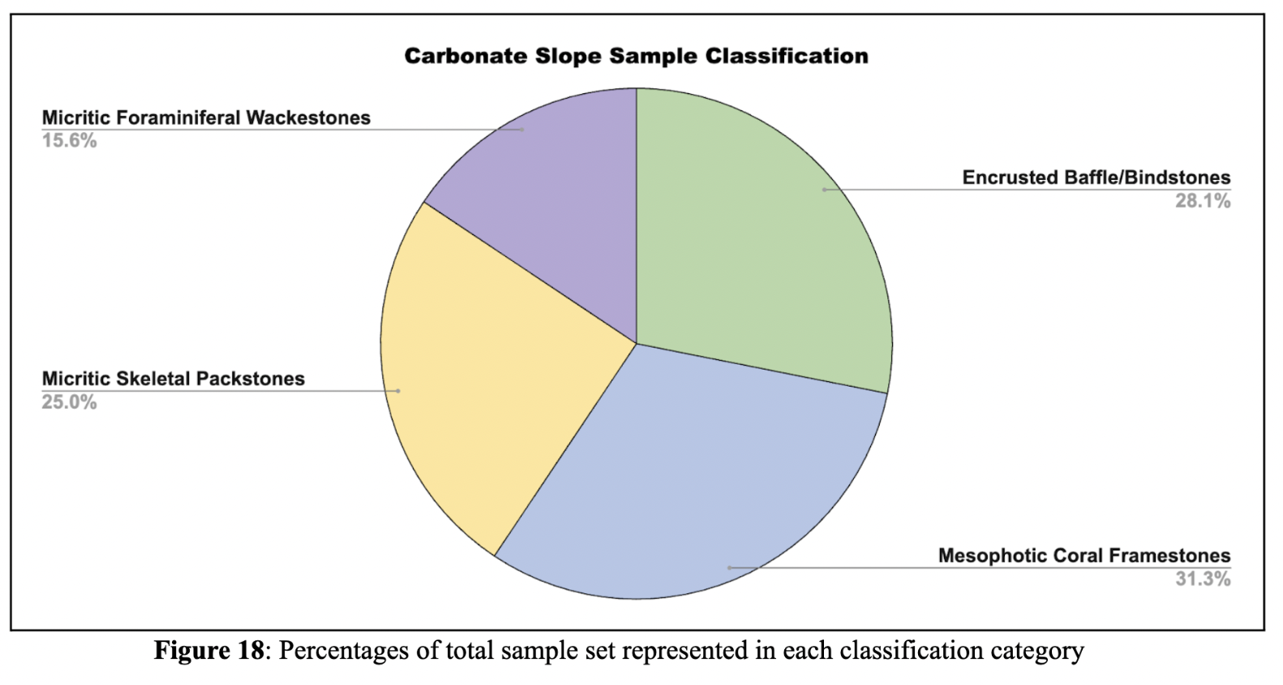
Composition of the slope
Barkyoumb et al. 2025

Slide 8
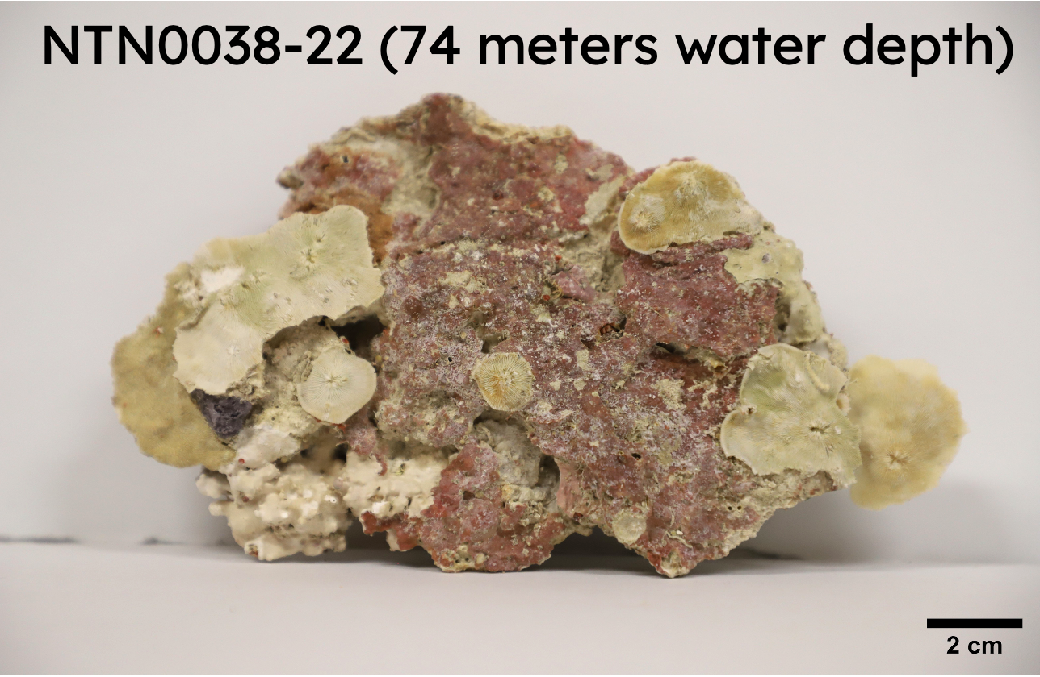
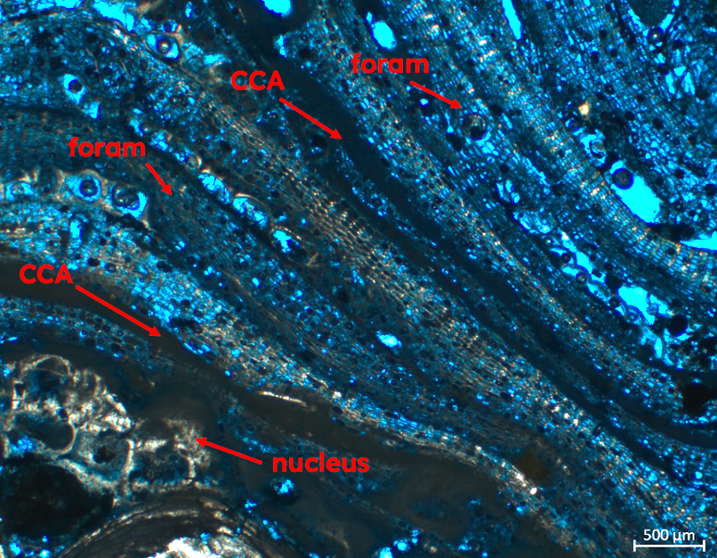
Encrusted Baffle/Bindstones (30-150 m)
Barkyoumb et al. 2025
Present in both the photic & mesophotic zones and encompasses both coralline bio-architects as well as Foraminiferal-Algal Nodules (FANs)
Exterior of samples are >50% encrusted by a diverse suite of organism (crustose coralline algae, zooxanthellate Scleractinian corals, foraminifera, sponges, & bryozoans)

Slide 9
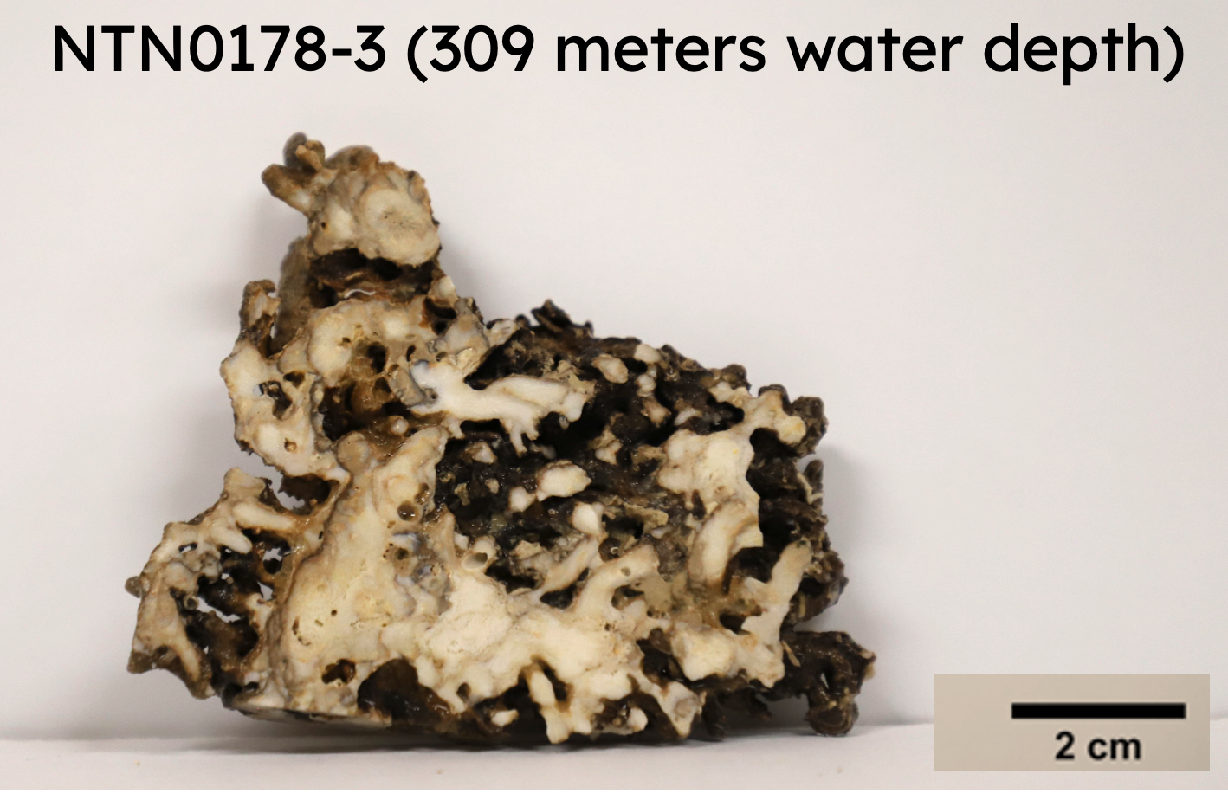
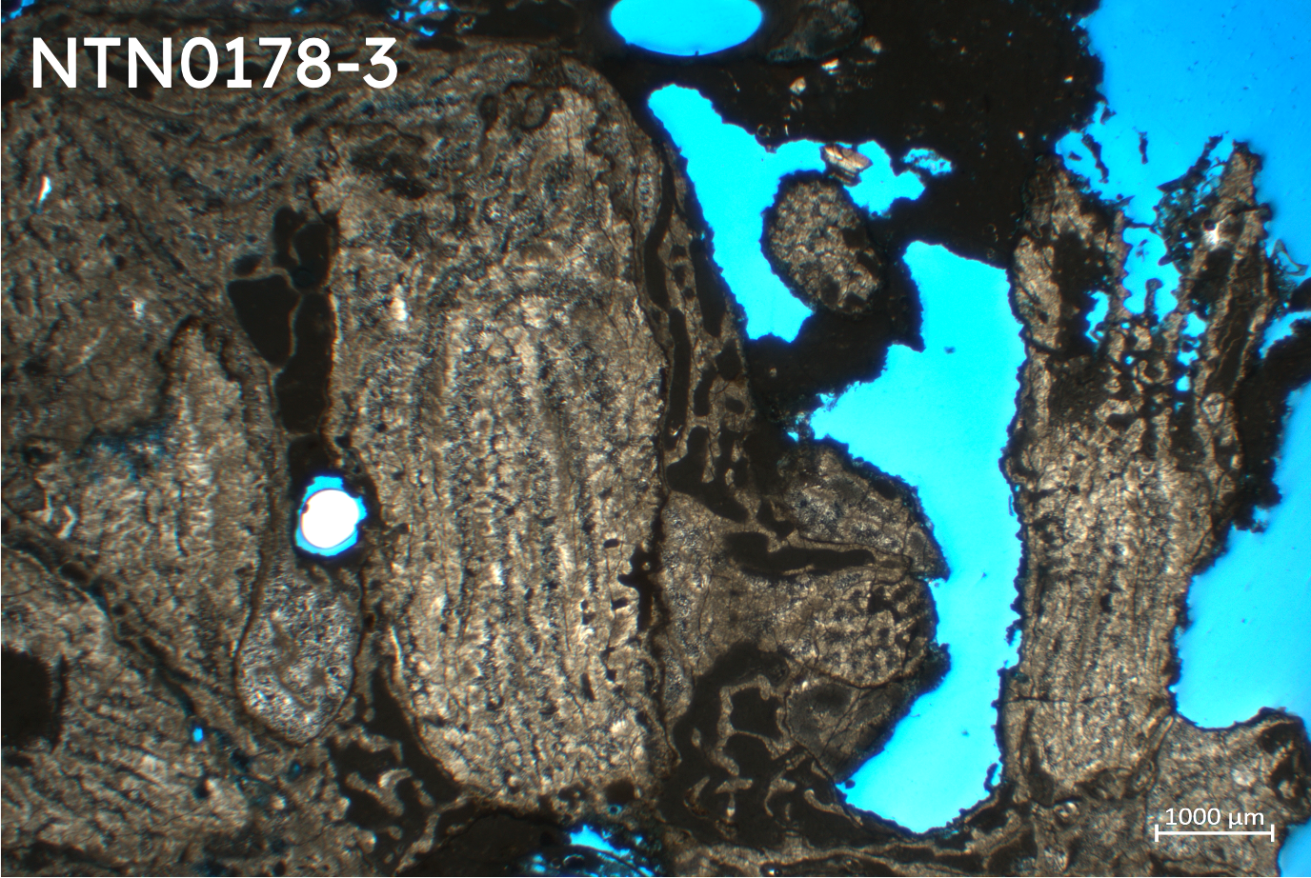
Mesophotic Coral Framestones (93-396 m)
Barkyoumb et al. 2025
Azooxanthelic Scleractinian corals (Madracis interjecta, Dendrophyllia minuscula, and Rhizopsammia compacta) provide an initial framework
Extensive microbial and acicular cementation visible in thin section, baffling of sediment & diagenesis leads to accretionary growth around initial framework

Slide 10
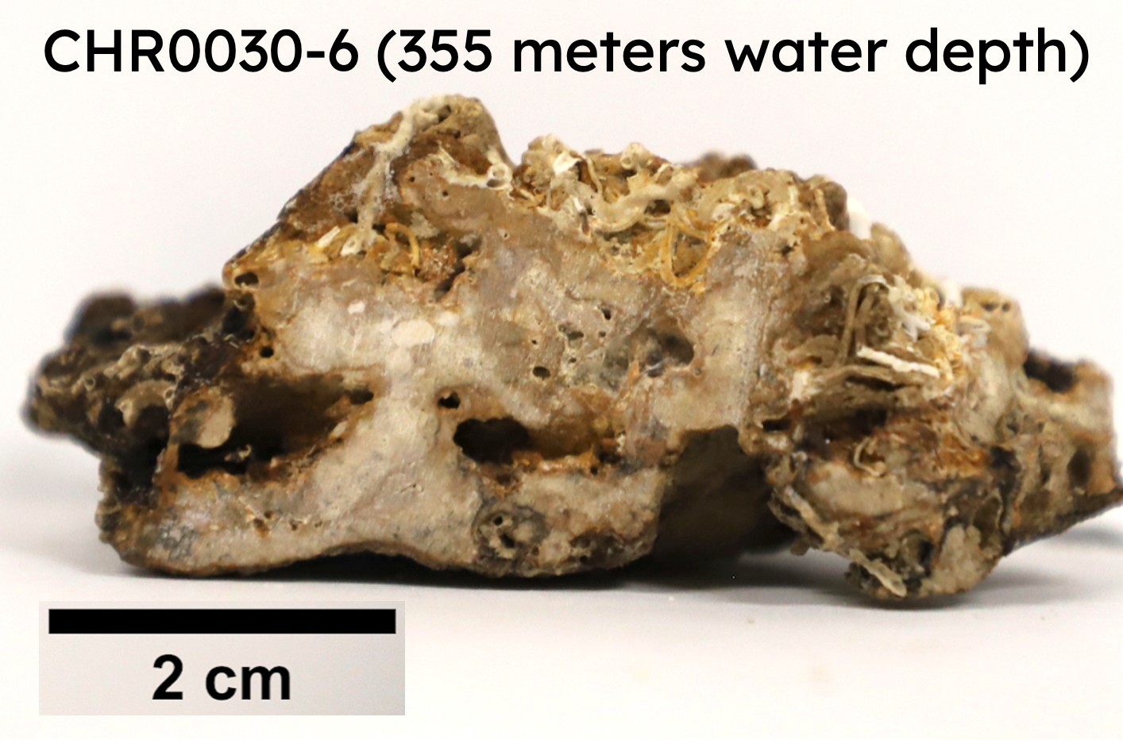
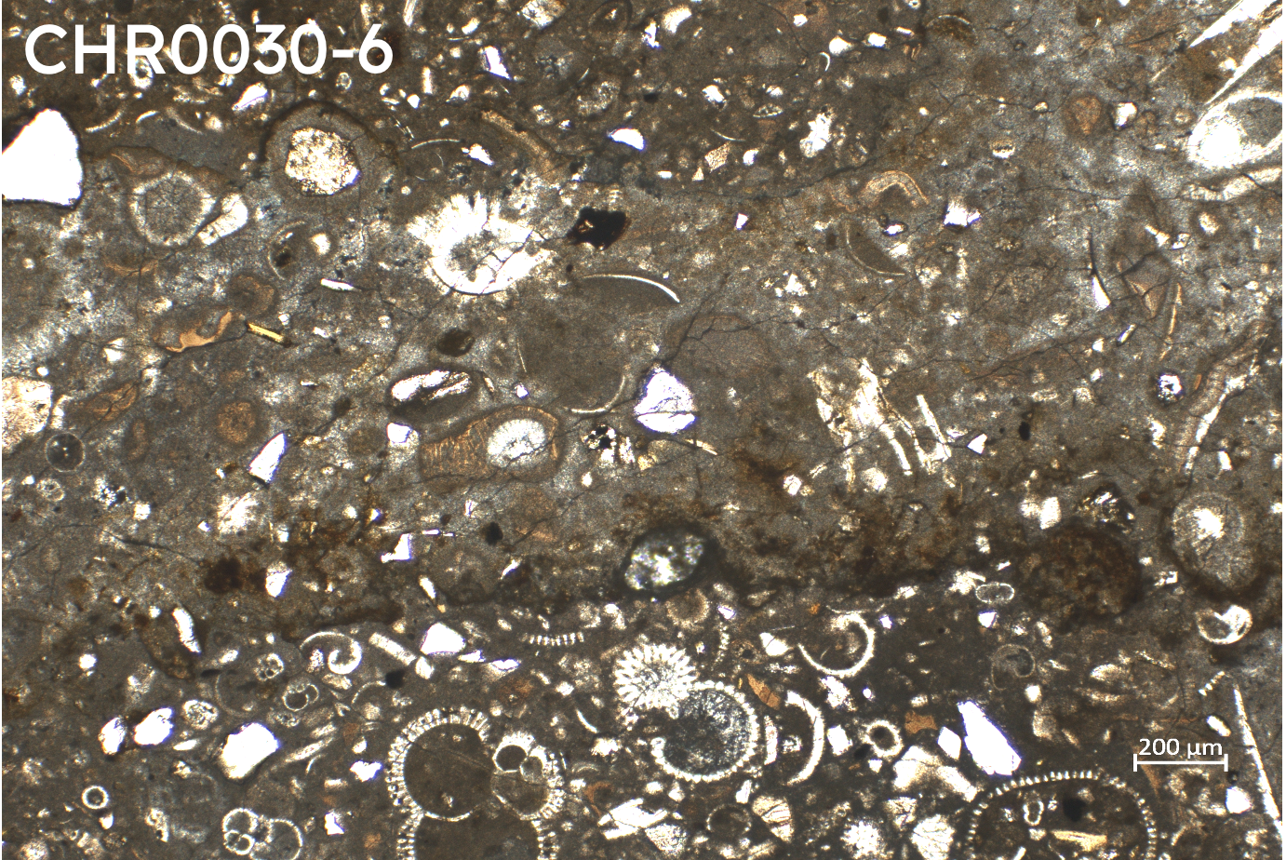
Micritic Skeletal Packstone (222-722 m)
Barkyoumb et al. 2025
Micritic matrix with diverse skeletal grains (bryozoans, pteropods , bivalve fragments, planktonic foraminifera, ostracods, sponges)
Some samples contain detrital fragments including quartz, potassium feldspar, biotite, & muscovite

Slide 11
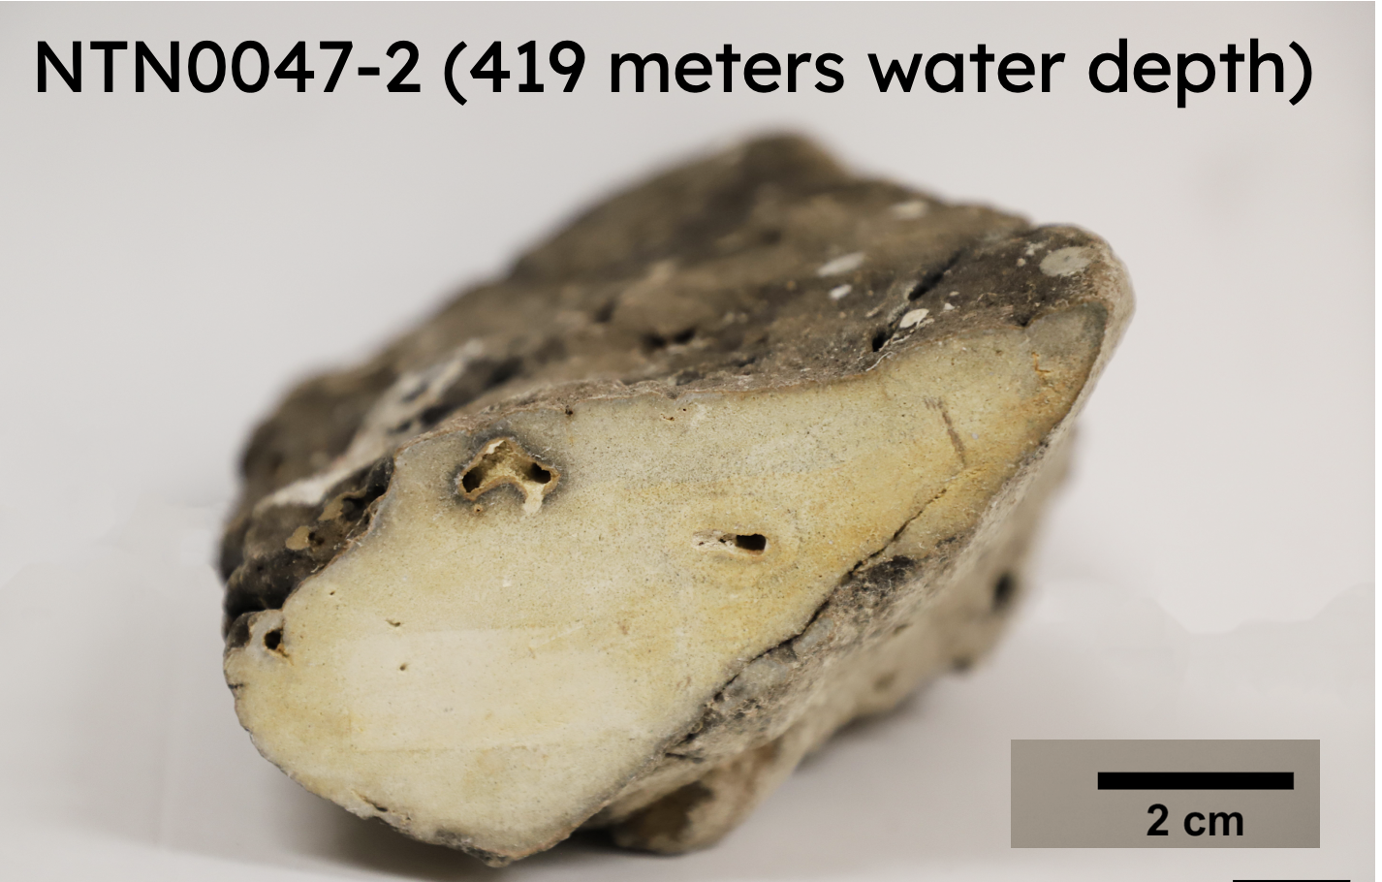
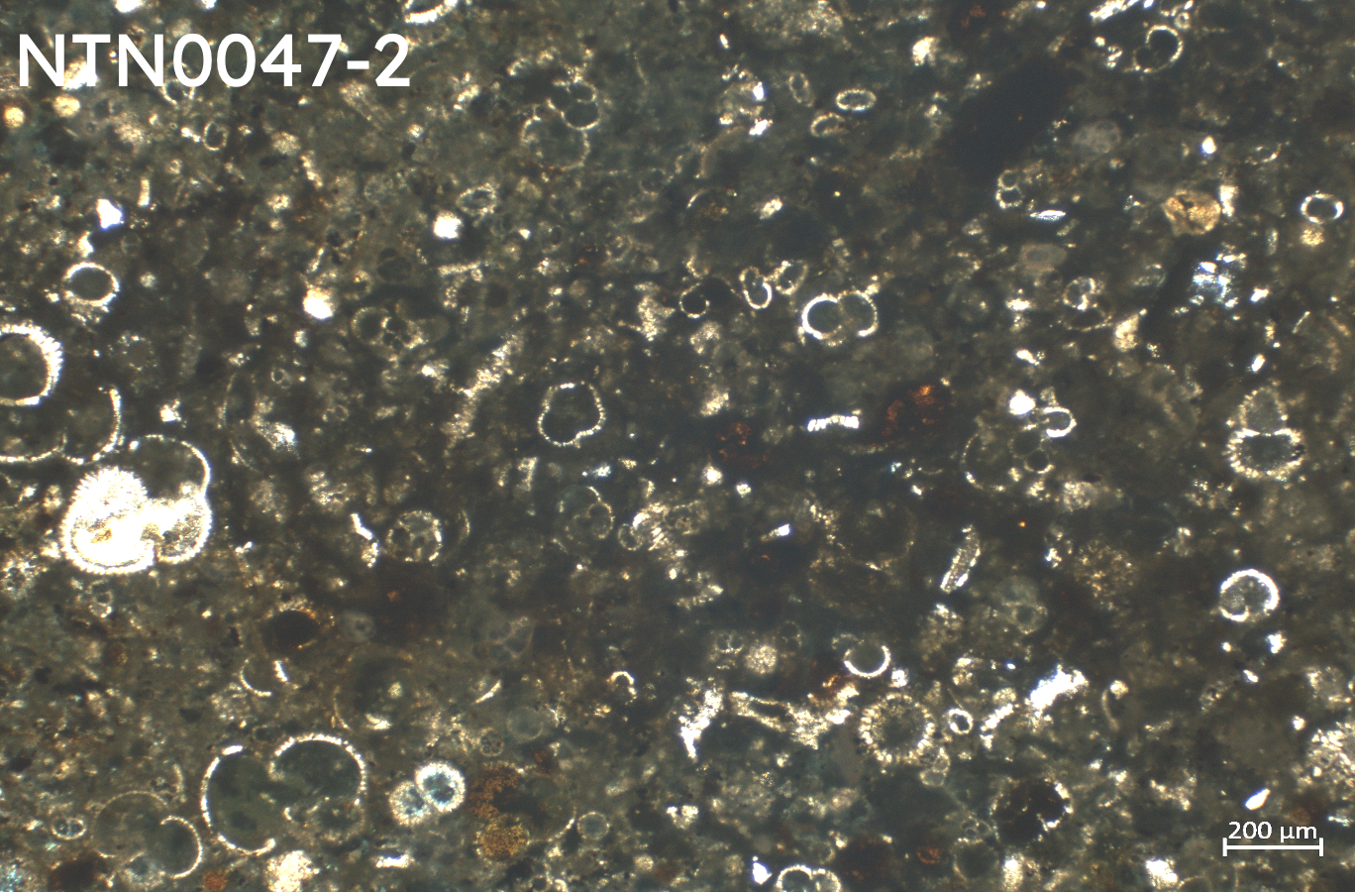
Micritic Foraminiferal Wackestones (313-597 m)
Barkyoumb et al. 2025
A structureless pteropod-globigerina-nano-ooze that contains 70-80% biogenic calcium carbonate (Tavani, 1998).
Borings and Mn-Fe staining is prominent on the exterior of the samples

Slide 12
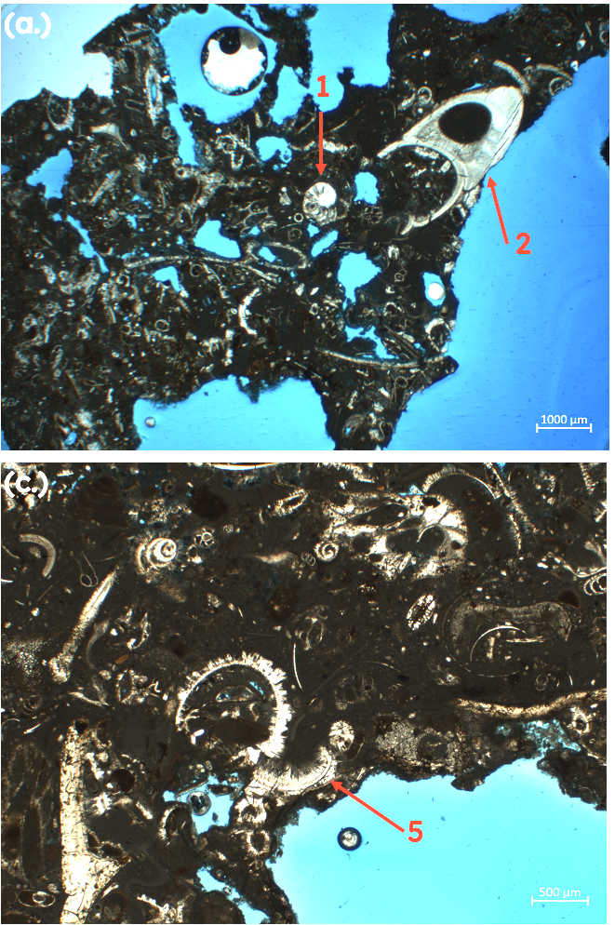
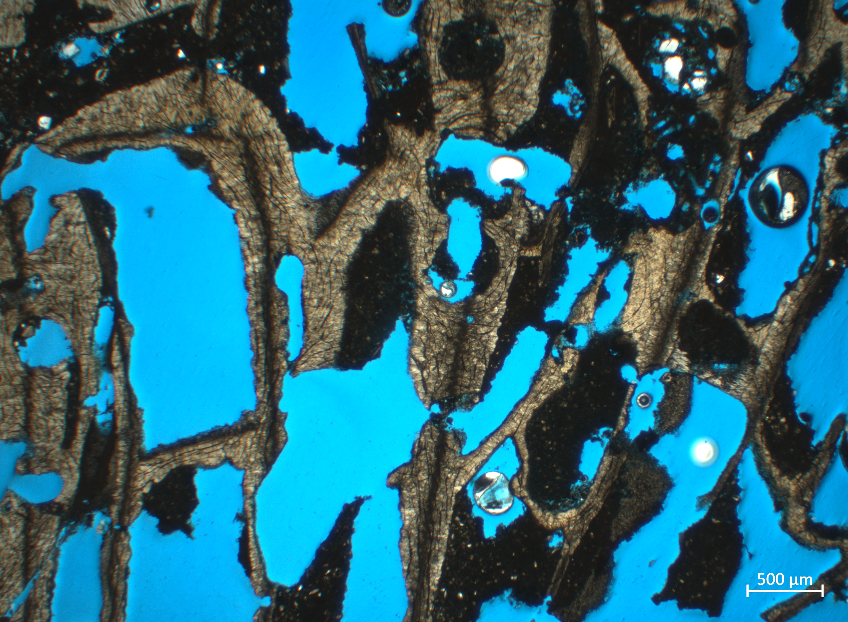
Micritic cements covering coral frame
Barkyoumb et al. 2025
Dark micritic cement is abundant in all lithofacies of the slopes in the Gulf of Aqaba

Slide 13
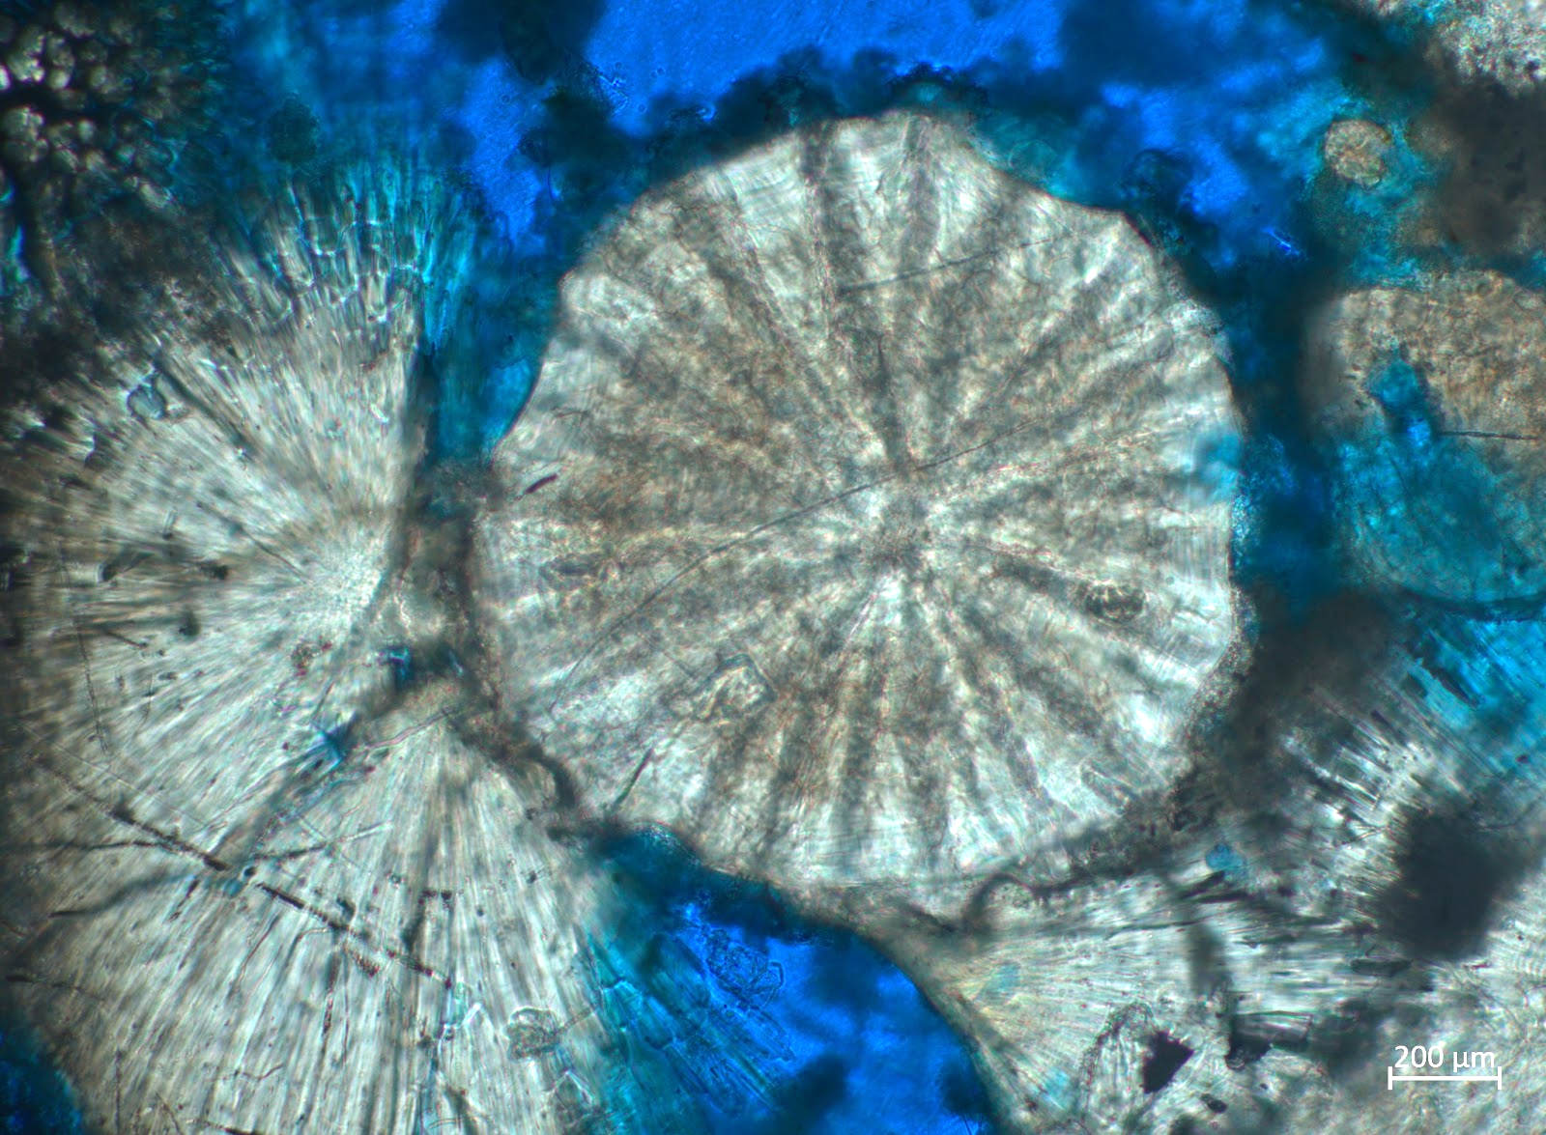
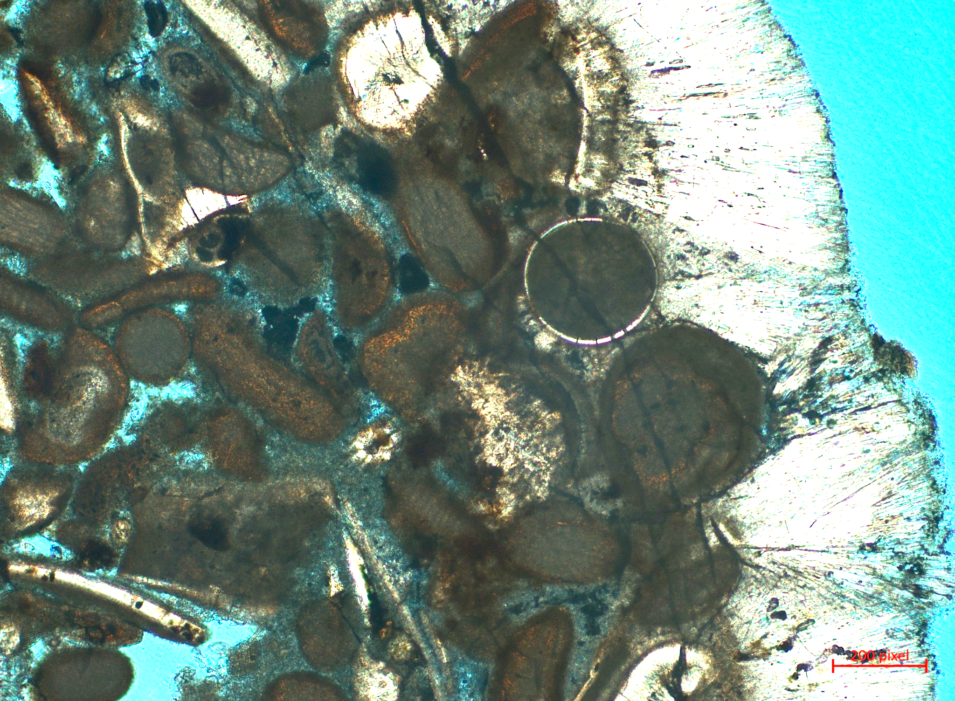
Micritic and botryoidal cements
Barkyoumb et al. 2025
The two most common types of cements that were documented in analysis of petrographic thin sections were microbially mediated micritc cement and acicular splays. At least one instance of microbially mediated cementation is visible in 86% of the thin sections analyzed.

Slide 14
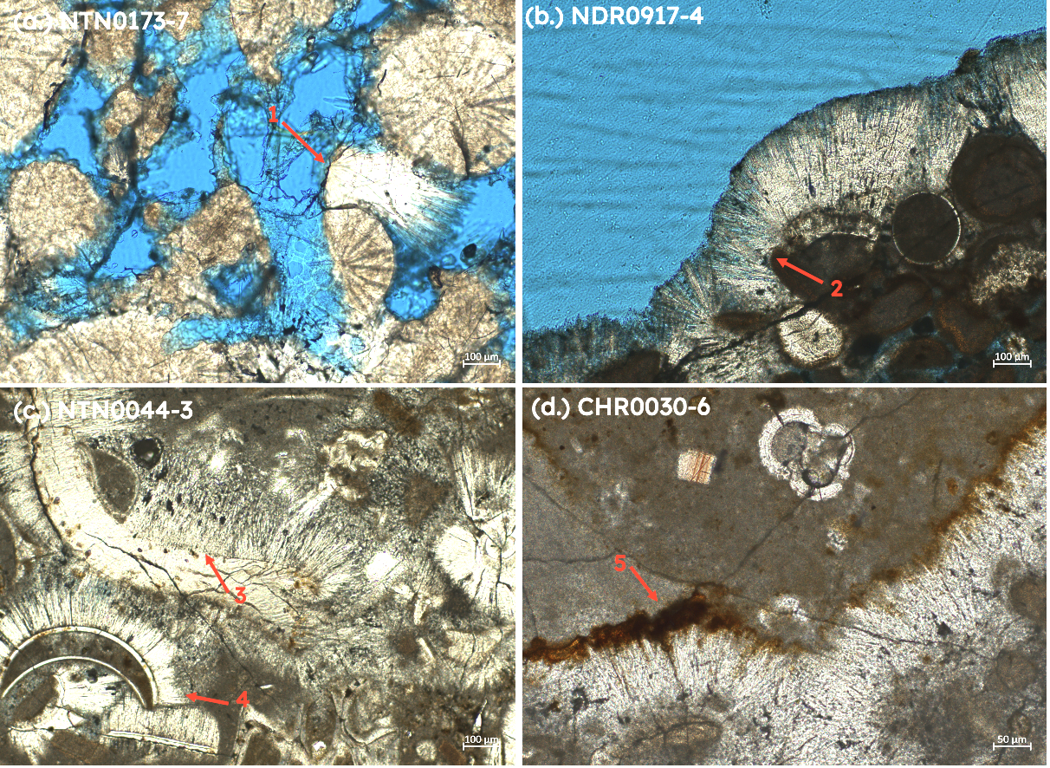
Acicular cement splays
Acicular cement splay (1) with visible dissolution of corralite grains (b.) Dense acicular cements
(2) forming a series of splays along coated grains
(c.) Acicular cements forming along a fragmented bivalve skeletal grain (3) as well as pteropod test fragments (4)
(d.) Acicular cements separating two phases of micrite deposition (5)
Notes:
:(a.) Acicular cement splay (1) with visible dissolution of corralite grains (b.) Dense acicular
cements (2) forming a series of splays along coated grains (c.) Acicular cements forming along a
fragmented bivalve skeletal grain (3) as well as pteropod test fragments (4) (d.) Acicular cements
separating two phases of micrite deposition (5)

Slide 15
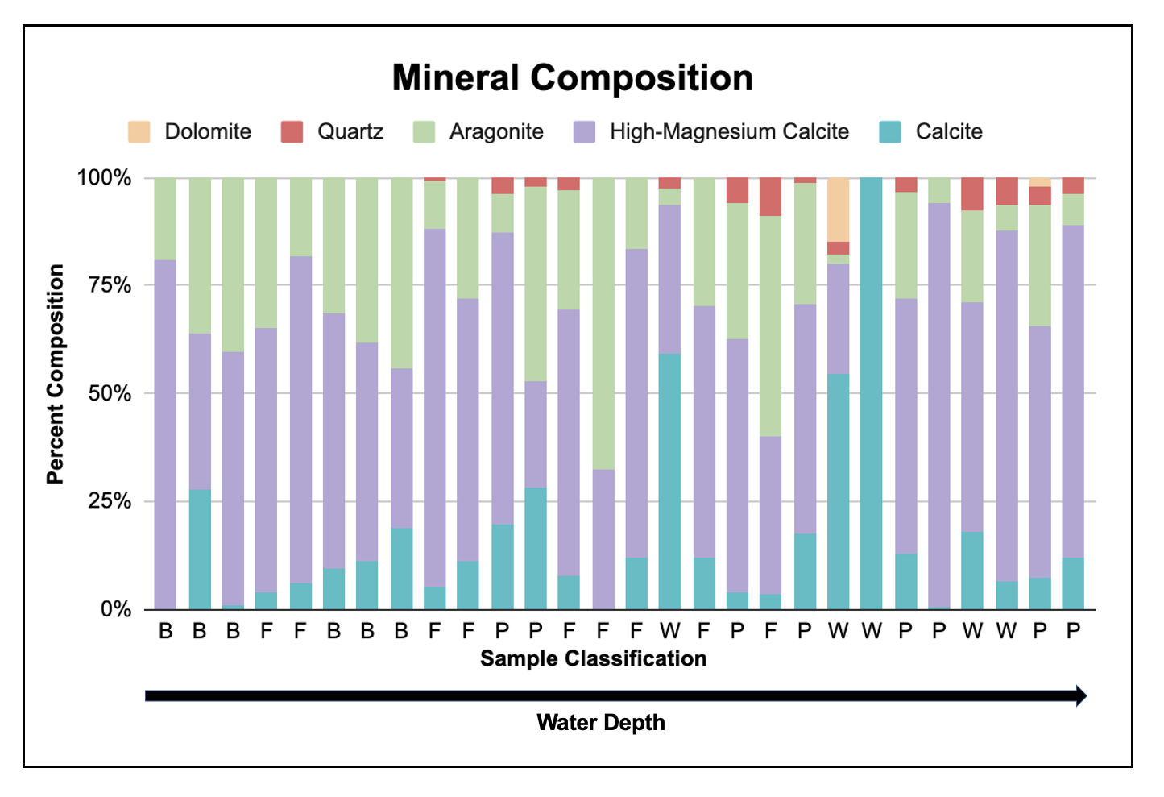
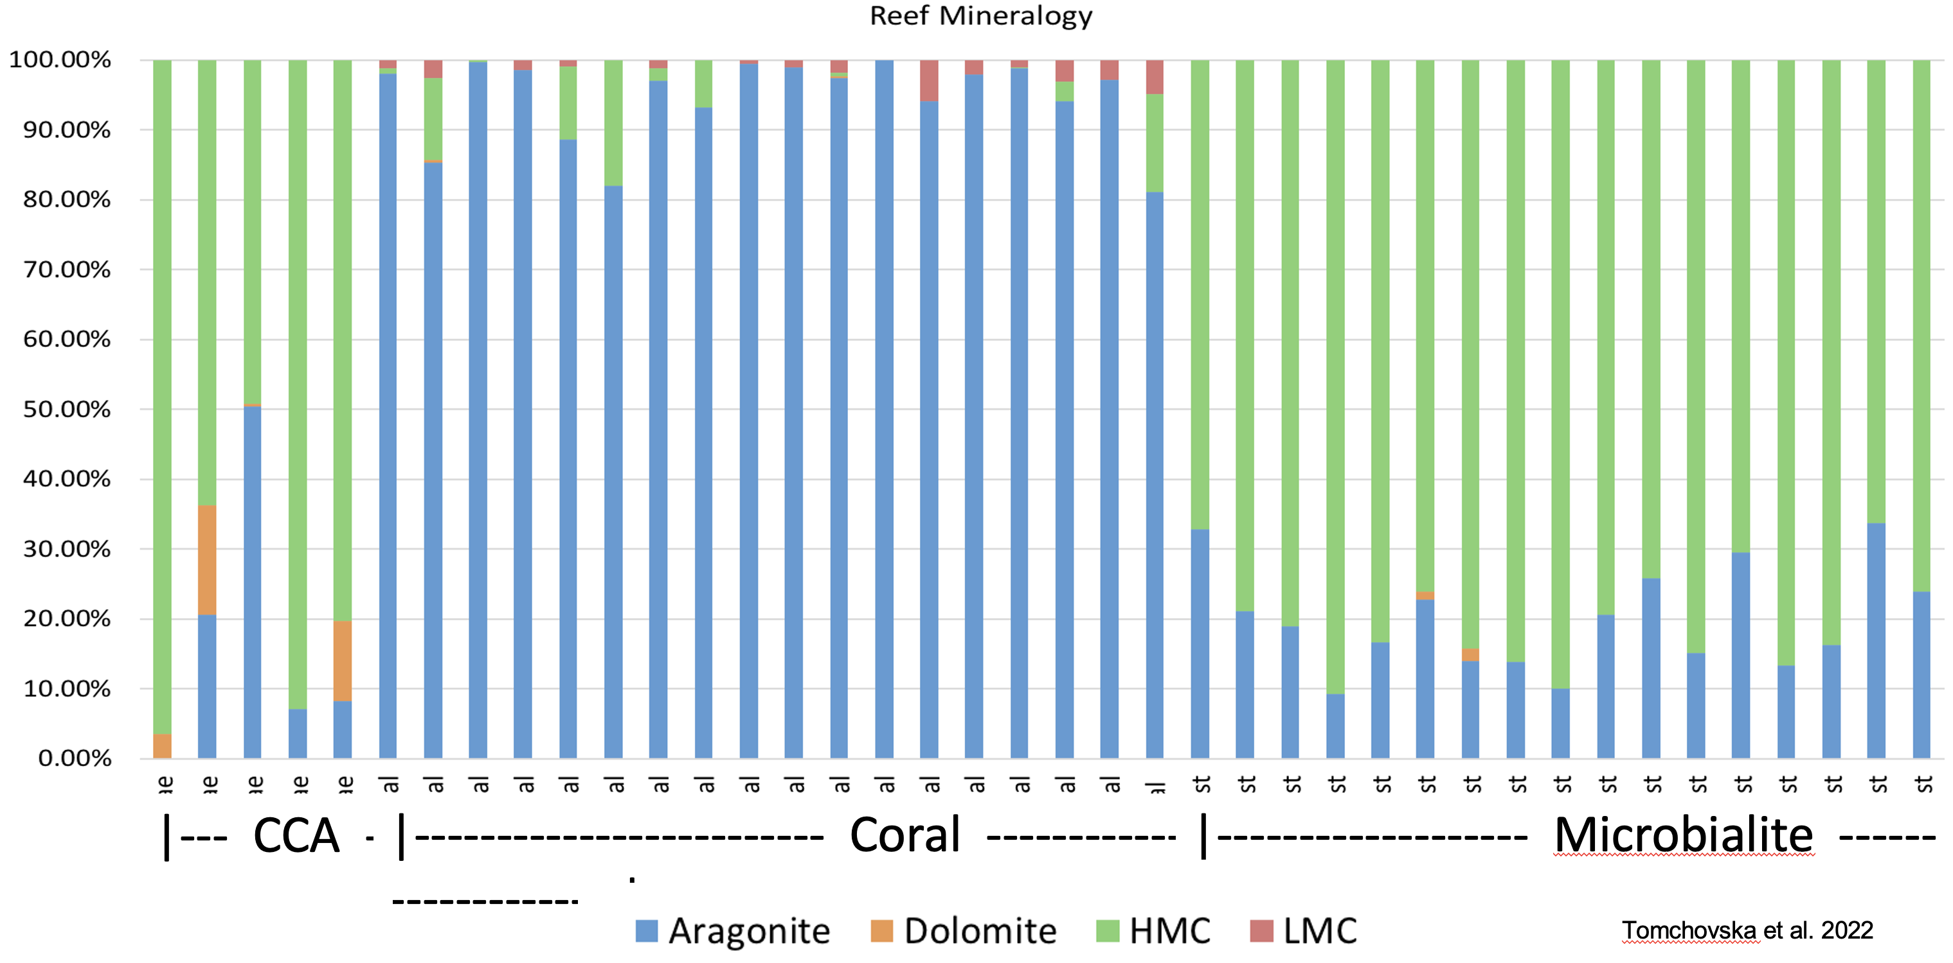
Mineral composition
High magnesium calcite is the typical mineral of microbialites.
Is all the micritic cement microbialite?
B is encrusted baffle/bindstone, F is mesophotic coral framestone,
P is micritic skeletal packstone, and W is micritic foraminiferal wackestone

Slide 16
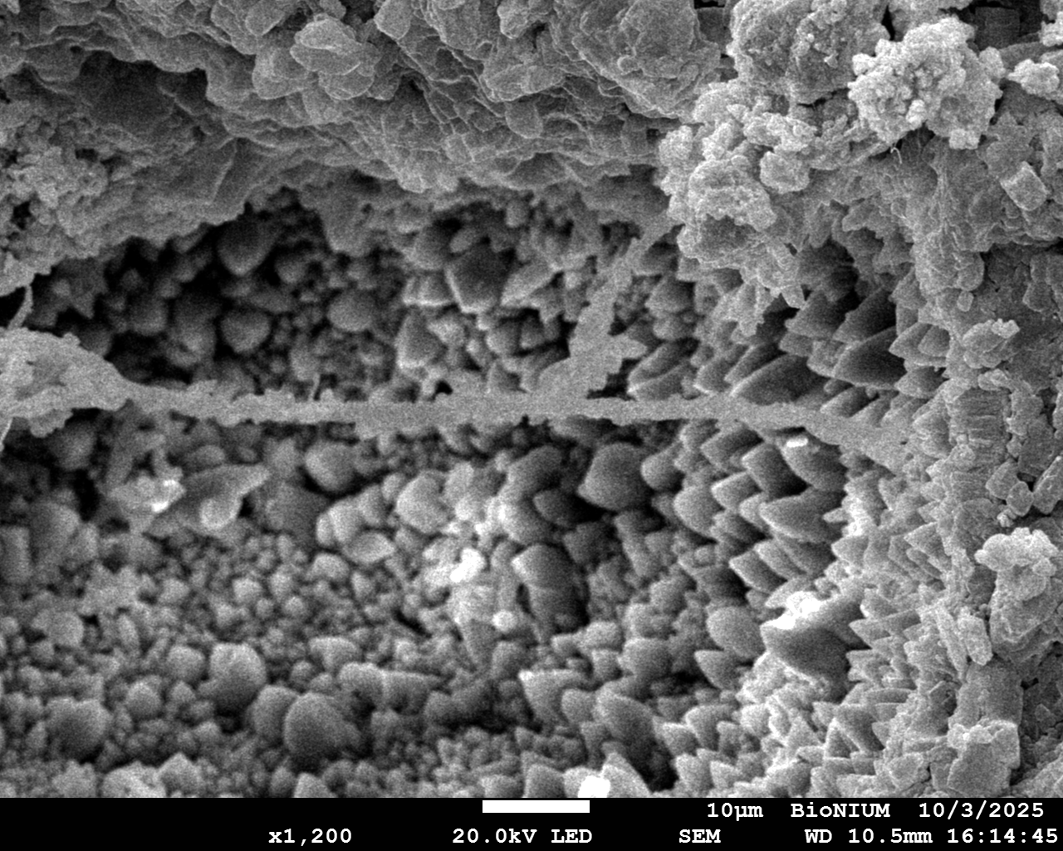
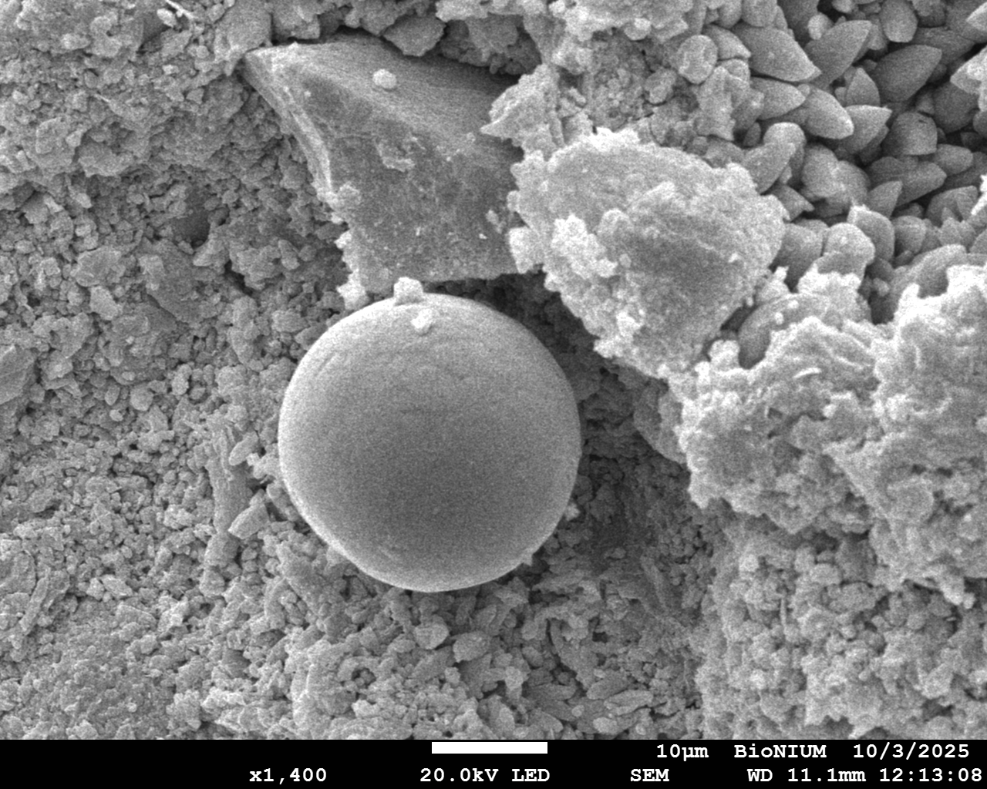
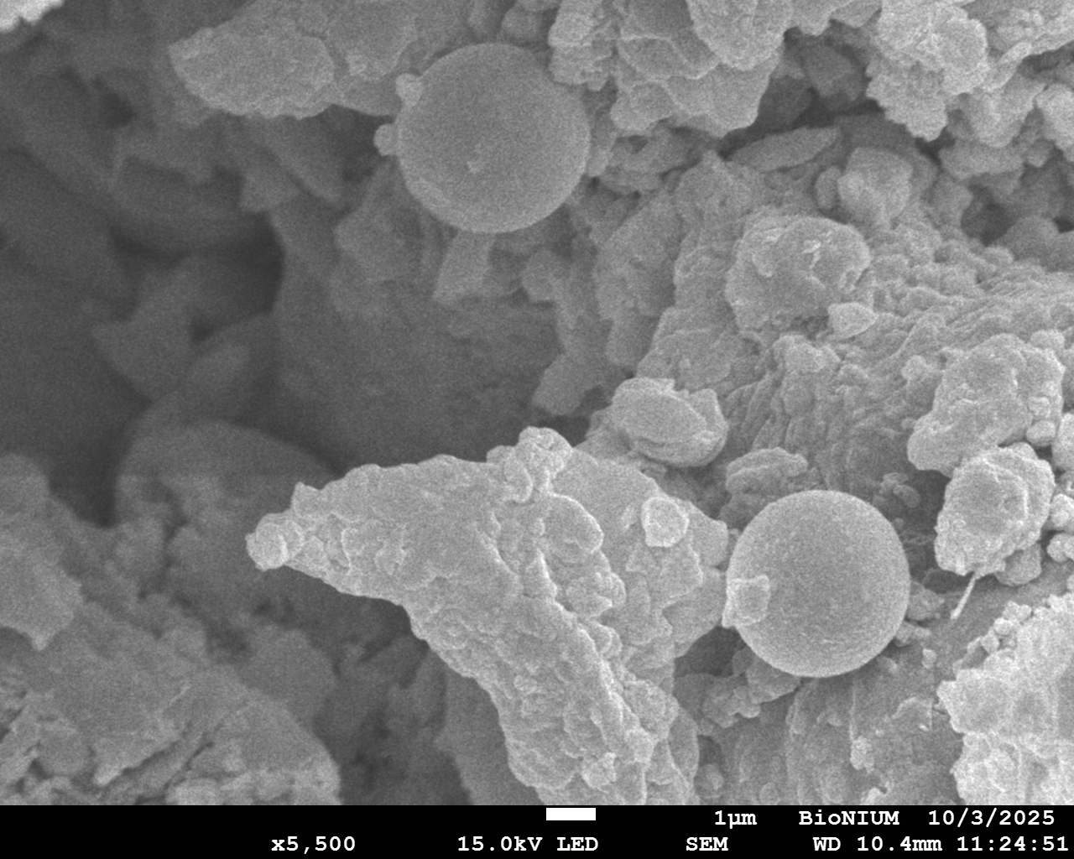
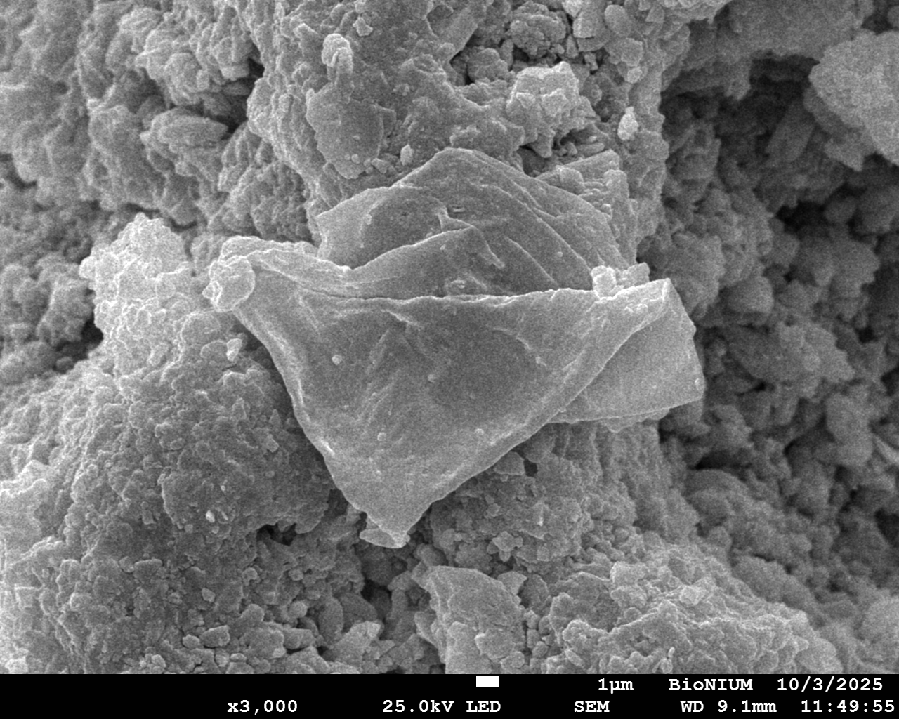
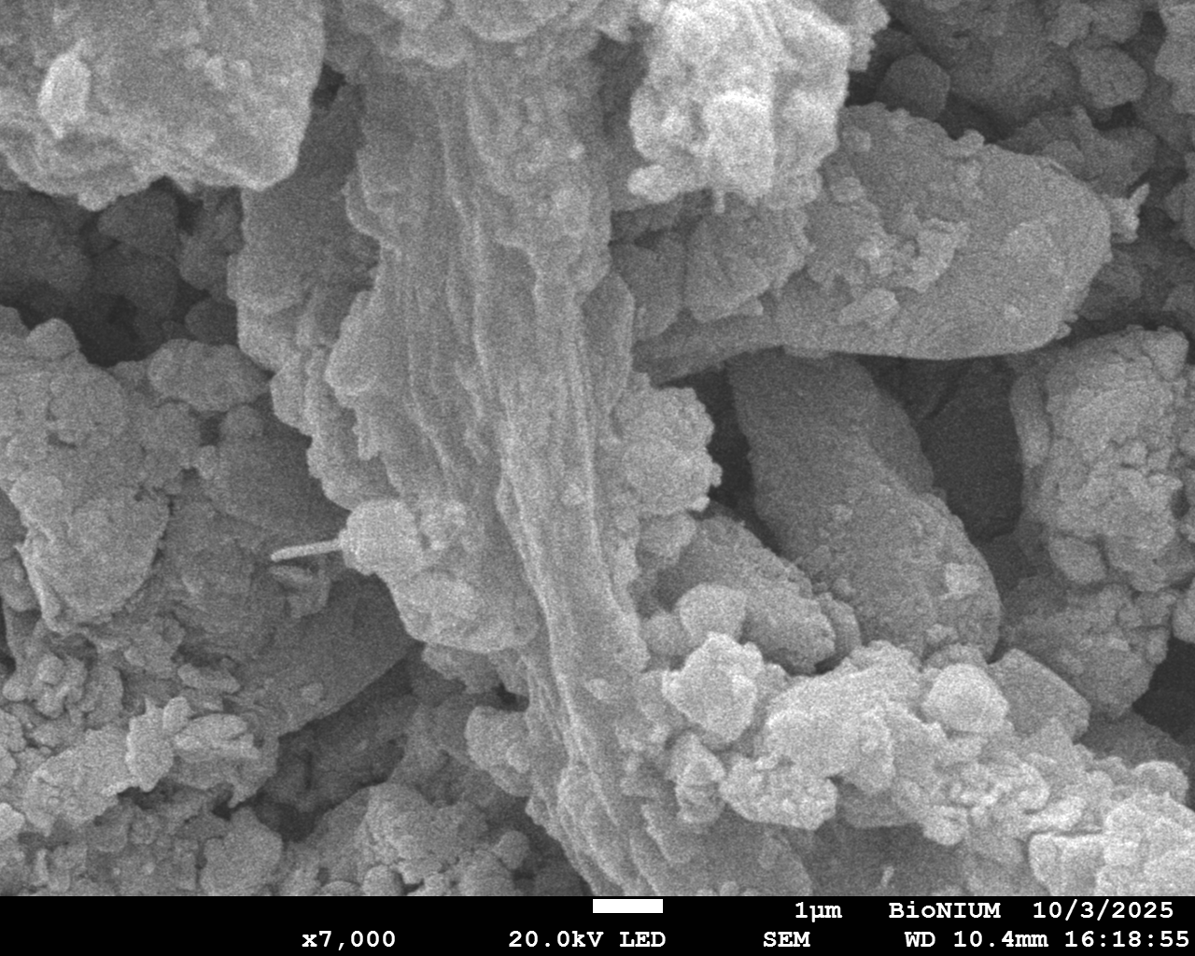
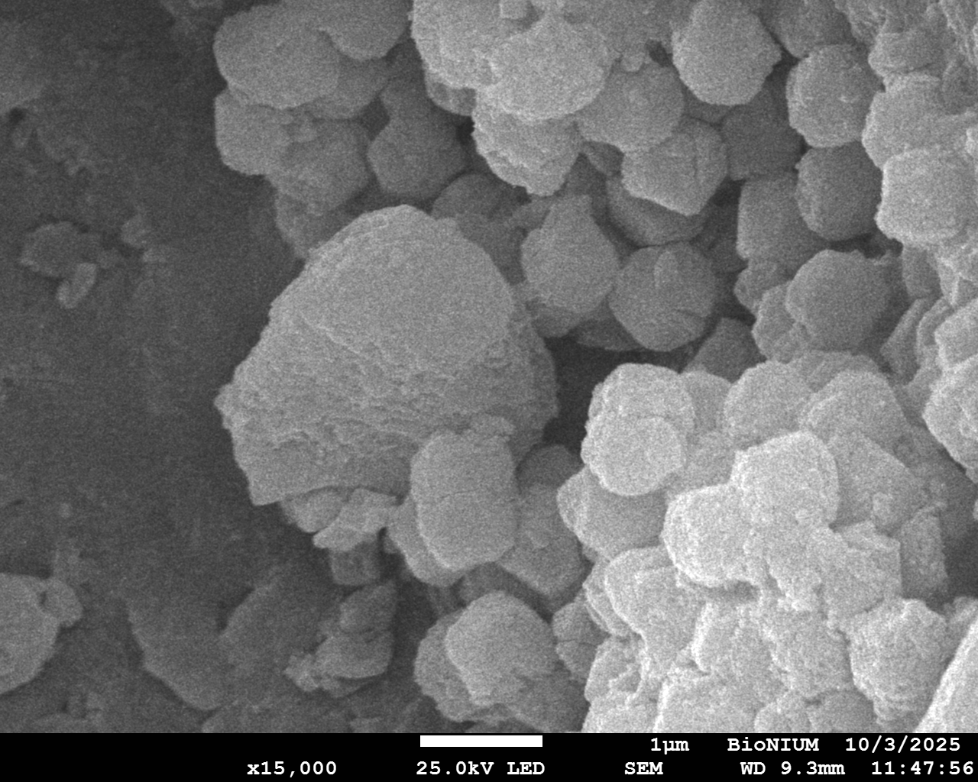
SEM inspection of potential microbialite

Slide 17
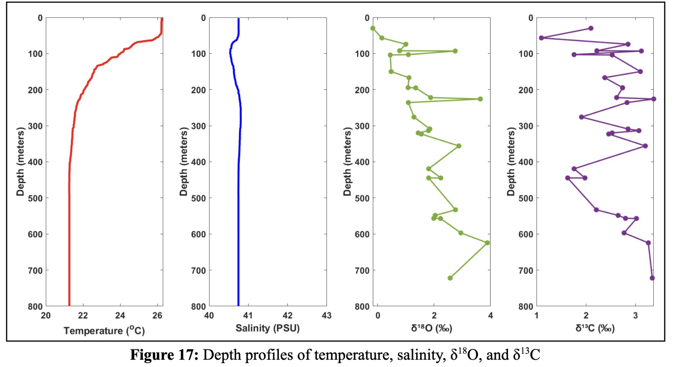
Stable isotope geochemistry
With depth an overall increase in δ¹⁸O values of 3.4‰
Modern temperature gradient and salinity do not explain the enrichment of δ¹⁸O,
Residual values from the last glacial maximum?

Slide 18
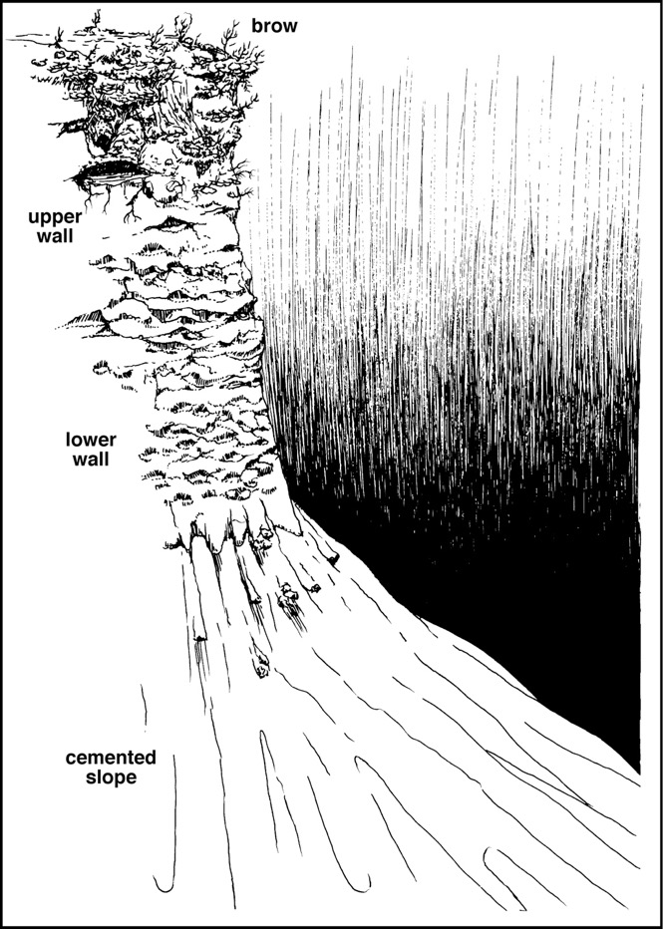
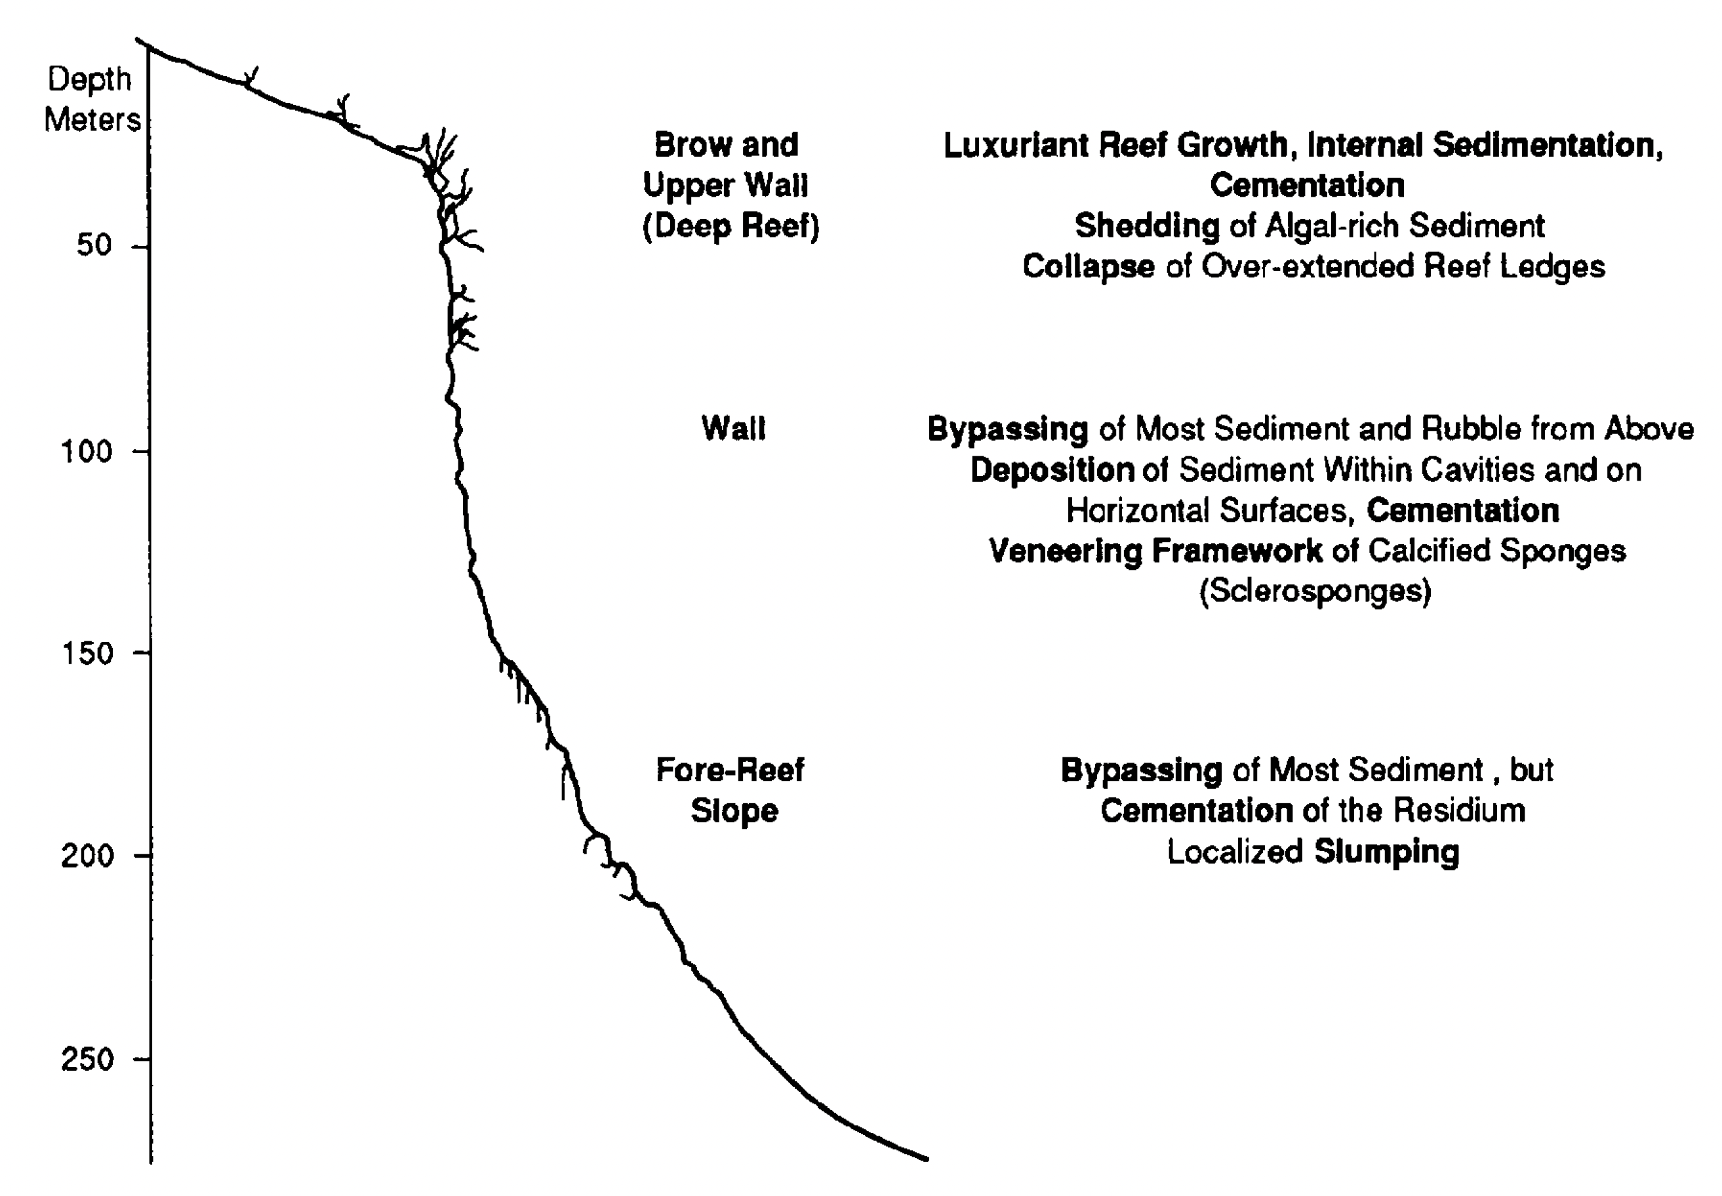
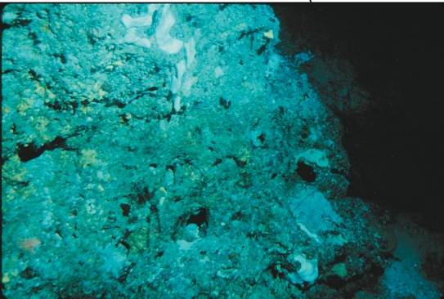
Chub Cay Wall Bahamas
Ledges and horizontal surfaces
drawing from Ginsburg et al. 1991

Slide 19
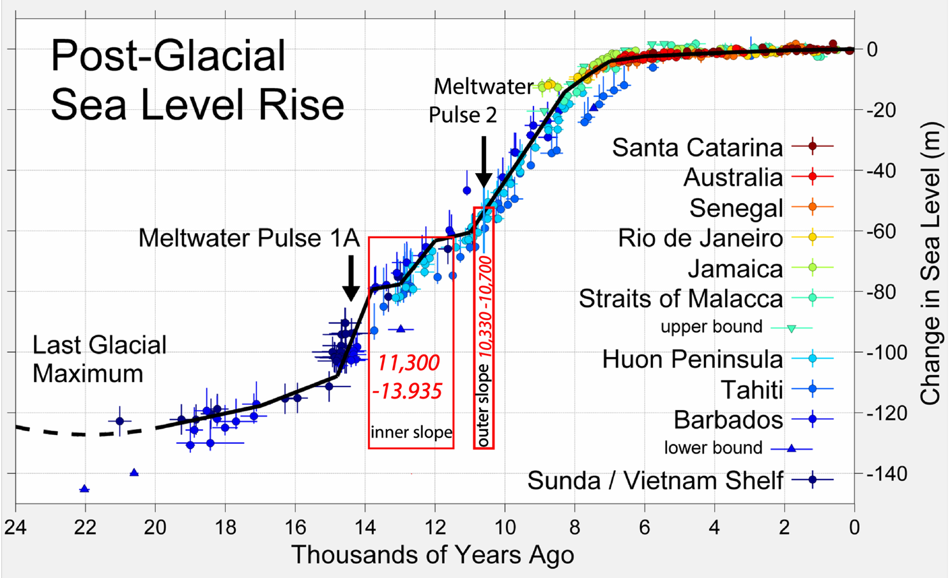
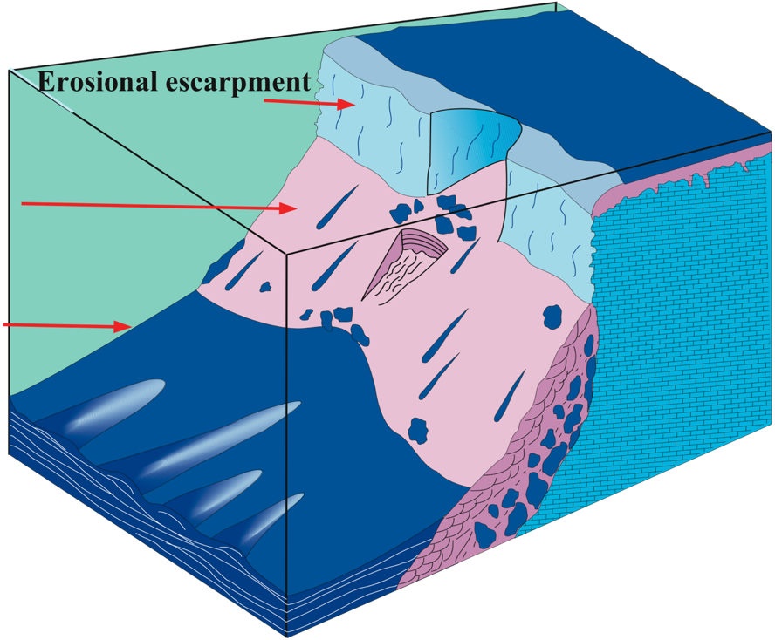
Cemented slope is a transgressive deposit
Ages from Grammer et al. 1993
TST
HST
Tongue of the Ocean
PA
PP
Slope accumulated mainly after Meltwater Pulse 1A
Ages of slope abruptly end at ~10,500 yrs

Slide 20
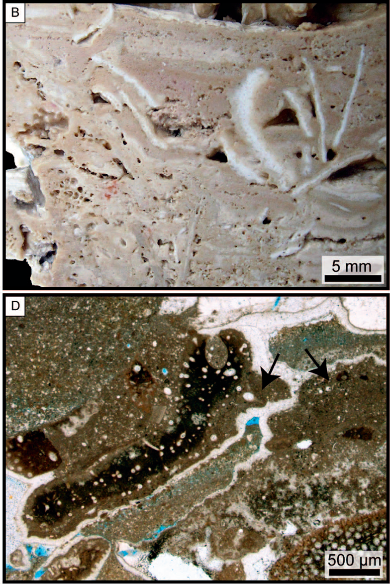
Microbial Binding: TOTO
Reolid et al. 2017, JSR
Slope at Palmer Point: field of microbial dome structures
Halimeda plates in a laminated dense to clotted micritic matrix
stromatolite-like irregular layering of the clotted to dense micrite

Slide 21
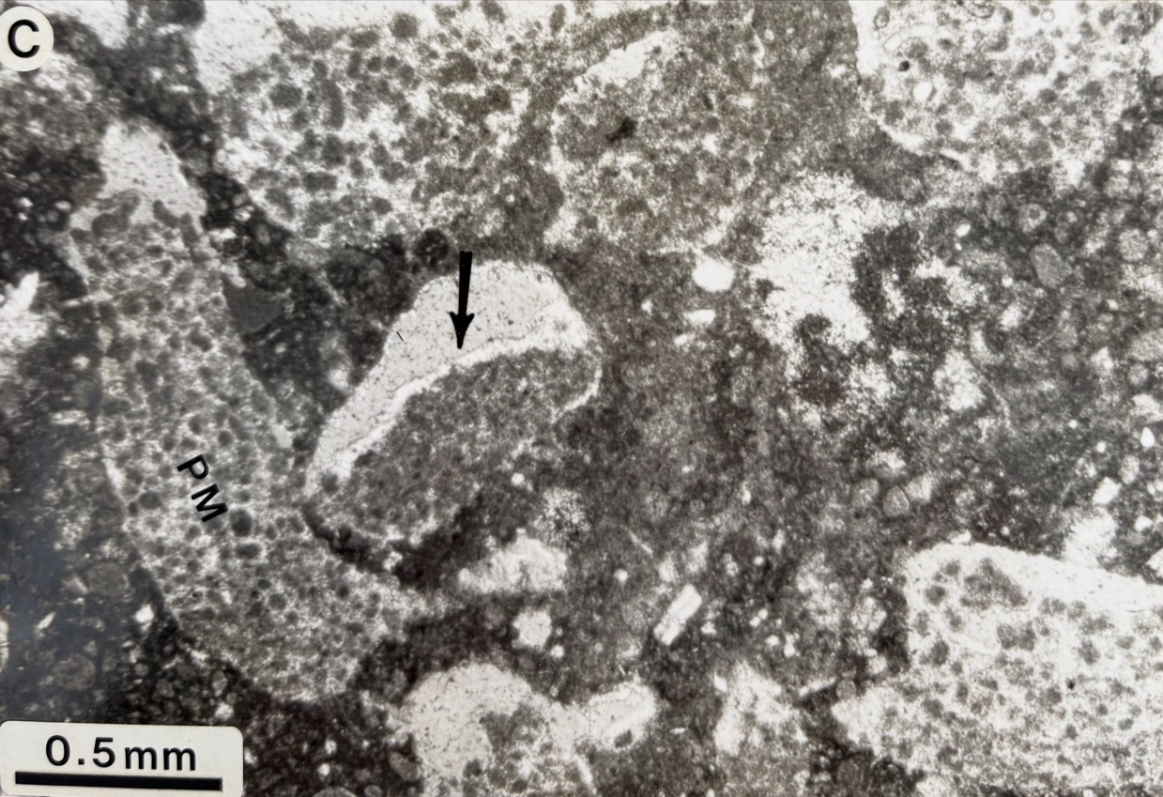
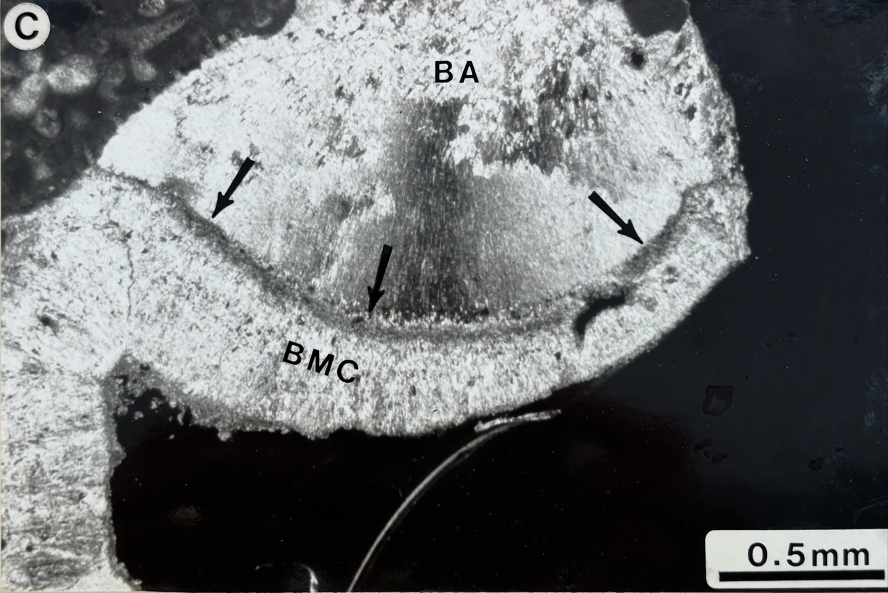
Botryoidal cements: TOTO Slope
“Peloidal micrite, consisting of rounded, "clotted” grains of micrite that average 20-40 μm in diameter, …. composed of Mg-calcite and are typically cemented with finely crystalline (20-75 μm) bladed Mg-calcite.” Grammer 1993
Rock Range, 152 m (500 ft).” Grammer et al. 1993
“…botryoidal aragonite (BA) cement terminating against isopachous bladed Mg-calcite (BMC) cement. The thin dark line (arrows) is a layer of Mg-calcite micrite.
Privitt Place, 168 m (550 ft).” Grammer et al. 1993

Slide 22
Conclusions
The slope in the Gulf of Aqaba has a unique long mesophotic reef zone.
The ledges of micritic crusts are reminiscent of microbialites in regard to mineralogy but neither microscopic nor SEM images do resemble microbialites texture.
The slope in the Gulf of Aqaba is reminiscent to the near-vertical walls off Chub Cay and the Belize Barrier Reef and the cemented slope in the TOTO.

