Slide 1
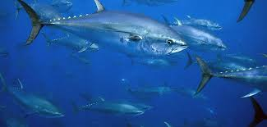
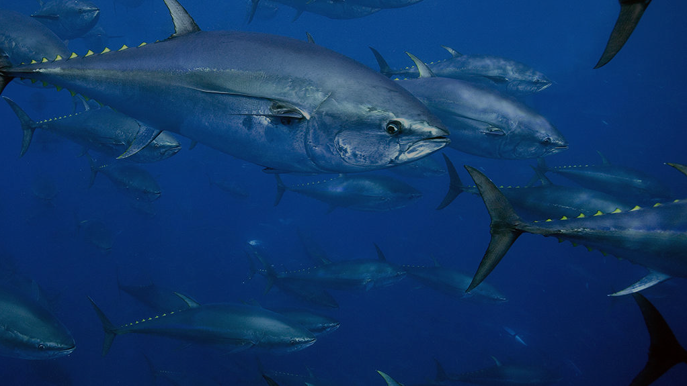

Refining Estimates of Dietary Carbon Utilization in Ichthyocarbonate Formation
Sam et al., 2025
Cameron Sam¹, Martin Grosell², Sarah Walls², Bret Marek², Rachael Heuer², Jazmin Garza¹, Felipe Muschel¹, Roxanne Reed², Amanda Oehlert¹
¹Department of Marine Geosciences, Rosenstiel School of Marine, Atmospheric, and Earth Science, University of Miami, FL, USA
²Department of Marine Biology and Ecology, Rosenstiel School of Marine, Atmospheric, and Earth Science, University of Miami, FL, USA
Notes:
Hi everyone I’m Cameron Sam and I’m currently in the second year of my PhD program in the department of marine geosciences here at the University of Miami. My advisor is Dr. Amanda Oehlert and today my talk is on refining estimates of Dietary Carbon Utilization in Ichthyocarbonate Formation.

Slide 2
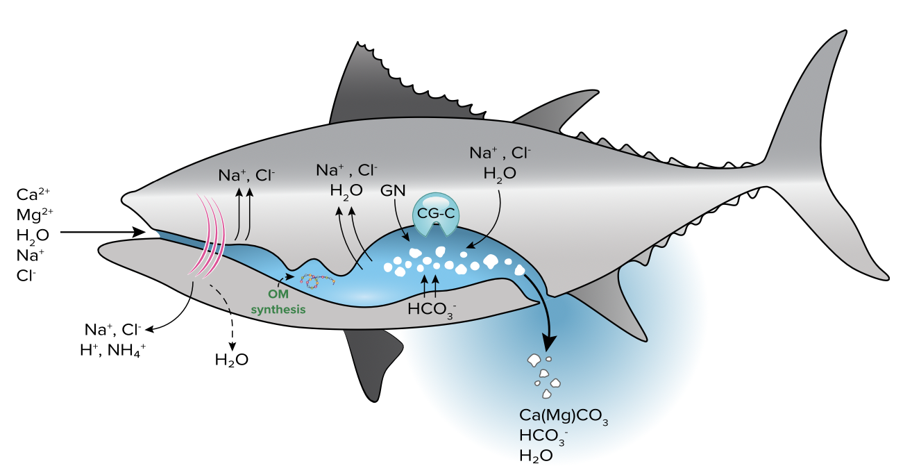
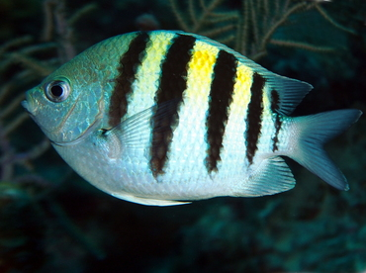
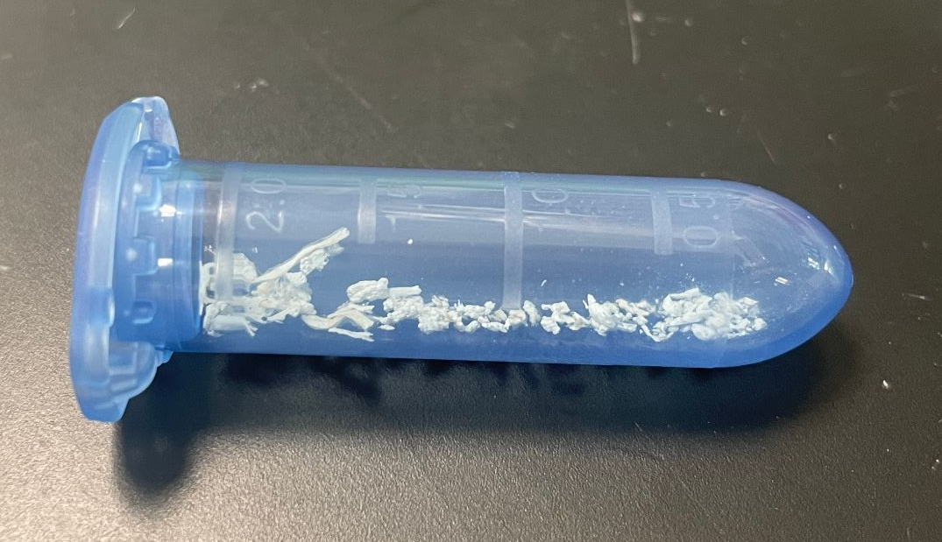
What is Ichthyocarbonate?
Sam et al., 2025
Magnesium rich carbonate Ca(Mg)CO₃ formed in the intestine
Organic mucus coating
Low δ¹³C values
  Oehlert et al., 2024a, Grosell et al., 2025
High δ¹⁸O values
  Hashim et al., 2024
Grosell and Oehlert, 2023
Grosell and Oehlert, 2023
Notes:
First off, what exactly is ichthyocarbonate? You may know by now from previous talks, but just as a reminder it’s a magnesium rich carbonate mineral produced by all marine teleost fish. As part of a fish’s osmoregulatory strategy for staying hydrated in a marine environment, they have to reduce the buildup of osmotic pressure in their lumen to be able to absorb water into their tissue. So they take the calcium, magnesium, and bicarbonate ions in the intestinal fluid and precipitate them as ichthyocarbonate in their intestine, which is then excreted to the water column. Previous research has so far shown that ichthyocarbonate is produced with an embedded organic mucus coating that reduces dissolution rate in seawater, and that ichthyocarbonate is characterized by low d13C values and high d18O values. So far, ichthyocarbonate precipitation has been observed to occur in marine fish of all species and lifestyles, including gulf toadfish, sergeant majors, olive flounder, and yellowtail snapper.

Slide 3
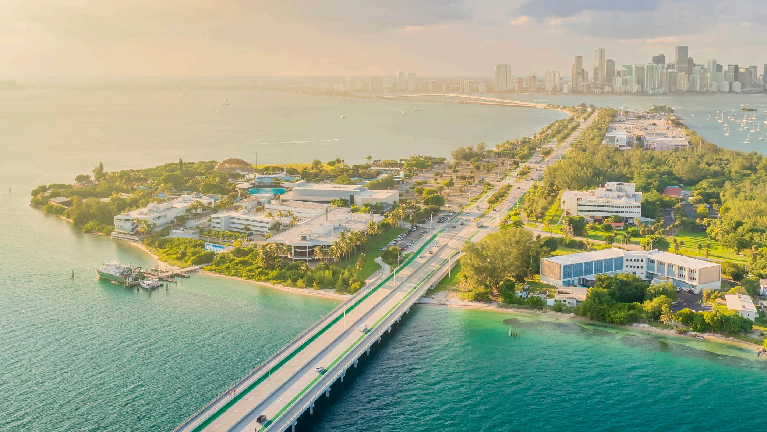
Sam et al., 2025
Key Points
Majority of carbon in ichthyocarbonate is derived from the marine food web
Ichthyocarbonate precipitation has unexpected impacts on seawater carbonate chemistry
Sinking ichthyocarbonate likely sequesters carbon in the deep ocean and potentially in marine sediments
Notes:
So the key points that I’ll touch on in my presentation are that the majority of carbon in ichthyocarbonate is derived from the marine food web, ichthyocarbonate precipitation has unexpected impacts on seawater carbonate chemistry, and that sinking ichthyocarbonate likely sequesters carbon in the deep ocean and potentially in marine sediments for thousands to millions of years

Slide 4
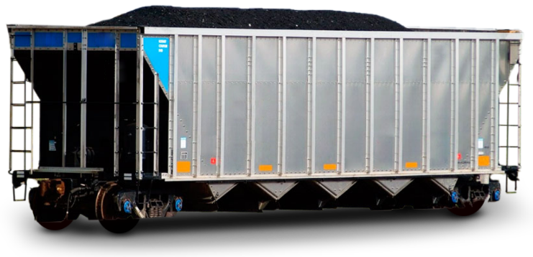

Marine Teleost Fish Make Lots of Carbonate
Sam et al., 2025
Carbonate produced by marine teleost (bony) fish is among the top three sources of carbonate to the oceans
1.43 – 9.03 Pg CaCO₃ yr ⁻¹
Oehlert et al., 2024a, Wilson et al., 2009
1 train car = 100 tons of coal
1 petagram = 156,500 mile long train
Wrap around the Earth 6 times
9 to 56 times around the Earth!
Notes:
What’s notable about ichthyocarbonate is that until about 2009 when Wilson and colleagues published the first estimates of global ichthyocarbonate production, contributions by marine fish tot he carbonate pump were completely underrecognized. But with the most recent estimates of global ichthyocarbonate production based on global fish biomass, researchers estimate that marine fish are among the top three sources of carbonate to the oceans, along with corals and foraminifera with about 1.43 to 9.03 Pg CaCO3 produced per year. And to visualize how much stuff is 1 petagram, the average train car carries 100 tons of coal. To carry 1 petagram of coal, we’d need a train that’s 156,500 miles long, meaning our little train would wrap around the equator 6 times. So to get 1.43 to 9.03 petagrams of carbonate, our train would wrap around the equator between 9 and 56 times. So to say marine bony fish are making tons of carbonate is a bit of an understatement. Even then, these are conservative estimates, and the true value could be much higher.

Slide 5
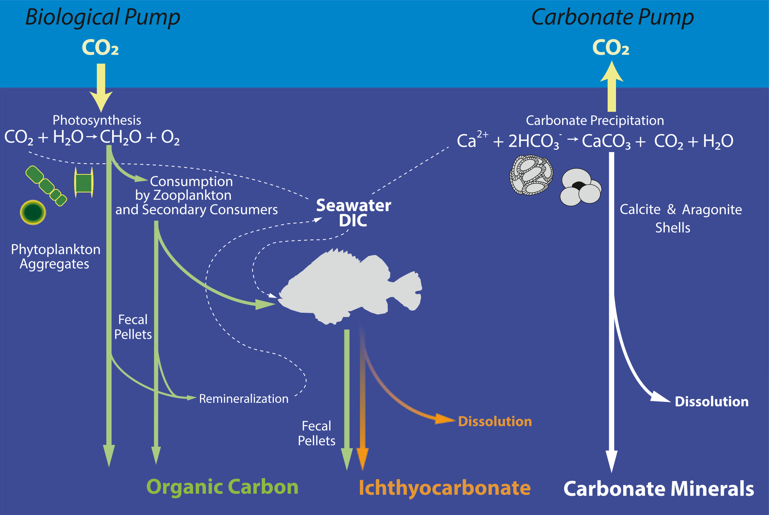
Marine Fish Participate in the Biological and Carbonate Pumps
Sam et al., 2025
Proportion of C from the diet: C_{DIET}
C_{DIC}
Proportion of C from seawater: C_{DIC}
C_{DIET}
C_{DIET} + C_{DIC} = 100%
Oehlert et al., 2024a
Notes:
So marine fish produce carbonate, so what?. But what makes marine fish stand out from other marine calcifiers is that unlike corals and foraminifera that mainly source carbon from the carbonate pump to build their shells and skeletons, marine bony fish incorporate significant amounts of carbon from the biological pump to form ichthyocarbonate. If 100% of the carbon they use to build ichthyocarbonate came from just the carbonate pump, there would be an overall neutral effect on carbon transport since for every mole of HCO3 used, 0.6 moles of CO2 are released back to the ocean. However, by using carbon from the biological pump, marine fish are utilizing already biologically fixed carbon which is not in equilibrium with the ocean or atmosphere, so there may be a net drawdown of CO2 and the potential for long term carbon sequestration in the deep oceans. And so for the rest of this presentation I’ll refer to the the proportion of dietary carbon incorporated into ichthyocarbonate CDiet, and the proportion of carbon from dissolved inorganic carbon in seawater as CDIC. And these two values together add to 100%
Look at saba et al 2021 and build out carbonate pump idea being one of top three producesr.
I’m trying to sell the idea that we don’t yet know where ichthyocarbonate is ending up but that’s part of our work. The d18O values would be indicative of the seawater conditions of Mg, salinity, other stuff

Slide 6
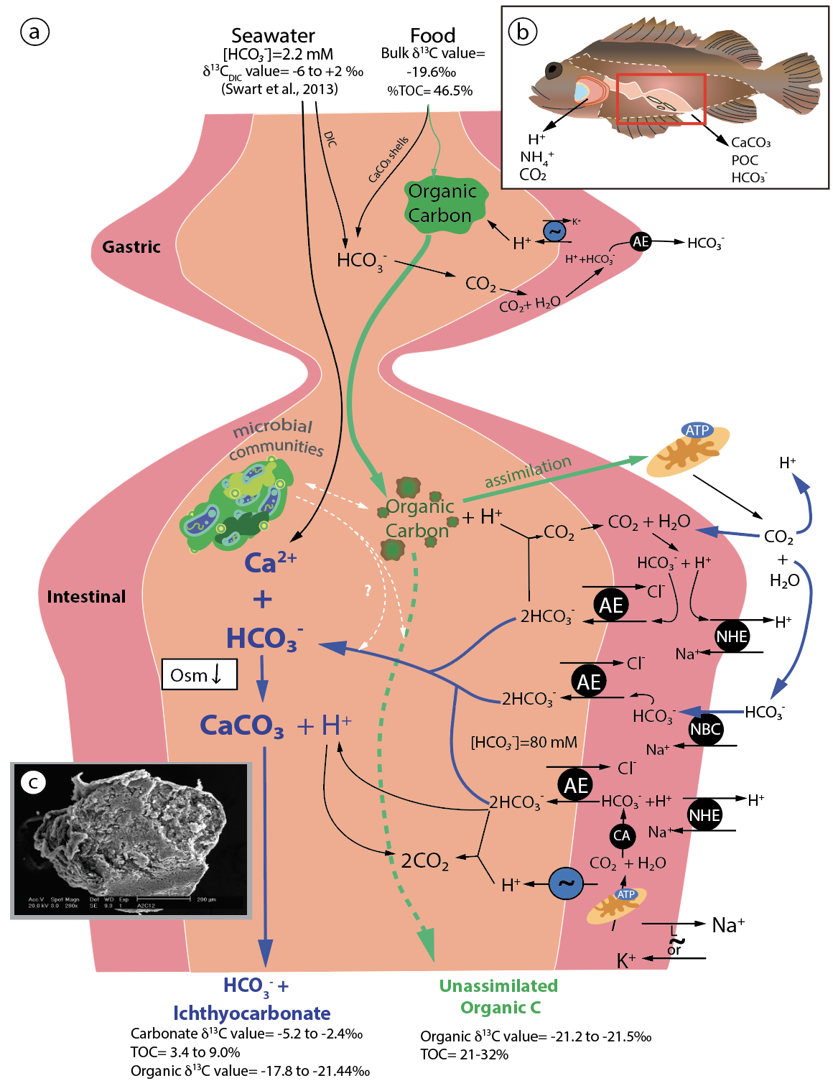
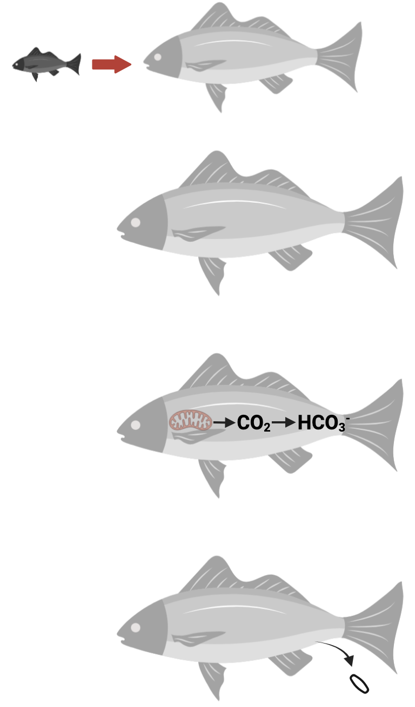

Biological Carbon is Converted into Carbonate
Sam et al., 2025
1. Fish eats food
2. Fish digests and grows
3. Mitochondria makes CO₂ which becomes HCO₃⁻ in the intestine
4. Ichthyocarbonate is produced and excreted
Oehlert et al., 2024a
Notes:
And to better understand how biological carbon is converted into inorganic carbonate within the fish, here is a very detailed diagram showing the pathway. Don’t worry about understanding this, the main message is that first, a fish eats food, second a fish digests the food and grows, third, the mitochondria in a fish’s tissue respire CO2 which is converted into bicarbonate in the intestine, fourth along with calcium and magnesium, this bicarbonate forms ichthyocarbonate and is excreted.

Slide 7
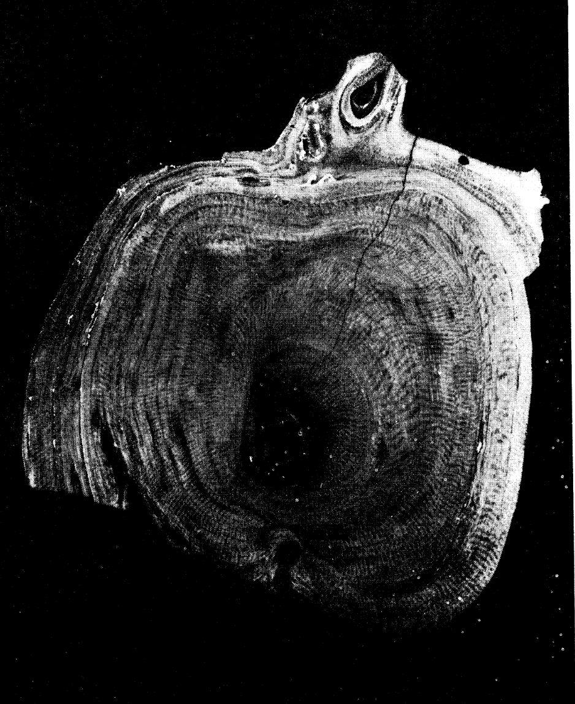
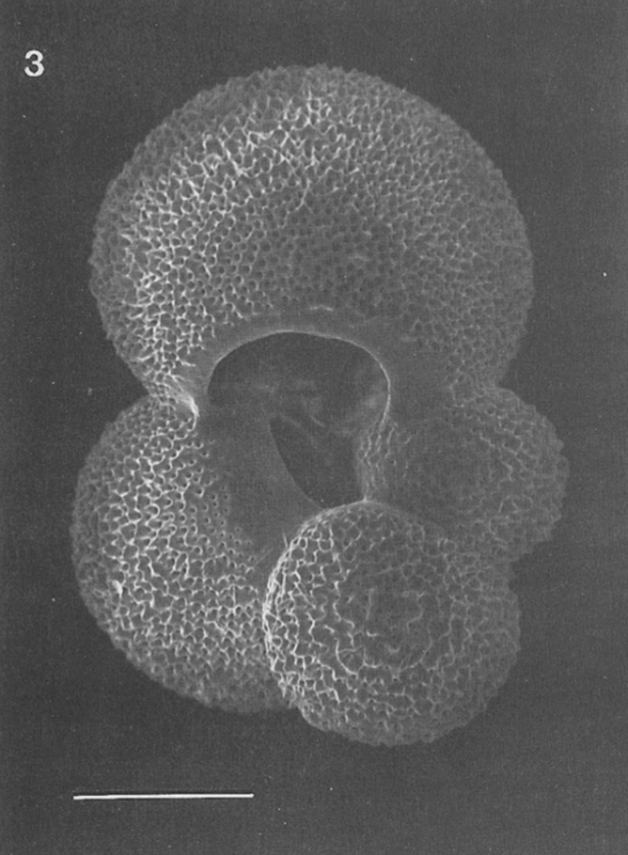
C_{DIET} Across Marine Calcifiers
Sam et al., 2025
Marine Fish – Ichthyocarbonate: 0 – 81%, average 28 – 56%
Oehlert et al., 2024a
Physiological mass balance – total rectal base excretion:
89.6% – 95.6%
Genz et al., 2008; Heuer et al., 2012; Wilson et al., 1996
Deep-sea Corals: 4% – 10%
Adkins et al., 2003; Griffin and Druffel, 1989
Foraminifera: 8% – 15%
Spero and Lea, 1996
This study
Griffin and Druffel, 1989
Spero and Lea, 1996
Notes:
Previous research has estimated CDiet in ichthyocarbonate to be anywhere from 0 to 81% with an average of 28-56%. However, this is pretty different from what’s predicted by physiologists. Physiologists looked at the total rectal base excretion by fish and saw that compared to the total amount of HCO3 excreted, only a small portion of the carbon actually comes from the dissolved inorganic carbon they ingest from seawater. So to account for this mass imbalance, physiological mixing models predict that the remaining 90 to 95% of their carbon would have to come from the food they eat. This estimate of CDiet, as well as what has been estimated through stable carbon isotope ratio mixing models, is vastly greater than values for CDiet measured for deep sea corals and foraminifera, which use about 4 to 10% and 8 to 15%, respectively. A higher value for Cdiet means there may be a greater potential for ichthyocarbonate to sequester carbon at depth, but this depends on where in the ocean ichthyocarbonate is ending up.

Slide 8
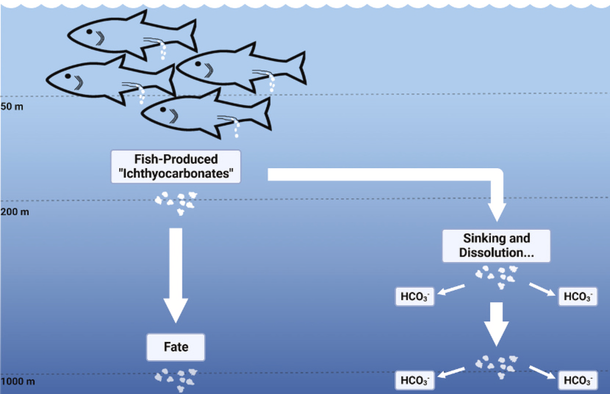
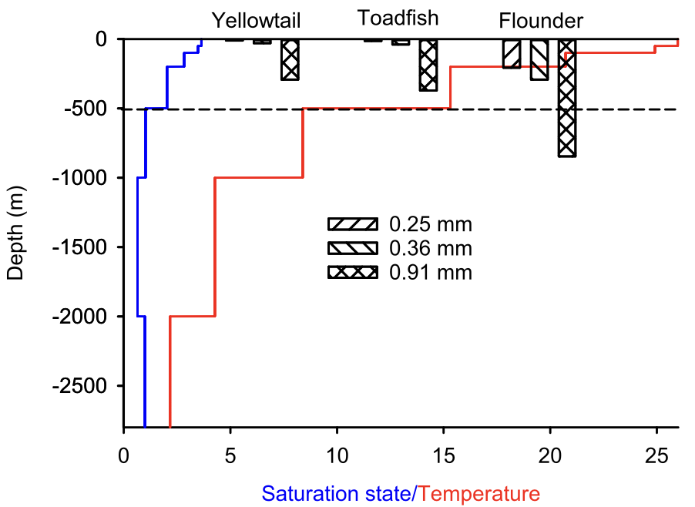
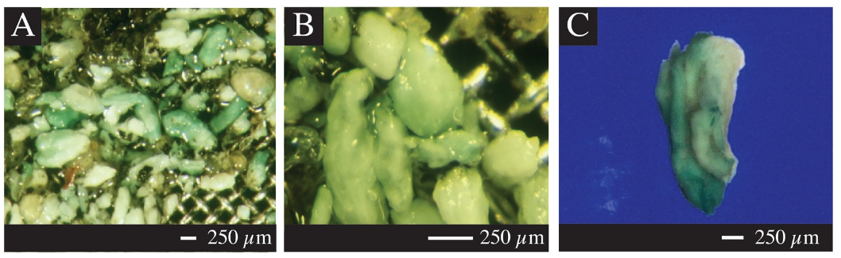
What is the Fate of Ichthyocarbonate Post-Excretion?
Sam et al., 2025
Pacific Ocean
Folkerts et al., 2024
Hashim et al., 2024
Notes:
So another important factor to consider is what happens to ichthyocarbonate post excretion? It can either sink to the seafloor and sequester in sediments on millenial time scales, or it may dissolve as it’s sinking and release HCO3, impacting alkalinity gradients in the water column. And we also have to consider whether ichthyocarbonate is dissolving above or below the thermocline. On the right is a graph showing the depths of ichthyocarbonate dissolution in the Pacific Ocean, with temperature in red. The thermocline is where we see the largest change in temperature. The thermocline physically separates the ocean water above and below from readily mixing, so once ichthyocarbonate sinks below the thermocline, dissolves, and increases alkalinity, it may be keeping that carbon trapped at depth and out of equilibrium with surface ocean water and the atmosphere. And if it reaches the seafloor sediment before dissolving, it may sequester that carbon for thousands to millions of years. From these graphs we can see that some ichthyocarbonate dissolves before reaching the thermocline, but other, larger grains like from the olive flounder sink below the thermocline before dissolving. Even then, these are conservative estimates, assuming excretion at sea surface level. In reality, we know that the majority of fish biomass comes from mesopelagic fish living between 200 and 1000m of depth. A recent paper by Hashim and colleagues in 2024 found ichthyocarbonate in sediment traps at 500 and 3200m depth.
All in all, we don’t yet know at what depths ichthyocarbonate is dissolving, but measuring CDiet will give us insight into the composition of ichthyocarbonate and its potential to sequester carbon at depth.

Slide 9
Project Goal
Sam et al., 2025
Problem:
Previous estimates of C_{DIET} and C_{DIC} were based on assumptions
Goal:
Revise estimates of C_{DIET} and C_{DIC} by measuring δ¹³C values of intestinal fluid, ichthyocarbonate, muscle, diet, and seawater
Notes:
So the main problem that my research aimed to address was that previous estimates of CDIET and CDIC were based on assumptions. And so the goal of my research was to revise estimates of CDIET and CDIC by addressing these assumptions through measuring d13C values of intestinal fluid, ichthyocarbonate, muscle, diet, and seawater.

Slide 10
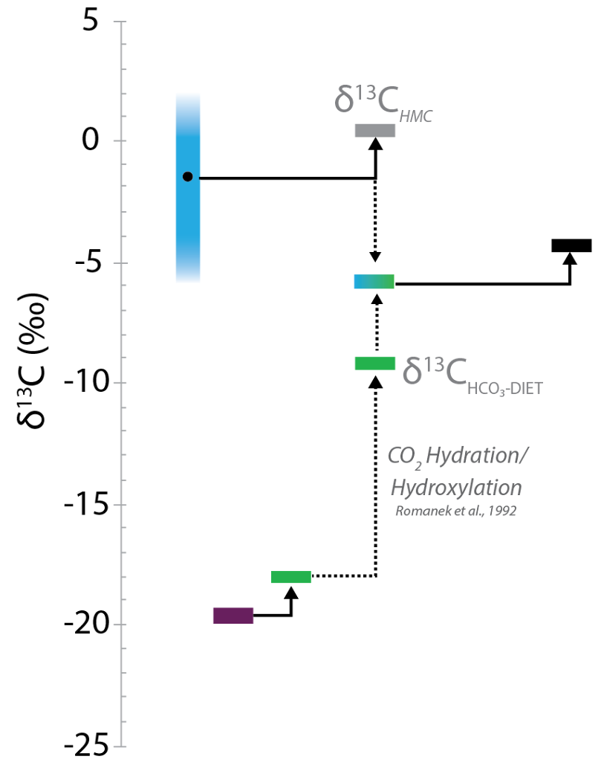
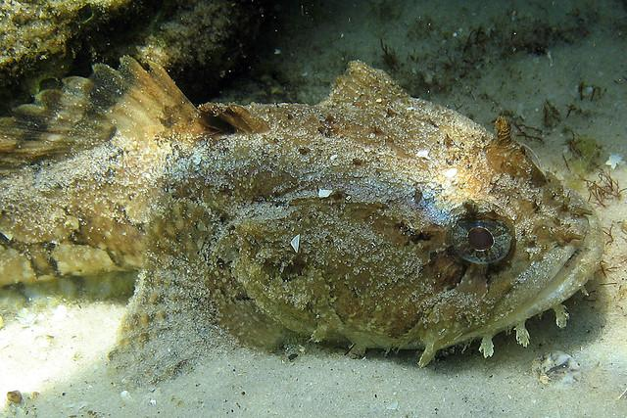
Carbon Sources to Ichthyocarbonate
Sam et al., 2025
δ¹³C_{DIC}
Using values of Δ_{ichthyo-IF} , δ¹³C_{DIC} , and δ¹³C_{HCO3-DIET} in the Iso ERROR (Phillips & Gregg, 1991) mixing model (Oehlert et al., 2024a) provides values for C_{DIET} and C_{DIC}
C_{DIC}
δ¹³C_{ICHTHYO}
δ¹³C_{IF}
Δ_{ichthyo-IF}
C_{DIET}
δ¹³C_{MUSCLE}
Assimilation
Factor
δ¹³C_{DIET}
Oehlert et al., 2024a
Notes:
And to better understand why the d13C values of all these samples are needed, here’s a diagram of the d13C values of dietary and dissolved inorganic carbon sources and fractionation to ichthyocarbonate. With the d13C values of the fish’s diet and muscle, we calculated the assimilation factor by taking the difference between the two. And by taking the difference in d13C values of the lumen, or intestinal fluid, and ichthyocarbonate we calculated the mineralogical fractionation factor. And using the assimilation factor, the mineralogical fractionation factor, and the d13C value of dissolved inorganic carbon in seawater, we used an IsoError mixing model to estimate CDiet and CDIC. And I want to point out that this is the first time the assimilation factor and mineralogical fractionation factor have ever been calculated for ichthyocarbonate. Previous studies had to assume them to estimate CDIET and CDIC, but by actually calculating them in this project we can get more accurate estimates of CDIET and CDIC.

Slide 11
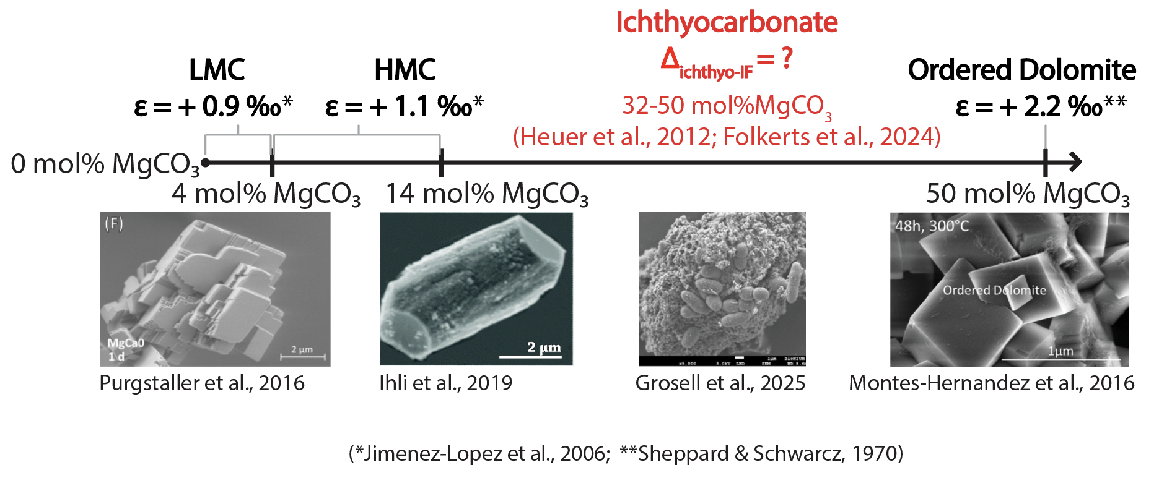
Mineralogical Fractionation Factors Increase with mol%MgCO₃
Sam et al., 2025
Notes:
And so before collecting and analyzing any samples, we first estimated the mineralogical fractionation factor of ichthyocarbonate based on its mol%MgCO3 content. Studies have shown that the mineralogical fractionation factor of carbonate increases with mol%MgCO3. Starting at the left side of the axis is LMC at 0-4 mol%MgCO3 with a mineralogical fractionation factor of + 0.9 ‰, then HMC at 4 to 14 mol%MgCO3 with a fractionation factor of +1.1 ‰, Previous research has measured ichthyocarbonate to contain 14 to 50 mol%MgCO3, and then ordered dolomite is at the high end with 50 mol%MgCO3 and a fractionation factor of + 2.2 ‰. Based on this range of mol%MgCO3 in ichthyocarbonate, we predicted it to have a fractionation factor between +1.1 and +2.2 ‰. Also along the bottom are corresponding SEM images of these carbonate minerals, with this one being ichthyocarbonate.
Show ichthyocarbonate from 0 to arrow off the page

Slide 12
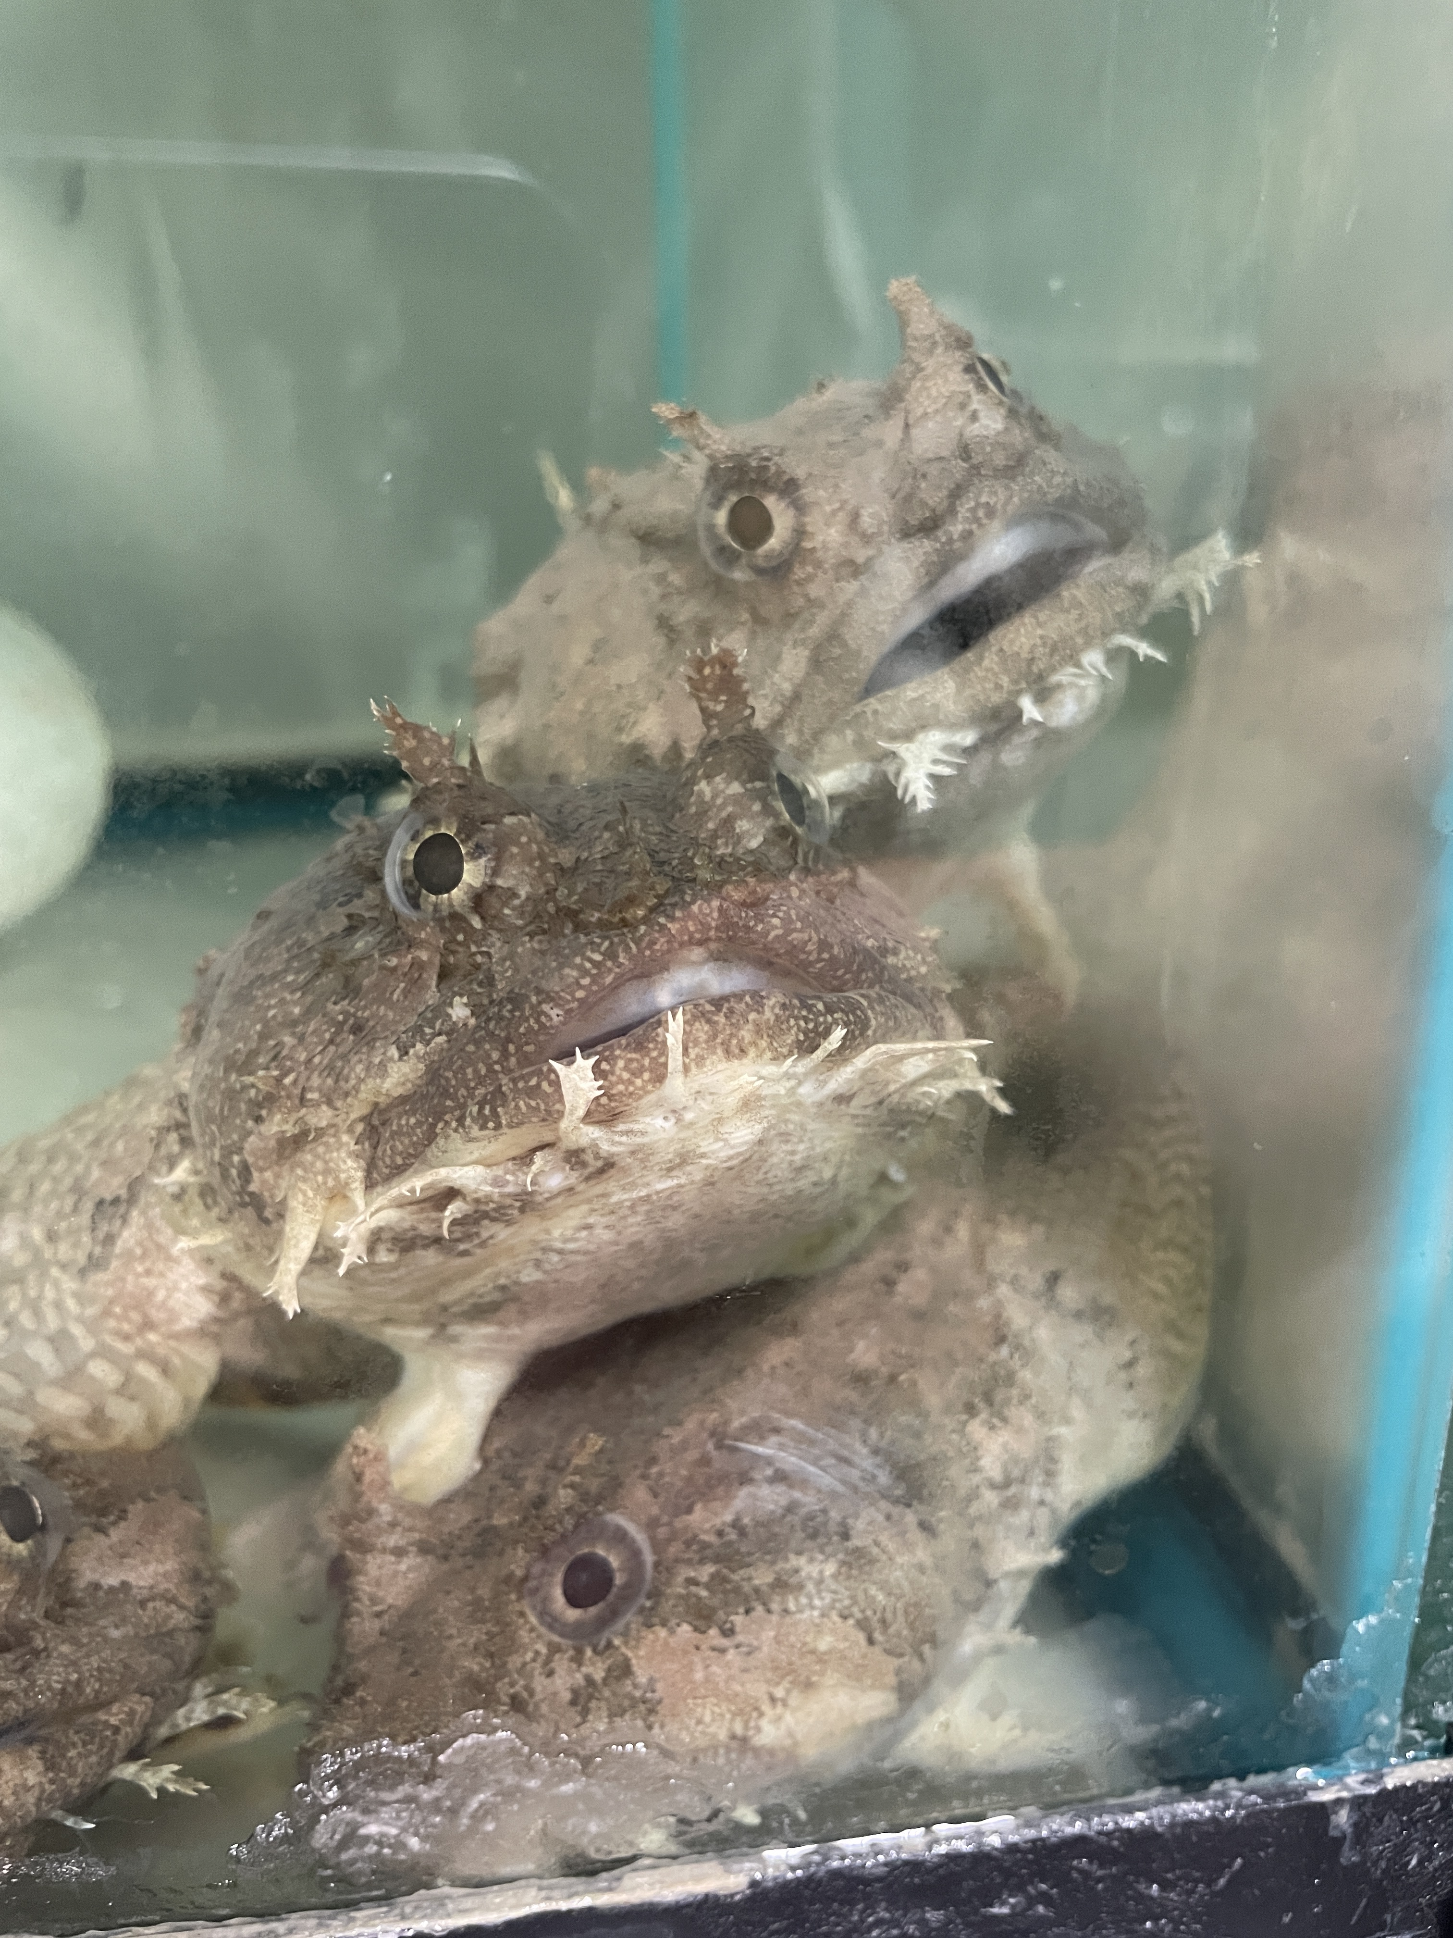
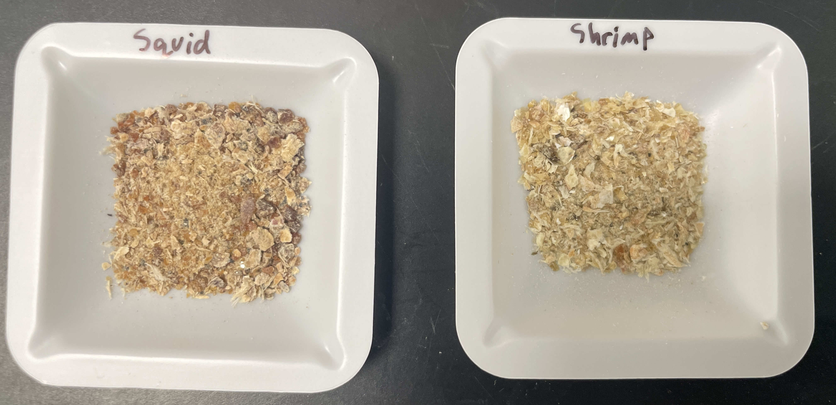
Methods – Sample Collection
Sam et al., 2025
Gulf toadfish – well known physiology Serafy et al., 2005
Toadfish fasted prior to dissection
Intestinal contents collected for intestinal fluid (IF) and ichthyocarbonate
Muscle, shrimp, and squid collected
Seawater collected, filtered, preserved
This study
Notes:
So to collect our samples, we used gulf toadfish since they’re easily available right in the waters right around Miami, they produce lots of ichthyocarbonate, and their physiology is well known. The fish were fasted for 9 days prior to dissection so that there was no waste in their intestines. We then dissected their intestines for intestinal fluid and ichthyocarbonate, collected a sample of their muscle, samples of the squid and shrimp they were being fed, and collected samples of seawater from their tanks. We also preserved the intestinal fluid and seawater samples with mercuric chloride to kill off any microbes that may respire and alter the stable isotope ratios.

Slide 13
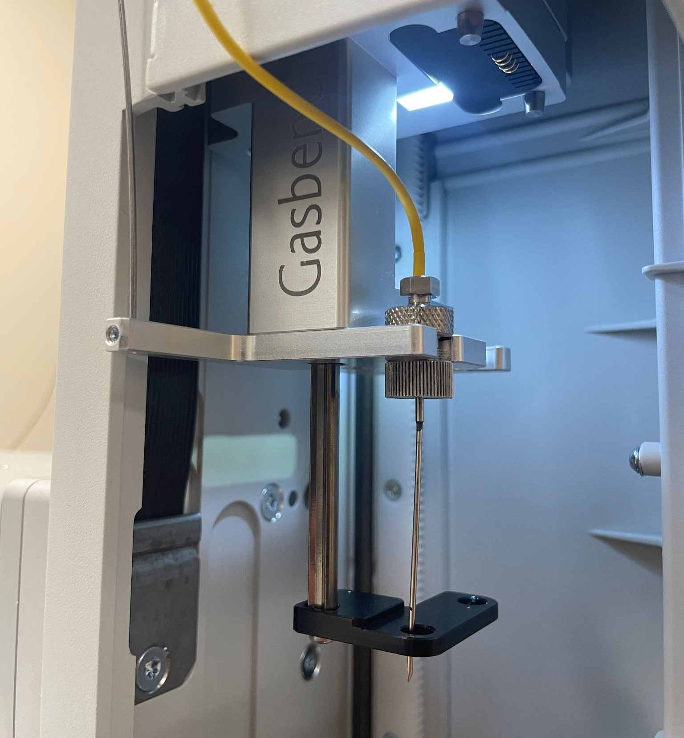
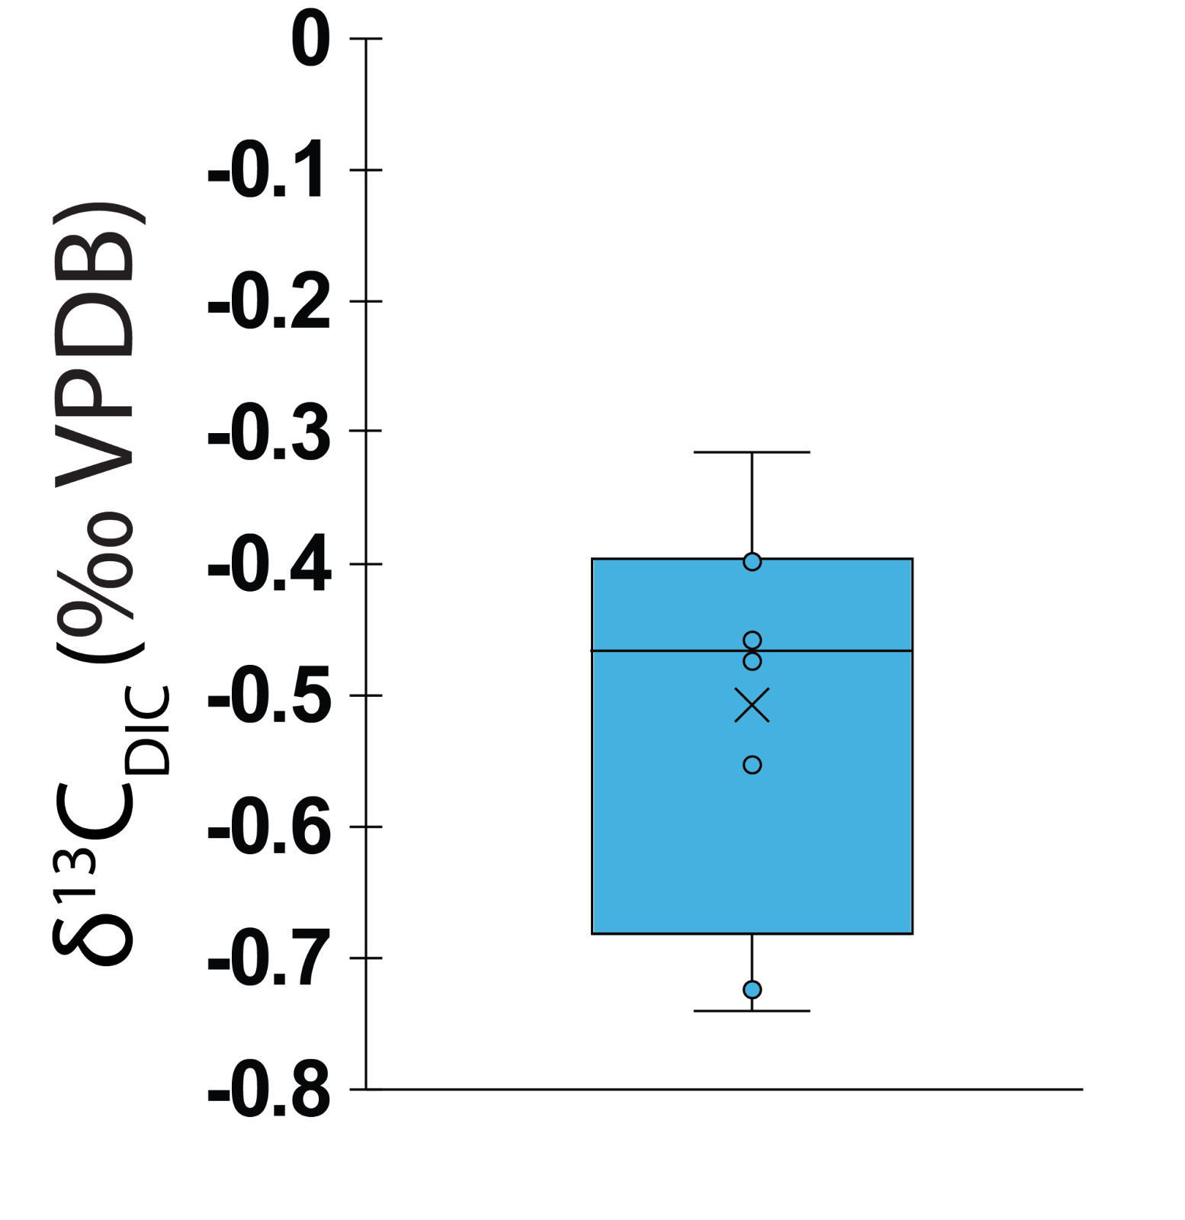
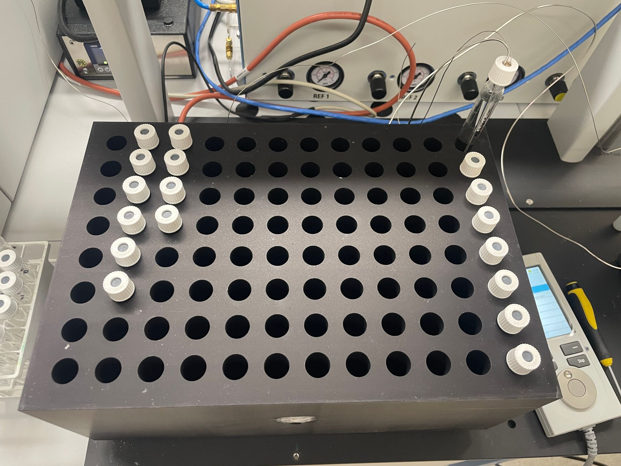
Methods – Seawater DIC Analysis
Sam et al., 2025
750 µL of seawater analyzed
Mean δ¹³C_{DIC} value: -0.5 ‰
Thermo Scientific Gasbench Plus and DELTA Q Isotope Ratio Mass Spectrometer (IRMS)
n = 8
Notes:
In order to measure the d13C values of dissolved inorganic carbon in seawater samples, as well as ichthyocarbonate and intestinal fluid samples, we used Thermo Scientific’s Gasbench Plus and DELTA Q Isotope Ratio Mass Spectrometer (IRMS). After running the 8 seawater samples on the gasbench, we got a range of d13C values from about -0.7 to -0.3 ‰ with a mean of -0.5 ‰.
It works by putting your sample into these glass exetainers, acidifying it with phosphoric acid which evolves CO2 gas, and then this needle on the gasbench arm moves and pierces the septa of each exetainer to sample the CO2. (which is in agreement with the range of d13C values of seawater from ocean water around Miami determined by Peter Swart) Certified Reference Materials IAEA 603, 610, and CO-8. Used 30 µL of IF, 750 µL of SW, and 0,125 mg of ichthyocarbonate

Slide 14
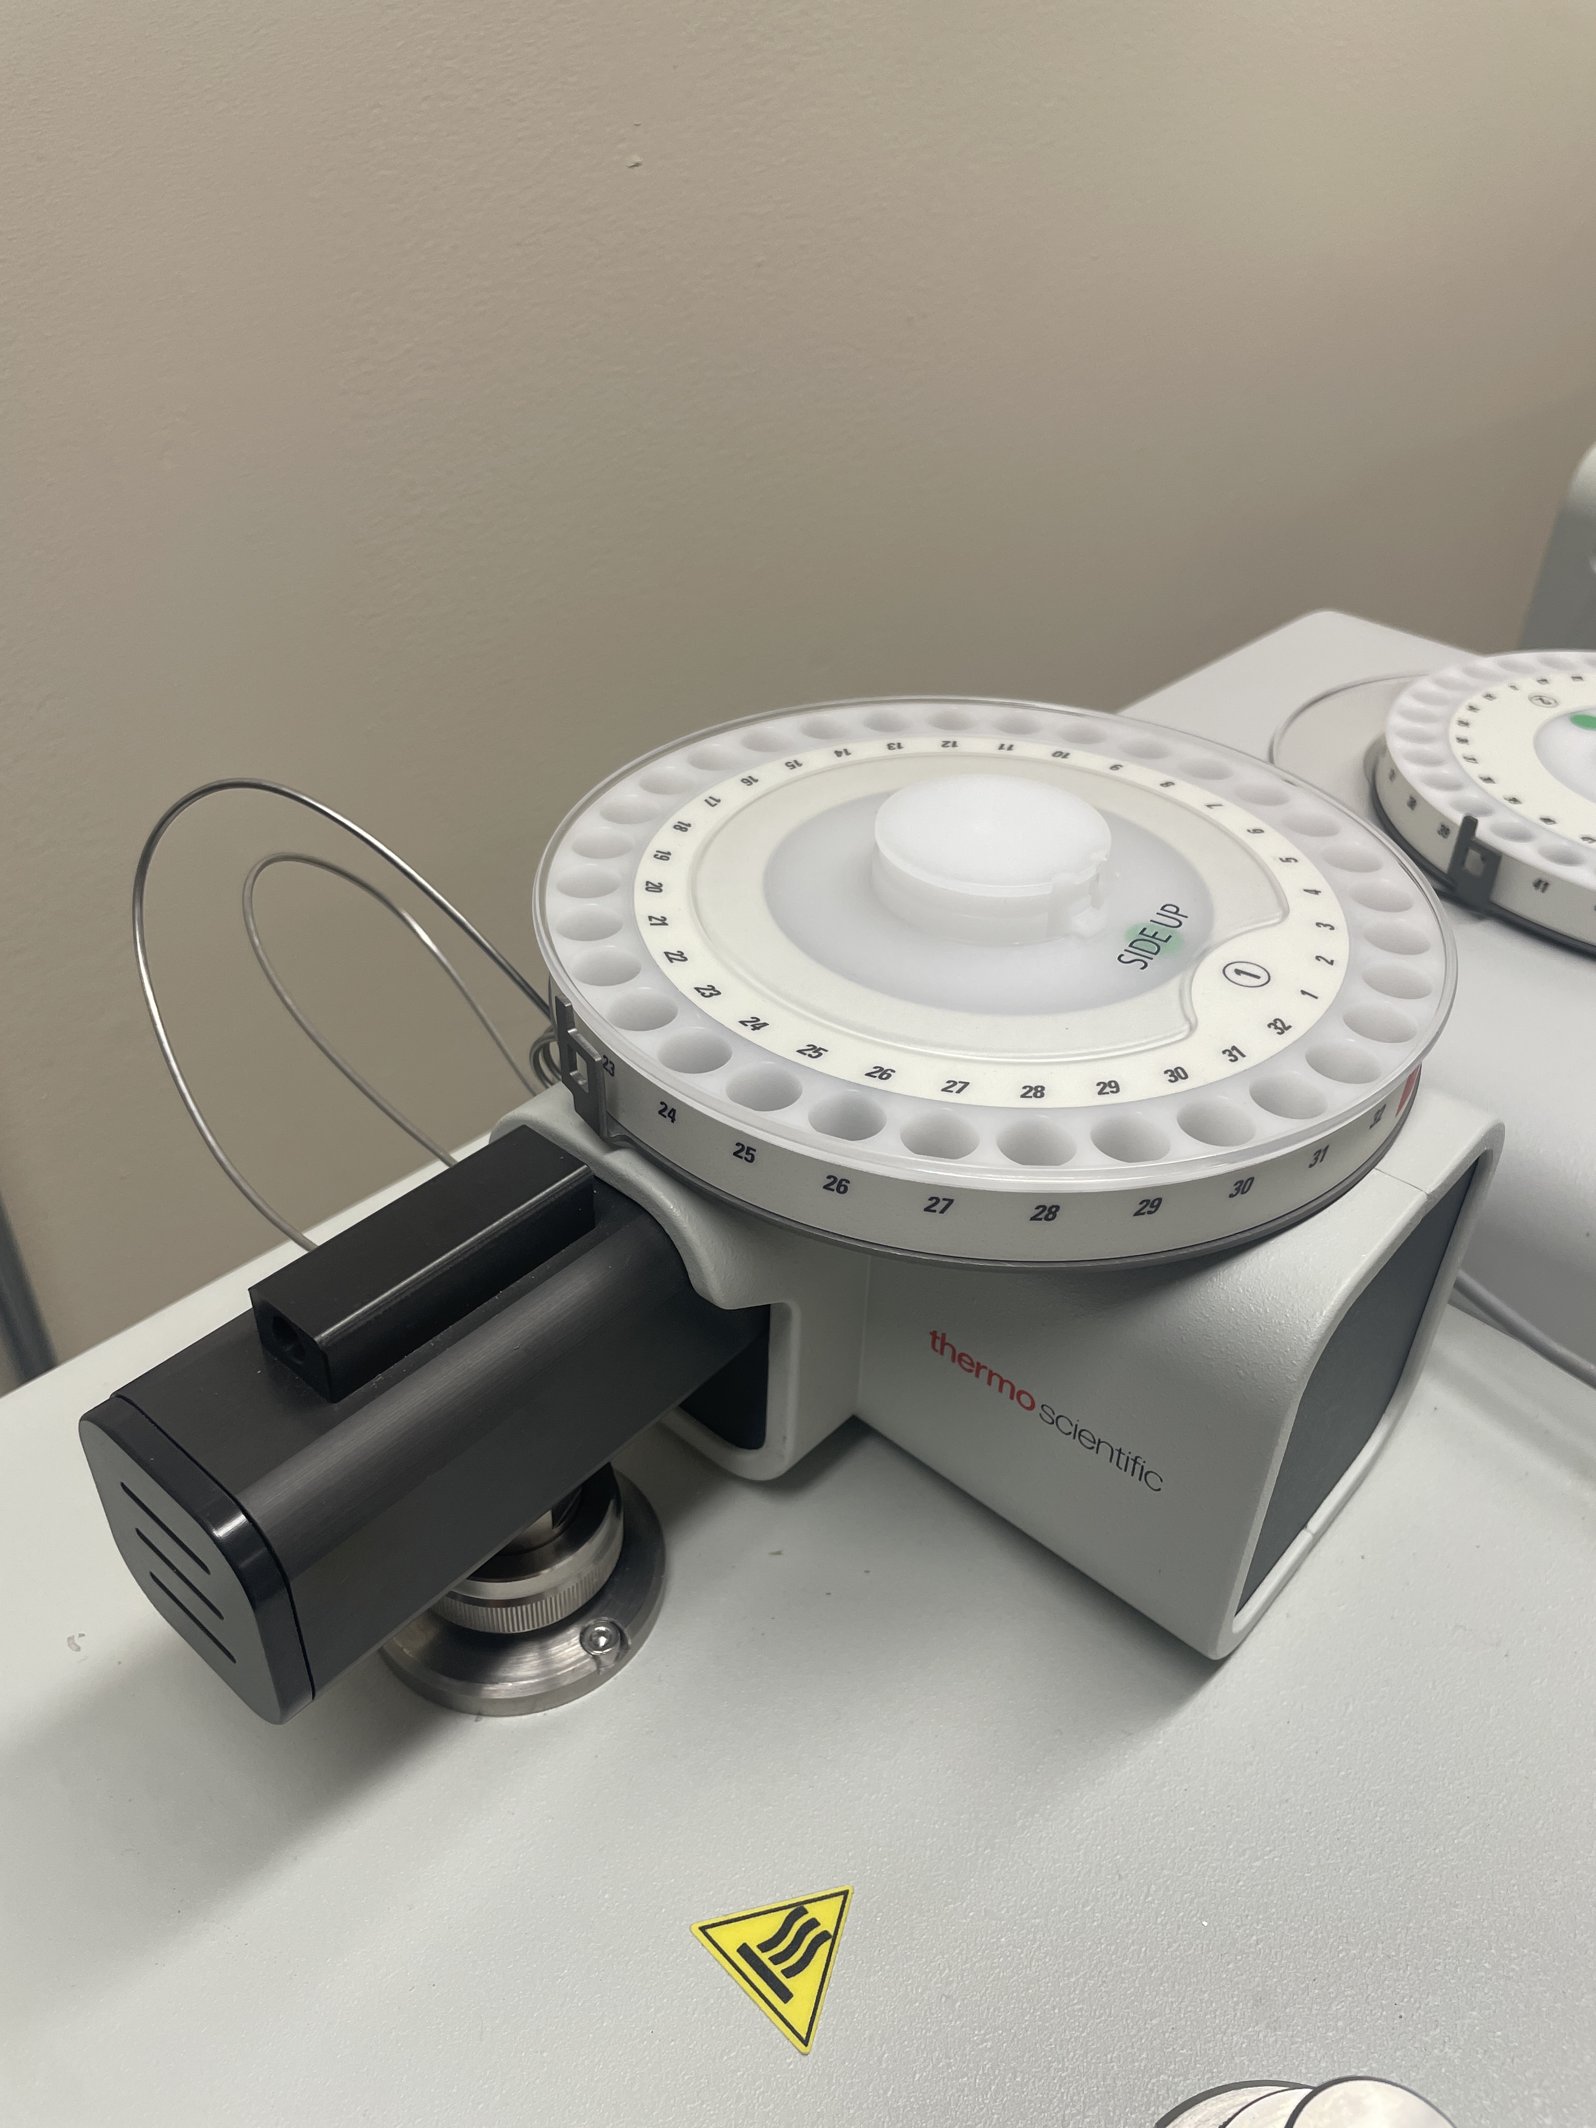
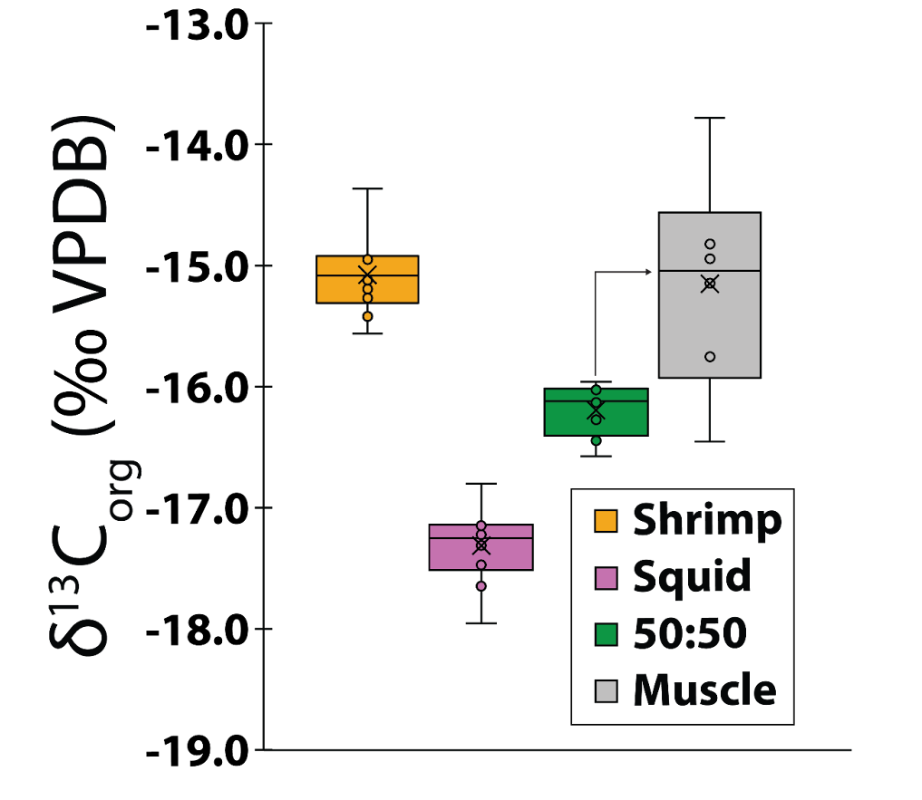
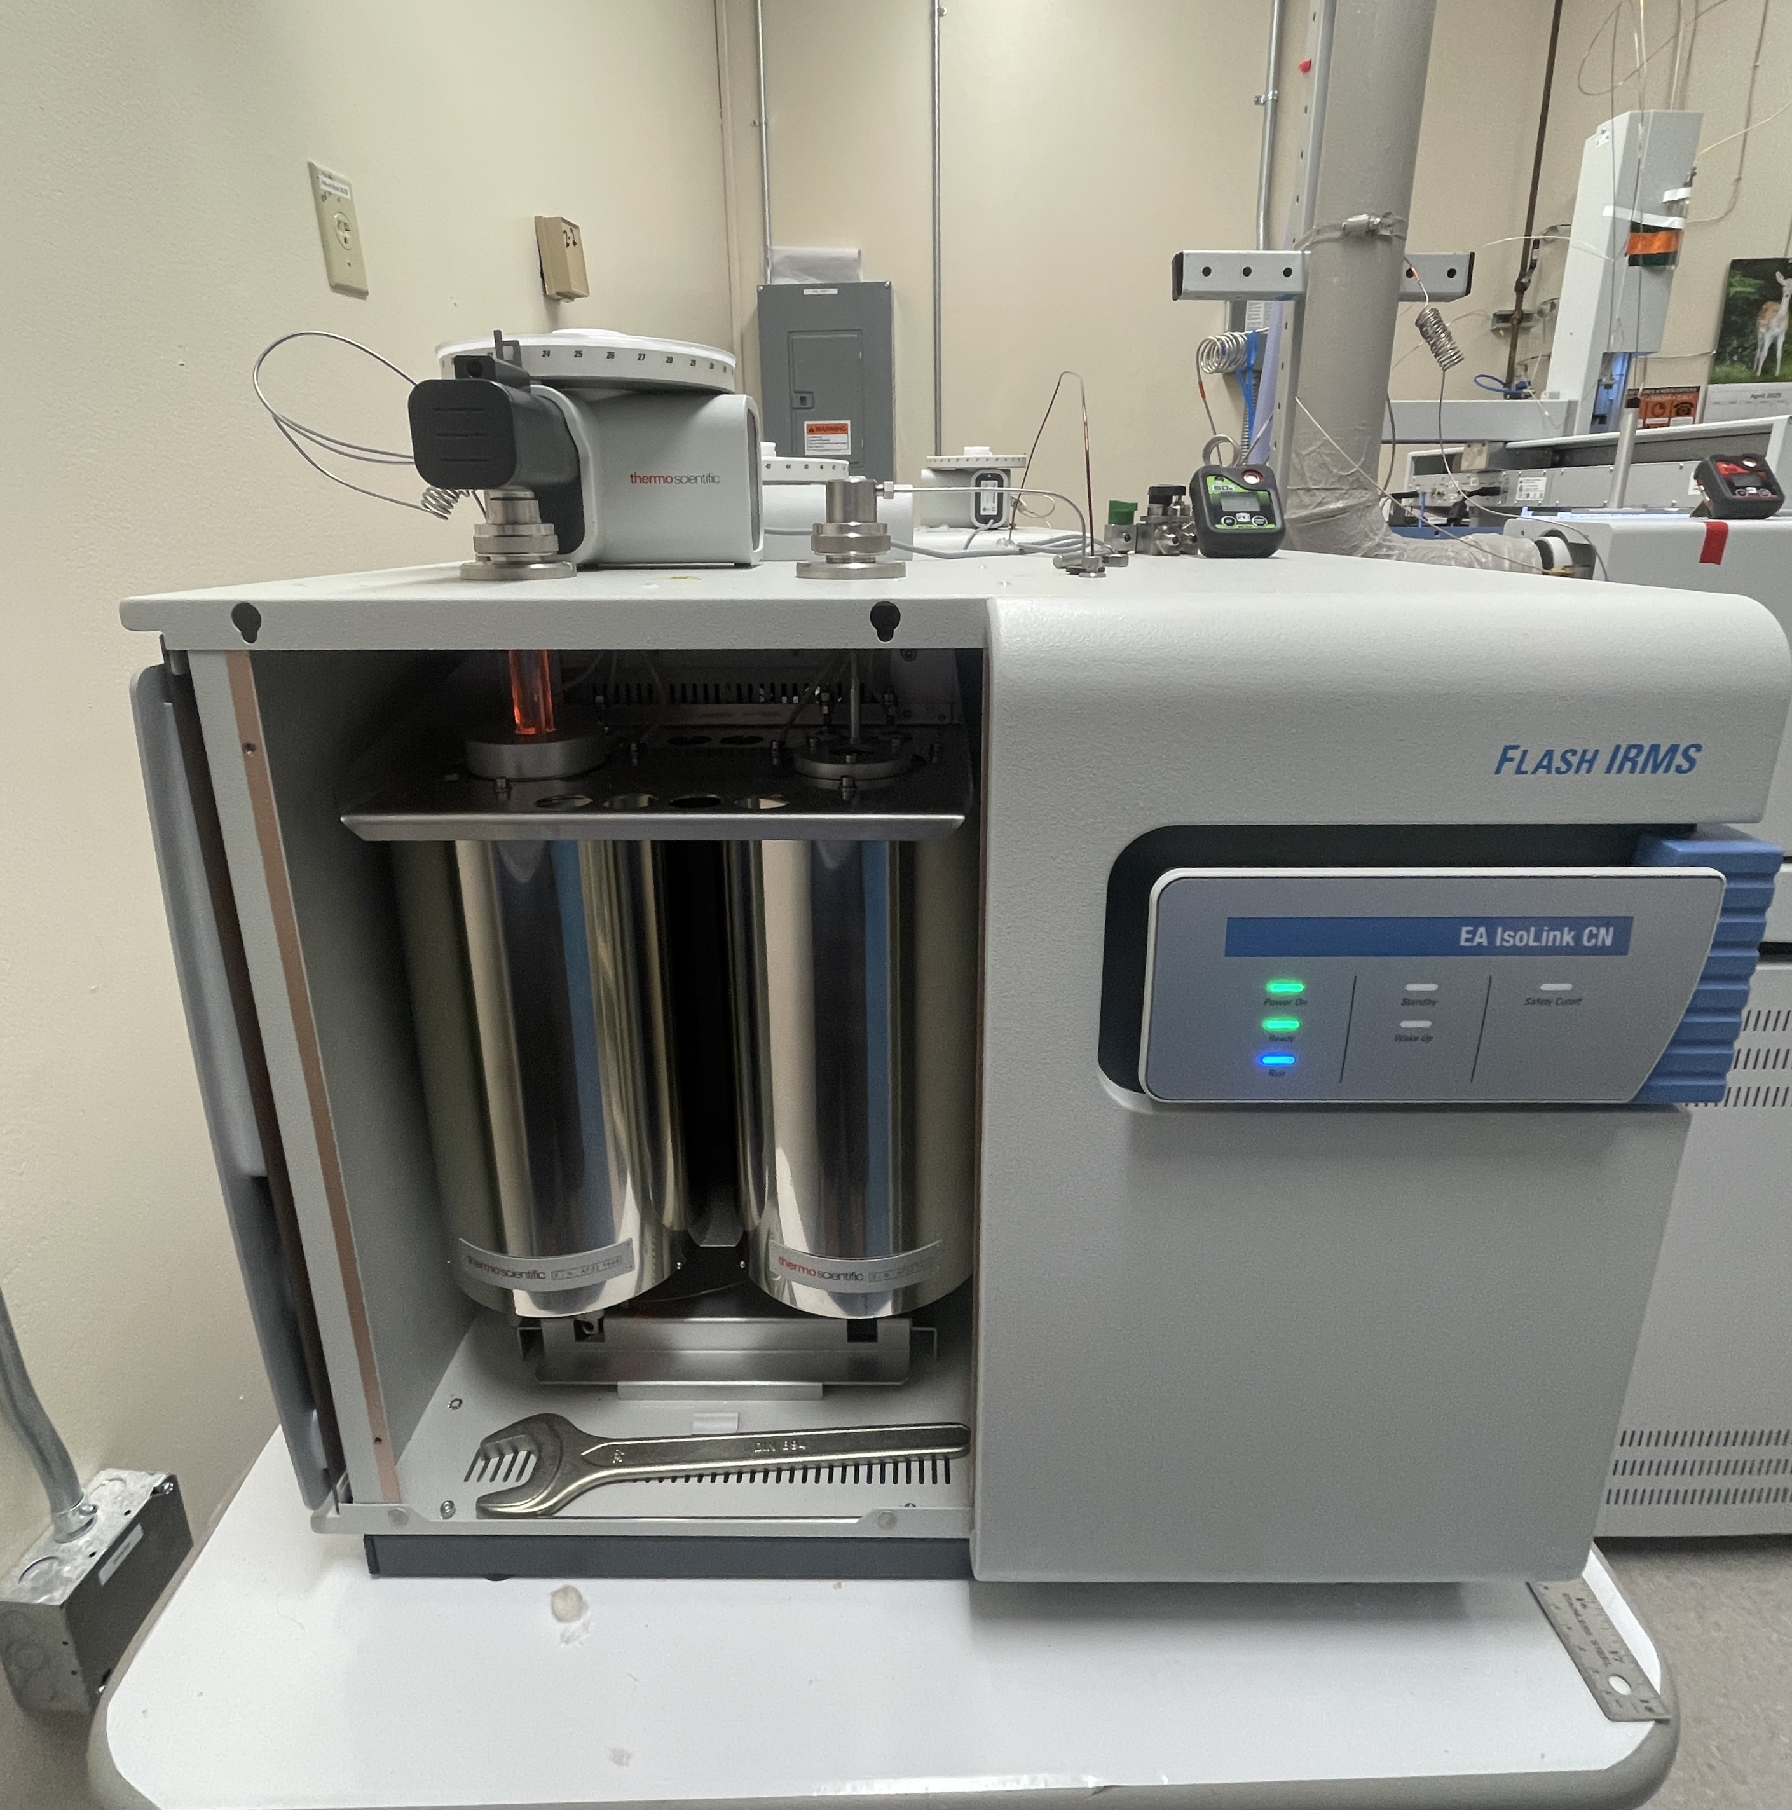
Muscle, Diet, and the Assimilation Factor
Sam et al., 2025
Diet (n = 10)
Mean δ¹³C_{DIET} value: -16.2 ‰
Muscle (n = 6)
Mean δ¹³C_{muscle} value: -15.2 ‰
Assimilation Factor:
-15.2 – (-16.2) = +1.0 ‰
CO₂ Hydration/Hydroxylation
(Romanek et al., 1992)
δ¹³C_{HCO3-DIET} = -15.2 + 9.0 = -6.2 ‰
Thermo Scientific EA Isolink CNS + DELTA Q Isotope Ratio Mass Spectrometer (IRMS)
Notes:
Next, to measure the d13C values of muscle, squid, and shrimp samples we used Thermo Scientific’s EA Isolink CNS + DELTAQ. This machine also is able to measure d15N and d34S values. On the right I’m showing you the d13C values of the shrimp, squid, and fish muscle. We also calculated that the fish were eating a 50:50 mix of squid and shrimp, and the d13C values for that are shown in green. The mean d13C value of the 50:50 mix was -16.2 ‰ and that of the muscle was about -15.2‰. The difference between those gave the assimilation factor of +1.0‰ which was just what we expected based on assimilation factors measured across other species and animals. Next, to model the through the hydration and hydroxylation of CO2 to bicarbonate, we added 9 ‰ to the muscle d13C value to get -6.2‰.
Hydration/hydroxylation is how CO2 is converted to bicarbonate

Slide 15
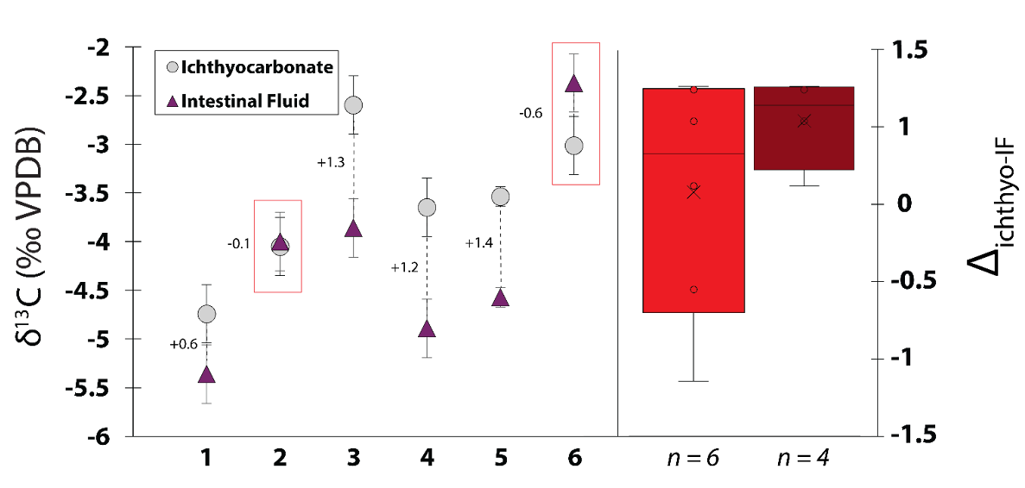
Intestinal Fluid and Ichthyocarbonate δ¹³C values
Sam et al., 2025
Ichthyocarbonate & IF (n = 6):
Mean δ¹³C_{ichthyo} value: -3.6 ‰
Mean δ¹³C_{IF} value: -4.2 ‰
Fractionation Factor (Δ_{ichthyo-IF}):
Δ_{ichthyo-IF} = -3.6 – (-4.2) = +0.6 ‰ (±0.3 S.E.)
Excluding anomalous pairs:
Δ_{ichthyo-IF} = +1.1 ‰ (±0.2 S.E.)
Notes:
Here I’m showing you the d13C values of paired samples of ichthyocarbonate and intestinal fluid dissected from 6 toadfish, with the ichthyocarbonate as the gray circles and the intestinal fluid as the purple triangles. The average d13C value of the ichthyocarbonate was -3.6 ‰ and that of the intestinal fluid was -4.2‰. Taking the difference between the d13C values of each pair gives the mineralogical fractionation factor, which is shown next to each pair. The average of these 6 samples was +0.6‰ shown in bright red, however there were two anomalous values that were negative, outlined in red. we expect the value of the fractionation factor to be positive as that’s what is exhibited across all carbonate minerals through precipitation, we excluded these two values and got an average fractionation factor of +1.1‰ shown in dark red.
Crossplot of mol%MgCO3 and fractionation factor

Slide 16
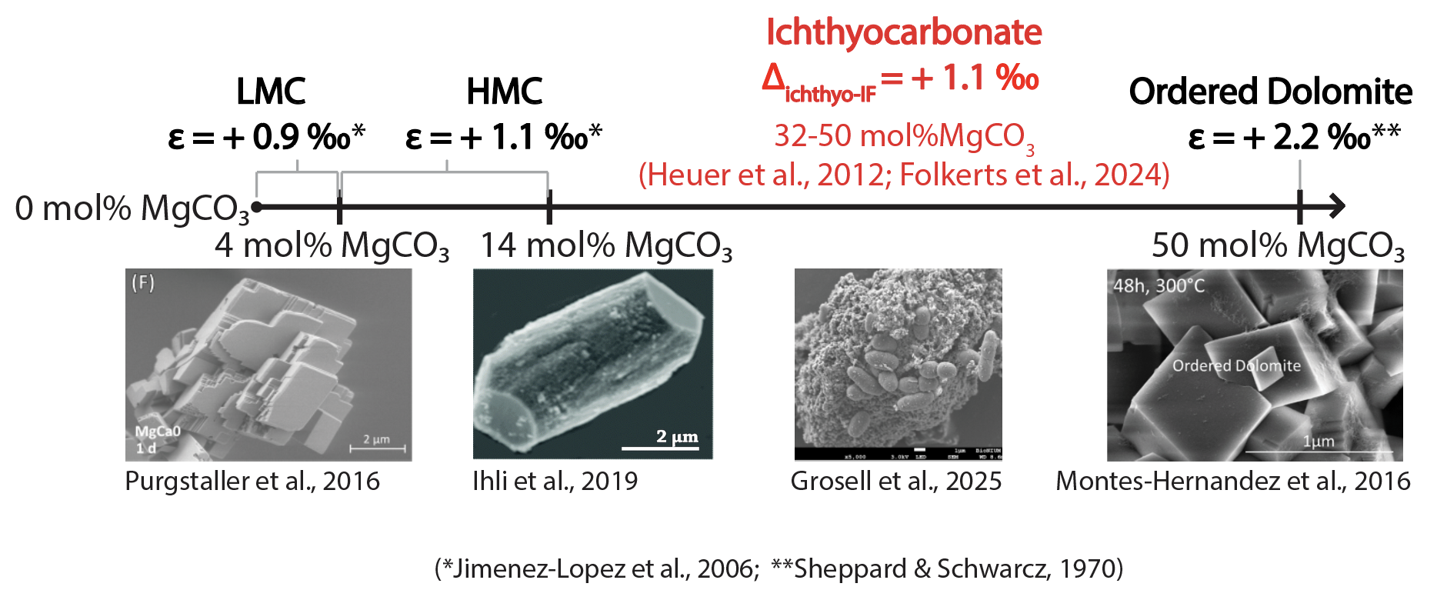
Intestinal Fluid and Ichthyocarbonate δ¹³C values
Sam et al., 2025
Ichthyocarbonate & IF (n = 6):
Mean δ¹³C_{ichthyo} value: -3.6 ‰
Mean δ¹³C_{IF} value: -4.2 ‰
Fractionation Factor (Δ_{ichthyo-IF}):
Δ_{ichthyo-IF} = -3.6 – (-4.2) = +0.6 ‰ (±0.3 S.E.)
Excluding anomalous pairs:
Δ_{ichthyo-IF} = +1.1 ‰ (±0.2 S.E.)
Notes:
And if you recall from the graph with the mol%MgCO3 values, a value of +1.1‰ for the fractionation factor of ichthyocarbonate does fall within the general range of expected values, but it’s still a little low, this may indicate other effects like kinetic factors influencing fractionation.

Slide 17
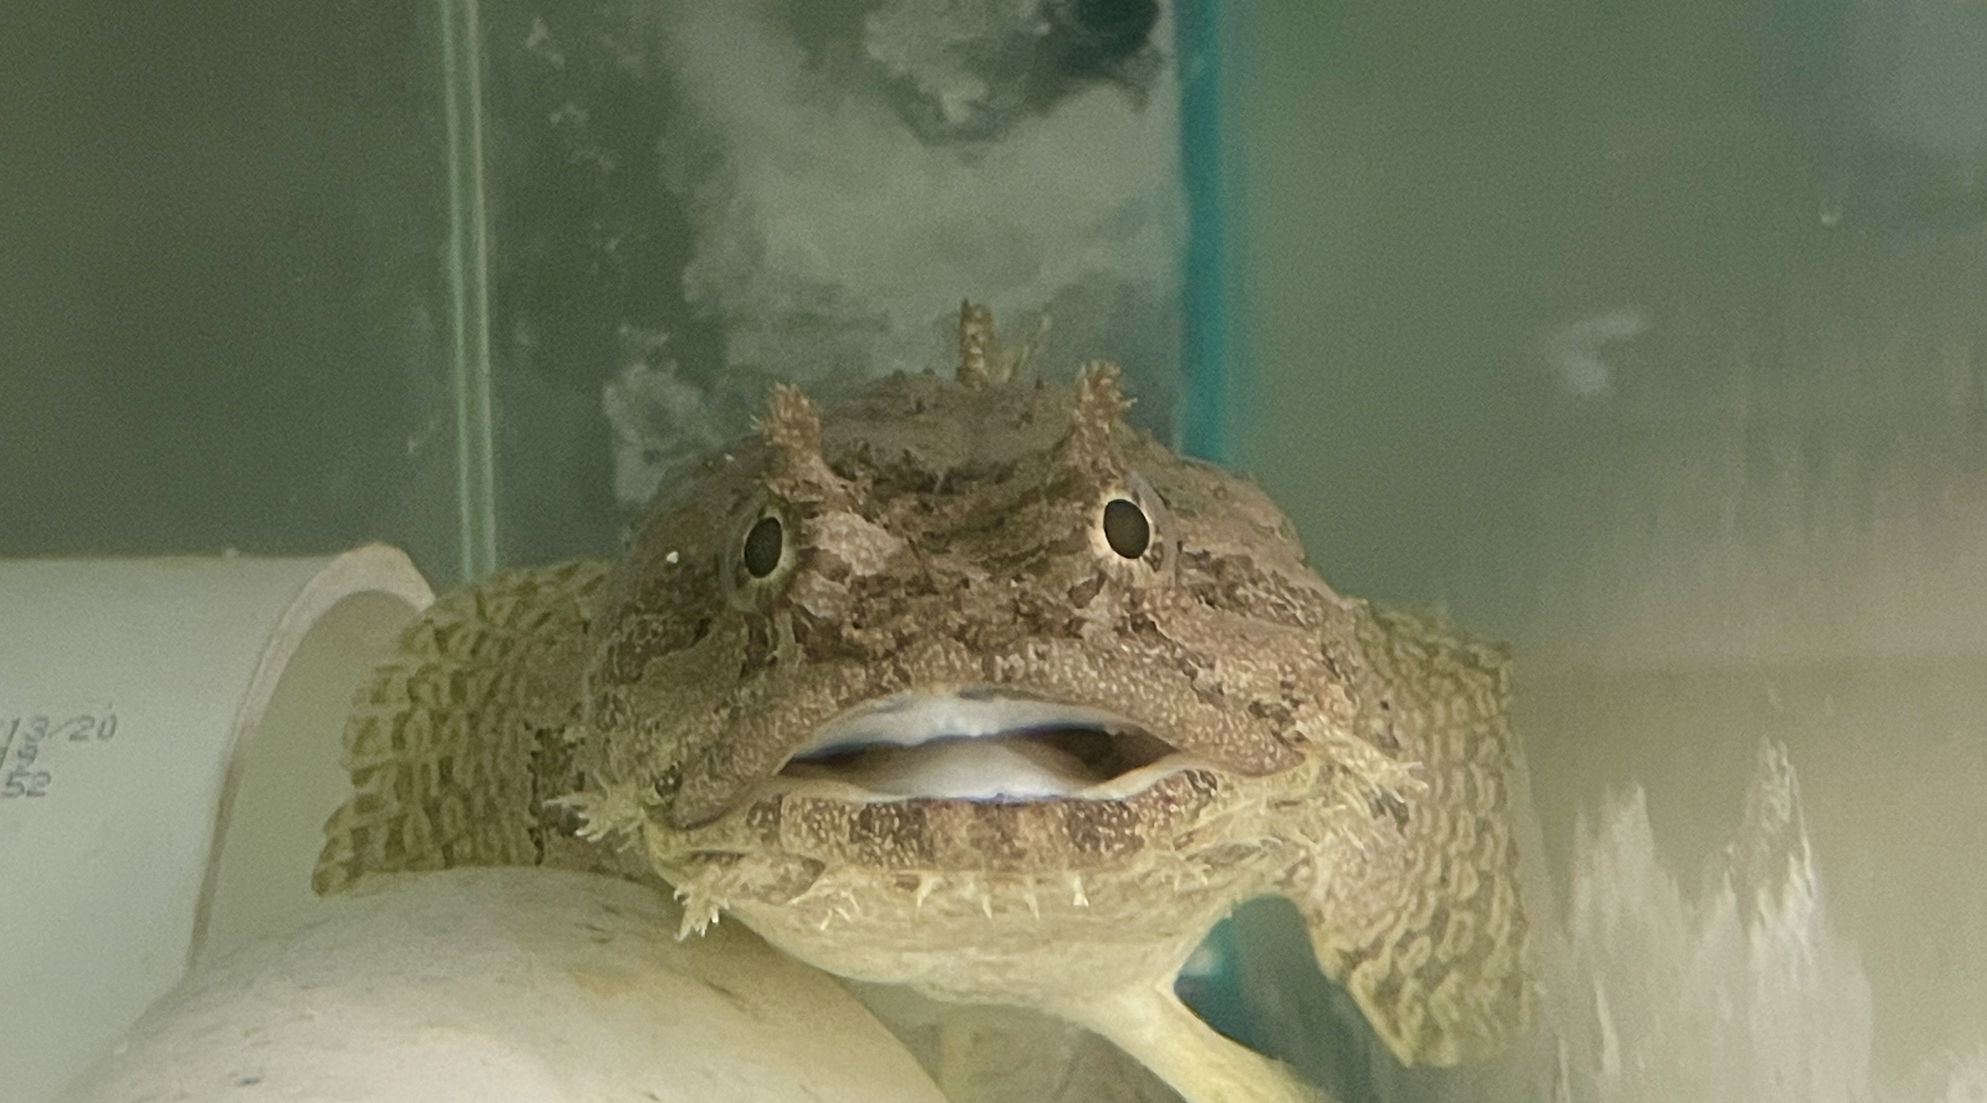
Estimating C_{DIET} and C_{DIC}
Sam et al., 2025
Δ_{ichthyo-IF} = +1.1 ‰
Mean δ¹³C_{DIC} value: -0.5 ‰
Assimilation Factor: +1.0 ‰
δ¹³C_{HCO3-DIET}: -6.2 ‰
Proportion of C
from each source
C_{DIET}: 65% (± 10% S.E.)
C_{DIC}: 35% (± 10% S.E.)
Future Projects?
Oehlert et al., 2024; Phillips & Gregg, 1991
Notes:
So next we took our value of +1.1 ‰ for the mineralogical fractionation factor, the d13C value for dissolved inorganic carbon in seawater of -0.5‰, and the assimilation factor of +1.0 ‰ and we used a stable carbon isotope ratio mixing model to estimate the proportions of C derived from dietary and dissolved inorganic carbon sources. This gave us 65% for CDiet and 35% for CDIC. While this value for CDiet is smaller than the 90-95% range expected by physiological mass balance, there may be additional factors involved in the fractionation of ichthyocarbonate precipitation, or that dietary carbon may be unevenly partitioned between ichthyocarbonate and HCO3 in intestinal fluid. Either way, 65% is a really large value for CDiet and far exceeds anything seen in corals, foraminifera, and other marine calcifiers. This really emphasizes how unique marine fish are as links between the marine biological and carbonate pumps.
So looking to the future, next steps would be to build out this dataset and add some replicates and then try to estimate CDiet in fish of other species and lifestyles, like the reef-swimming sergeant major and the deep sea blackbelly rosefish.

Slide 18
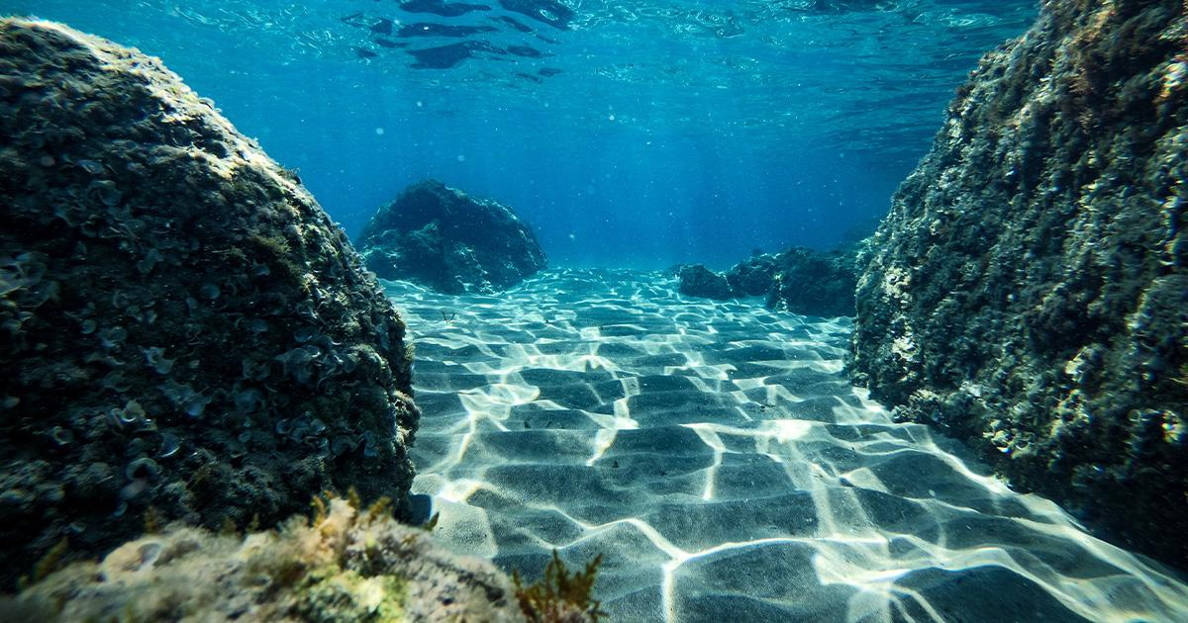
Summary
Sam et al., 2025
Majority of carbon in ichthyocarbonate is derived from the marine food web
Ichthyocarbonate precipitation has unexpected impacts on seawater carbonate chemistry
Sinking ichthyocarbonate likely sequesters carbon in the deep ocean and potentially in marine sediments
Notes:
So to wrap things up, the key points I touched on was that the majority of carbon in ichthyocarbonate is derived from the marine food web. More specifically, we estimated that 65% of the carbon came from the fish's diet. Additionally, ichthyocarbonate precipitation has unexpected impacts on seawater carbonate chemistry through the conversion of biological carbon into inorganic carbonate. And lastly, sinking ichthyocarbonate likely sequesters carbon in the deep ocean through dissolution and release of HCO3, and potentially in marine sediments for thousands to millions of years.
With this data, we are now more confident in saying that marine bony fish play a very substantial and underrecognized role as a link between the marine biological and carbonate pumps. This is a major advance in bettering our understanding of how ichthyocarbonate production may have unexpected impacts on carbon fluxes in the shallow and deep oceans. While there are still many unknowns regarding ichthyocarbonate production and fate, there are a lot of opportunities for research here with some fascinating implications for the carbon cycle.

Slide 19

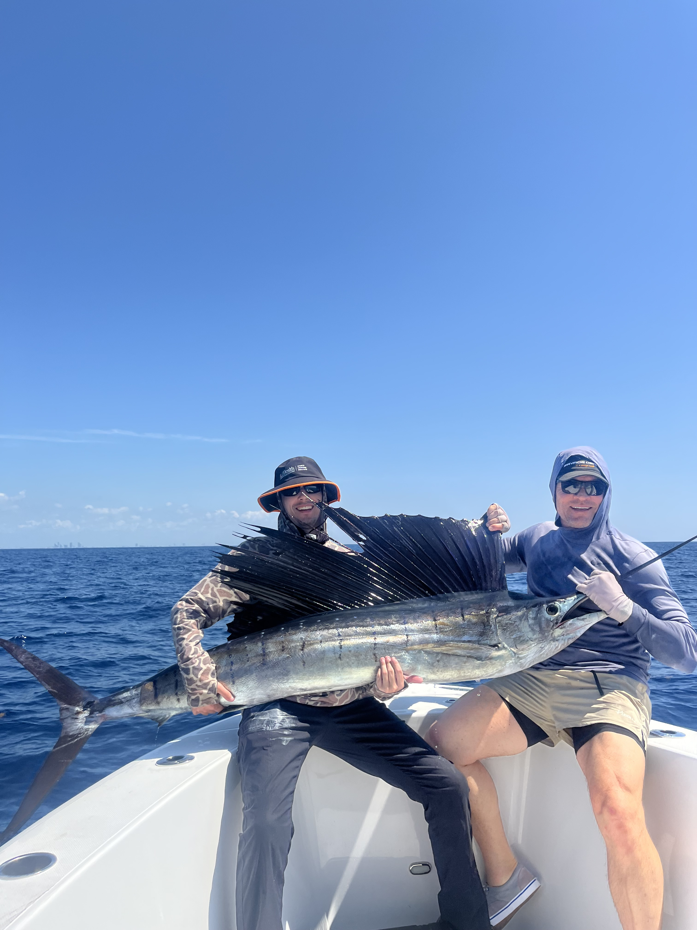
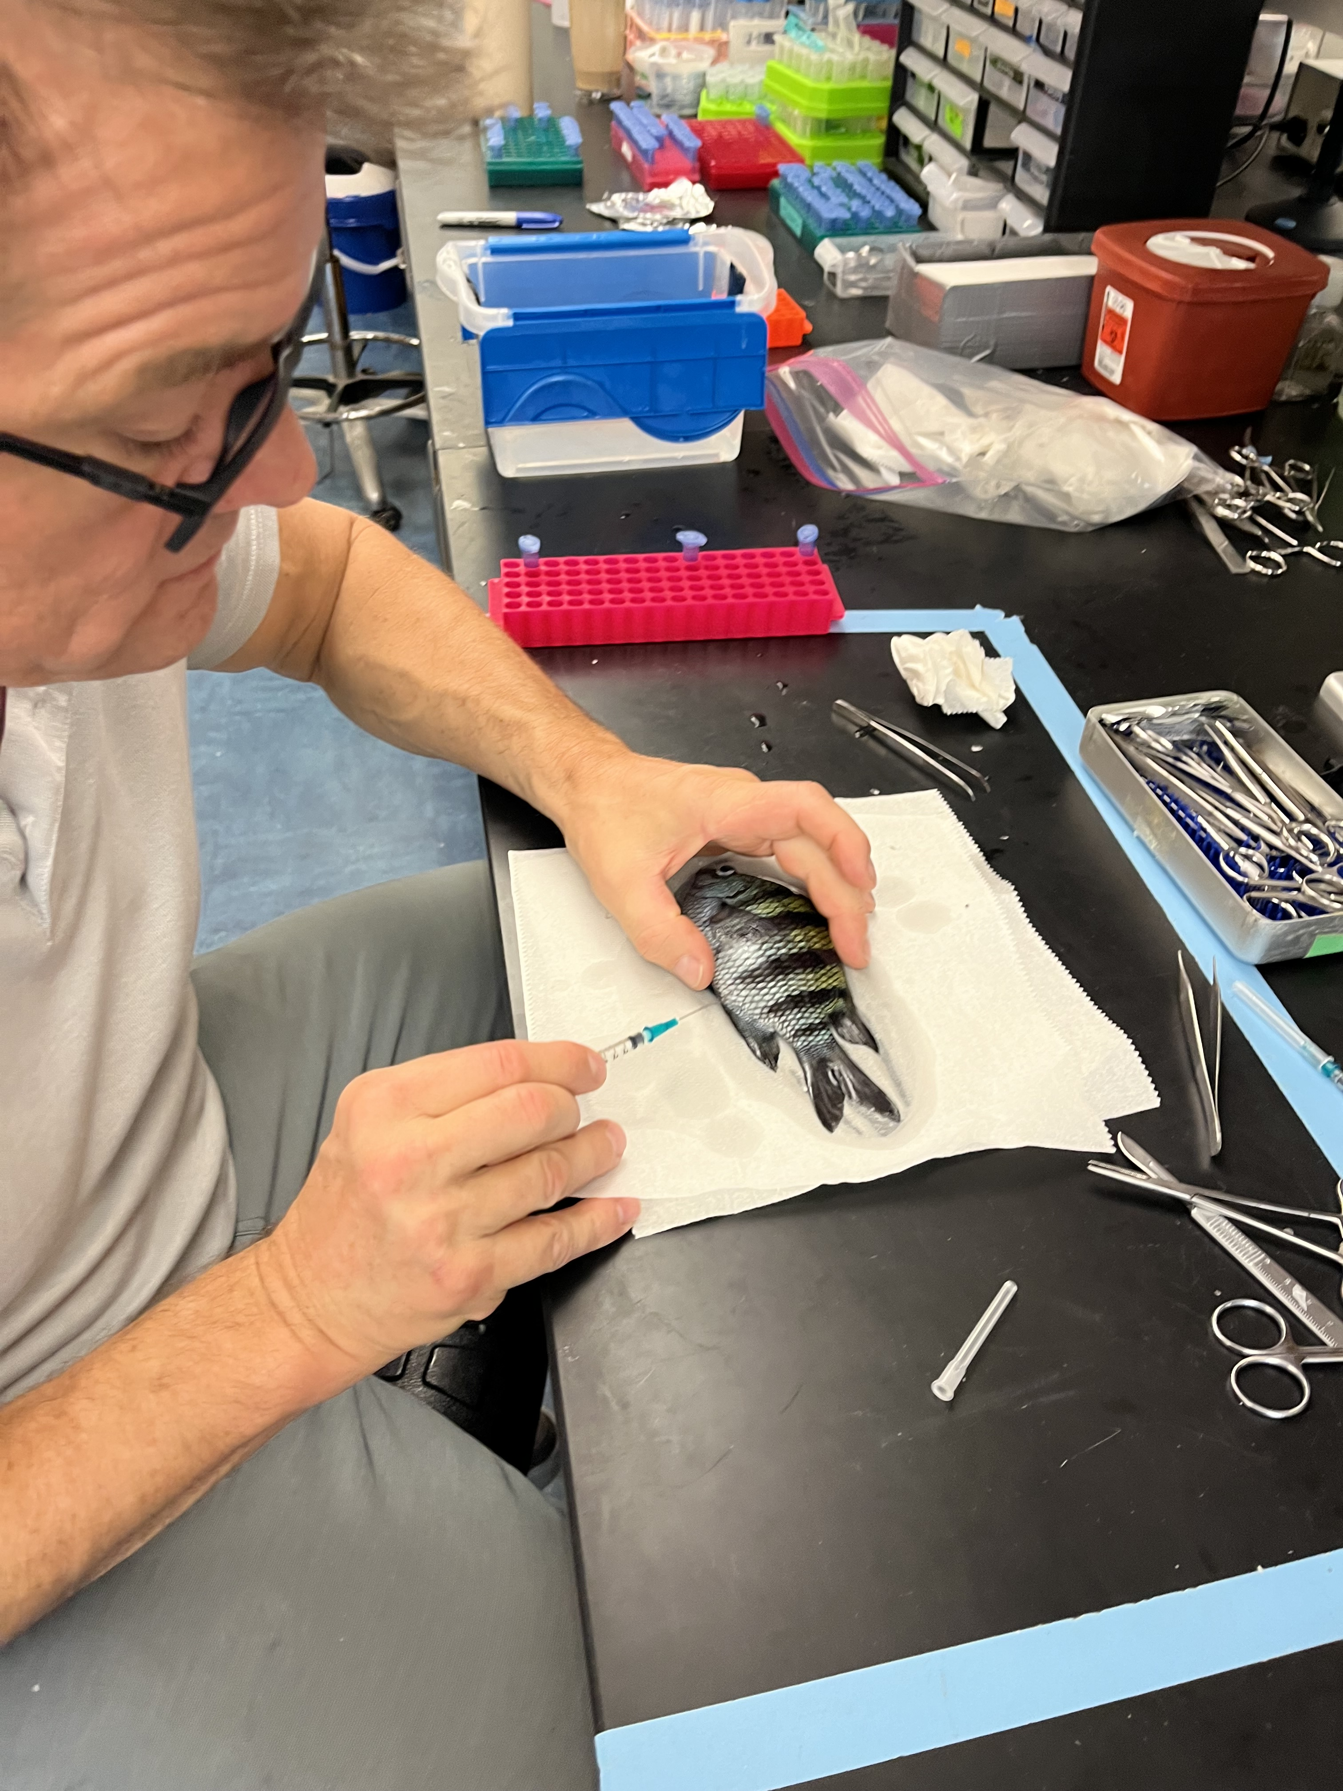
Thank You
Sam et al., 2025
Acknowledgements:
Peter Swart
Amel Saied
Funding Provided by:
NSF’s Chemical Oceanography Grant
NSF-OCE-2319245

