Slide 1
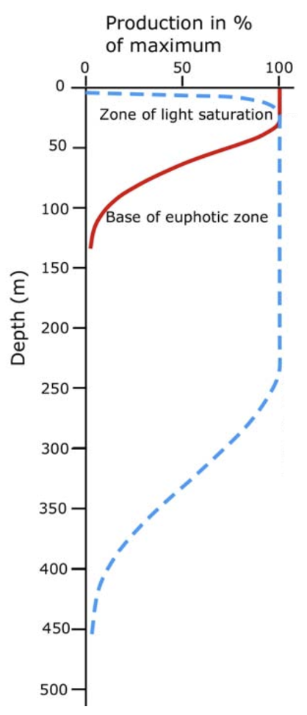
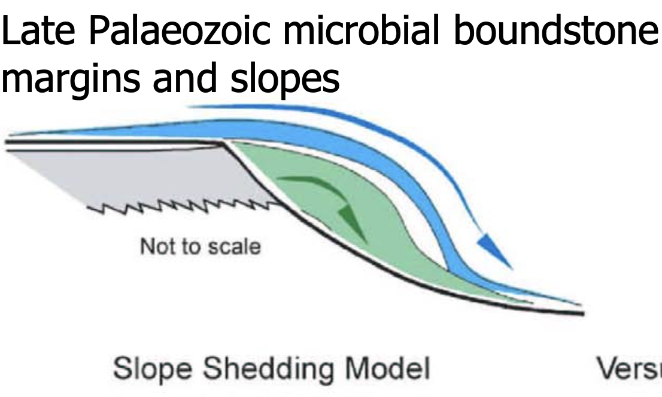
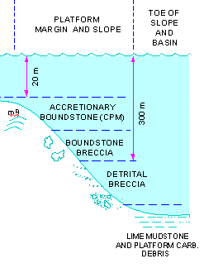

Steep Microbial Boundstone Margins –
Rethinking the Carbonate Factory-Depth Paradigm
Paul (Mitch) Harris
CSL – Center for Carbonate Research, University of Miami RSMAES

Slide 2
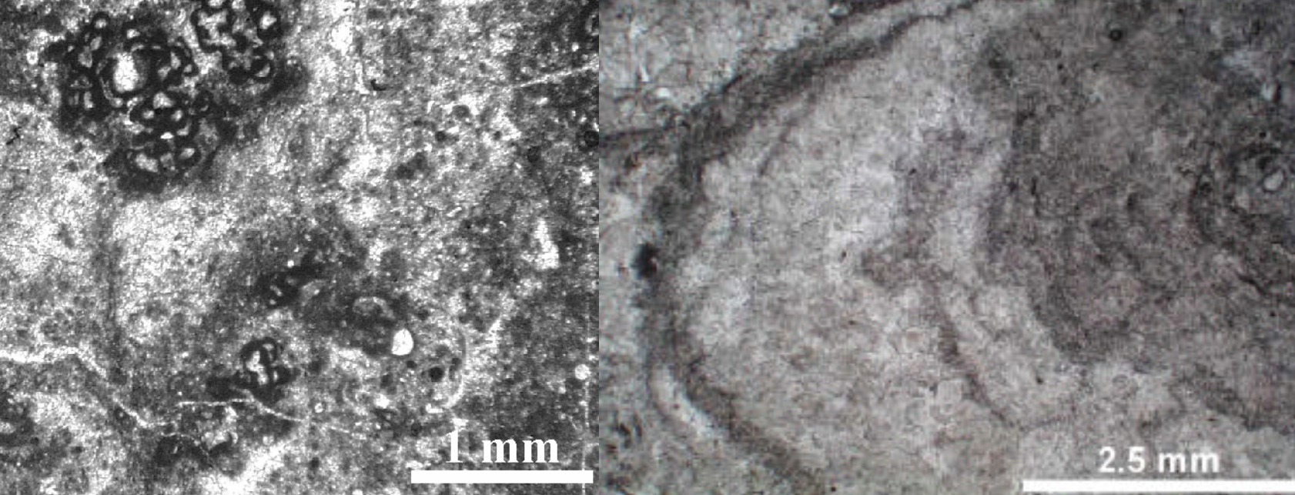

Key Points
Examples of a highly productive microbial boundstone factory extending significantly down the slope provide sedimentological insight and a depositional model to be used elsewhere.
When the dominant factory is microbially induced, high rates of carbonate production extend to dis/aphotic depths and new production-water depth profiles should be considered.
Harris, 2025

Slide 3
Rationale for Talk
CSL and Microbial Carbonates – A Long History
Bob Ginsburg – Peritidal laminates, sediment trapping and cementation of stromatolites in Bahamas
Pam Reid – Sediment trapping and cementation of stromatolites in Bahamas and Shark Bay; peloid precipitation in Belize and Shark Bay
Mara Diaz – Microbially-mediated cementation of peloids and grapestones, ooid formation, precipitation of marine cements
Differrent Direction
Gregor Eberli et al - “Microbial Cementation from the Shallow to the Deep”
Offshore Mozambique fringing reef that flourished during the last glacial maximum
Cemented slopes in the TOTO (Great Bahama Bank) and Gulf of Aqaba
Review of My Past Studies of Deeper Microbial Settings
Harris, 2025

Slide 4
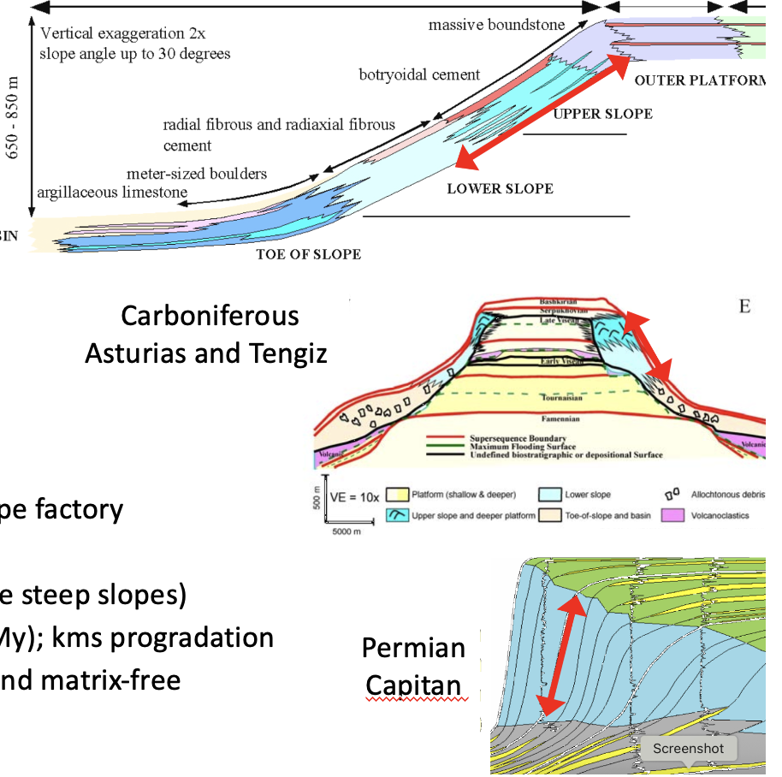
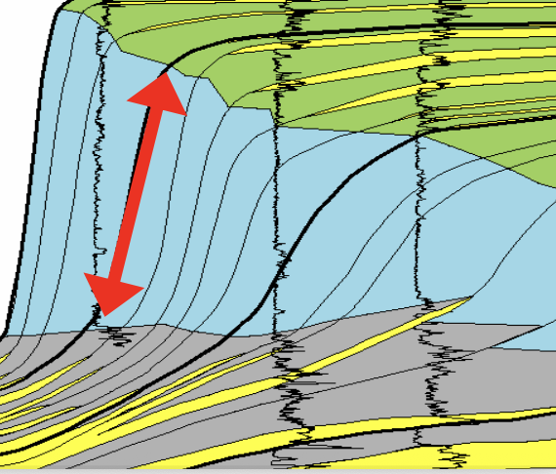
Outline of Talk
Rationale for talk
Subsurface example
Outcrop examples
Implications & Take-Aways
Harris, 2025

Slide 5
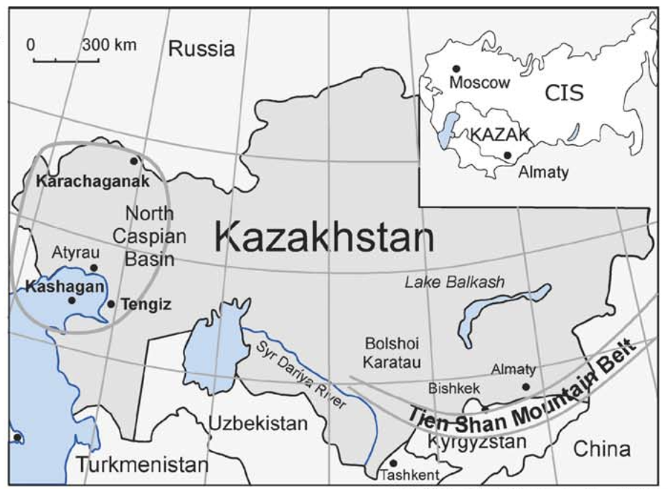
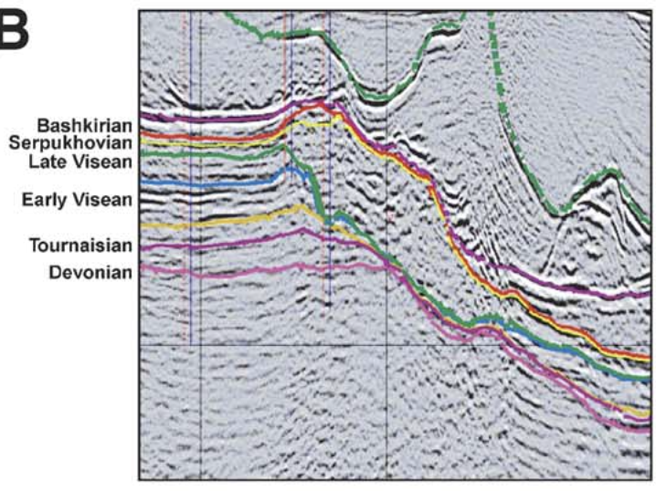
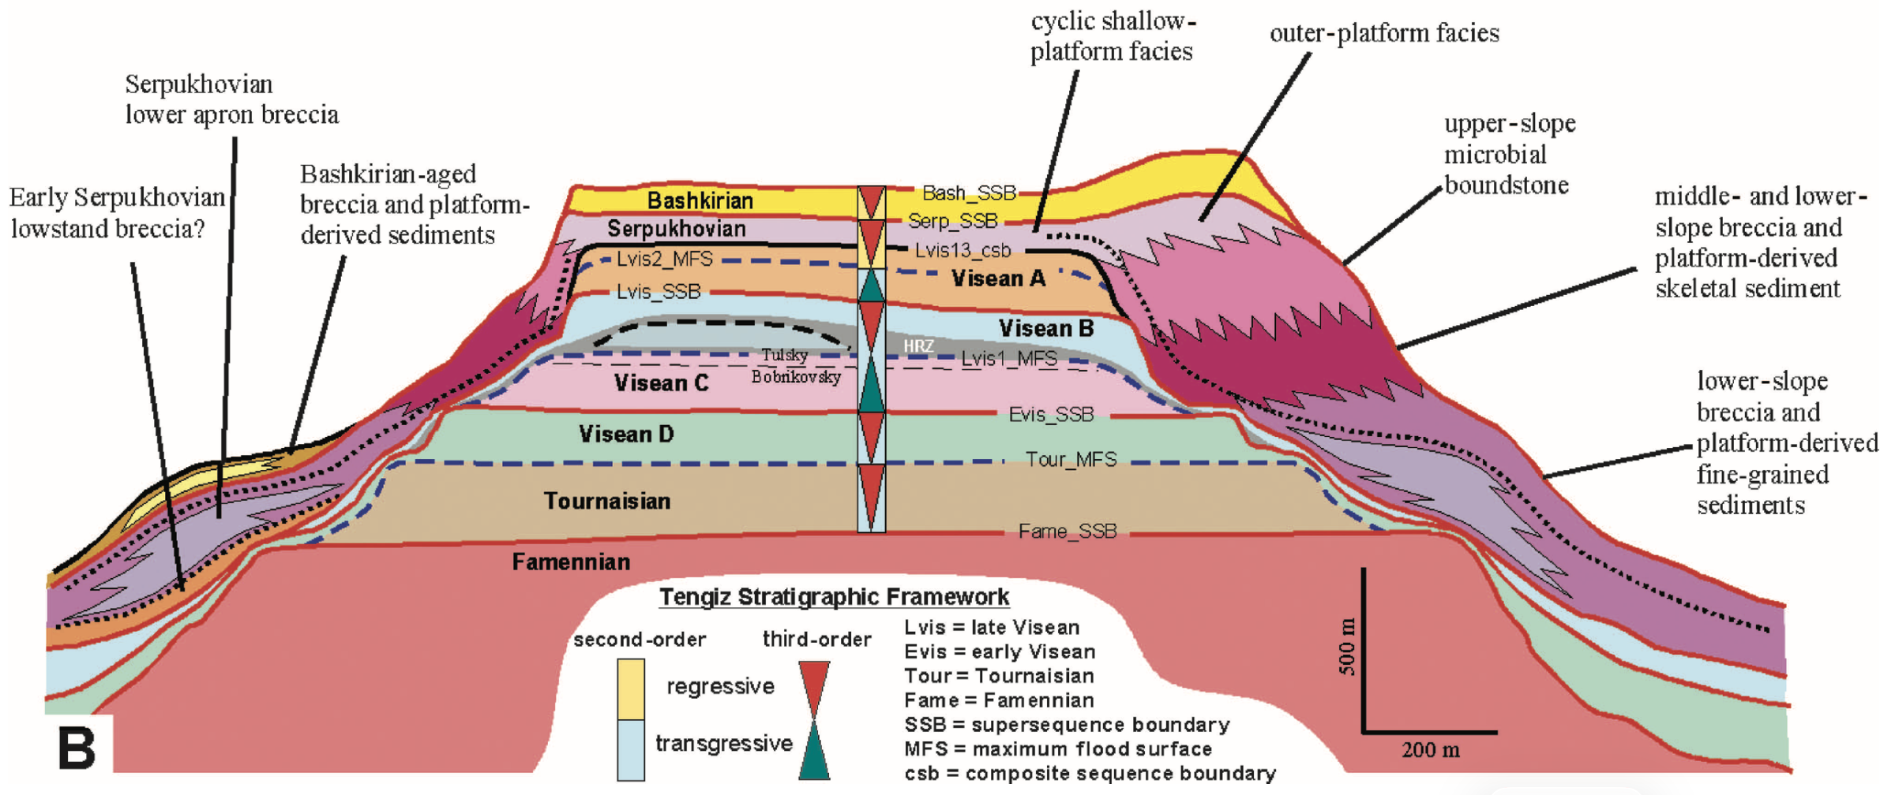
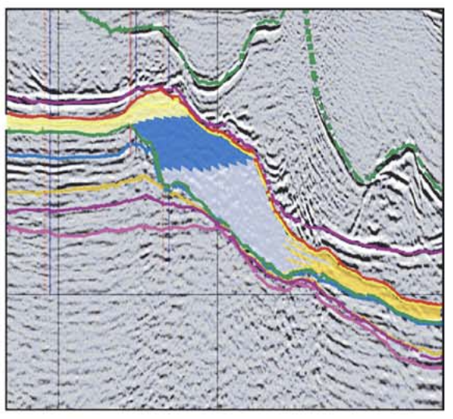
Tengiz
2000 m
Modified after Weber et al., 2003; Collins et al., 2006
Harris, 2025

Slide 6
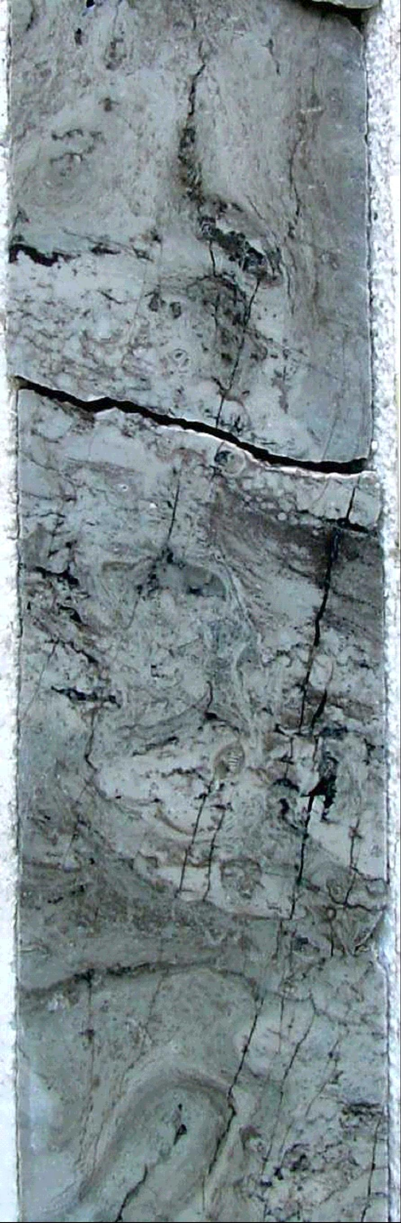
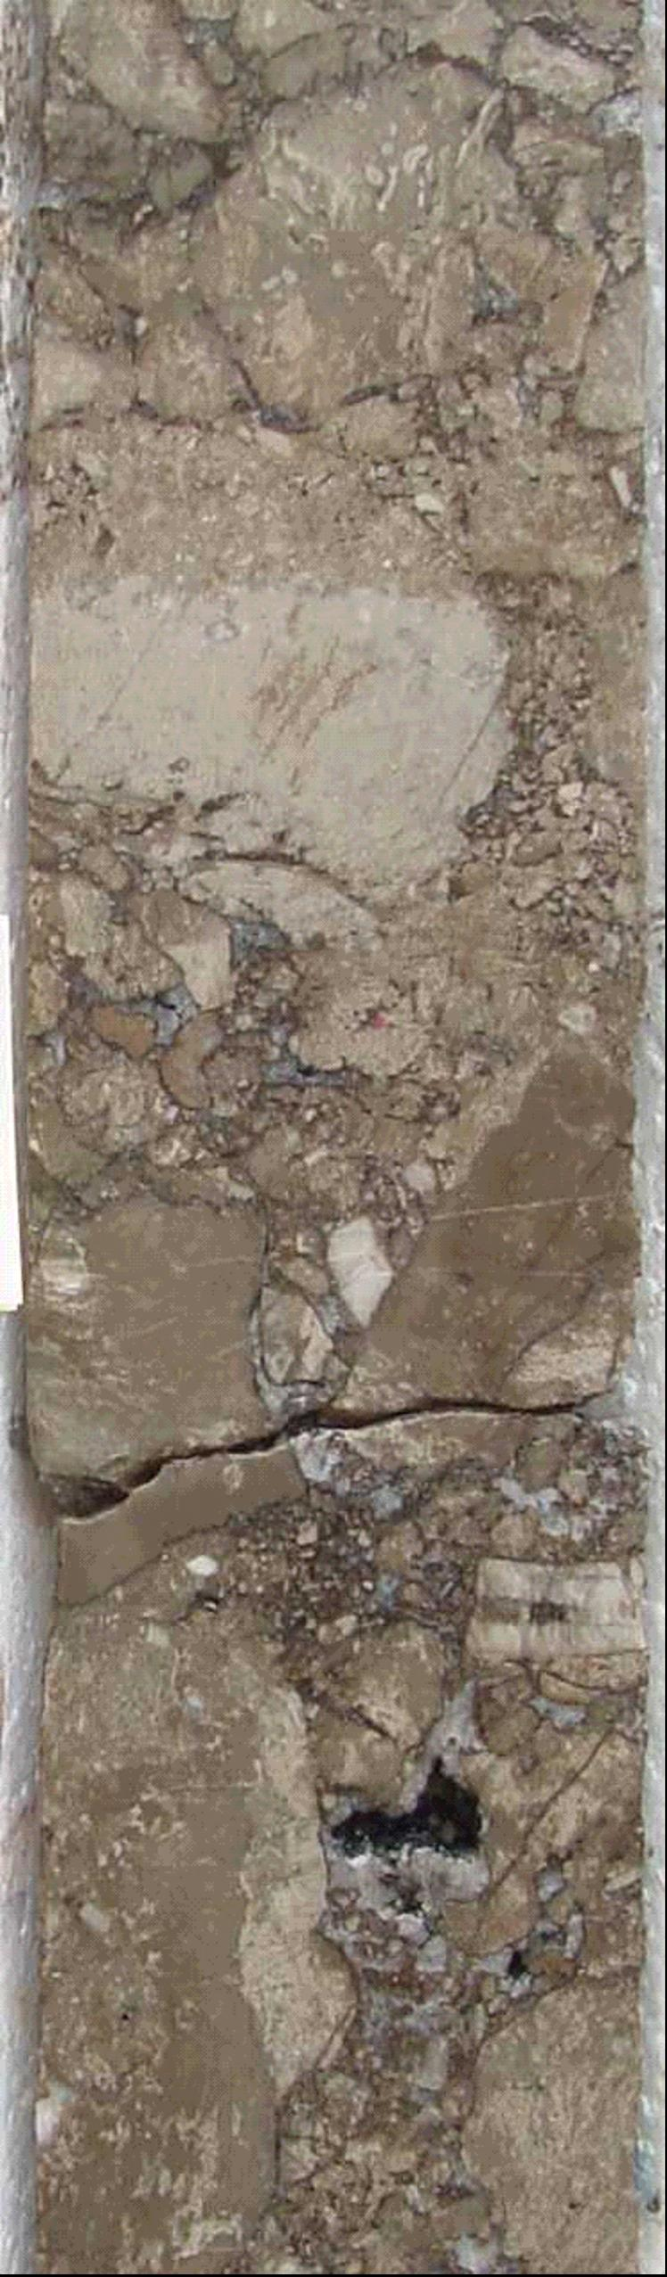
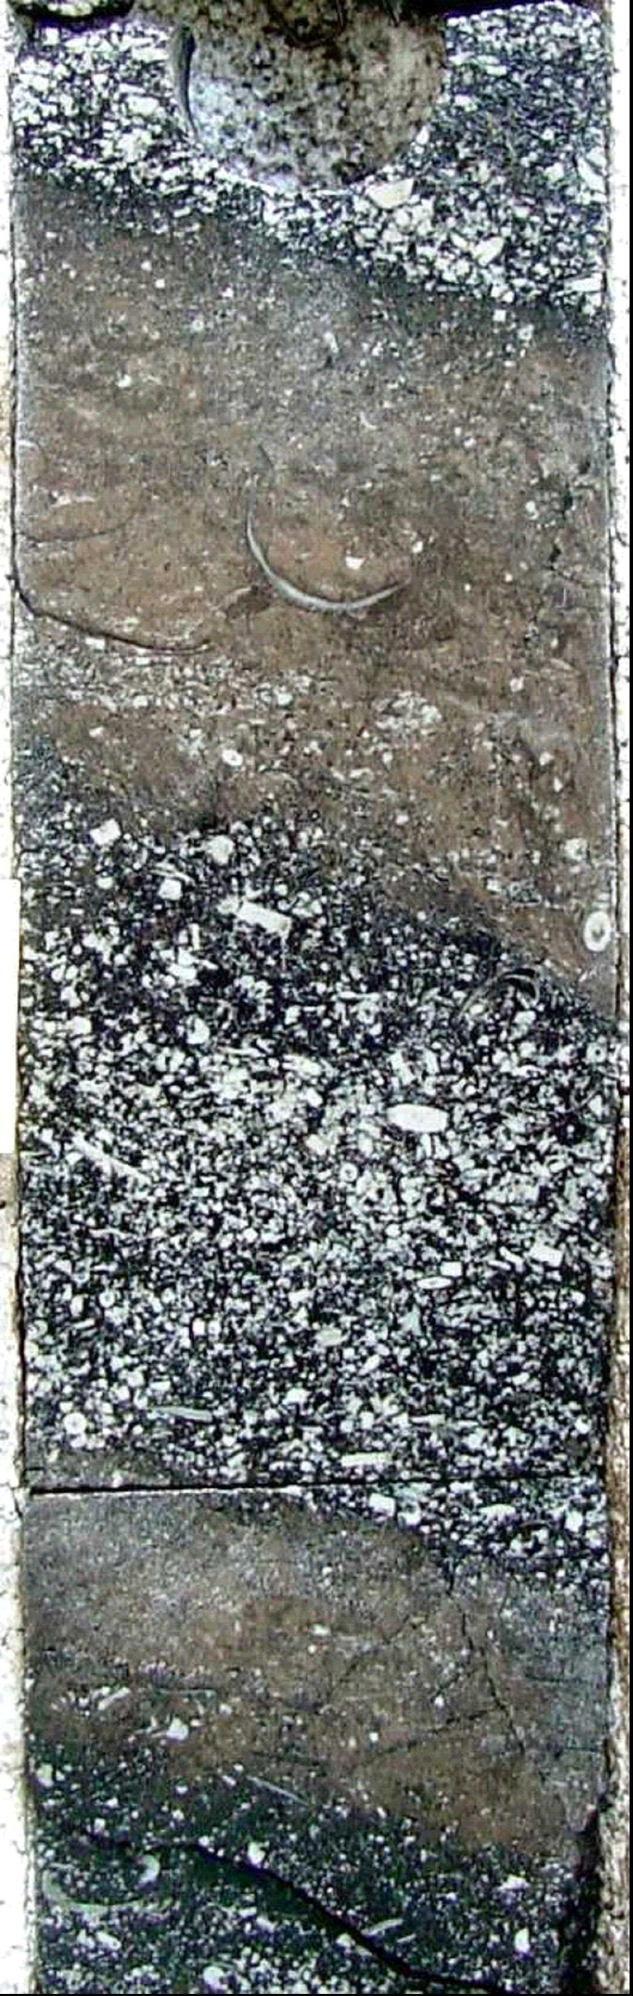
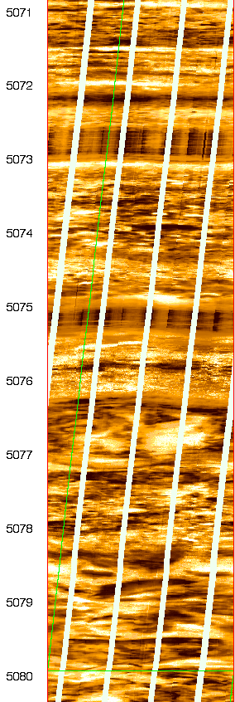
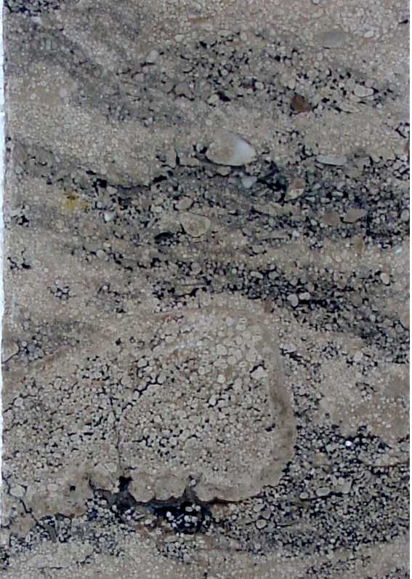
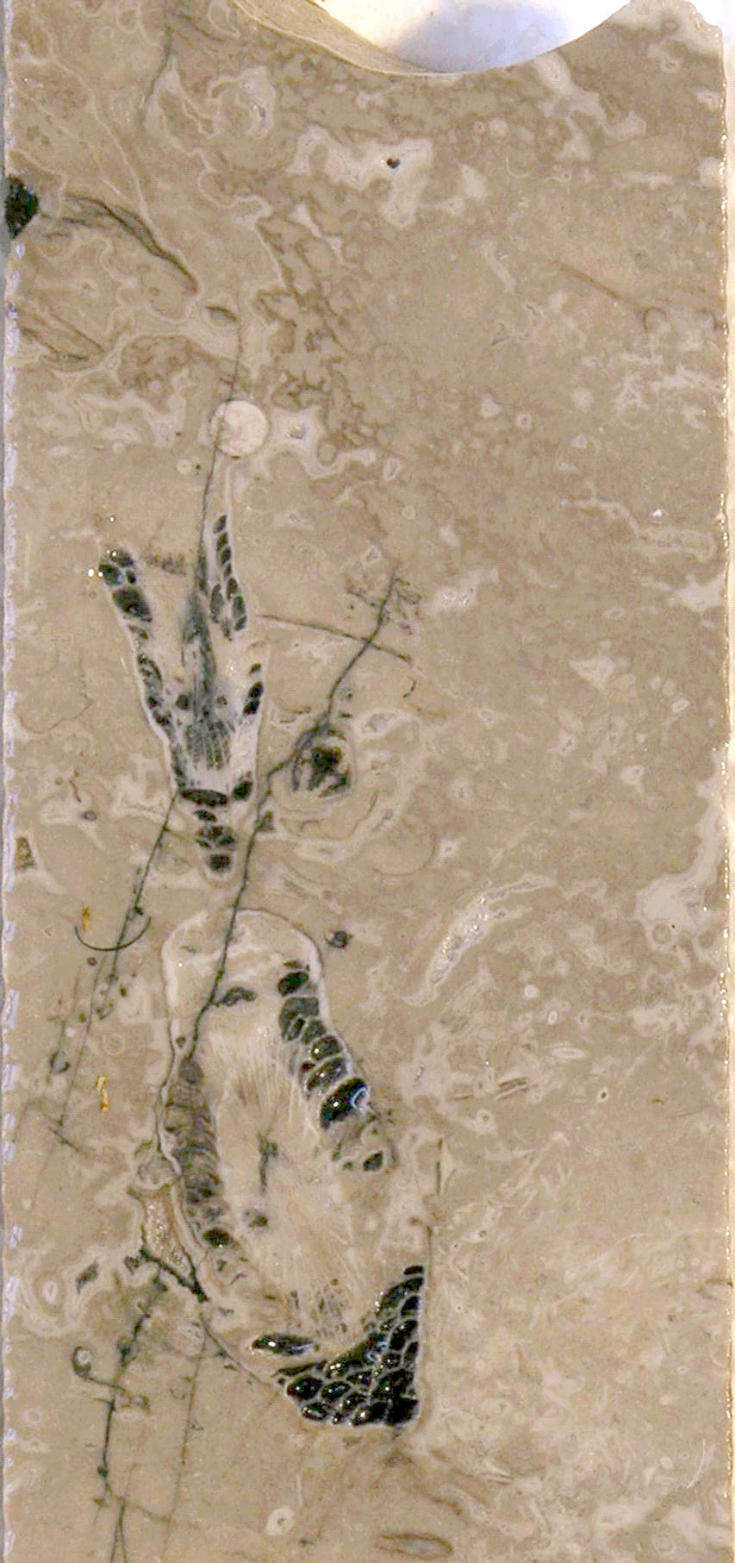
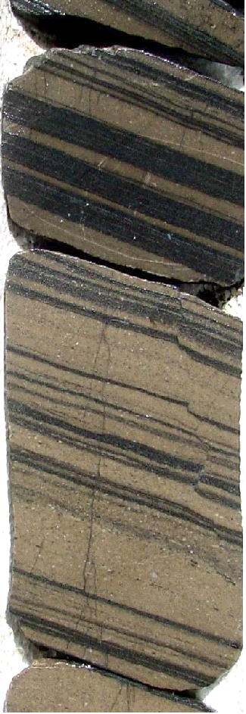
Dipping crinoid beds
Microbial
boundstone
Ooid – skeletal grainstone
Skeletal – microbial
boundstone
Massive
boundstone
breccia
Laminated
mudstone -
grainstone
Bedded
boundstone
breccia
Bash
Serp
outer platform
upper slope
middle slope
500 m.
lower slope
lower apron
Tengiz Rim and Slope Facies
Harris, 2025
Modified after Collin et al., 2006

Slide 7
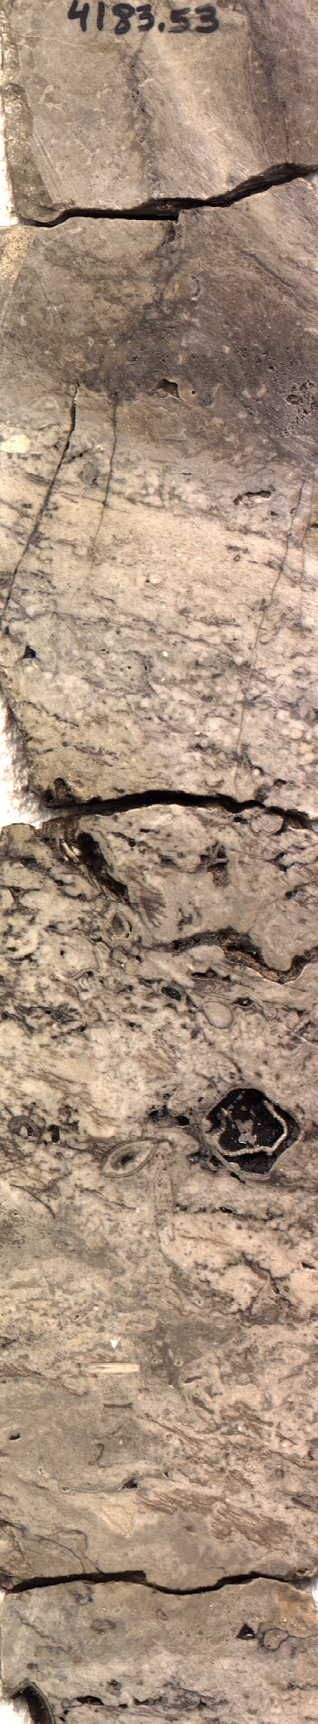
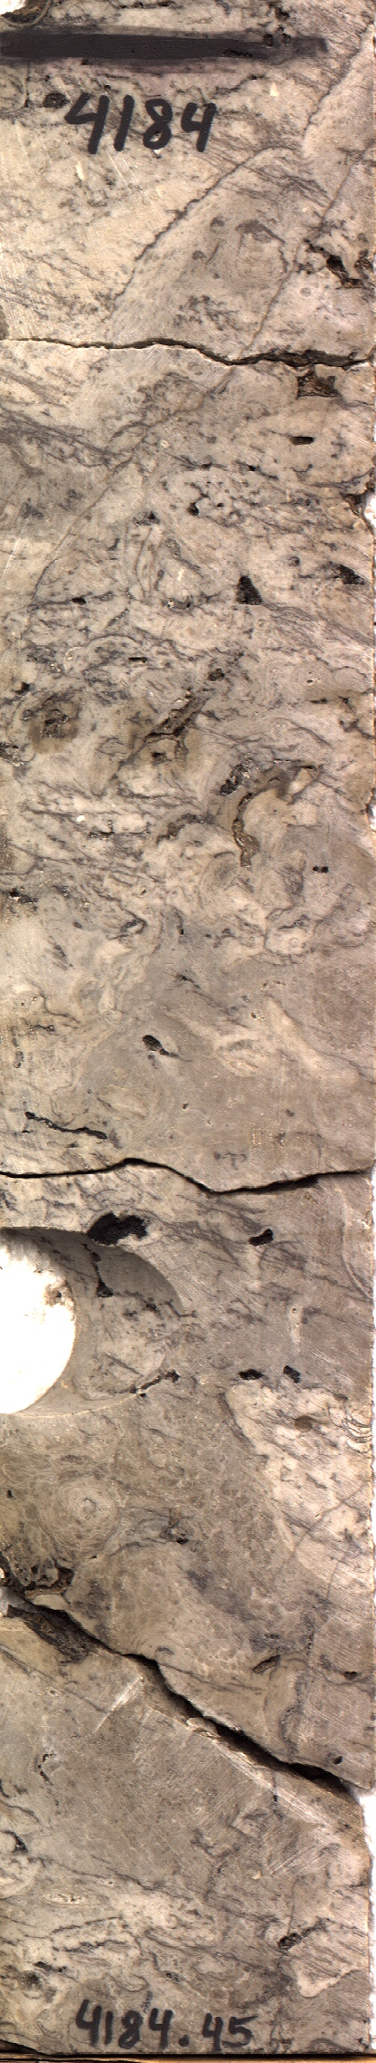
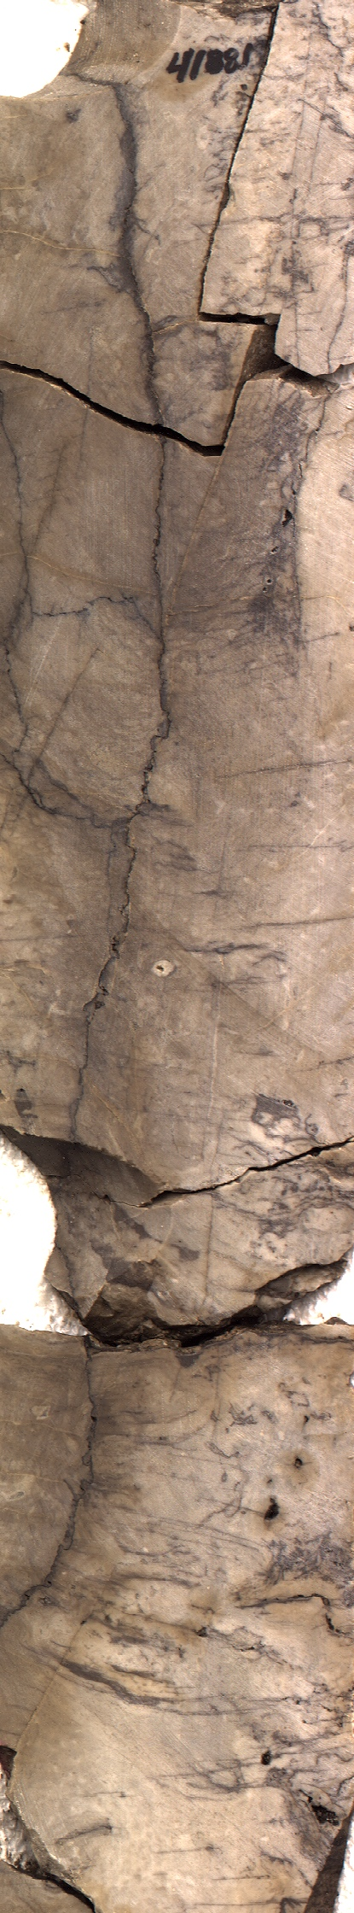
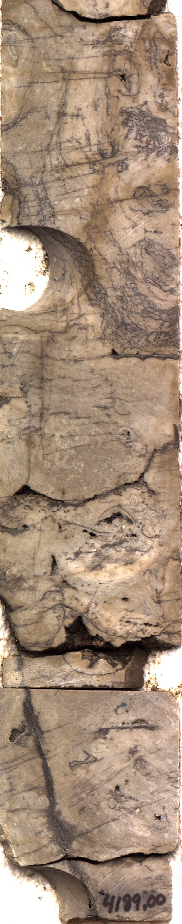
Tengiz Upper Slope Boundstone
Accretionary
crust
Laminated micritic
crust and marine
cement
Fractures
Harris, 2025

Slide 8
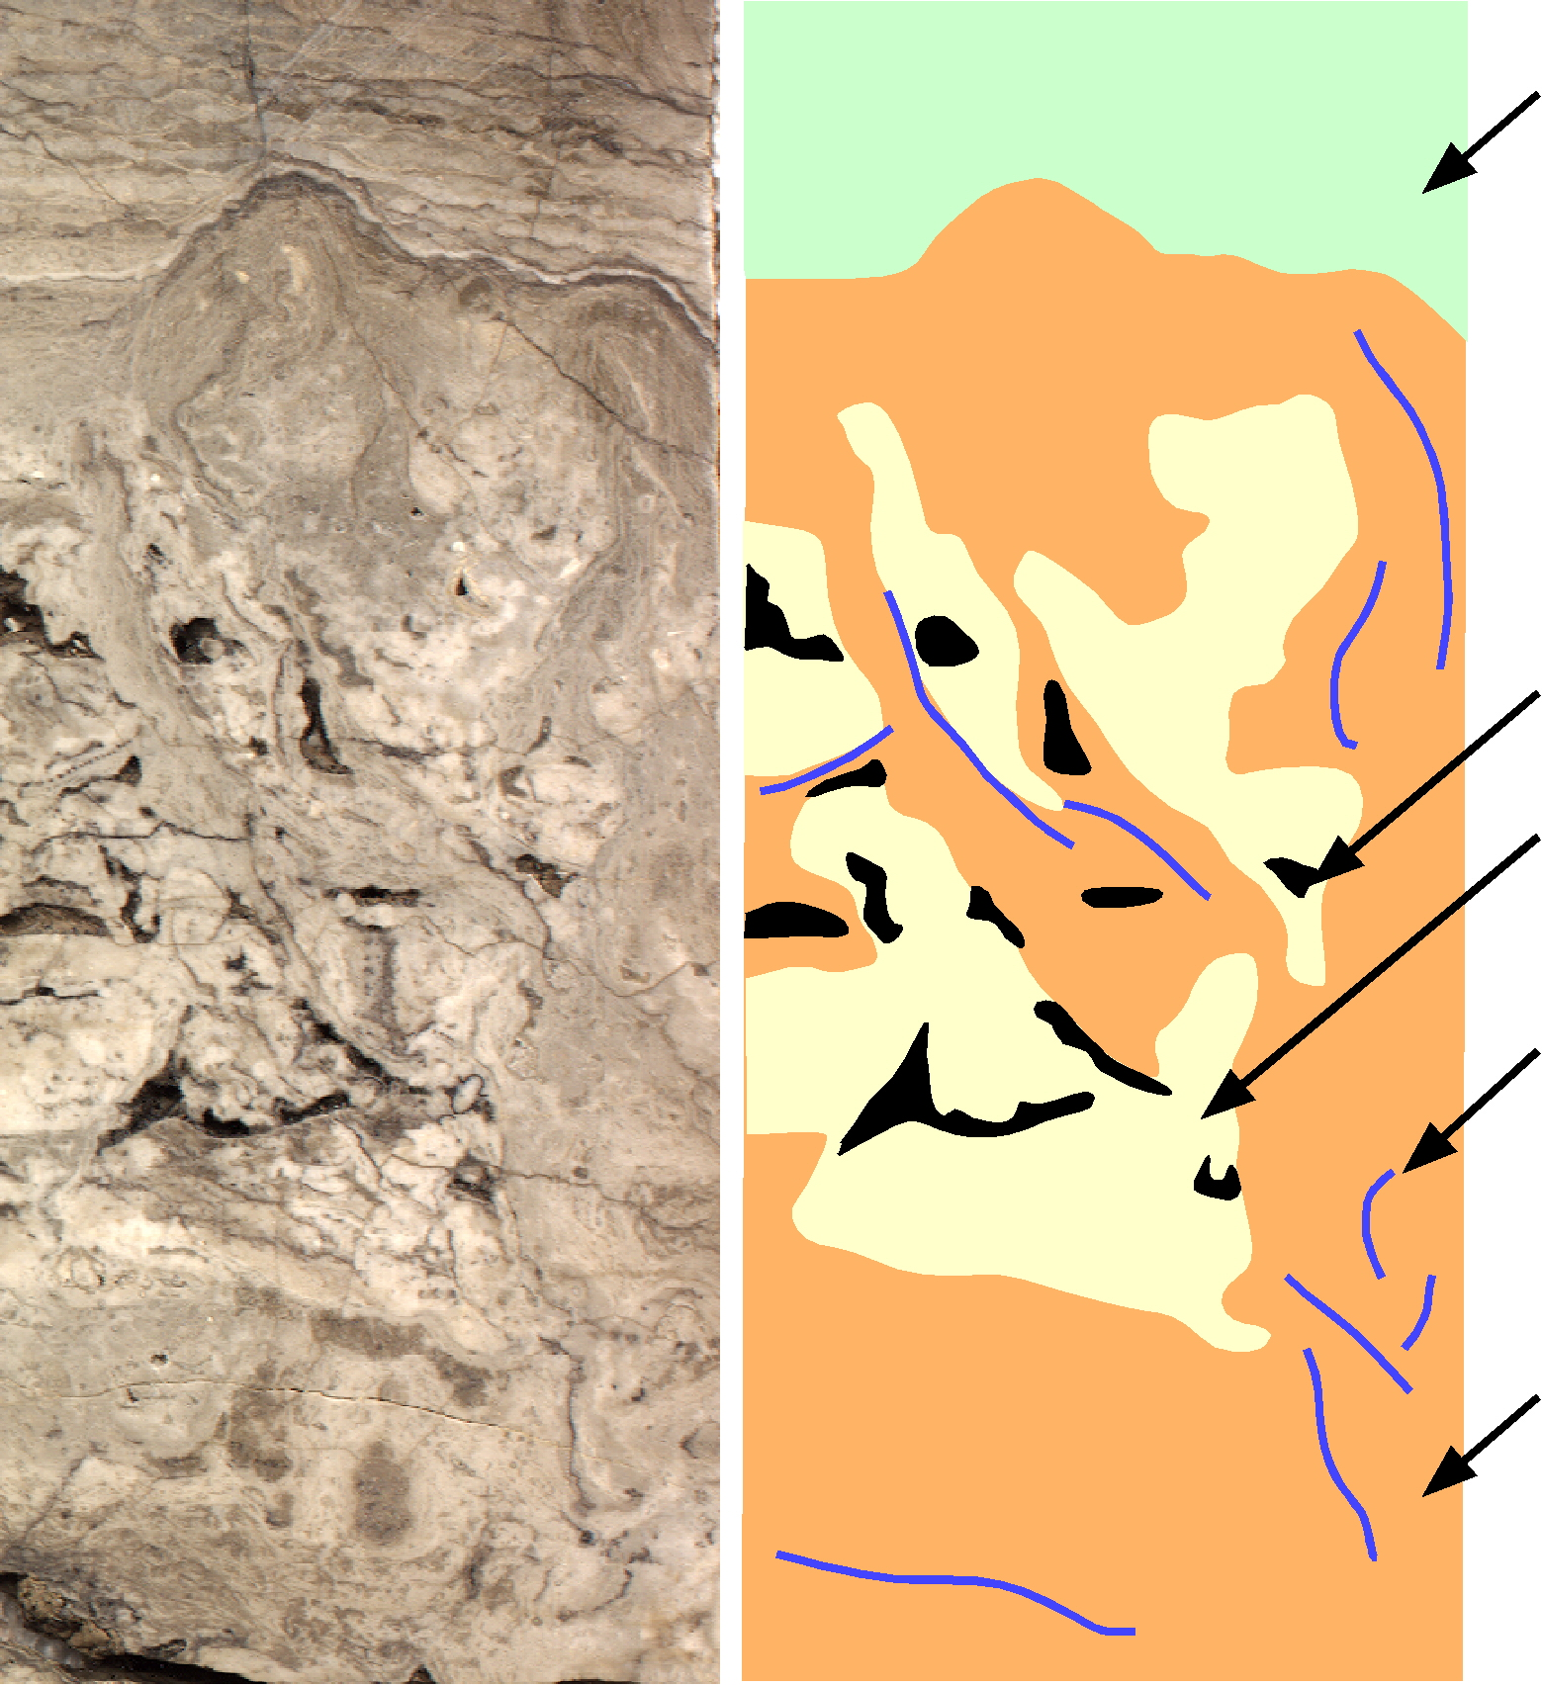
Tengiz Upper Slope Boundstone
Botryoidal cement crust
Preserved primary porosity
Porosity occluded by radiaxial and botryoidal cement
Fenestellid bryozoan fronds
Wavy laminated clotted peloidal micrite (micrite crusts and >35% microspar cement)
~ 5 cm
Harris, 2025
Modified after Kenter et al., 2005

Slide 9
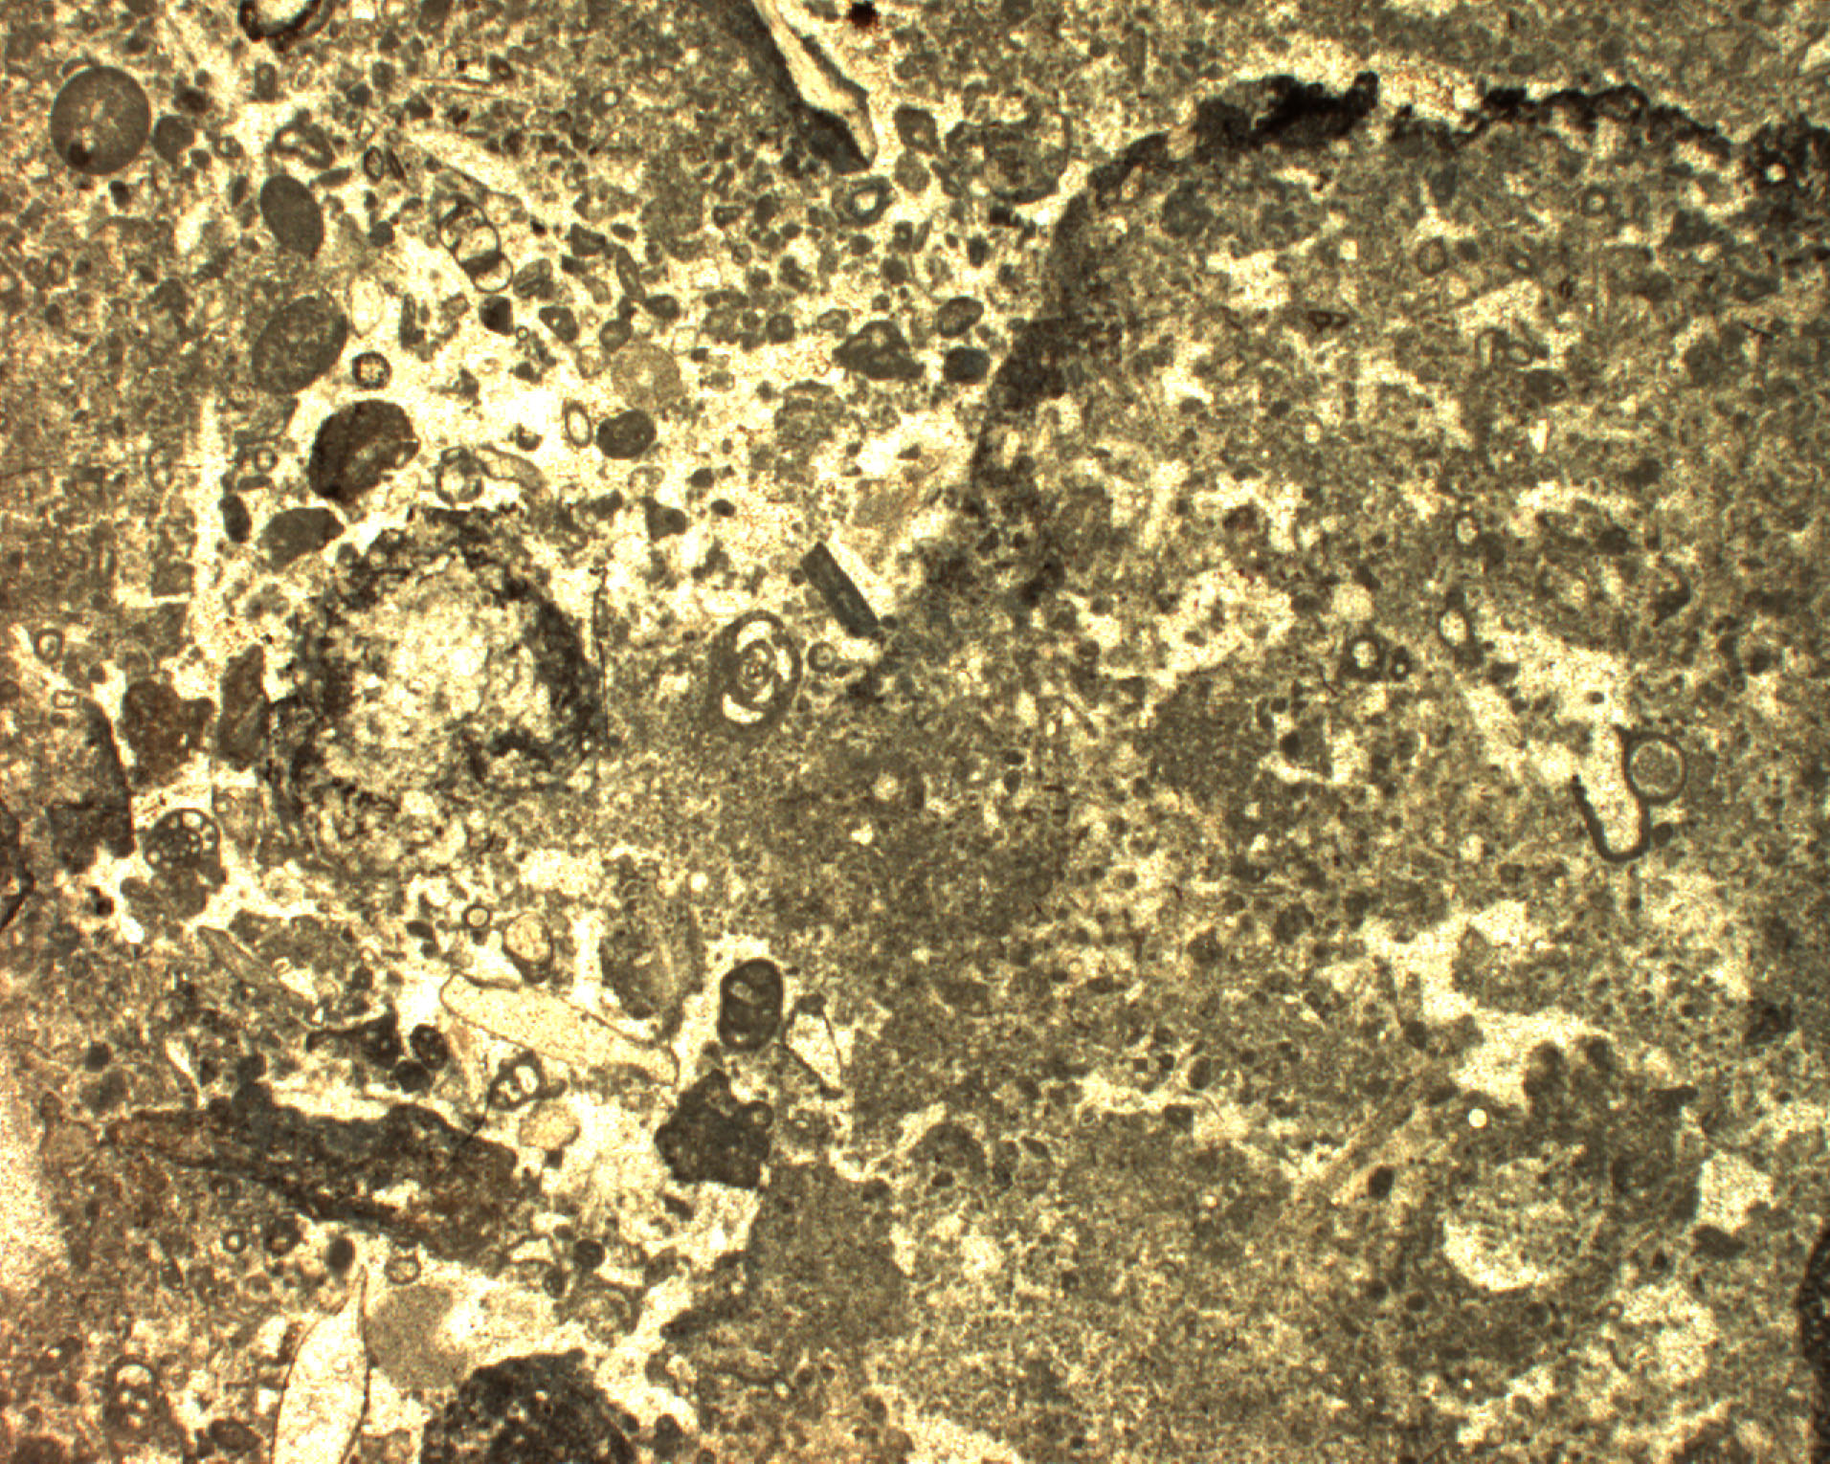
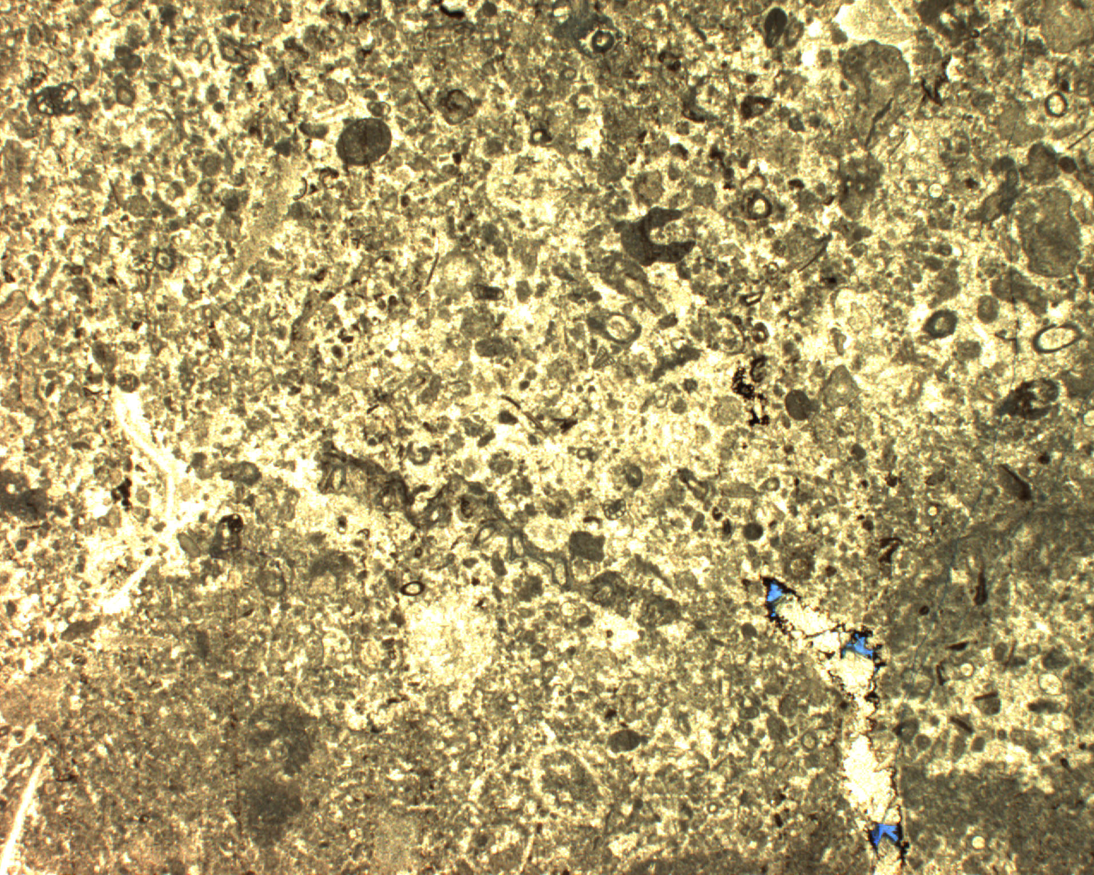
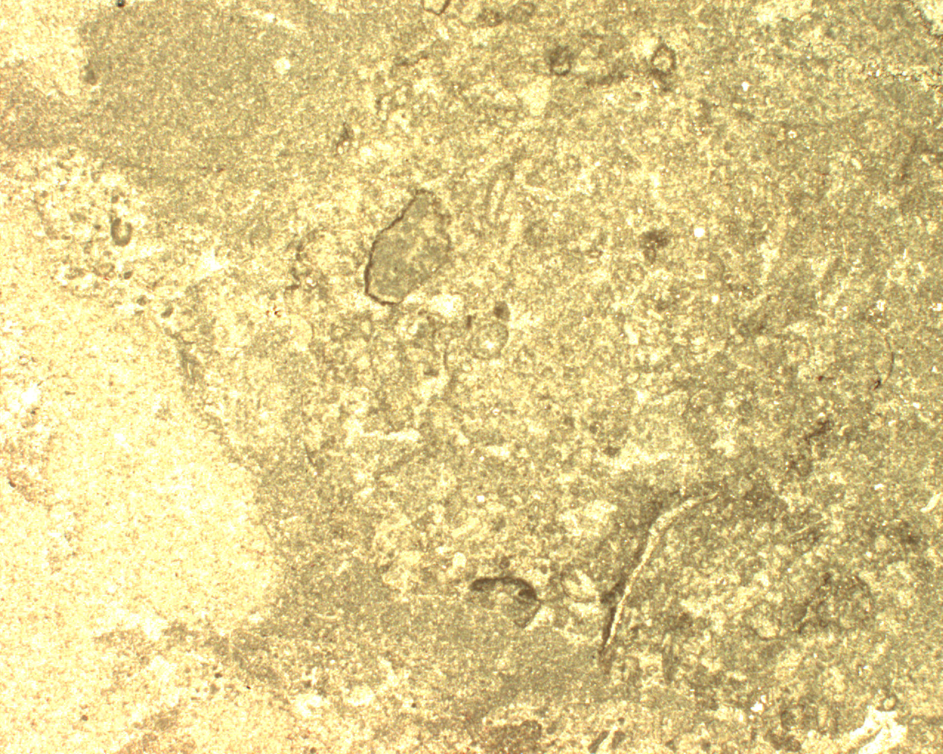
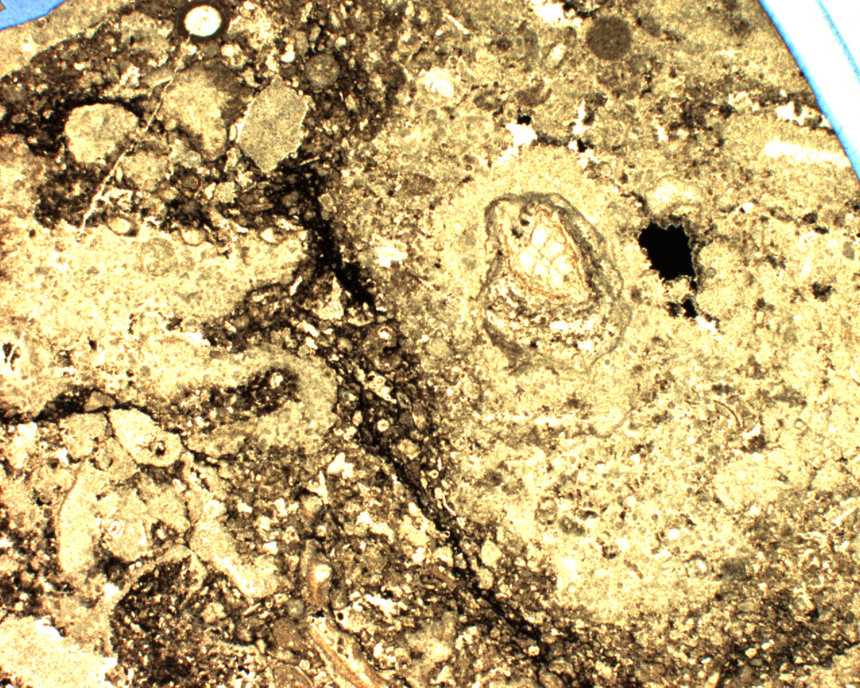
Tengiz Boundstone in Thin Section
0
2
4810.89 m
4813.07 m
mm
Harris, 2025
4820.45 m
4827.43 m

Slide 10
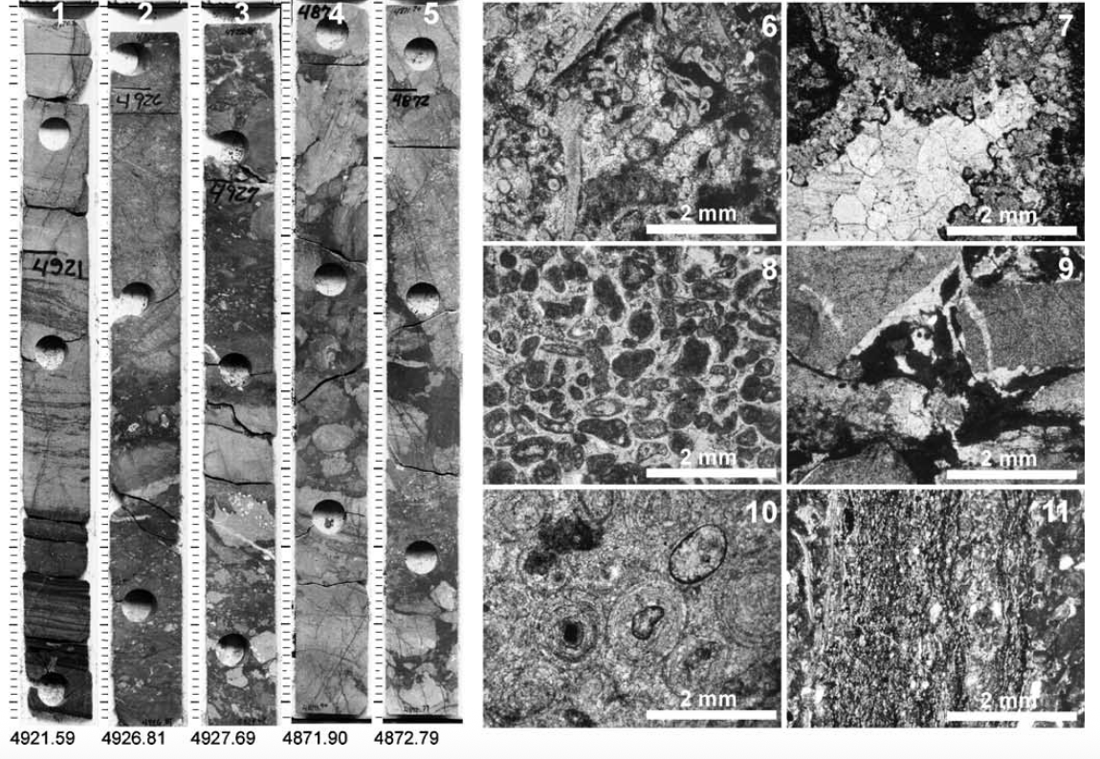


Tengiz Lower Slope Breccia and Grain Flows
Grain flow deposits
Detrital boundstone breccia
Harris, 2025
Modified after Kenter et al., 2005

Slide 11
Depositional Model for
Tengiz Margin
and Slope
Marine cemented boundstone factory and in-situ breccias from platform break to ~300 m or more
Detrital breccias further downslope
Minimal platform top contribution
Harris, 2025
Modified after Kenter et al., 2005

Slide 12
Outline of Talk
Rationale for talk
Subsurface example
Outcrop examples
Implications & Take-Aways
Harris, 2025

Slide 13
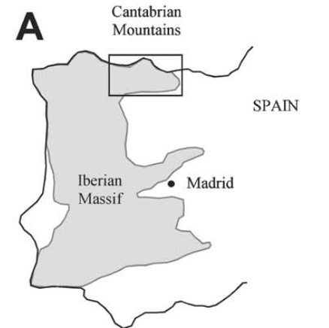
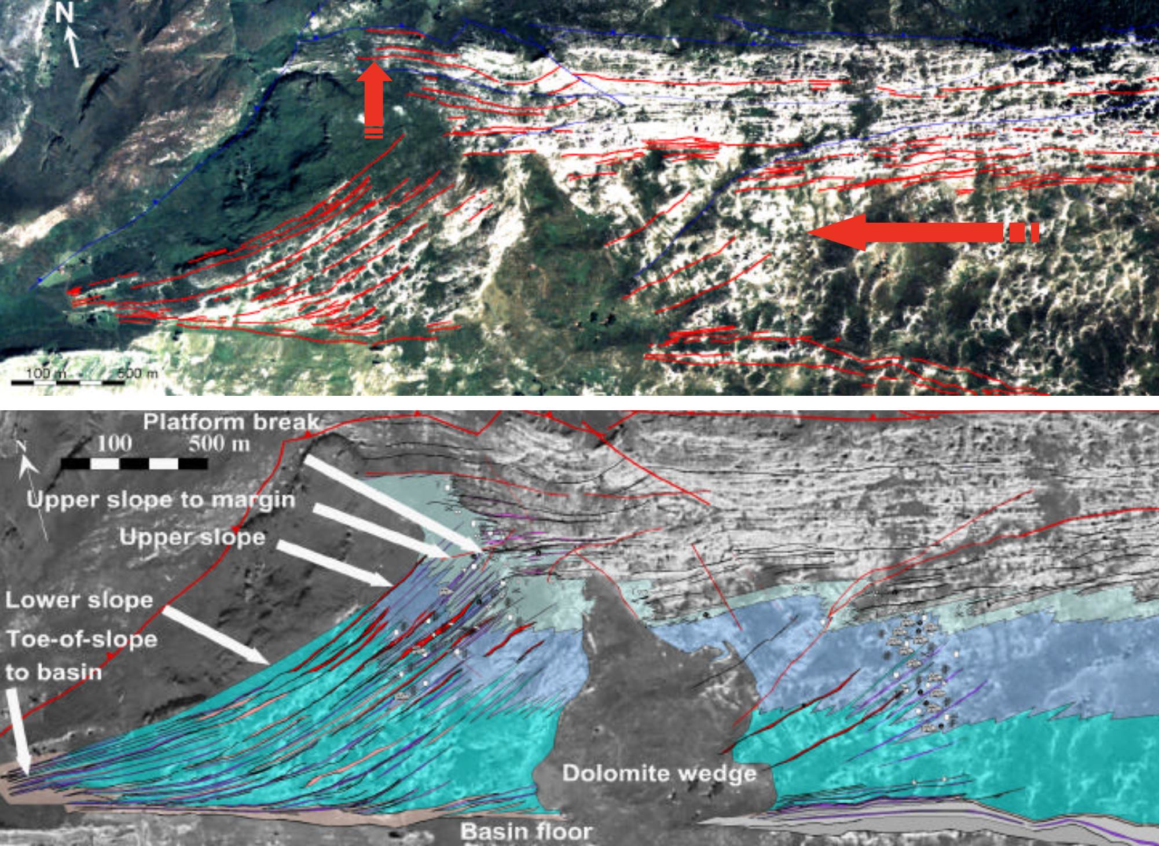
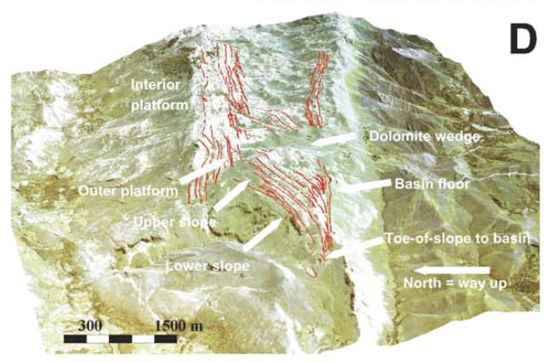
Asturias
Harris, 2025
Modified after Della Porta et al., 2003, 2004

Slide 14
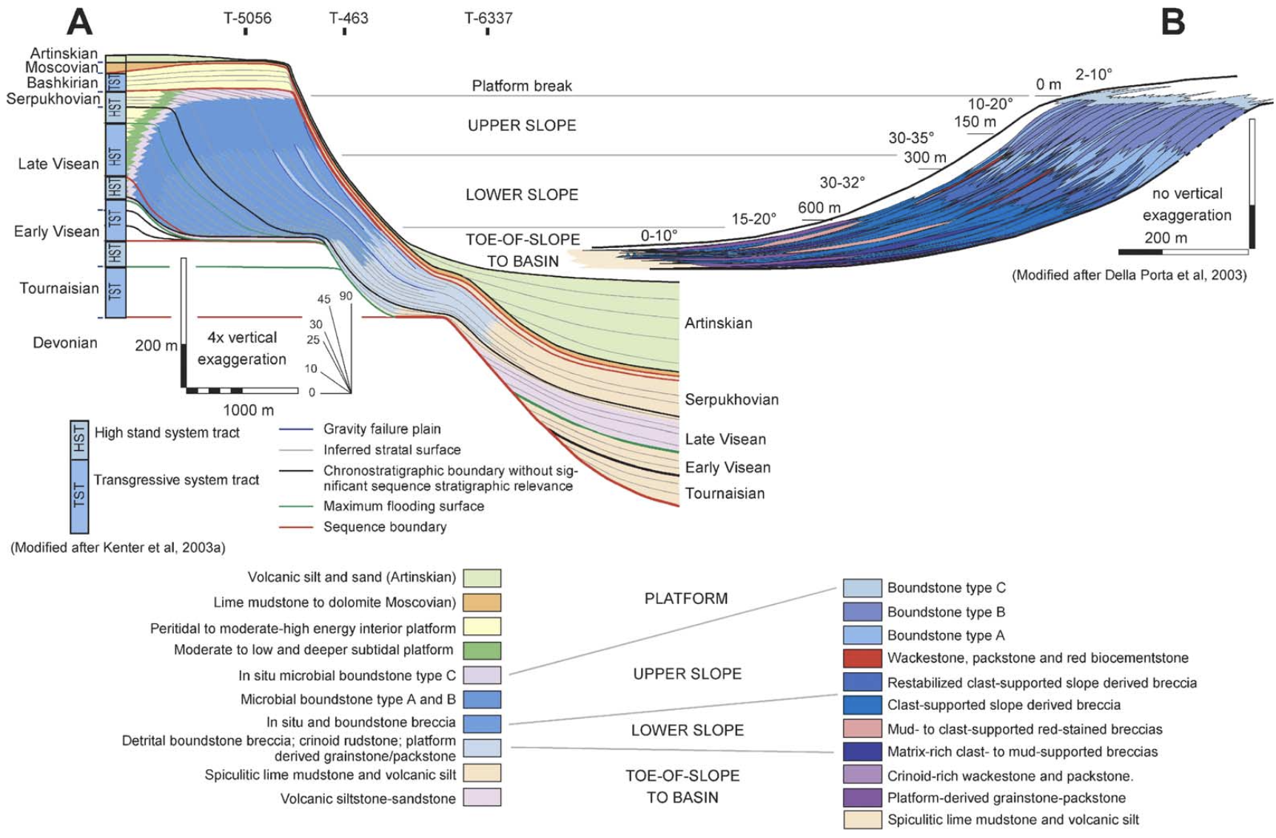
Subsurface Outcrop Comparison
Modified after Kenter et al., 2005
Harris, 2025

Slide 15
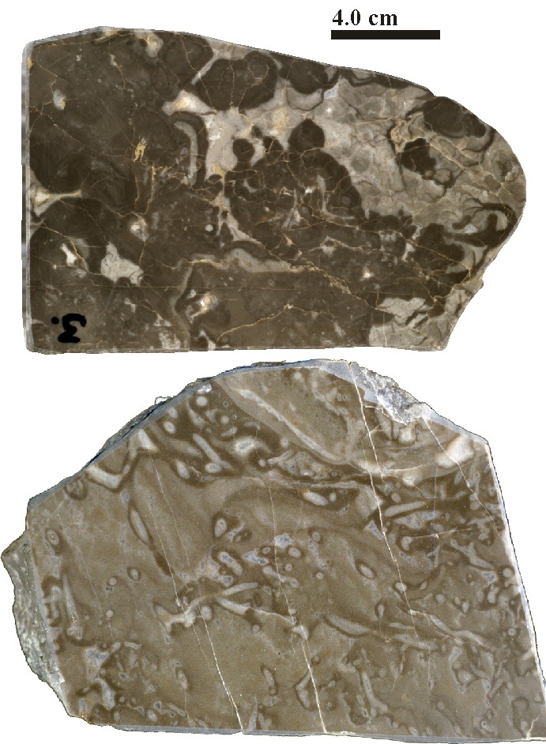

Asturias Upper Slope Boundstone
Botryoidal
cements
Crusts form framework
Algae or sponge?
Constructional cavities lined
with micritic crusts
Harris, 2025
Modified after Kenter et al., 2005

Slide 16
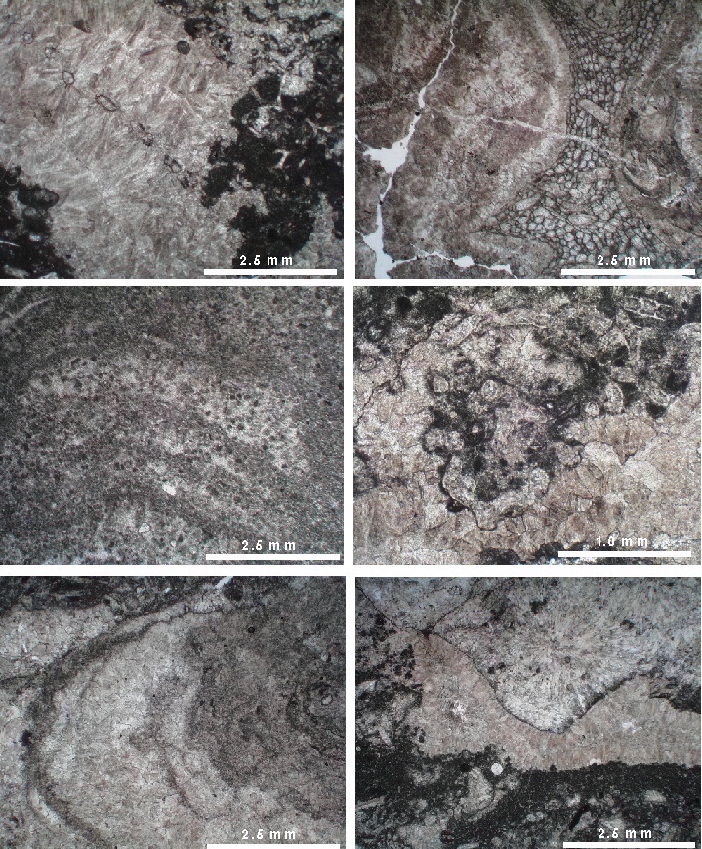
Asturias Boundstone in Thin Section
Bryozoan
Bryozoan
Radial and radiaxial fibrous cement
Micritic and cement crusts
Calcareous algae
Laminated peloidal texture
Micritic and fibrous cement crusts
Radial and radiaxial fibrous cement
Botryoidal cements
Clotted and peloidal micritic crusts
Harris, 2025
Modified after Kenter et al., 2003

Slide 17
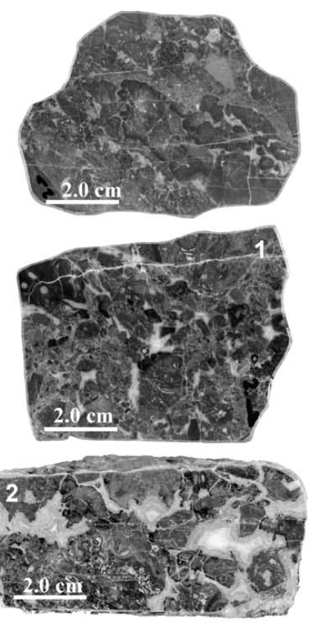
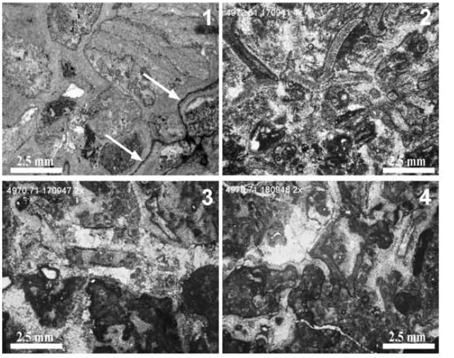

Asturias Lower Slope Breccia and Grain Flows
Harris, 2025
Modified after Kenter et al., 2005

Slide 18
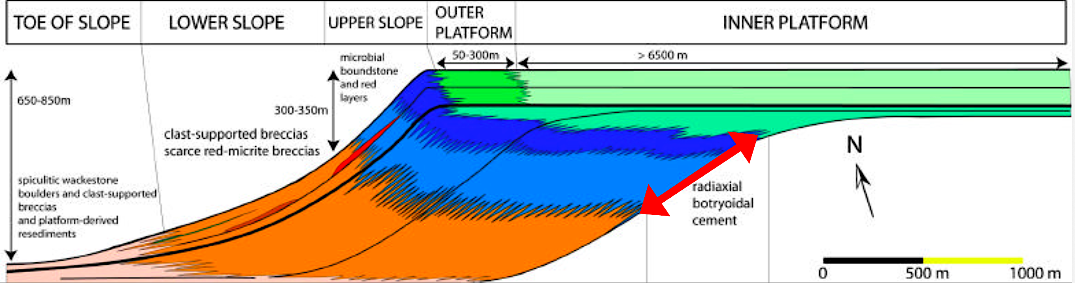
Depositional Model for Asturias Margin and Slope
Modified after Kenter et al., 2003; Della Porta et al., 2008
Cemented boundstone and stabilized breccias from platform break to >400 m
Detrital boundstone breccias and rudstone further downslope
Minimal platform top contribution
Harris, 2025

Slide 19
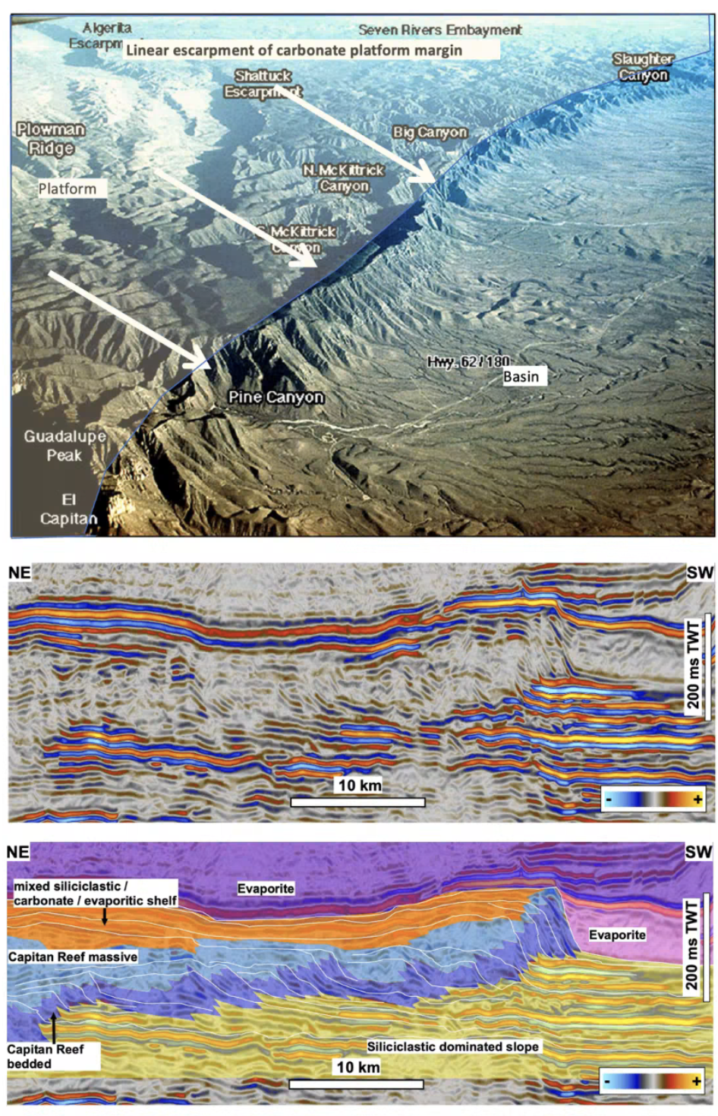
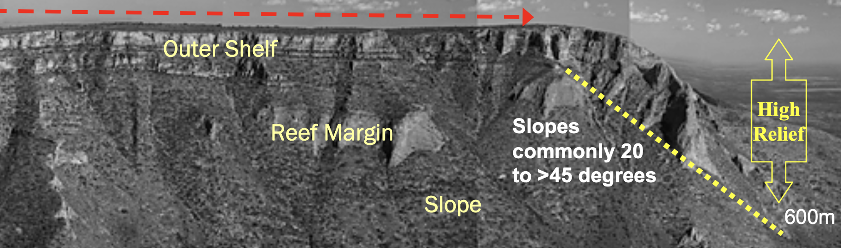
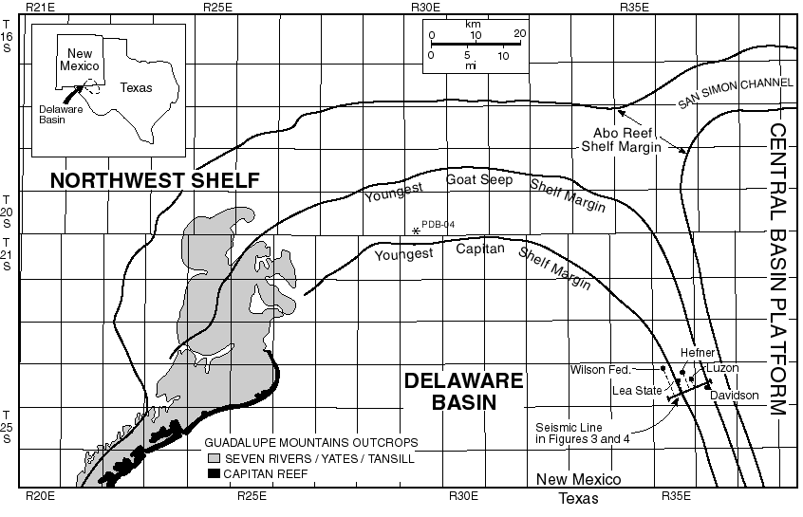
Capitan Shelf Margin
Janson, 2025 Pers. Comm.
19 km
progradation
7 km
progradation
5 km
progradation
Harris, 2025
Modified after Garber et al., 1989; Harris and Saller, 1999

Slide 20
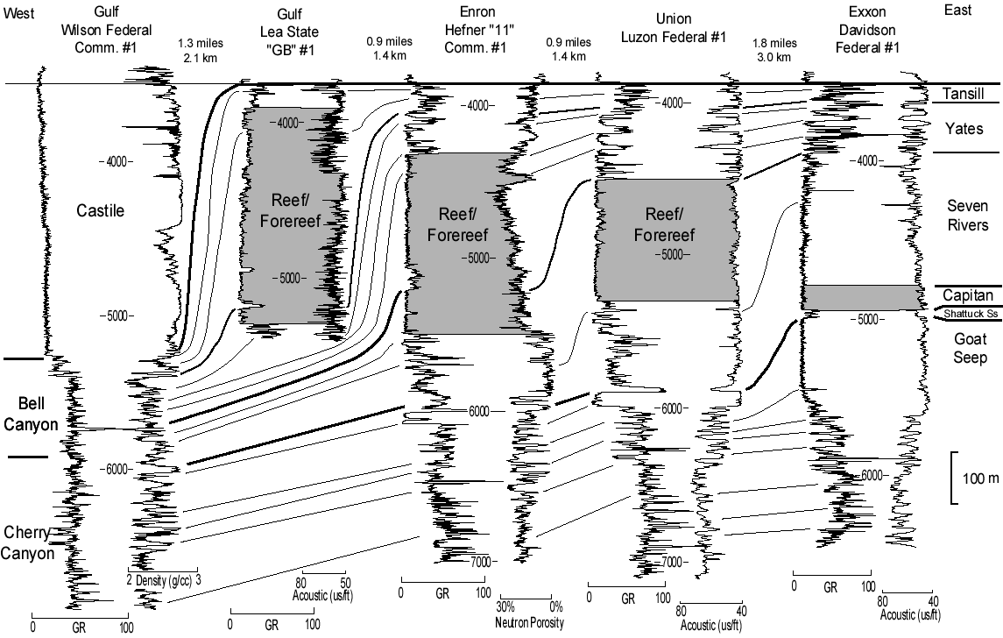
Capitan Shelf Margin
0
7 km of progradation
500 m
Modified after Harris and Saller, 1999
Harris, 2025
Harris and Saller, 1999

Slide 21
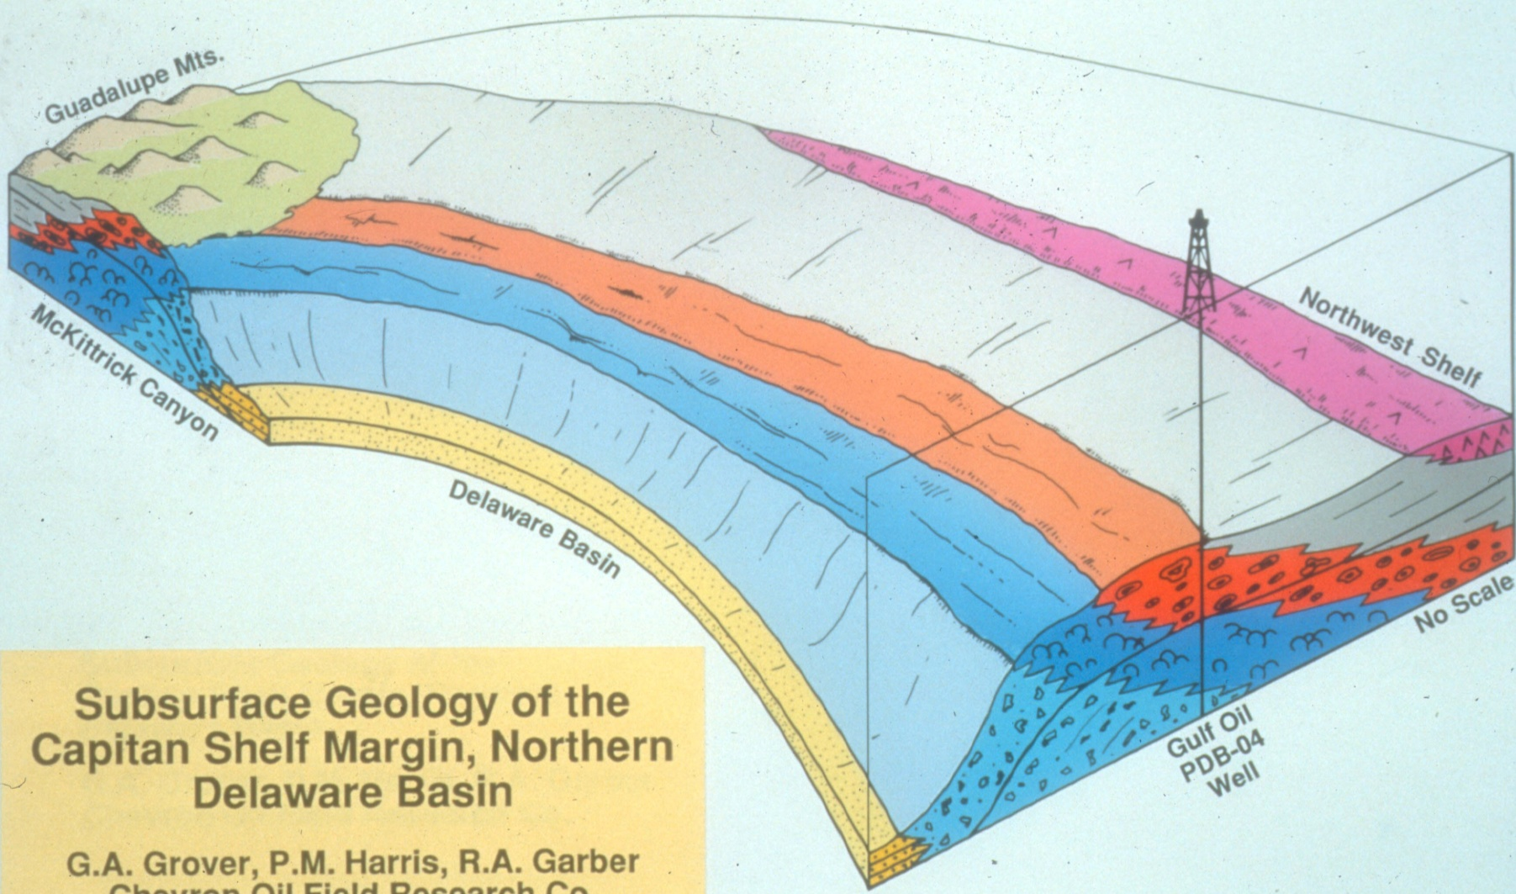
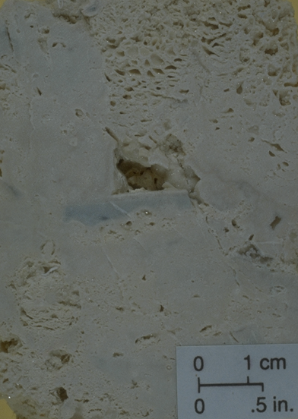
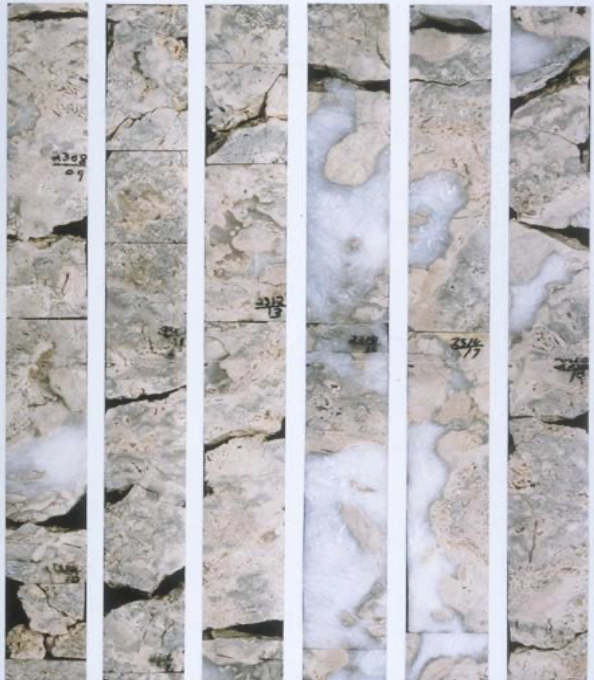
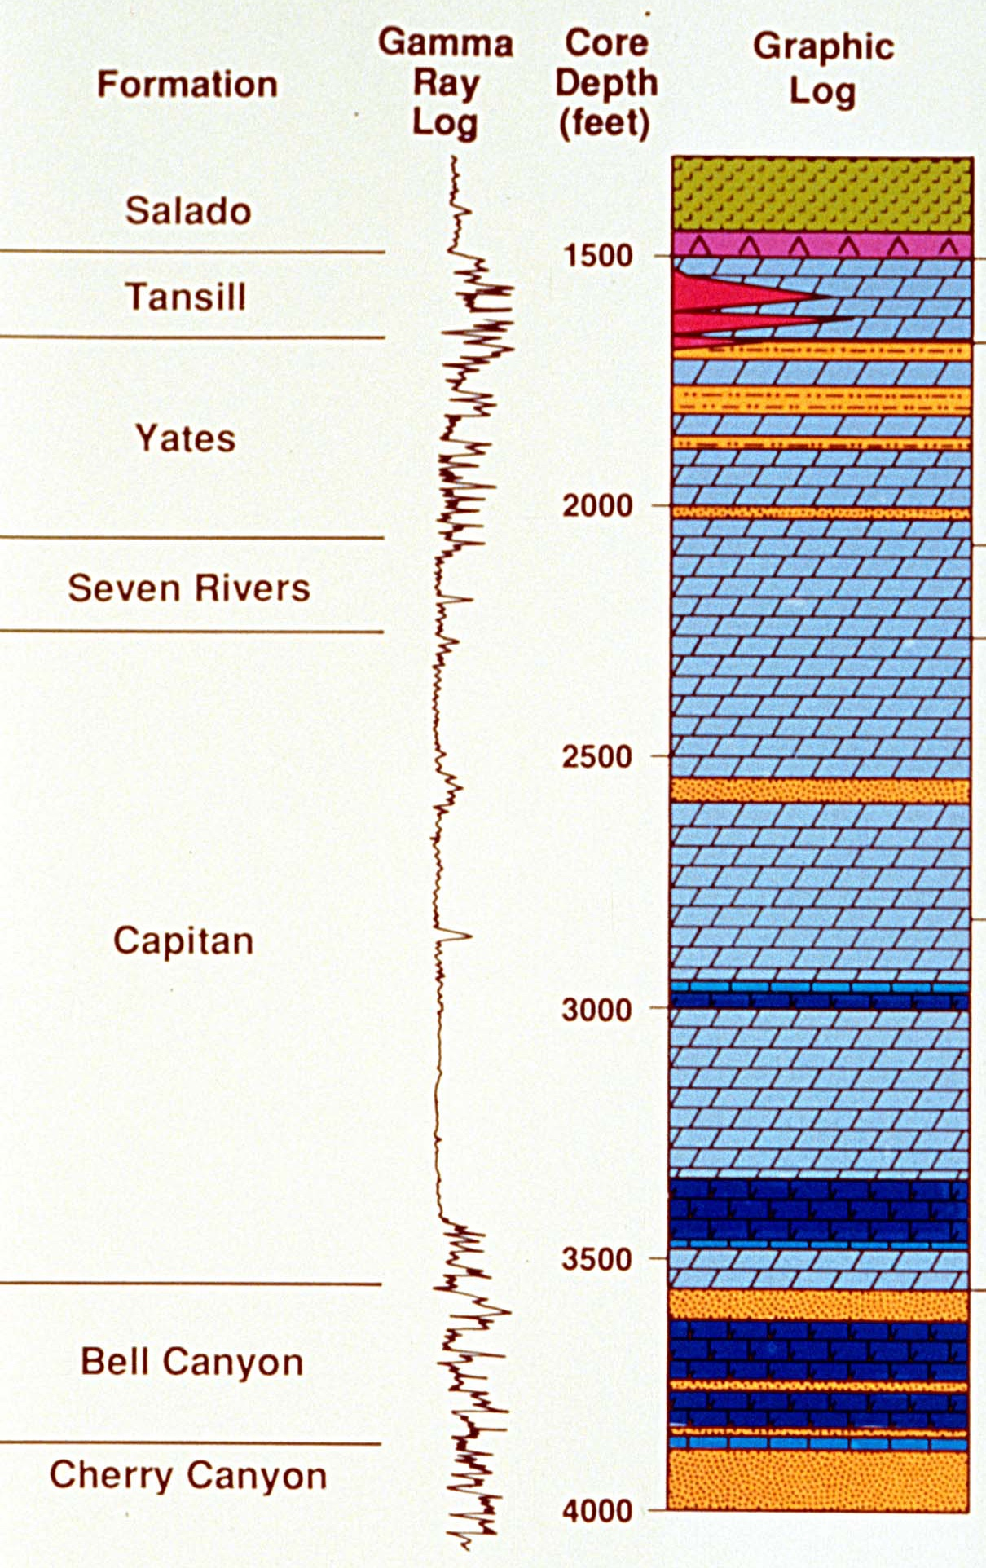
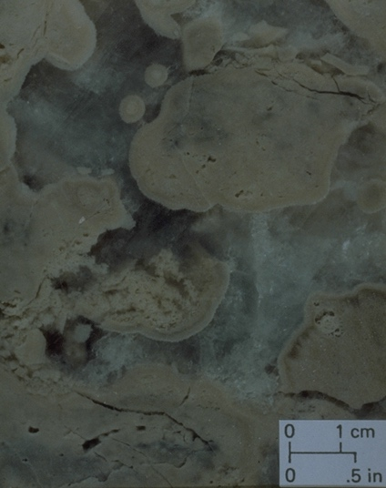
Capitan Boundstone
Sponge
Internal
Sediment
Microbial Cement
Encrustation
Micrite Cement
Botryoidal Cement
Harris, 2025
Modifed after Garber et al., 1989

Slide 22
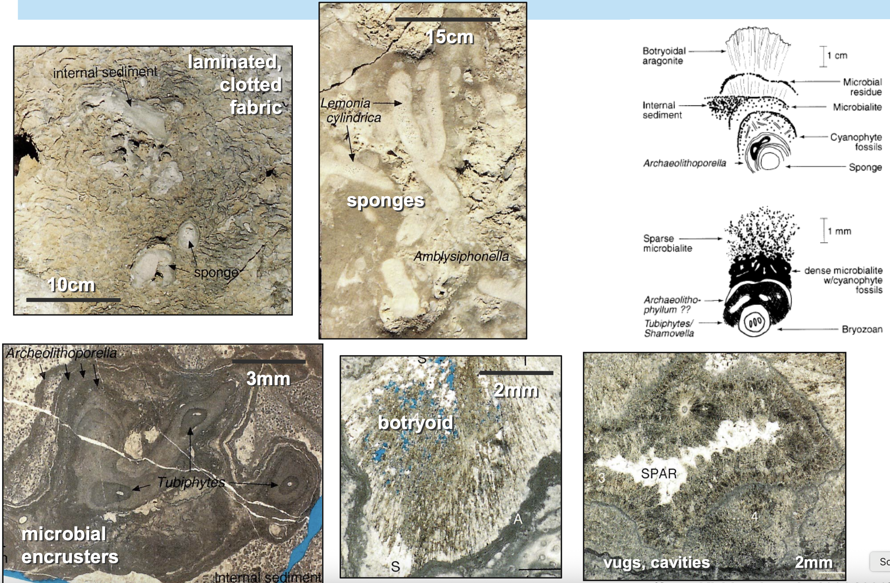
Capitan Boundstone
Modified after Kirkland et al., 1993, 1998
Harris, 2025

Slide 23
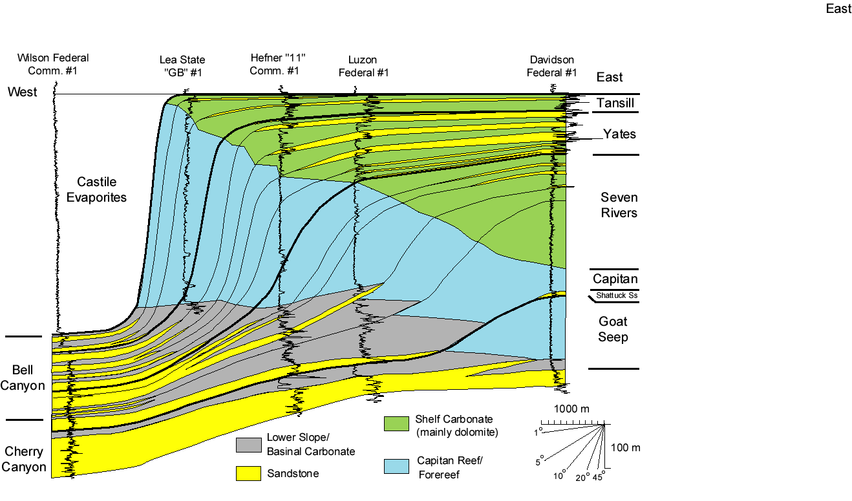
Depositional Model for Capitan Margin and Slope
CEMENTED
MICROBIAL
BOUNDSTONE
IN-SITU
BOUNDSTONE
BRECCIA
BOUNDSTONE
MINOR
PLATFORM TOP
INPUT
Modified after Harris and Saller, 1999; Harris, 2012
Harris, 2025

Slide 24
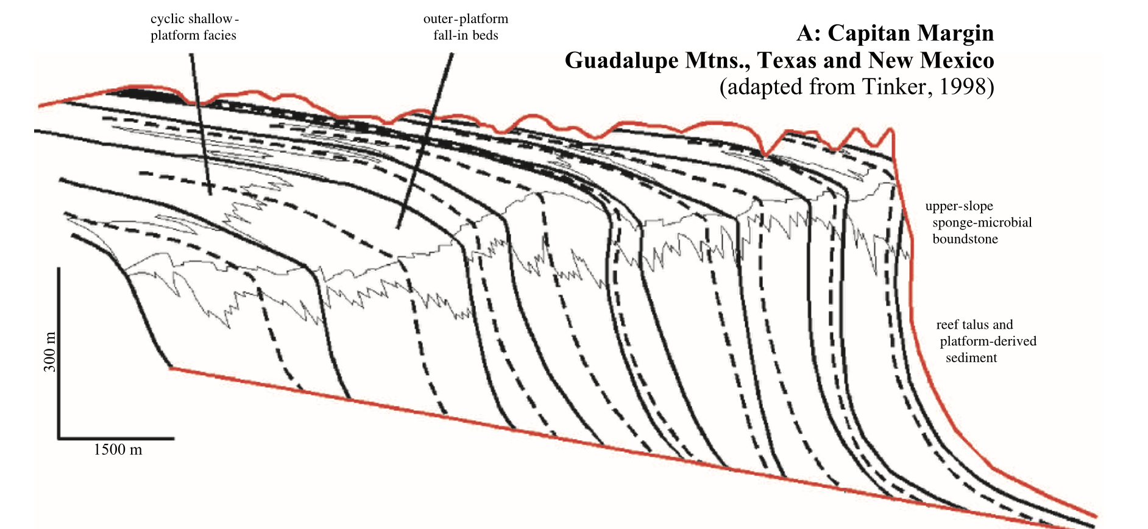

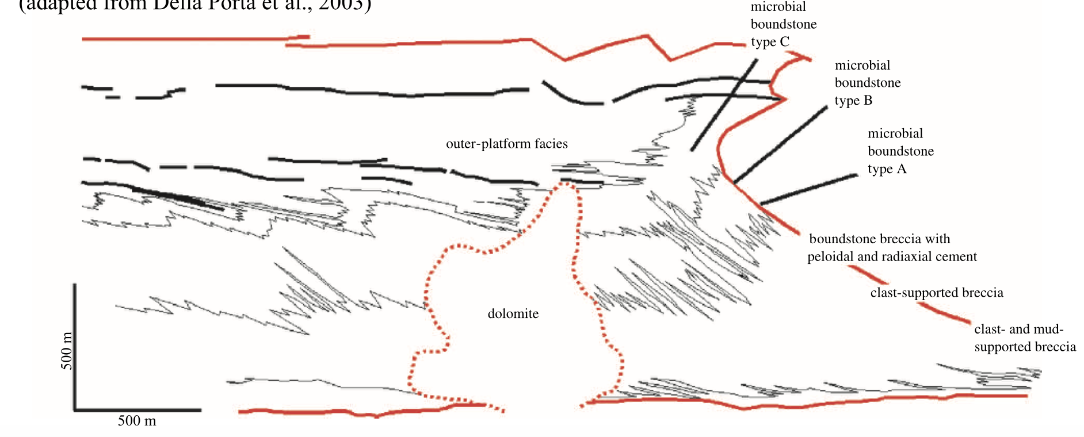
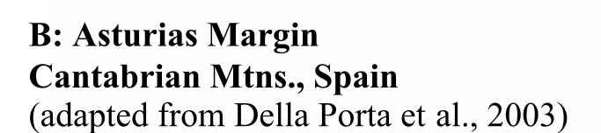
Valuable Analogs for Tengiz Microbial Slope
Harris, 2025

Slide 25
Outline of Talk
Rationale for talk
Subsurface example
Outcrop examples
Implications & Take-Aways
Harris, 2025

Slide 26

Depositional Model
Late Paleozoic Steep High-Relief Microbial Boundstone Slopes
Carboniferous
Asturias and Tengiz
Microbial dominated margin and slope factory
  Broad depth range (up to 300-400 m depth)
    Pervasive marine cementation (stable steep slopes)
      Detrital “talus” breccias cemented and matrix-free
        Minimal platform-top contribution
          High production rates (400-1000m/My)
            Kms progradation of 30° or steeper slope
Permian
Capitan
Harris, 2025

Slide 27


Comparison of Growth Rates
Geometry
ª Durations in My (following Gradstein et al., 2004): Serpukhovian 8.3 My; Bashkirian 6.4 My; Pennsylvanian 17.1 My; Miocene–Recent 15.97 My; Capitanian (Seven Rivers and Yates/Tansill Fms) 5.4 My.
Modified after Kenter et al., 2005
Harris, 2025

Slide 28

Self Nourishing Slope
Modified after Kenter et al., 2005
Harris, 2025

Slide 29

Paradigm Shift
Harris, 2025
Modified after Della Porta, 2003 and Kenter et al., 2005

Slide 30


Key Take-Aways
New production-water depth profiles needed when the dominant factory is microbially induced.
Microbial boundstone slope response to relative sea-level changes differs from modern reefs in that carbonate growth continues downslope during sea-level fall.
Progradation and accretion function of boundstone growth vs off platfrom (highstand) shedding
Generalized concepts of leeward progradational vs. windward aggradational margins need revision.
Carbonate production on the slope is controlled by environmental parameters (e.g., temperature, nutrients, oxygenation) that need more study.
Harris, 2025

Slide 31


Insight for CSL
The slope can be self nourishing and progradation can take place at high rates despite the lack of platform top shedding (slope vs. highstand shedding).
Implications for modern examples such as TOTO, Belize, Red Sea, etc.
Microfabrics that evidence microbial activity during deposition include (1) clotted micrite patches locally connecting bioclasts or infilling primary pores, (2) porostromate structures in the micrite, (3) dense micritic masses, (4) binding structures, (5) micritic crusts, and (6) peloidal textures.
Reolid et al., 2017
Modified after Grammer and Ginsburg, 1992
Harris, 2025

Slide 32

Harris, 2025
In 2012, Mancini, E.A., Morgan, W.A., Harris, P.M., and Parcell, W.C. (eds.), AAPG Hedberg Conference on Microbial Carbonate Reservoir Characterization, Abstract Volume.

Slide 33



Insight for CSL CML
Microbial micro textures from Carboniferous slope samples are comparable to those documented by the CSL from modern settings. Investigate other slope examples!
Examples of micro textures observed in scanning electron microscopy (SEM) imaging from Tengiz samples. Modified from Andres et al., 2012.
Viable microbial communities from the active shoals of the Bahamas. From Diaz & Eberli, 2019.
Examples of microbial micrite binding and encrustation from TOTO samples. From Reolid et al., 2017.
Harris, 2025

Slide 34
If interested, read these -
Collins, J.F., Kenter, J.A.M., Harris, P.M., Kuanysheva, G., Fischer, D.J., and Steffen, K.L., 2006, Facies and reservoir quality variations in the Late Visean to Bashkirian outer platform, rim, and flank of the Tengiz Buildup, Pricaspian Basin, Kazakhstan: In Harris, P.M. and Weber, L.J. (eds.), Giant hydrocarbon reservoirs of the world: from rocks to reservoir characterization and modeling, AAPG Memoir 88, p. 55-95.
Della Porta G., Kenter J.A.M. and Bahamonde J.R., 2004, Depositional facies and stratal geometry of an Upper Carboniferous prograding and aggrading high-relief carbonate platform (Cantabrian Mountains, NW Spain): Sedimentology, v. 51, p. 267-295.
Kenter, J.A.M., Harris, P.M., and Della Porta, G., 2005, Steep microbial boundstone-dominated platform margins—examples and implications: Sedimentary Geology, v. 178, p. 5–30.
Thank you for listening!
Harris, 2025

