Slide 1
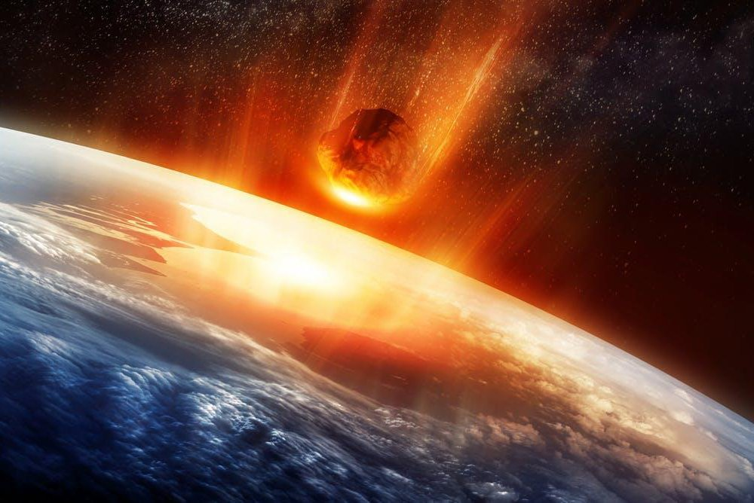

Resilience of carbonate platforms to mass extinction events - a tribute to Michael T. Whalen
Gregor P. Eberli
Elizabeth Guzmán-Hidalgo

Slide 2
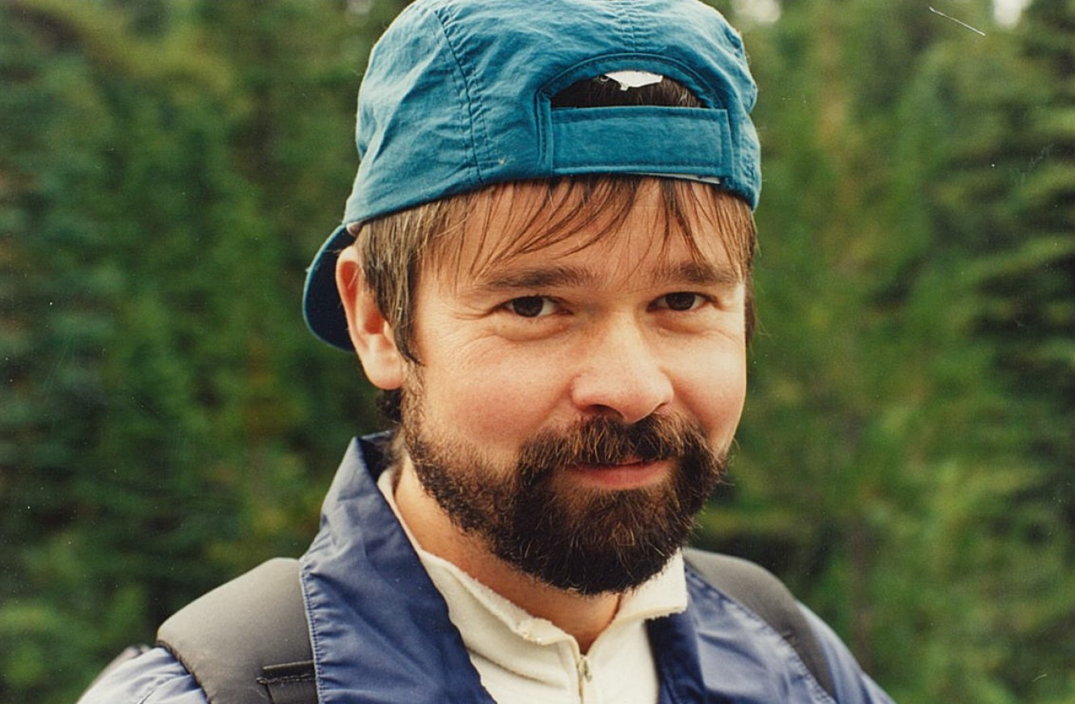
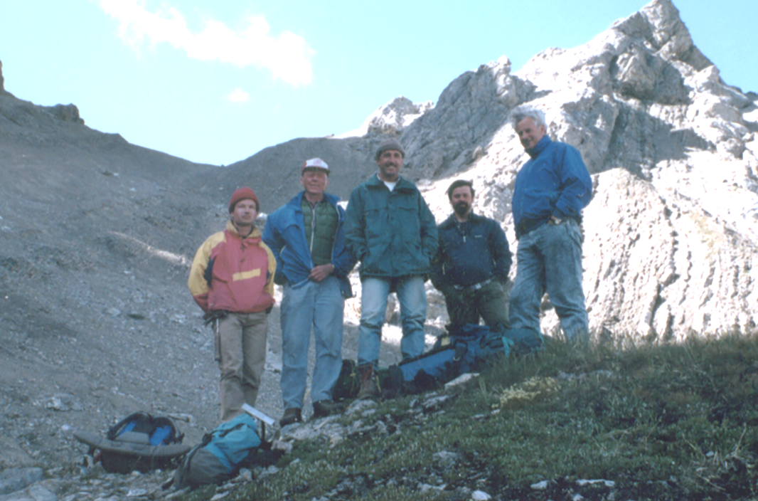

Mike Whalen – a great field geologist

Slide 3
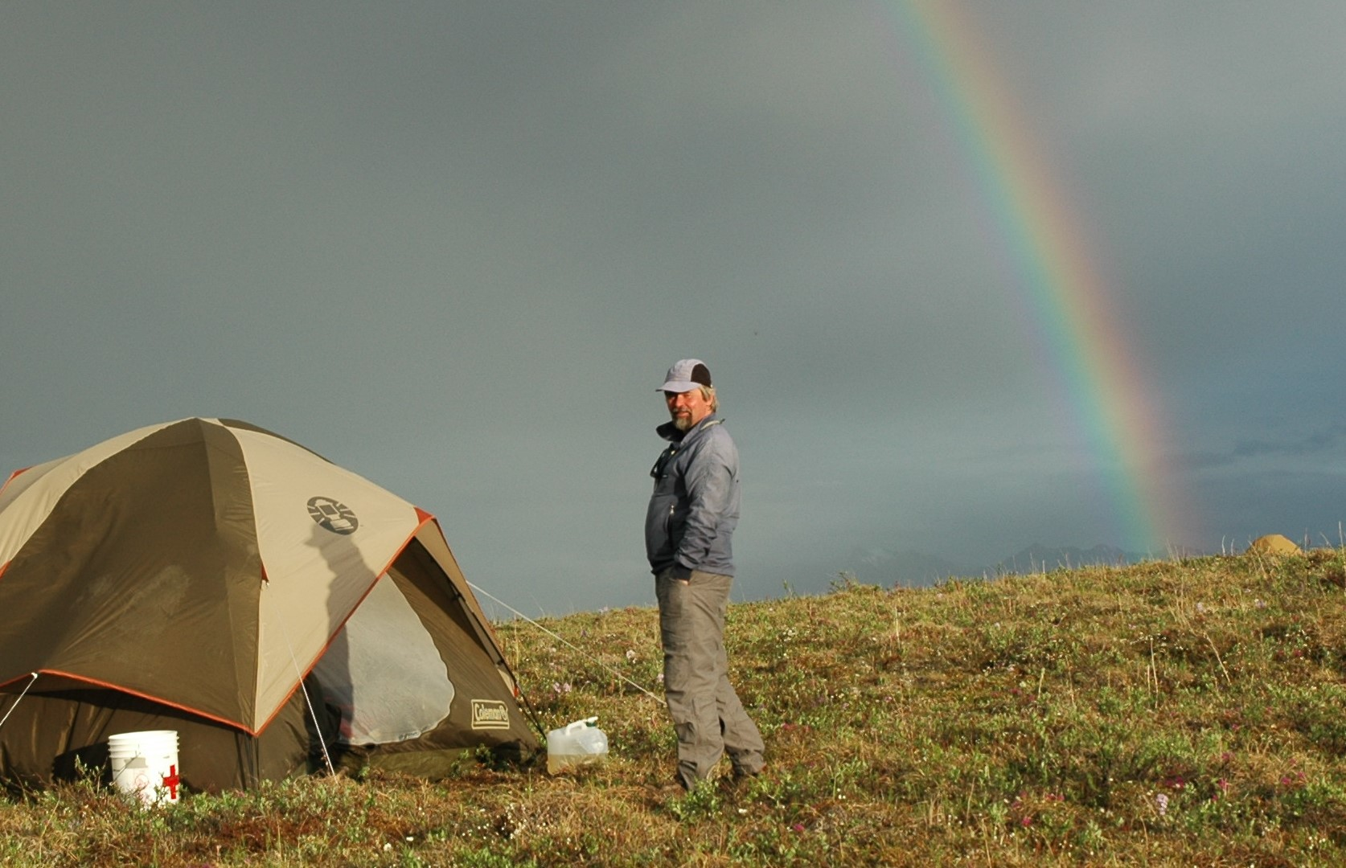

Mike Whalen – a great field geologist

Slide 4
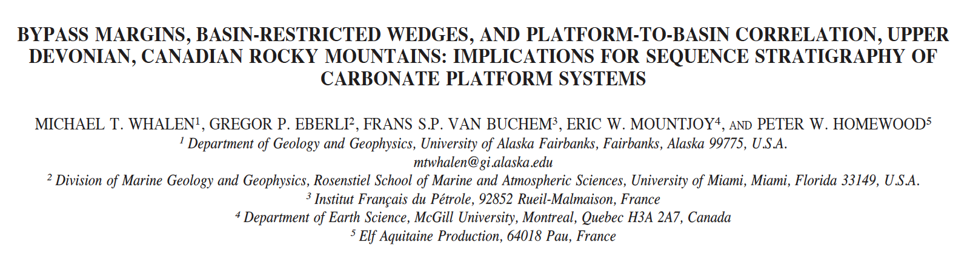
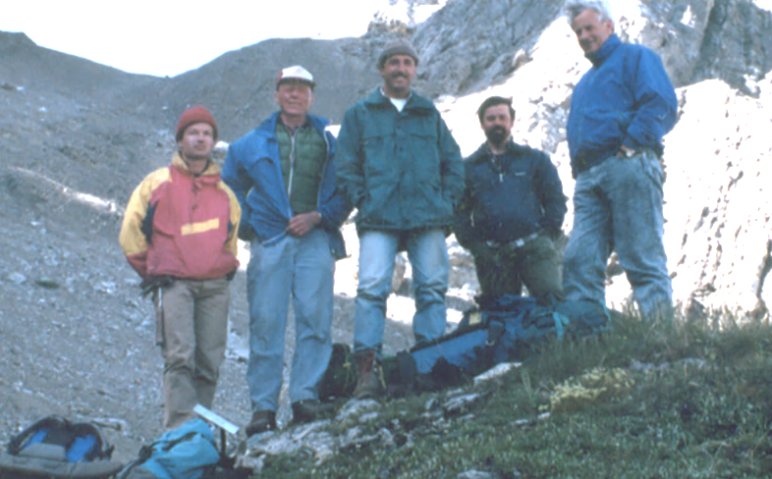
Medal of Merit – Canadian Geological Society
JOURNAL OF SEDIMENTARY RESEARCH, VOL. 70, NO. 4, JULY, 2000, P. 913–936

Slide 5
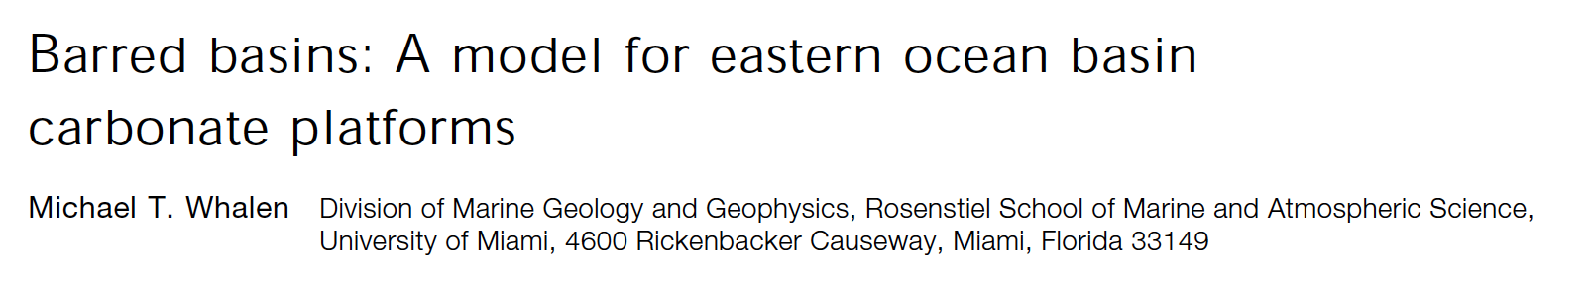
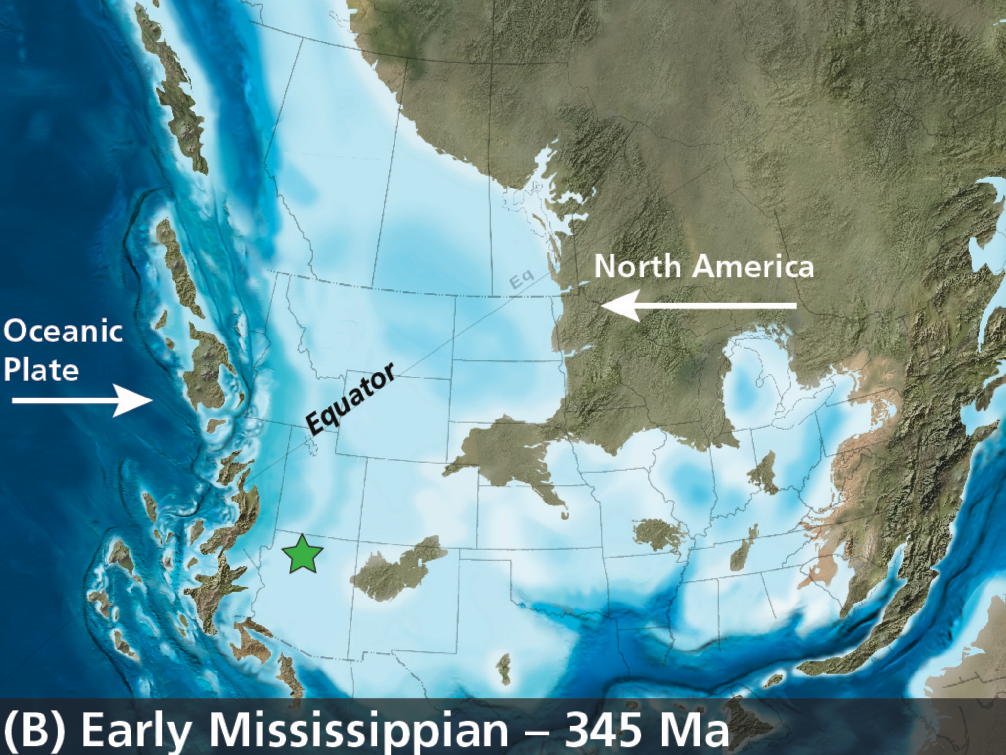
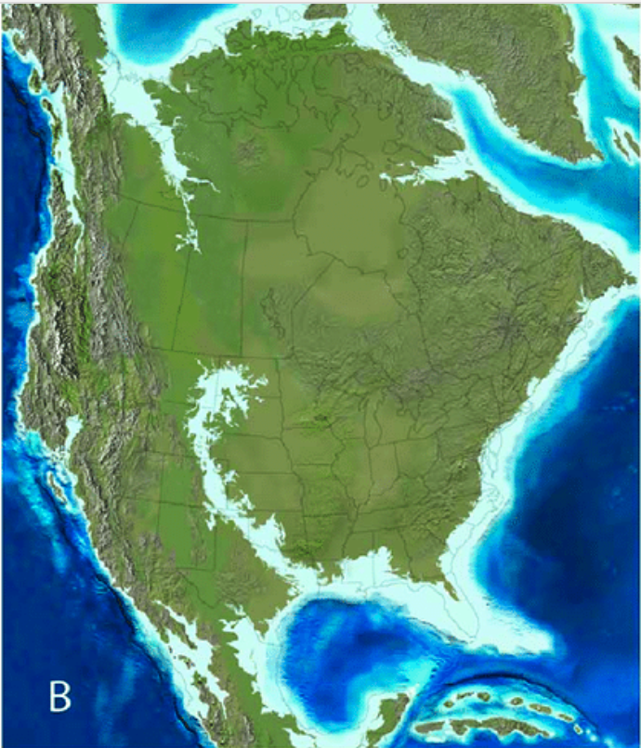
Carbonate platforms and ocean circulation
Geology; July 1995; v. 23; no. 7; p. 625–628; 4 figures.
Extensive carbonate platforms are conspicuously absent from most modern eastern ocean basins.
Carbonate platforms fail to develop due to sea-surface temperature instability, nutrient excess resulting in high biotic surface productivity, and oxygen-depleted conditions.
In contrast extensive Paleozoic carbonate platforms developed along the western margin of North America because marginal oceanographic barriers (island arcs, thrust belts, suspect terranes) existed during much of this interval. These barriers effectively protected land-ward carbonate platforms from the adverse conditions typical of open eastern ocean basins.
Late Maastrichtian – 65 Ma
Notes:
(1) cool-water intrusion due to open-ocean gyral circulation;(2) upwelling of cool, nutrient-rich, and sometimes toxic water; and (3) anoxic plat-form drowning during transgression.

Slide 6
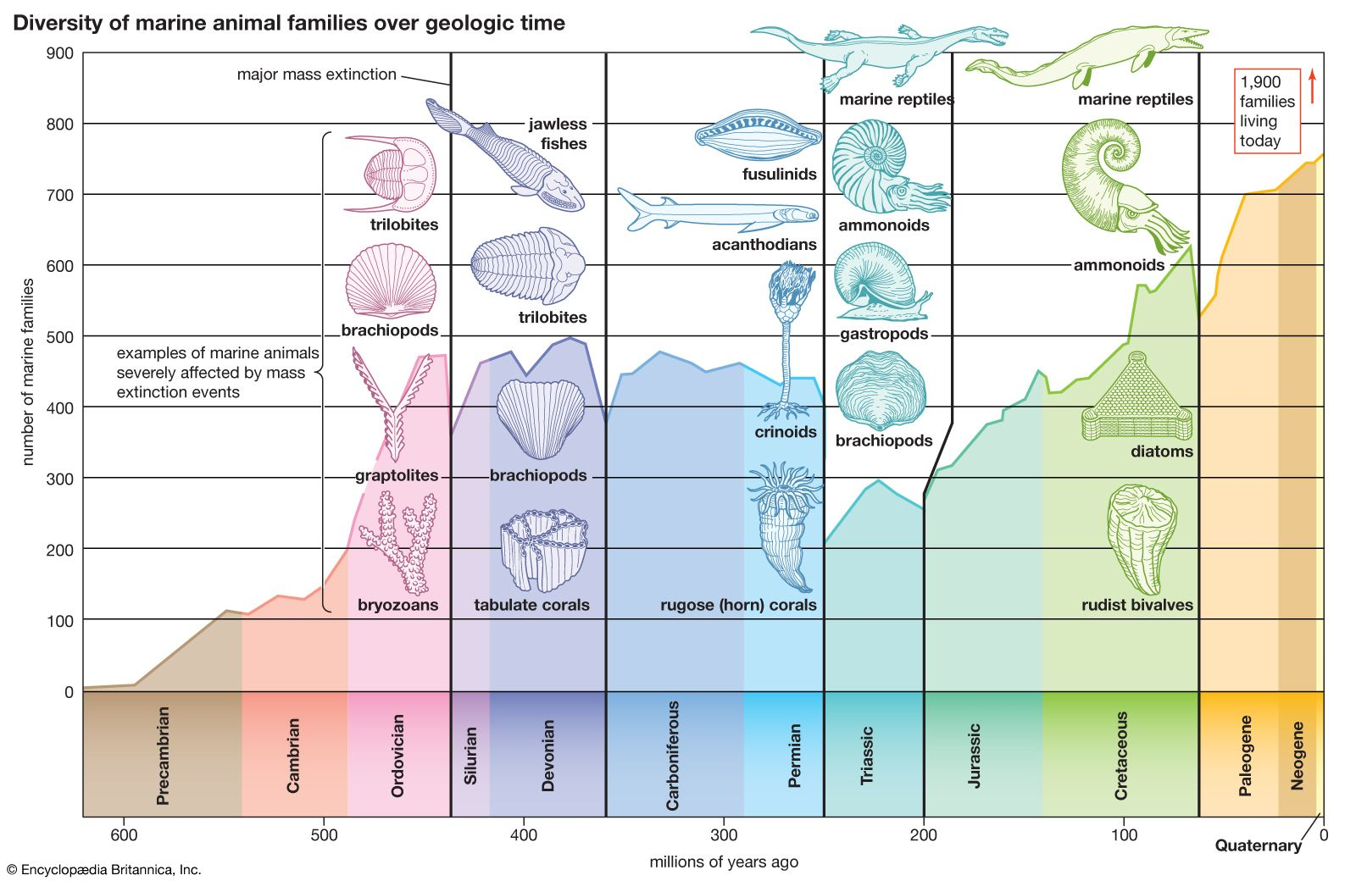
Devonian and End Cretaceous extinction
The Cretaceous–Paleogene extinction event was a sudden mass extinction of three-quarters of the plant and animal species on Earth, approximately 66 million years ago. The cause was an asteroid impact, although some scientist still seek other explanations.
The Late Devonian mass extinction, also known as the Kellwasser event, which occurred at 372.4 Ma for the Frasnian–Famennian boundary, is a series of anoxia and extinction events (Percival et al. 2018)

Slide 7
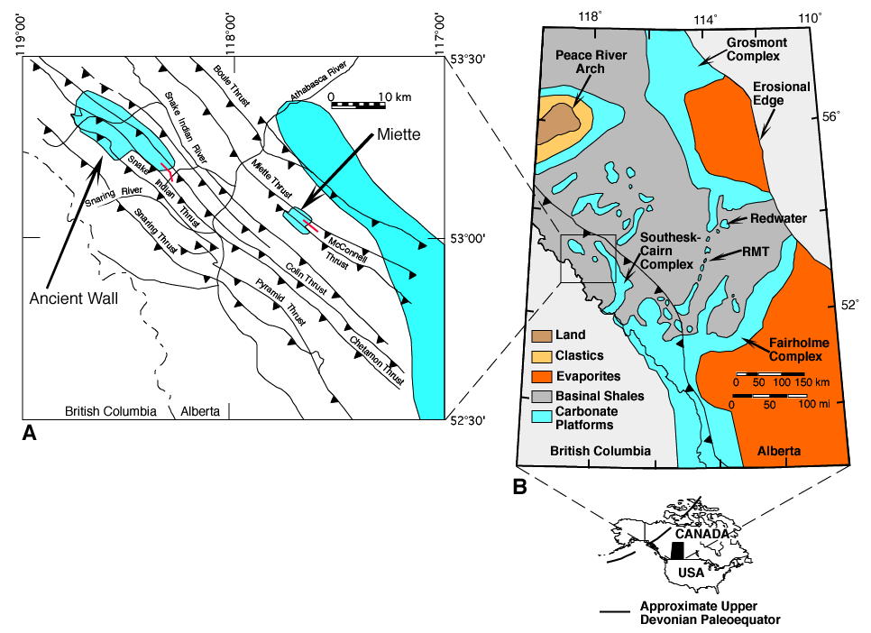
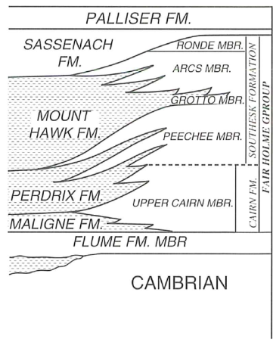
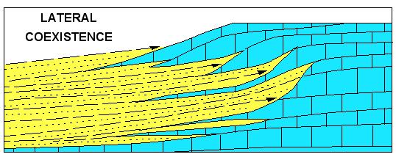
Miette and Ancient Wall: Western Canadian Basin

Slide 8
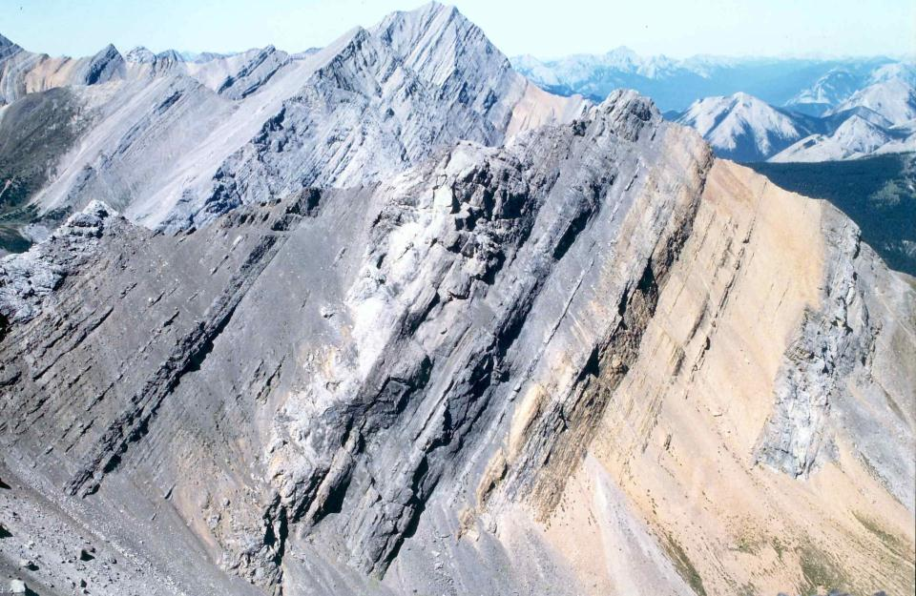
Miette Buildup
Platform
Margin
Mt Hawk
Clastics
Cambrian

Slide 9
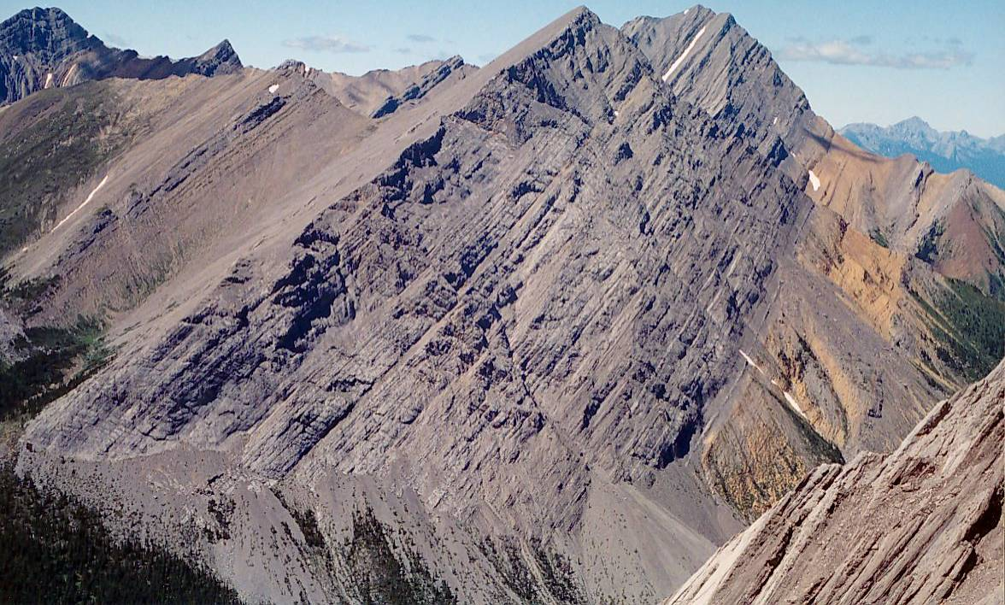
Devonian extinction – Kellwasser events
The extinction is caused by stepwise ocean anoxia - the Upper and Lower Kellwasser anoxia event beds.
Most of the typical late Frasnian Mount Hawk brachiopod fauna became extinct just prior to or during the major deepening coinciding with the Lower Kellwasser event in the very late Frasnian.
At Ancient Wall, extinction of latest Frasnian (Upper Kellwasser event) shelly faunas occurs very high in MN 13, as indicated by a crisis fauna in the uppermost Simla.
Whalen and Day (2008)
Frasnian/Famenian Boundary at Miette

Slide 10
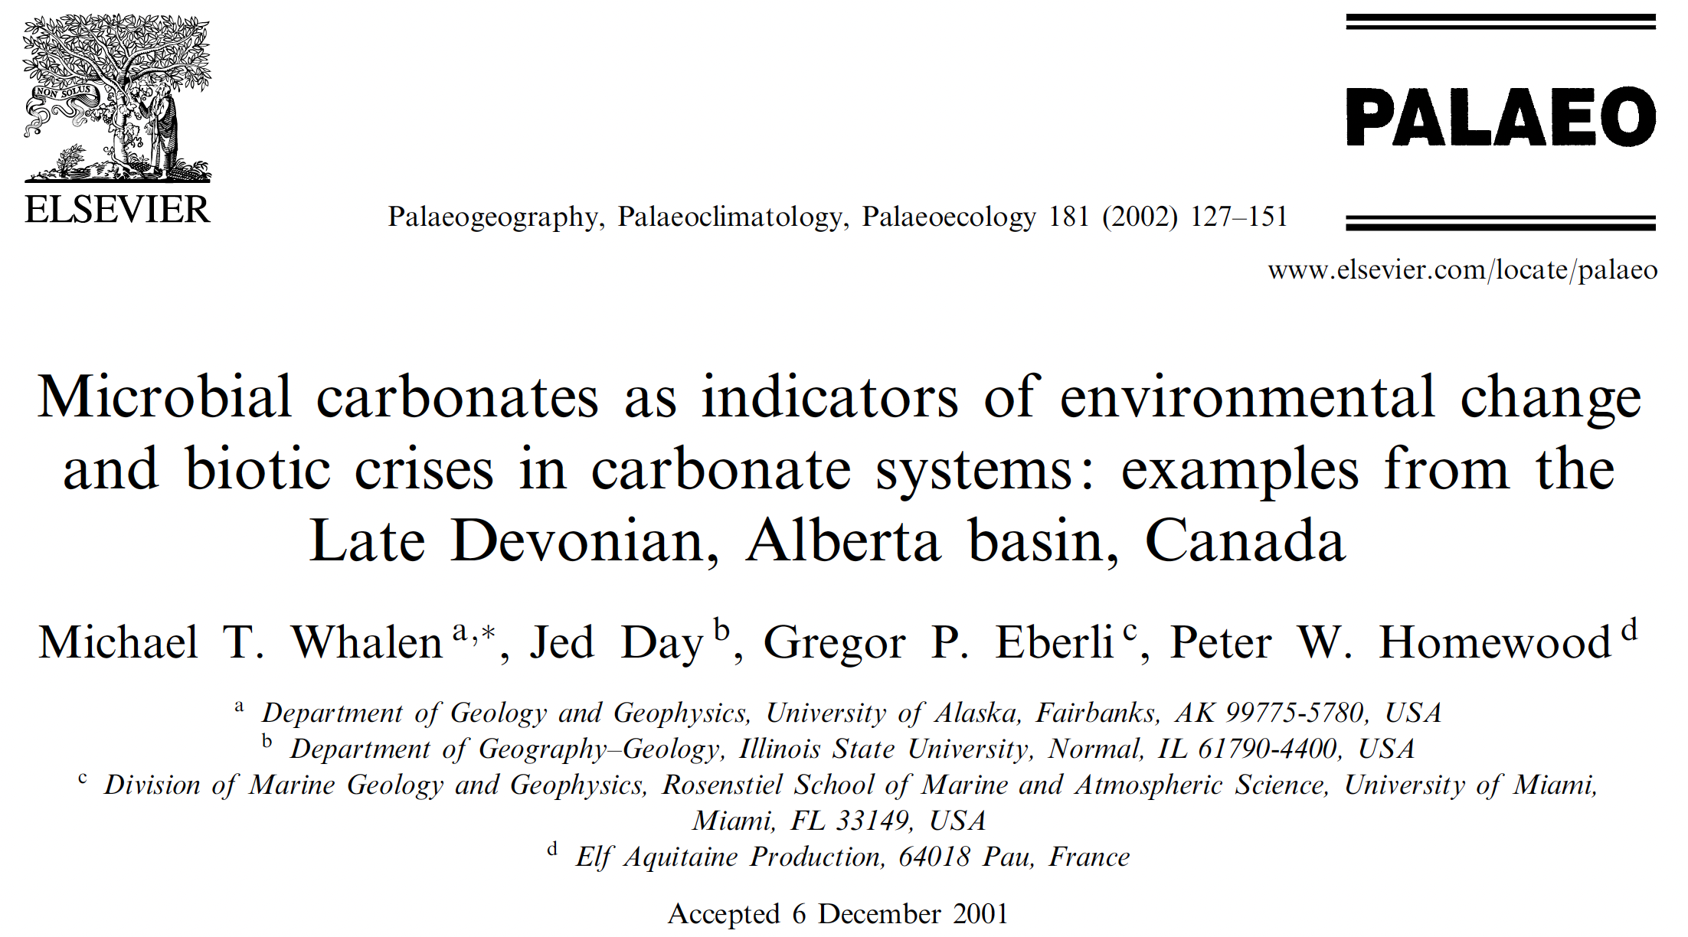
A seminal paper

Slide 11
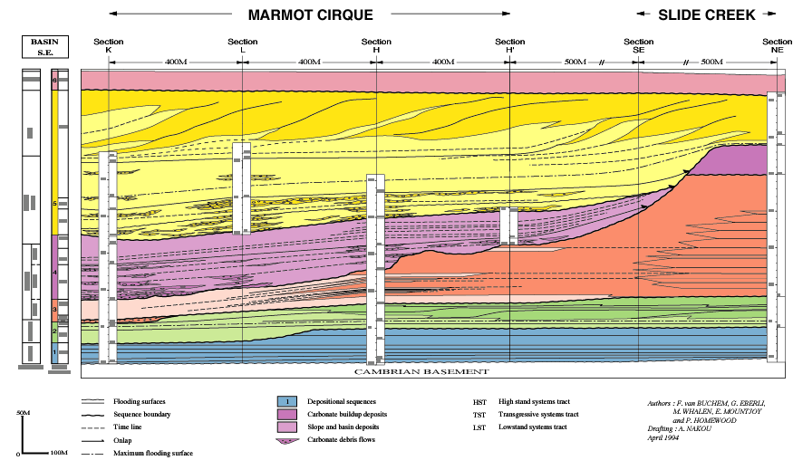
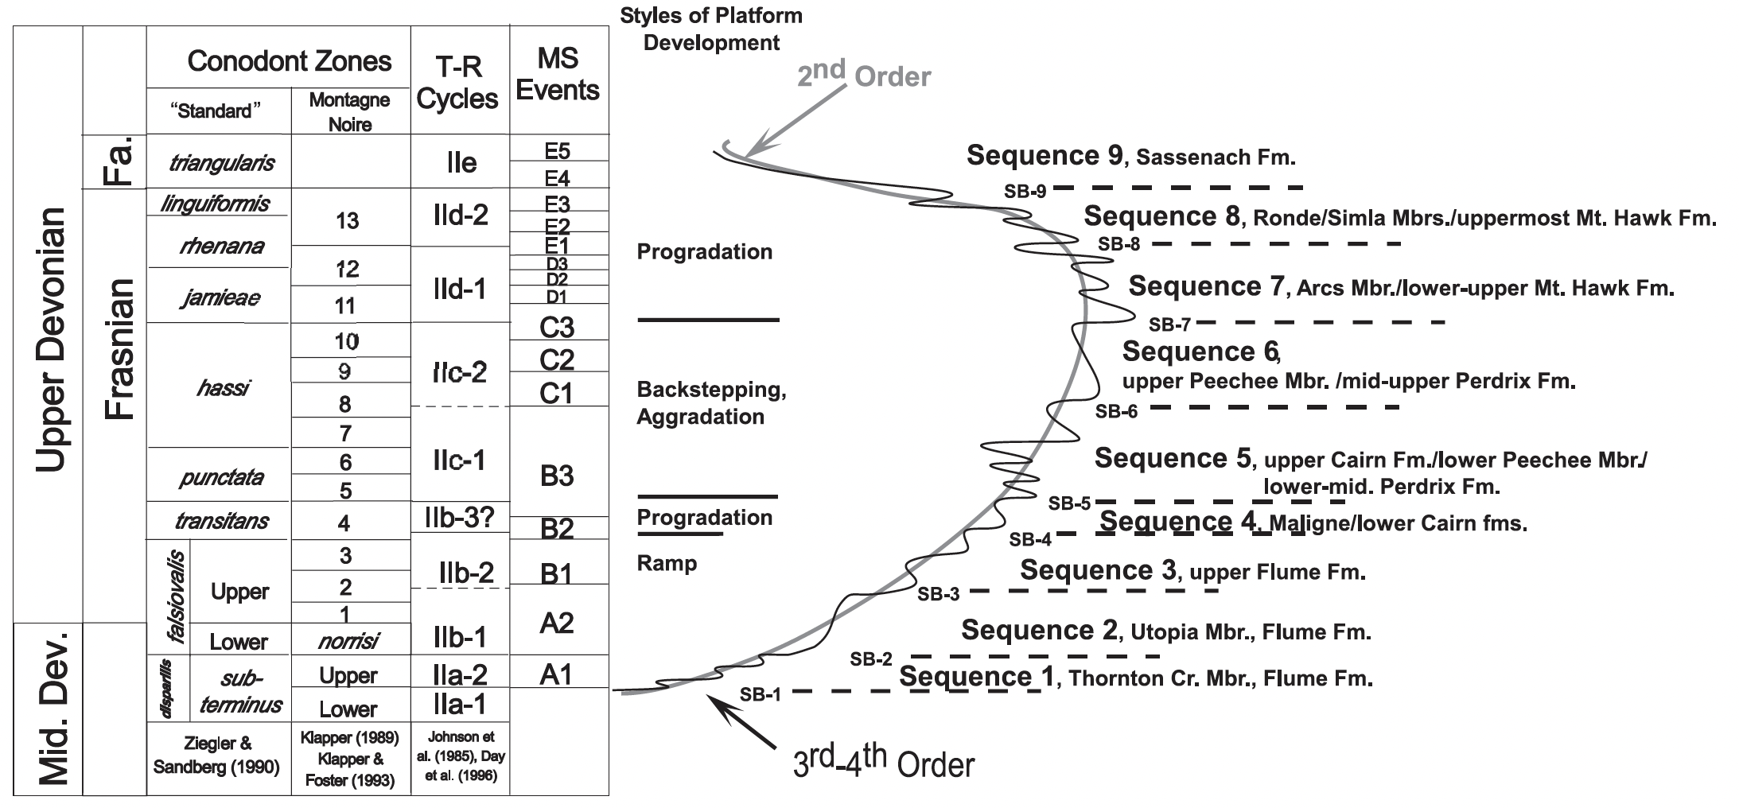
SE Margin of Miette buildup: Depositional Sequences
Prograding Platform 2
Backstepping Platform
Prograding Platform 1
Ramp

Slide 12
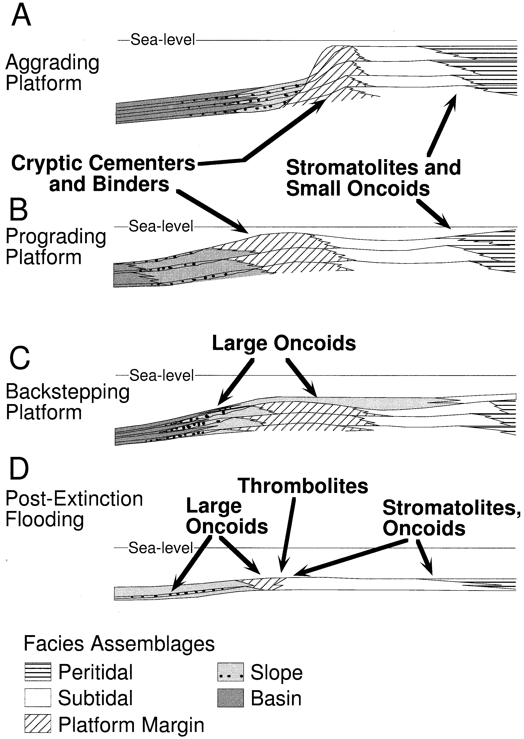
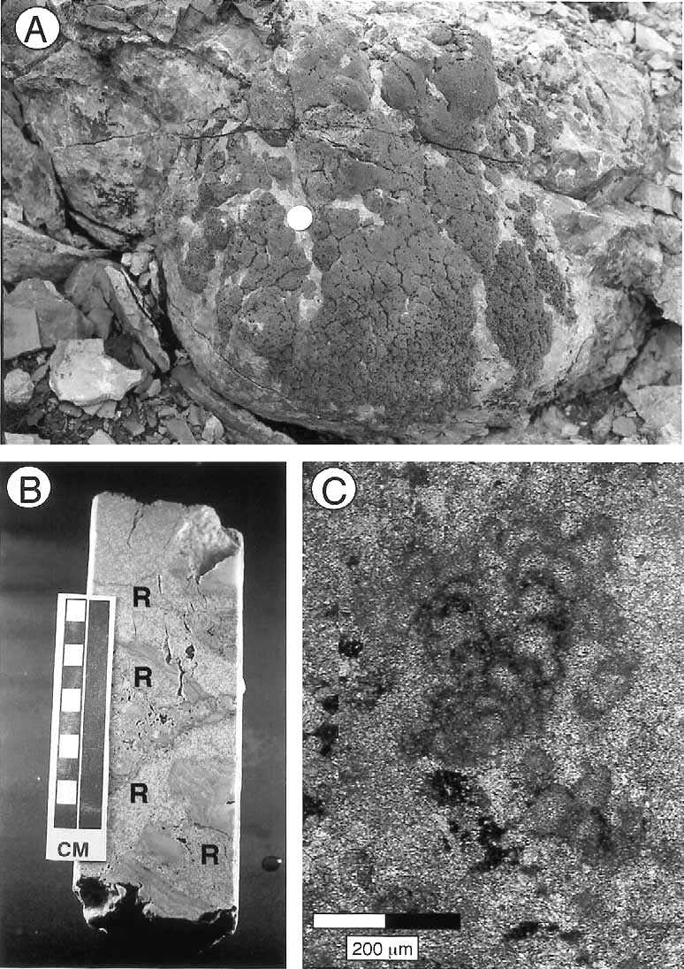
Microbial communities within platform evolution
Cryptic Cementer
Renalcis colony
Cryptic microbes like Renalcis occupy crevices and overhangs in a relatively wide belt of domal stromatoporoid framestones of the reef margin facies association.
Branching Renalcis

Slide 13
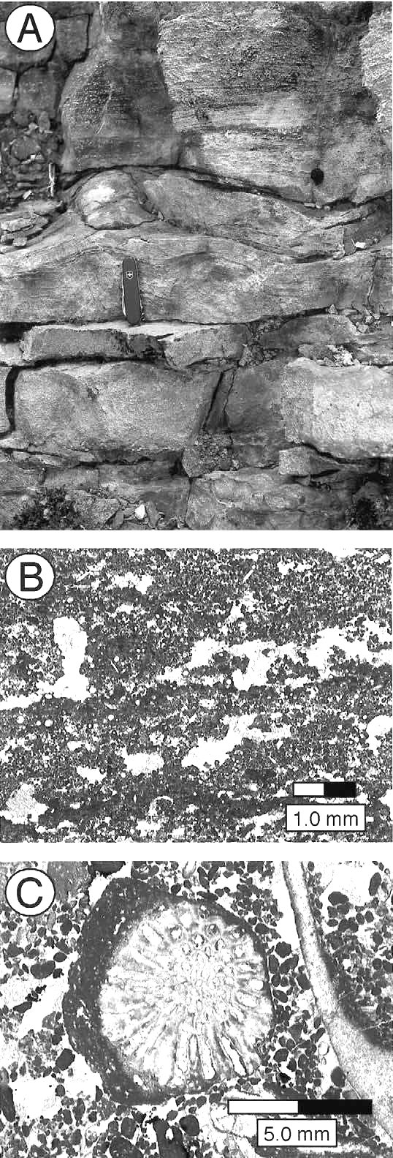
Microbial communities within platform evolution
Stromatolites and small oncoids occur in the peritidal facies association

Slide 14
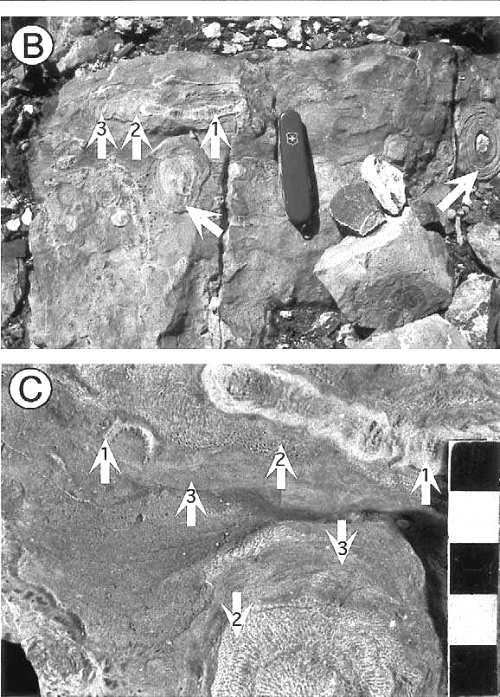
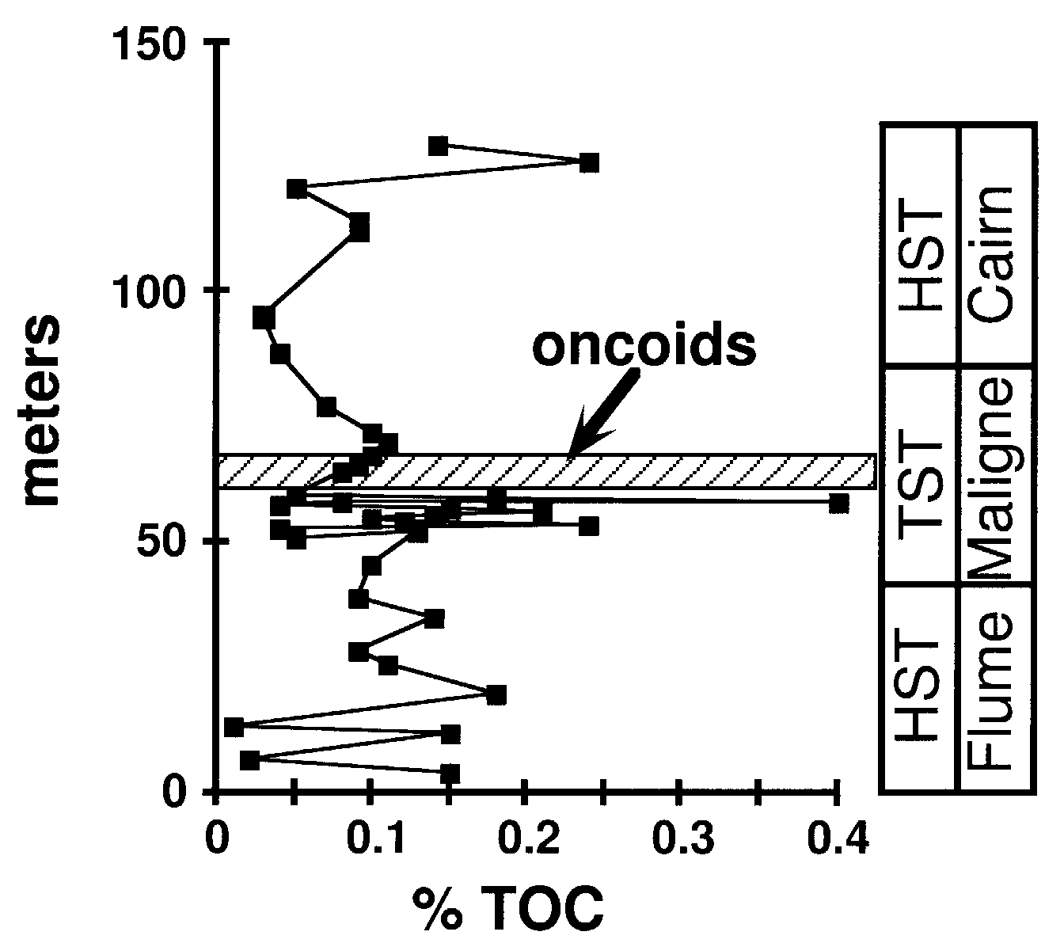
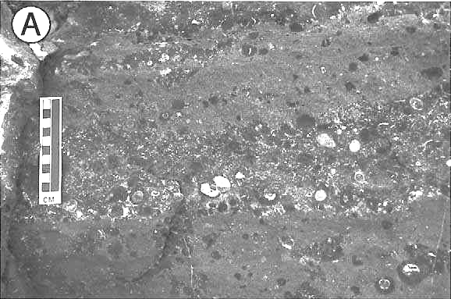
Microbial communities within platform evolution
The large oncoids in transgressive systems were
deposited when normal-marine reefal communities
were episodically interrupted by deepenings that
may be associated with changes from oligotrophic
to mesotrophic conditions.

Slide 15
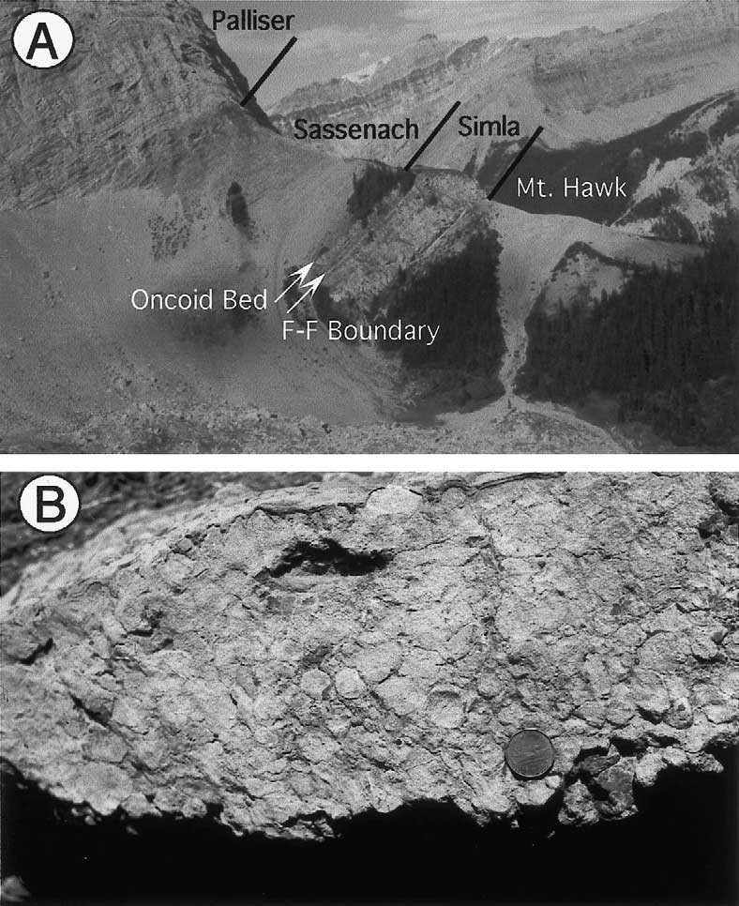
Devonian extinction

Slide 16
Microbial communities within platform evolution
Microbial communities have existed throughout the evolution of the Frasnian reefs, coexisting with other biota such as stromatoporids, corals , brachiopods.
They were the sole survivors of the extinction event.
They were always there and did not move in.

Slide 17
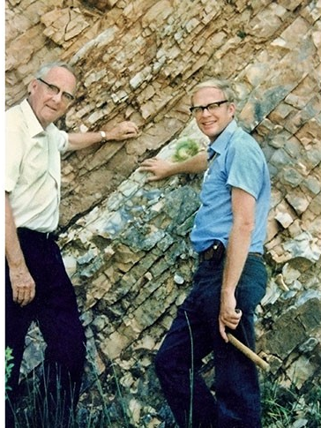
End Cretaceous extinction
Luis Walter Alvarez (left) and his son Walter (right) at the Gubbio outcrop of the K/T boundary. They put forward the. theory that an asteroid collided with Earth 66 million years ago and caused all non-bird dinosaurs and many other animals to die out.
They based this theory on the iridium content at the boundary that was so high that it only can come from a large asteroid.
No impact crater was known at the time, leaving room for other explanations.

Slide 18
Key points
The Chicxulub crater was buried by prograding carbonates.
The Yucatan platform in the late Cretaceous was dissected by a large seaway
The 17 km wide asteroid fell into the seaway and as result he crater rim is asymmetric

Slide 19
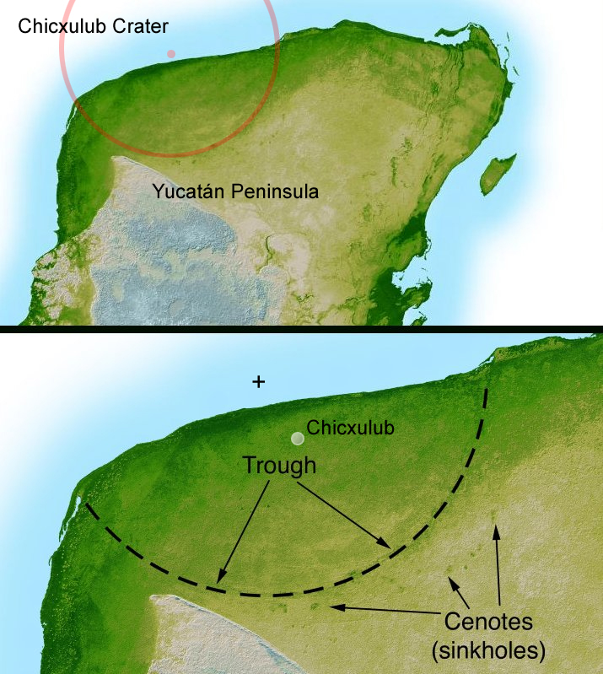
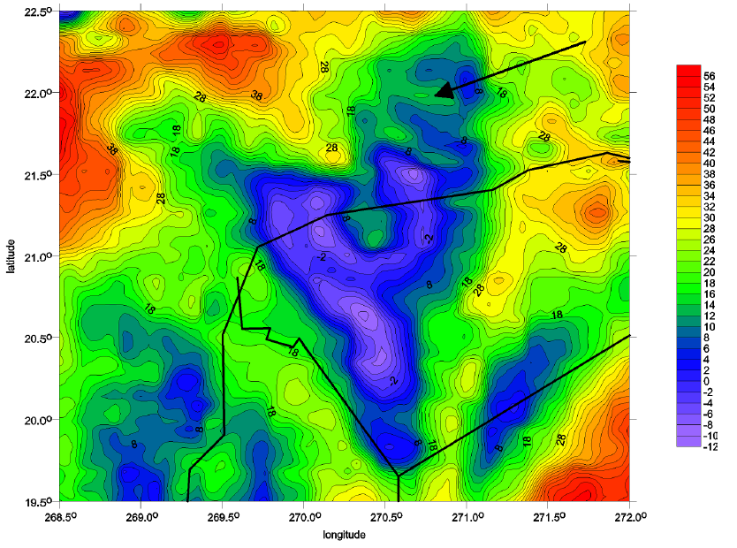
The hidden crater
180–200 kilometres
Free-air Bouger gravity anomaly
Aligned sinkholes and gravity data provide evidence of a crater

Slide 20
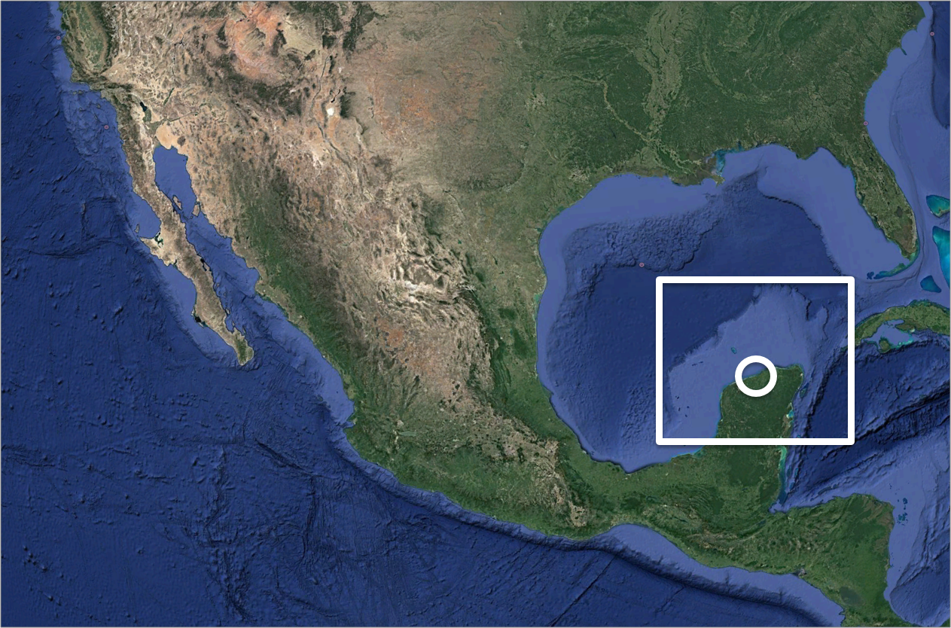
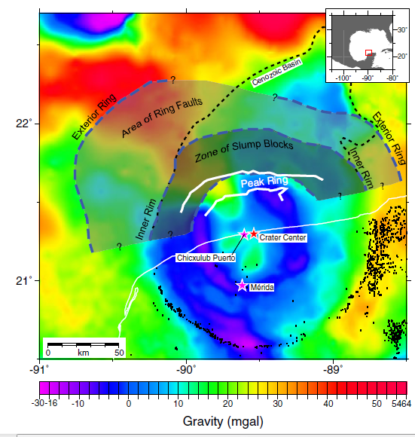
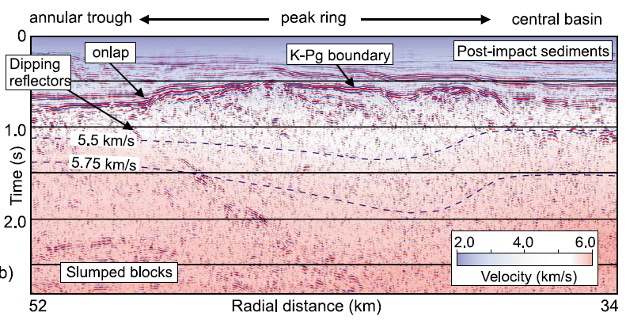
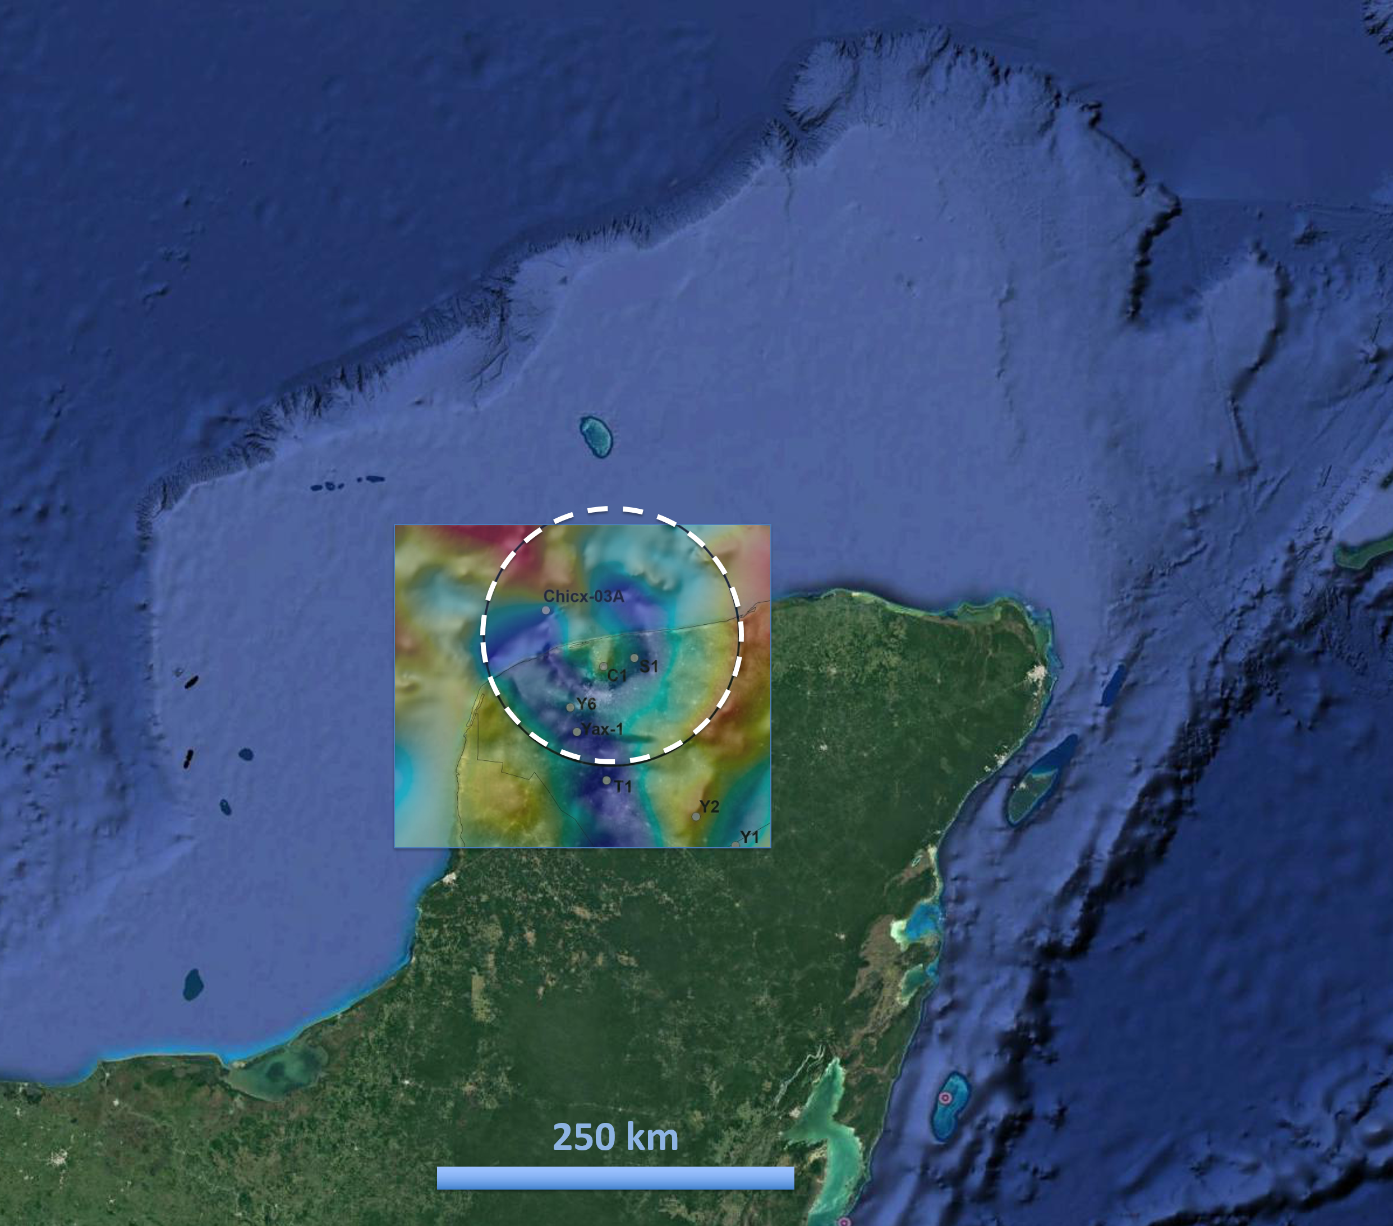
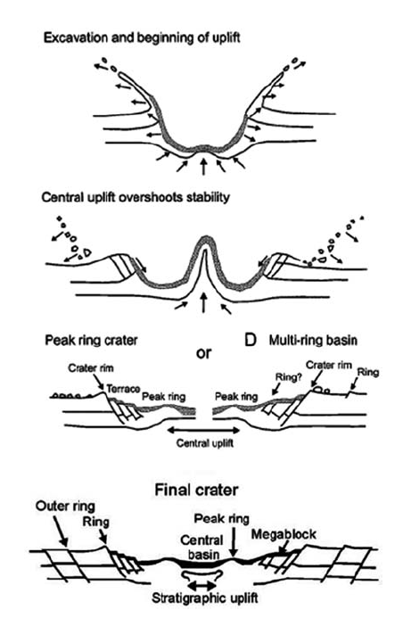
Chicxulub Crater (K/Pg boundary)
Location
Bouguer gravity anomaly
Seismic signature
Cenozoic basin
Gulick et al., 2013.
Morgan et al., 2011.
Urrutia et al., 2011.
Notes:
At the left side is the general evolution of the Chicxulub crater
And here below is the final crater structure. Which consist of a central uplift formed by the basement uplifted rocks. A topographic peak ring, also made up basement rocks.
A terrace zone of faulted carbonates.
This is the gravimetric signature, wich is a circular low gravity anomaly, with a relative high values at the center. That correlates with the uplifted basement rocks
The formation of the Chicxulub crater has been reconstructed with numerical models that relate the formation of the crater in 10 minutes, but in general it can be schematized in 3 stages: The excavation stage (when the sedimentary cover is expelled and vaporized), then crustal rocks rebounded forming a central uplift (fluidized by pressure and temperature effects). Then central uplift collapsed pushing the surrounding material and forming the peak ring. And the final crater has a set of blocks collapsed downward and inward the crater structure, with normal failure. That make up a terrace zone.
The gravimetric signature is a circular anomaly that displays higher values ​​at the central zone and is due to the uplifted basement rocks. The dark blue and magenta region are the lowest gravity values and they are distributed in the peak ring and terrace zone.
And in the seismic signature of the chicxulub crater, can be observed as a continuous reflector of great amplitude. This reflector marks the end of the Cretaceous period and it is over a huge massive package of weak, chaotic and discontinuous reflections. And this reflections are due to the deformed and fractured basement rocks. And they are very different from the reflections of overlying post-impact sediments.
This was the general framework with which the project began. And the objective is to know the distribution of the K/Pg boundary, not only within the crater and throughout the Yucatan Platform.
Why:
It is of universal scientific interest (mass extinction)
Why gravimetric anomalies (some has been associated to the impact direction)
Why the Yucatan platform has not been explored. (Why it is thought that it does not contain hydrocarbons).
La formacion del crater ha sido reconstruida con modelos numericos que relatan la formacion del crater in alrededor de 10 segundos, pero en general puede esquematizada en 4 etapas: La etapa de excavacion (donde es expulsada y vaporizada la cubierta sedimentaria), .Luego el levantamiento central, que es el rebote de las rocas de la corteza, fluidizadas por efectos de presion y temperature. Luego el colapso del levantamiento central y el empuje de la region circundante que hace que se forme el anillo de picos. Y el crater final con una serie de bloques colapsados hacia abja y hacia adentro, con fallamiento normal. Que conforman la zona de terrazas.
La firma gravimetrica es una anomalia circular que despliega valores mas altos en la zona central y que corresponde al levantamiento central. Los valores mas bajos en la zona del anillo de picos y la zona de terrazas.
Y en la firma sismica del evento, se ha observado como una capa de roca fundidas que pueden ser observadas como un reflector continuo de gran amplitude, que es el que marca limite K/Pg, que se encuentra sobre un paquete masivo de reflecciones debiles, caoticas y dicontinuas. Las cuales son muy diferentes a los sedimentos postimpacto.
El objetivo de este projecto es conocer la distribucion de este limite K/Pg, no solo dentro del crater, sino en toda la plataforma de Yucatan.
Por que:
Es de interes cientifico universal.
Por que las anomalias gravimetricas
Por que la plataforma de Yucatan no ha sido explorada. Por que se piensa que nocontiene hidrocarburos.

Slide 21
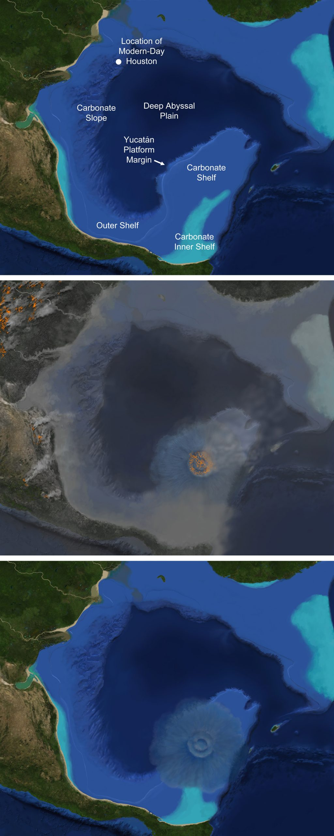
Asteroid impact crater Yucatan
Left: Pre-impact paleogeography of the Gulf of Mexico region. Right: The Chicxulub impact crater y. The impactor hit the sea, penetrating carbonate shelf sediments, underlying carbonate platform strata that included sulfate-rich anhydrite beds, and crystalline basement rocks. Coastal seas were turbid with debris.
Credit: Pre-impact paleogeographic reconstruction provided by John Snedden. Credit: Art by Victor O. Leshyk

Slide 22
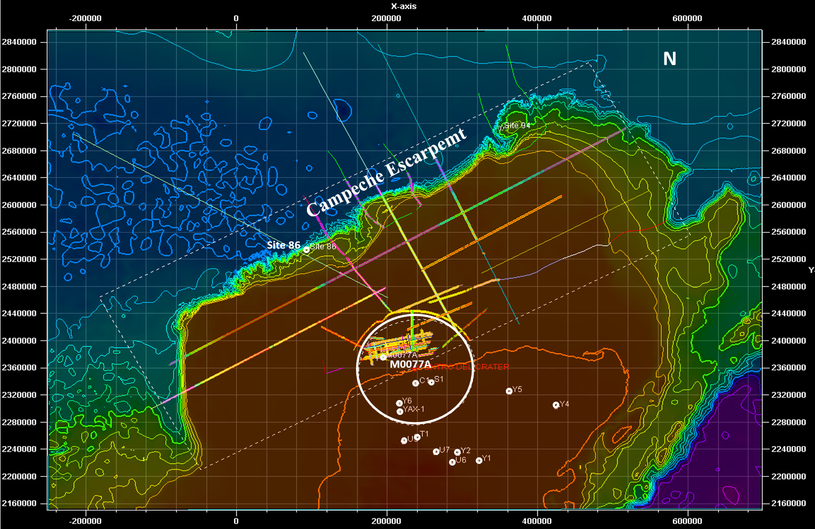
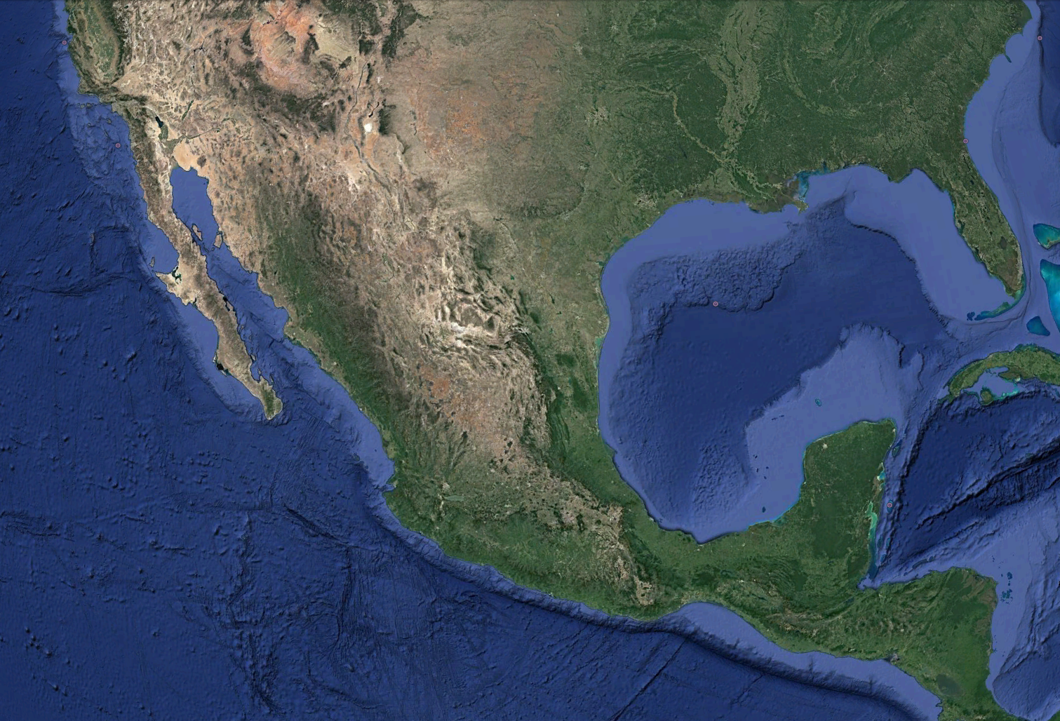
Geophysical dataset
Elizabeth Guzman
2D offshore seismic lines:
Seismic dataset from the Academic Seismic Portal (ASP), University of Texas, Institute for Geophysics UTIG (Christeson et al., 2017), and the National Hydrocarbons Information Center-(CNIH).
Offshore boreholes:
M0077A - International Ocean Discovery Program,
IODP (Gulick et al., 2017).
Site 86 – Worzel et al., 1973.
Multi-Resolution Global Topography Synthesis (GMRT)
Notes:
The geophysical data sets wich consist of 3 sets od 2D seismic lines.
We have collected around 50 2D offshore seisic lines. Annd 13 onshore boreholes.
There are just two offshore boreholes close to seismic lines, that we ese to control the seismic interpretation.
offshore Yucatan Platform seismic lines.
The dataset in A. is a set of 39 seismic lines obtained by the IODP, in 2005. They are distributed mainly in a grid within the northern half of the Chicxulub Crater.
is a set of 7 2D seismic lines that are mainly crossing the north face of the Campeche Escarpment.
It is a set of 8 regional seismic lines obtained by Pemex. Between 2002 and 2004.
On the background is the bathymetry map of Multi-Resolution Global Topography Synthesis (GMRT)
39, 7, 8
39. Es un conjunto de 39 líneas sísmicas 2D obtenido por IODP en 2005. que esta distribuido principalmente en un grid dentro de la mitad norte del cráter chicxulub.
7Es Un conjunto de líneas sísmicas 2D que se encuentran principalmente cruzando la cara norte del Escarpe de Campeche.
8
Es un conjunto de líneas sísmicas regionales obtenidas por Pemex. Entre 2002 y 2004.
El mapa de fondo es el mapa de batimetría de Multi-Resolution Global Topography Synthesis (GMRT)
39, 7, 8

Slide 23
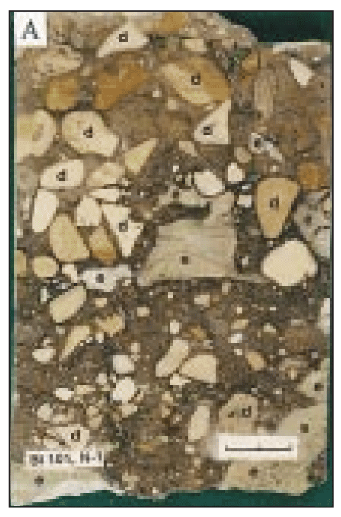
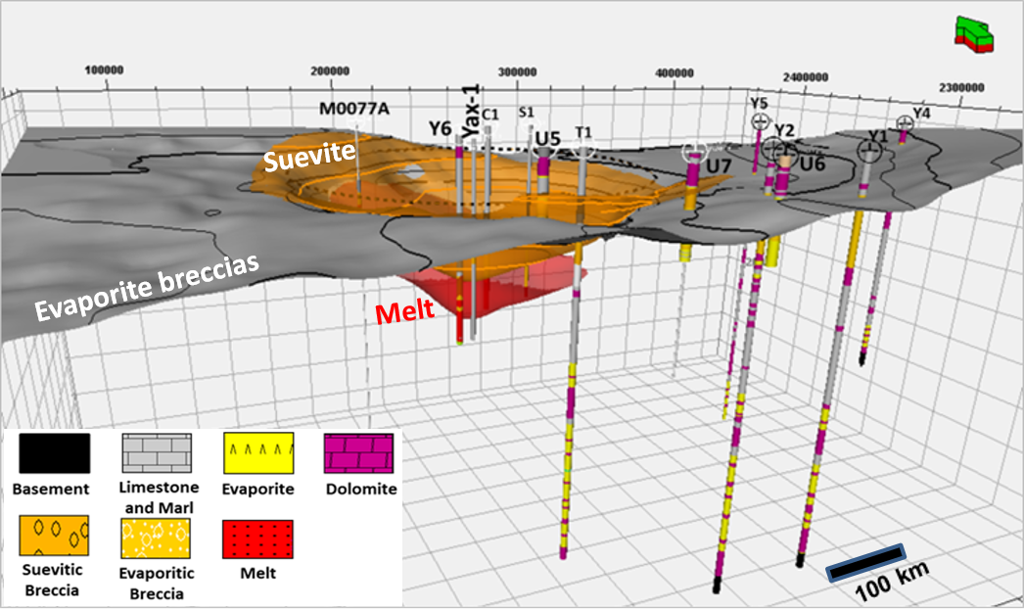
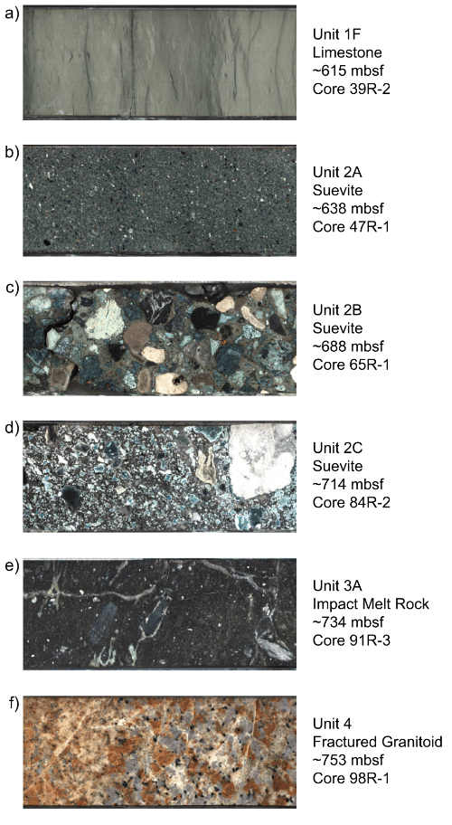
Geological dataset
Elizabeth Guzman
Impact lithologies
K/Pg boundary based on boreholes stratigraphy
Chicxulub crater
melt rock
suevite breccia
evaporite breccia
~ 25-50 m
Thickness
~70-450 m Thickness
~ 30-500 m
Thickness
Impact breccias ~300-m-thick western part of the Campeche Escarpment, 350 km ( Grajales et al., 2000)
Stratigraphic columns reported by:
Ward et al., 1995, Stoffler et al., 2004 Urrutia-Fucugauchi et al., 1996, Rebolledo-Vieyra et al., 2000, Kring et al 2004, Urrutia Fucugauchi et al., 2011, Morgan et al., 2016, and Kring et al., 2017.
Onshore boreholes
Notes:
This is an estratigraphic section
The geological datasets are the stratigraphic columns summarized of 13 boreholes reported by the authors mentioned here below. Most of the borehole are onshore. Except the first one, M0077A, which is a marine borehole.
This stratigraphic section was used to infer the distribution of impact lithologies. There are three main types of impact lithologies:
-Impact melt rock unit (in red) is distributed near from the crater center- and It is the crystalline rock solidified from impact melt, excavated from the silicate-rich basement.
-Suevite breccias (in orange) distributed inside and outside the crater- and they are made up of excavated basement fragments and melt particles.
-Evaporite breccia (in yellow) outside the crater-has abundant clasts of gypsum and anhydrite.
What we can observe in the section, is that impact lithologies are placed between two large carbonate packages.
The lower package is the sequence desited during the Mesozoic era, it starts from the basement, around 3000 m and consists of intercalations of evaporites and dolomites and limestones.
Then we observe evaporite breccias which are impact lithologies.
And the package above the evaporate breccias is the sequence of post impact sediments deposited during de Cenozoic era.
El conjunto de datos geologicos son las columnas estratigraficas de 13 pozos que fueron resumidas de los trabajos de los autores aqui mencionados. La mayoria de los pozos se encuentran en tierra. Excepto M0077A.
Esta sección estratigráfica se utilizo para inferir la distribución de las litologías de impacto.
Impact melt rock unit (en rojo) is the crystalline rock solidified from impact melt, excavated from the silicate-rich basement.
Suevite breccias (en anaranjado) is made up of the excavated basement fragments and melt particles ( embedded in a clastic calcite-rich matrix )
Evaporite breccia (en amarillo) has abundant clasts of gypsum and anhydrite.
Lo que podemos observar a grandes razgos es que se encuentran atrapadas entre dos grandes paquetes de carbonatos (limestones, evaporites and dolomites).
El paquete inferior es la secuencia del mezozoico, comienza desde el basamento, alrededor de los 3000 m y consiste de intercalaciones de evaporitas y dolomitas y calizas.
Luego están las brechas de evaporitas que son litologías de impacto.
El paquete Superior es la secuencia del paleógeno al reciente.

Slide 24
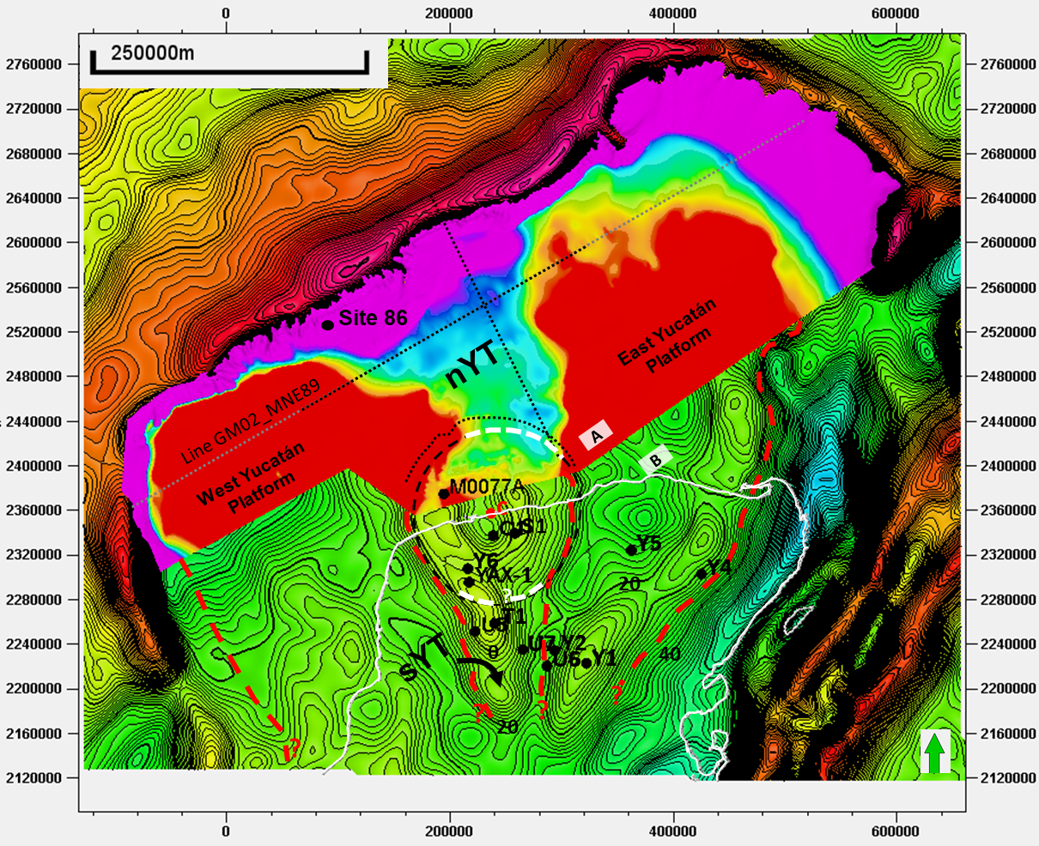
Seaway in the platform
Elizabeth Guzman
K/Pg map (TWT) + gravity anomalies map
Seismic and gravity data show that the east and west Yucatán platforms are relatively high and flat surfaces.
In the impact zone, the eastern and western interior margins of the platforms display the semi-circular shape of the Chicxulub crater consistently with the ~70–85 km inner rim radius, implying that the former Yucatán Trough margins were excavated during the impact event.
Guzman-Hidalgo et al., 2021

Slide 25
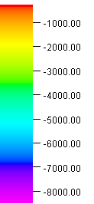
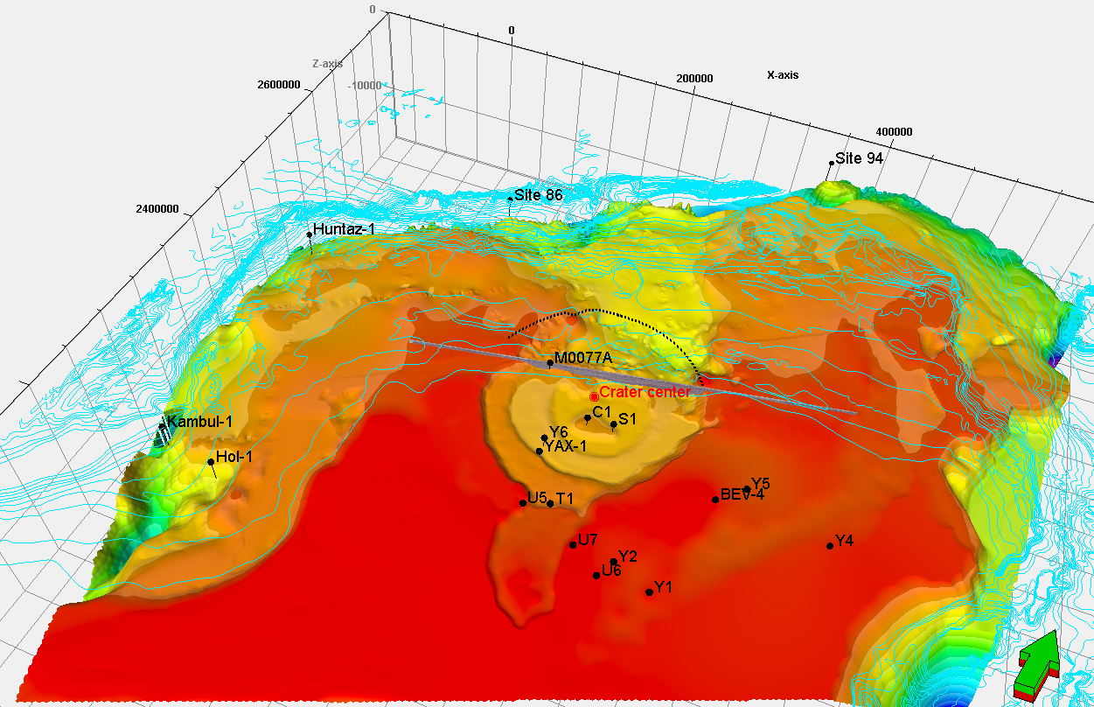
Regional estimation of the K/Pg depth
Elizabeth Guzman
Central uplift
(C1, S1)
Terrace zone
(Yax-1, Y6)
Southern Yucatán Trough
(T1)
East Yucatán Platform
(Y4,Y5, BEV-4, Y1,Y2, U6, and U7)
West Yucatán Platform
U5

Slide 26
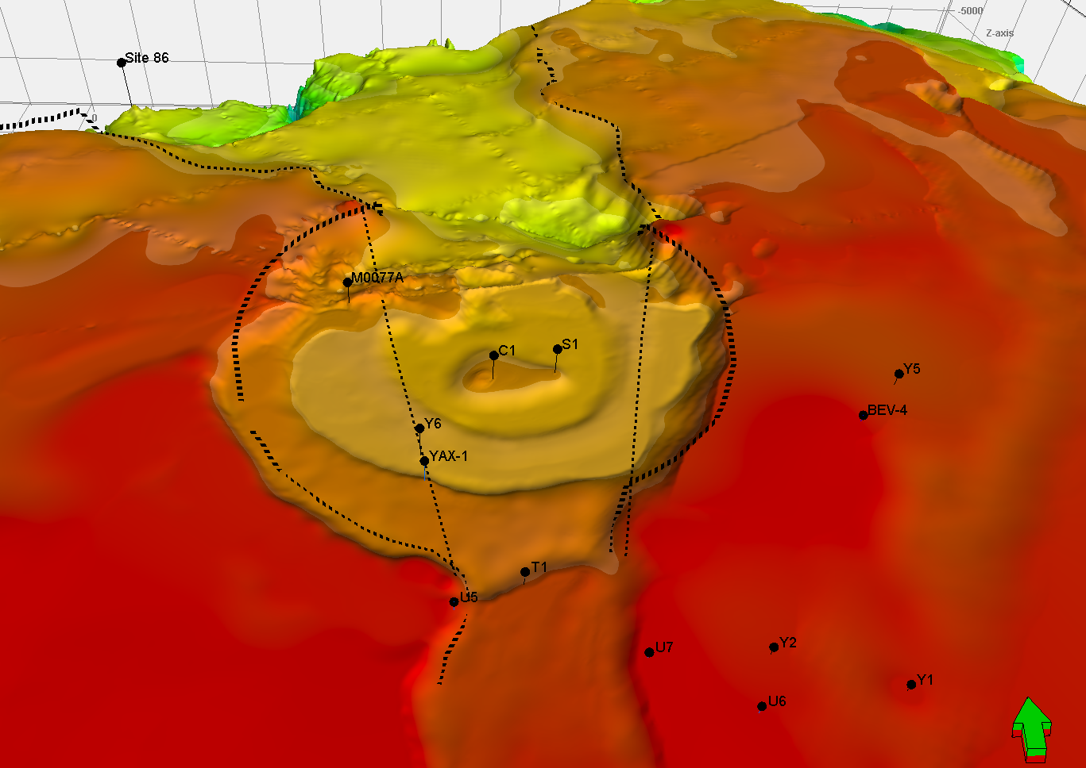
Margins of the Yucatán Trough
Elizabeth Guzman
The width of the previous margins is unknown but extrapolating the margins we estimate the trough to be ~80 km before the impact.
80 km

Slide 27
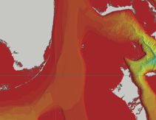
Comparison of size of seaway
Elizabeth Guzman
Miami
Straits of Florida
Bimini
80 km
Florida Shelf
80 km
Great Bahama Bank
The Seaway was comparable in width to the Straits of Florida but it was deeping to the north.
This explains the asymmetry in the crater rim and the lack of rim to the north.

Slide 28
Hiding of the crater
Guzman-et-al-2021

Slide 29
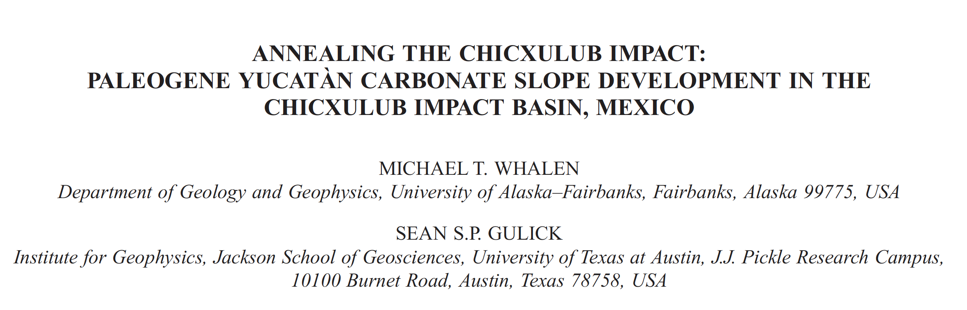
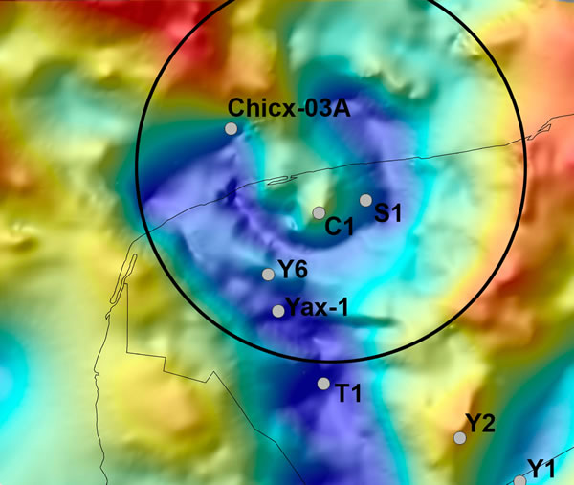
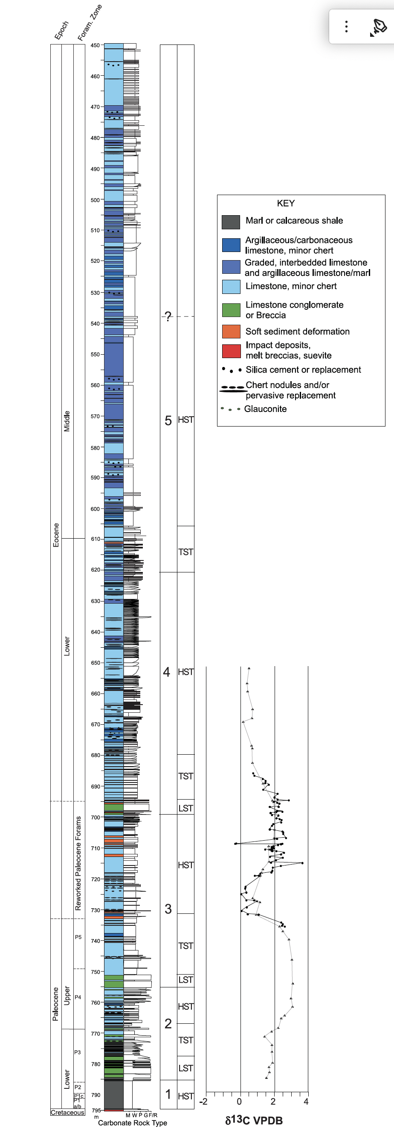
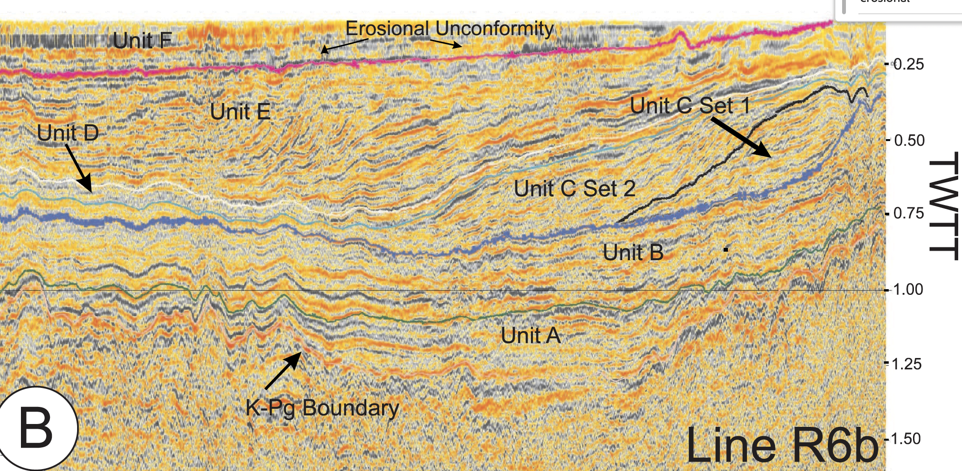
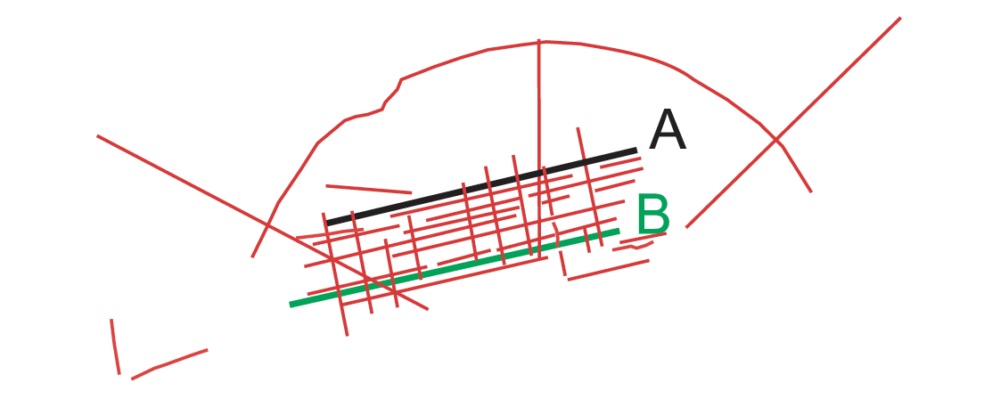
Core through the filling sequences

Slide 30
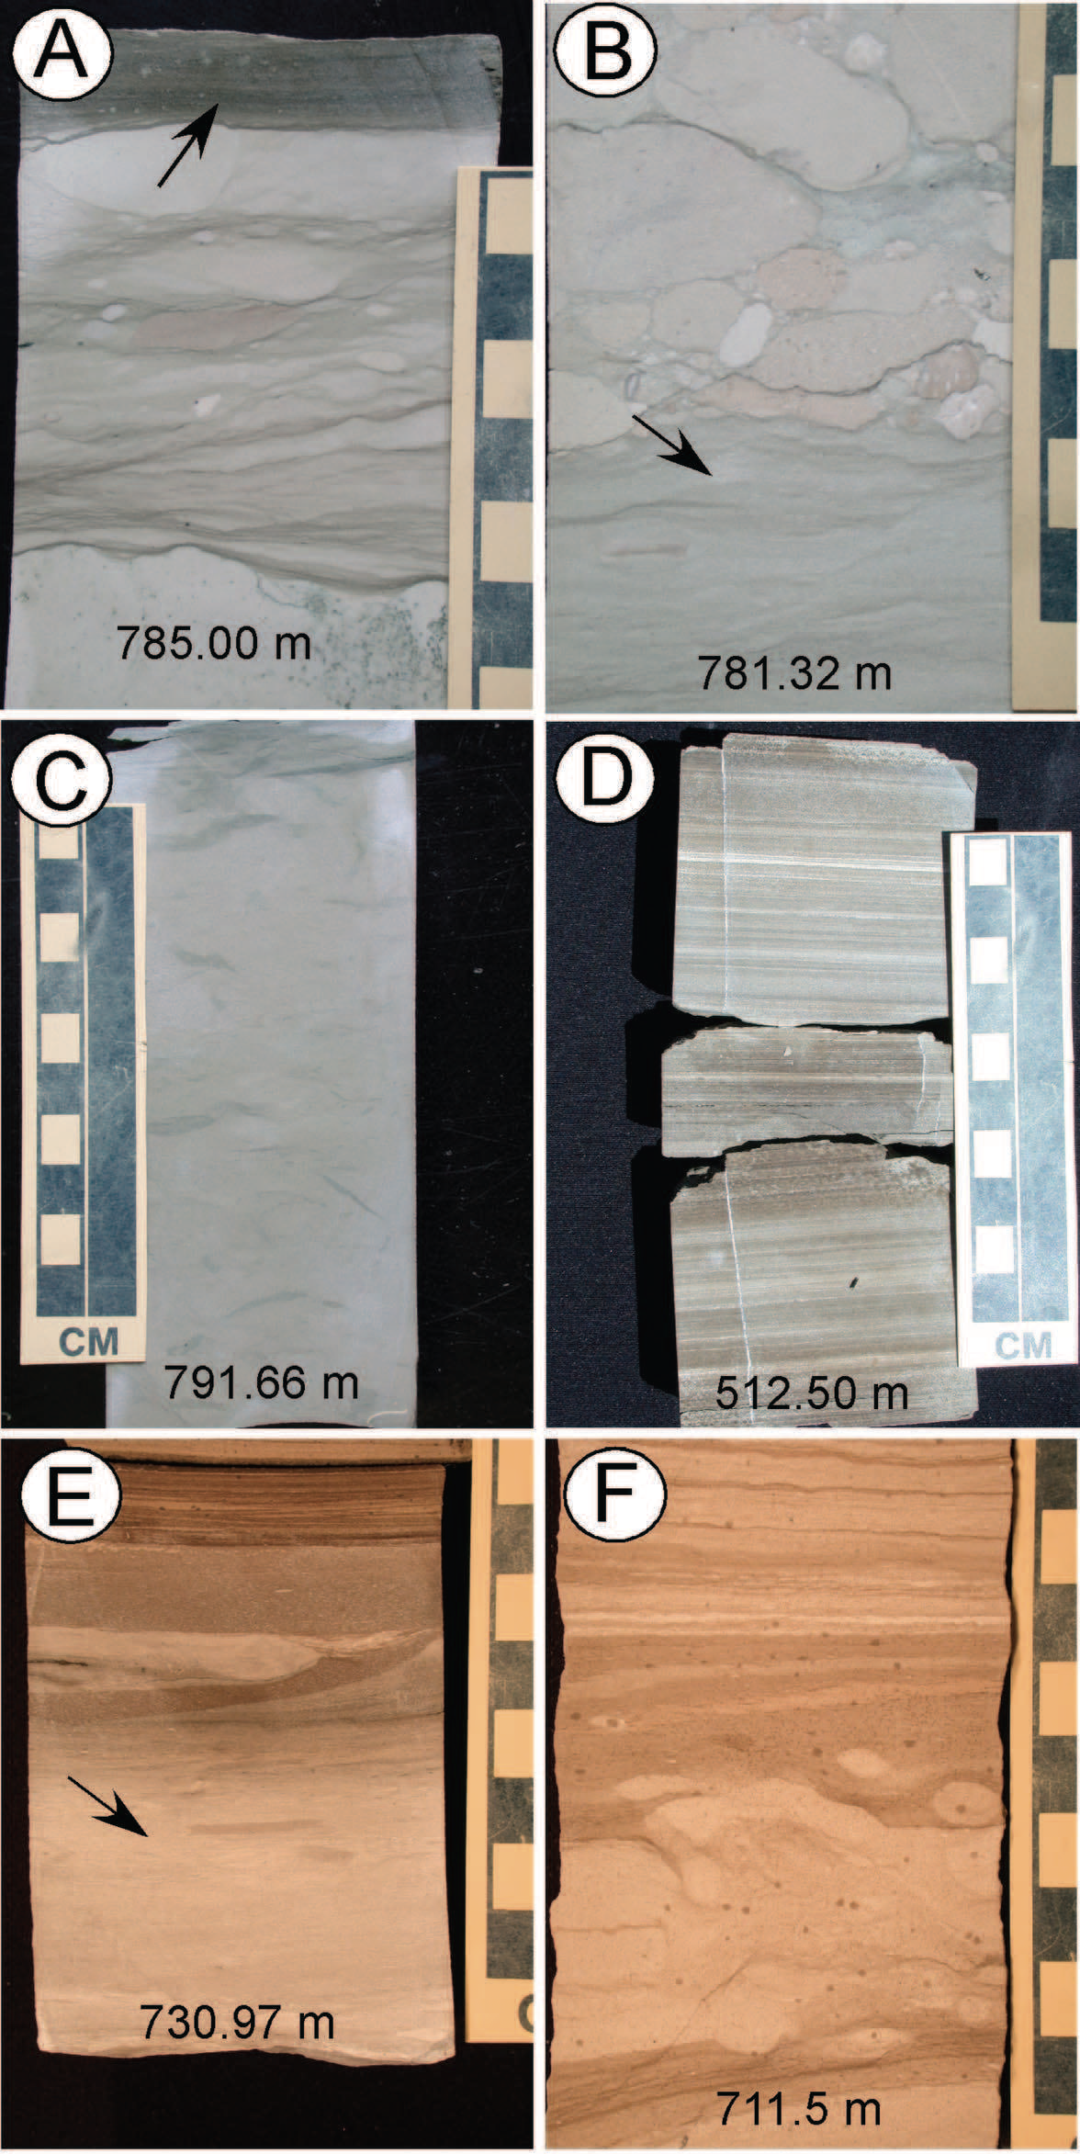


Sediment in the prograding sequences
Whalen et. 2009

Slide 31




Expansion of the western platform
Progradational patterns
Cenozoic
High, medium, and low amplitude reflectors, downlaping terminations
Chaotic reflection patterns
Aggradational patterns
Slight progradational patterns
Mesozoic

Slide 32
Conclusions and Implications
Mike Whalen documented that microbial carbonates are an integral part of the Frasnian build-up in the western Canadian Basin.
The stromatolite, oncoids and thrombolites at the F-F boundary are survivors not disaster taxa.
The asteroid causing the end Cretaceous extinction hit a seaway in the Yucatan platform.
Prograding carbonates did hide the crater and expand the Yucatan Platform to its large modern size.

