Slide 1
Microbially Induced Permeability Reduction: Example of Project SEALOR for South Florida Flood Management
Alexander Suma, Robert Smith, and Ralf J. Weger

Slide 2
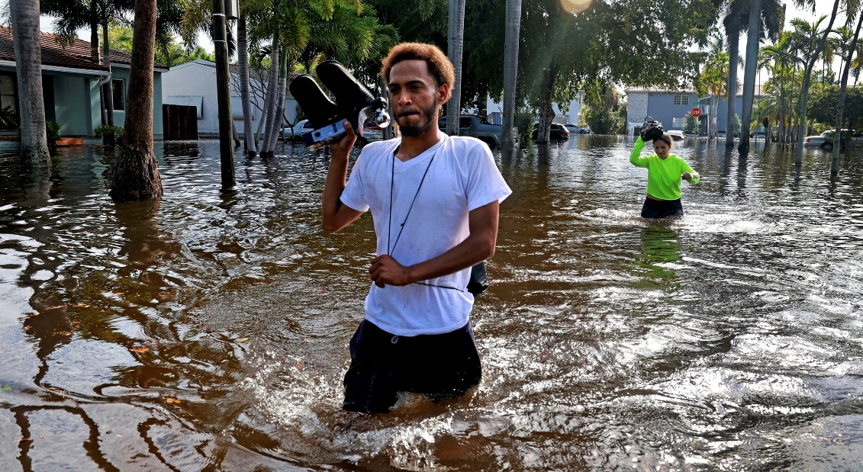
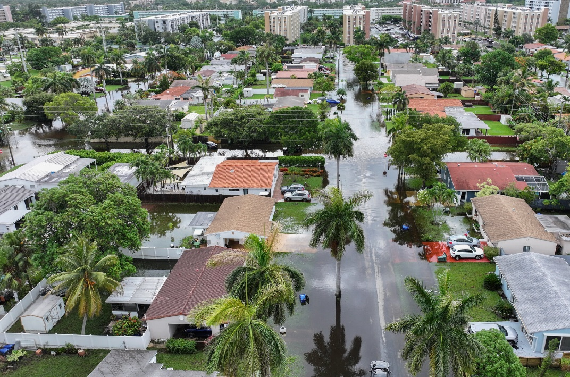
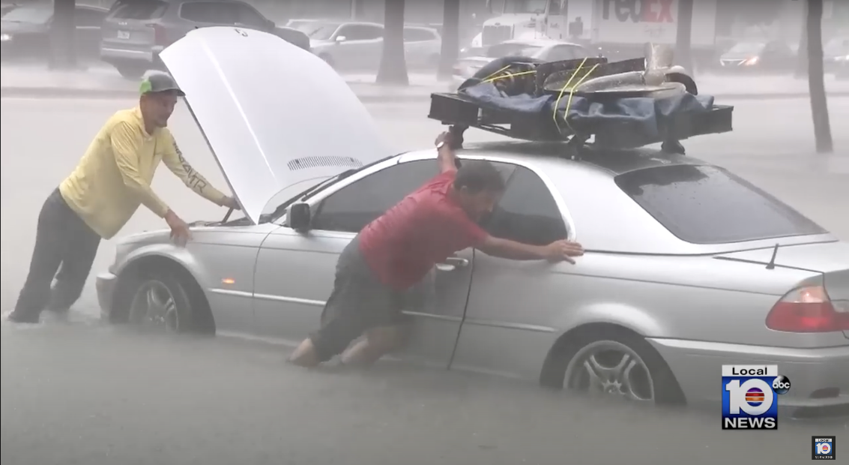
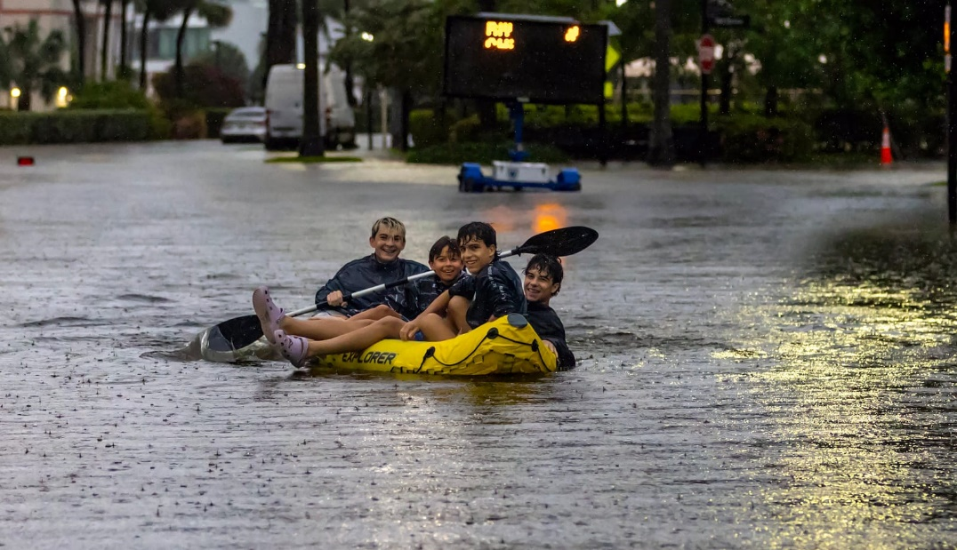

Slide 3
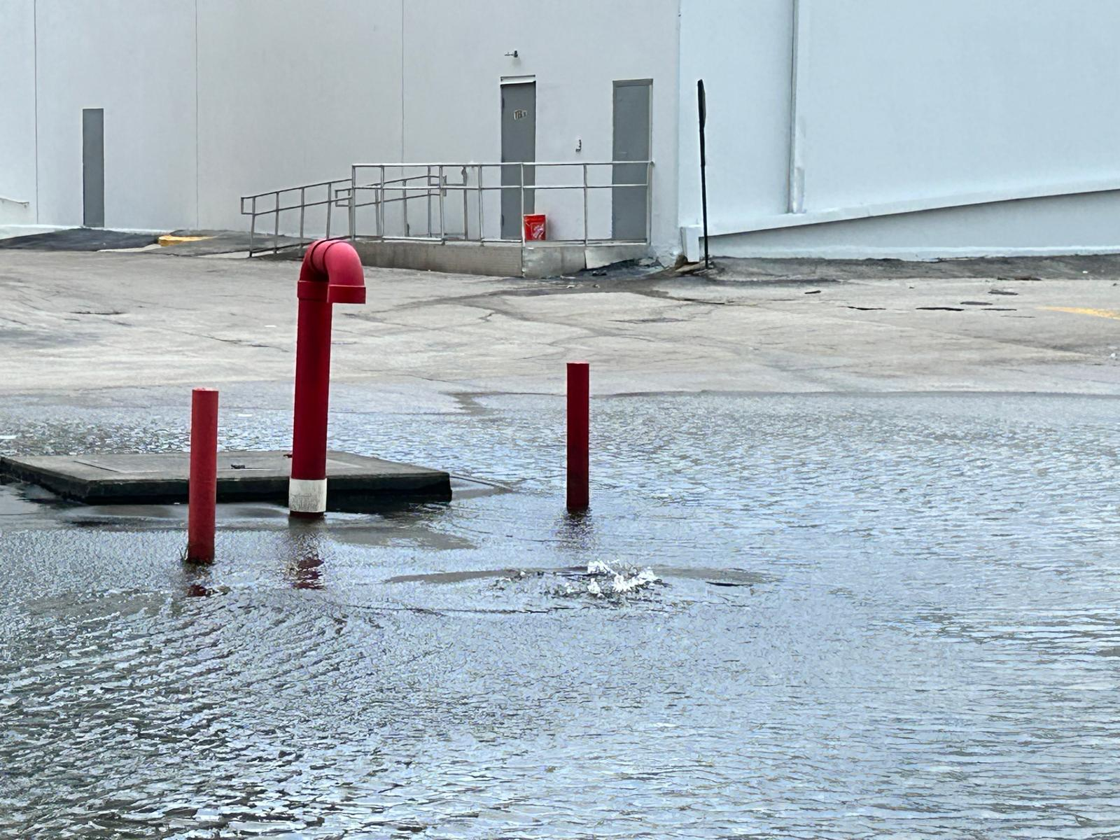
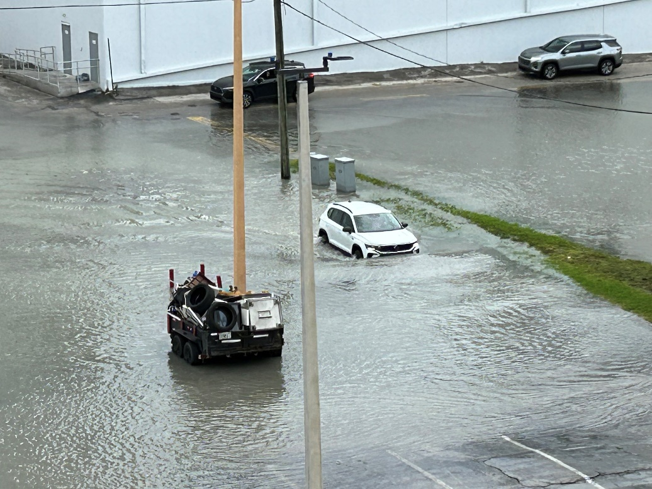
Bottom-Up Flooding, King Tide 2024
One night of rain, August 8th, 2025

Slide 4
Why should you care?
SEALOR represents a unique intersection of carbonate sedimentology, energy transition, and applied subsurface engineering.
The approach provides:
Flood & Infrastructure Protection: Enabling long-lasting, low-toxicity reinforcement of porous carbonates, directly relevant to coastal urban resilience.
Carbon Sequestration: Permanent mineralization of CO₂, aligned with global decarbonization goals.
New Pathways for Carbonate Engineering: Insights into pore-filling, strength enhancement, and permeability control in carbonate reservoirs, directly translating to subsurface storage, enhanced recovery, and wellbore stabilization.
Industrial Synergies: Oil and gas companies exploring Carbon Capture, Utilization & Storage (CCUS) and reservoir integrity can adapt SEALOR ’s methodology in carbonate formations globally.

Slide 5
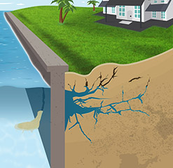
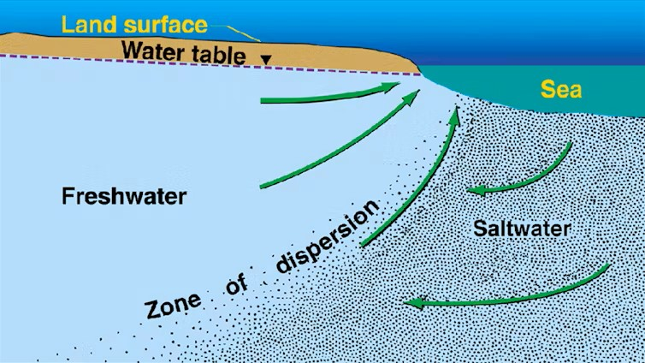
Sea Walls
Saltwater Intrusion

Slide 6
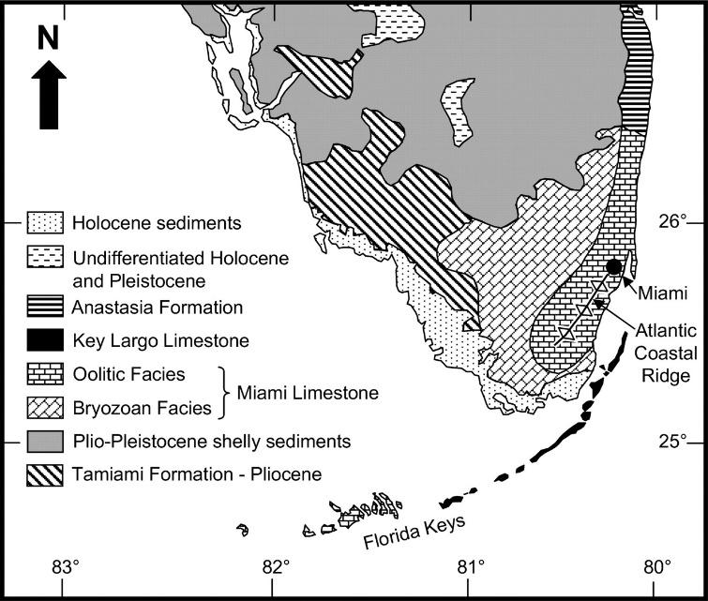
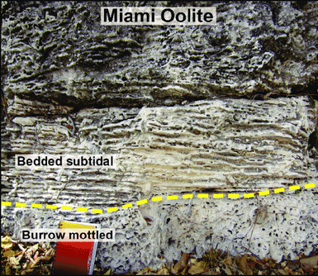
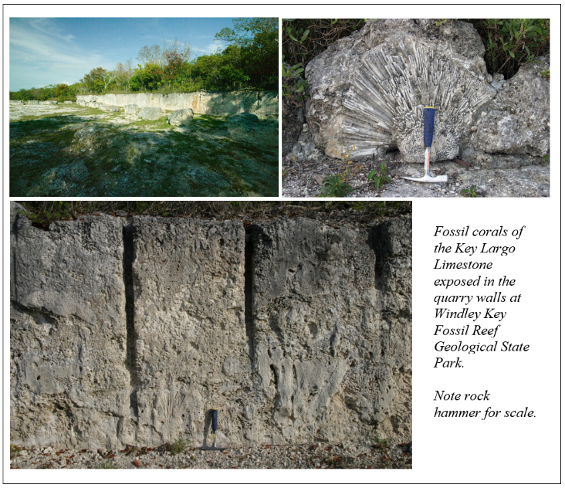
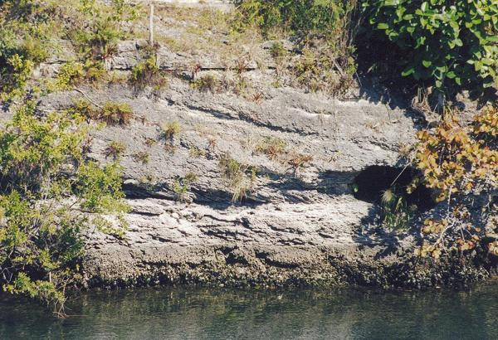
Caglar Usdun
Neal et al., 2008
Florida Geological Survey News and Research - September 2019

Slide 7
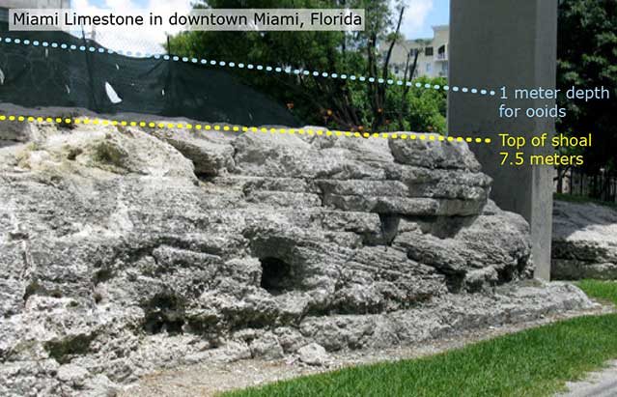
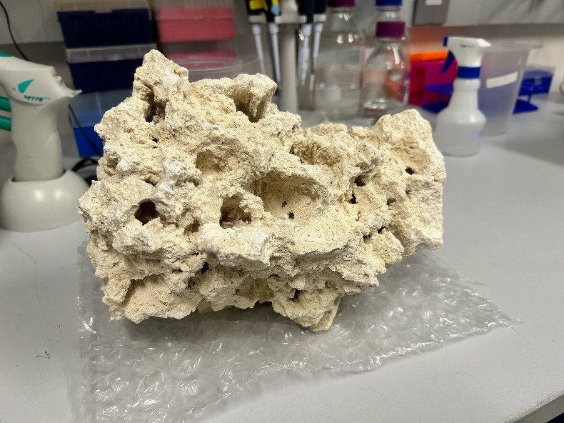

Miami Limestone
Florida’s to layer composition
~3ft of dirt
~30ft of Miami Oolite
Miami Oolite
Average 37% cavity
Up to 60% cavity space in matrix

Slide 8
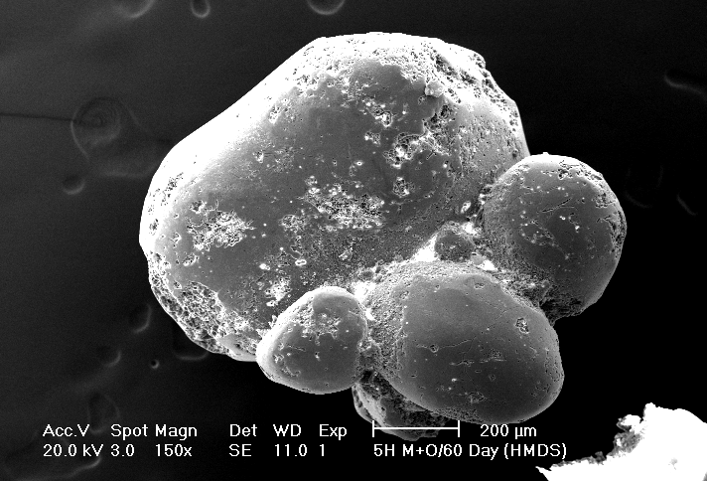
Joulters Cay – experiment comparison
Fused grains at Joulter Cays
In vitro Fused grains (60 days)
Notes:
Joulters Cay

Slide 9
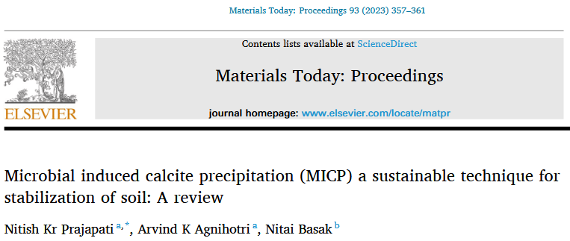
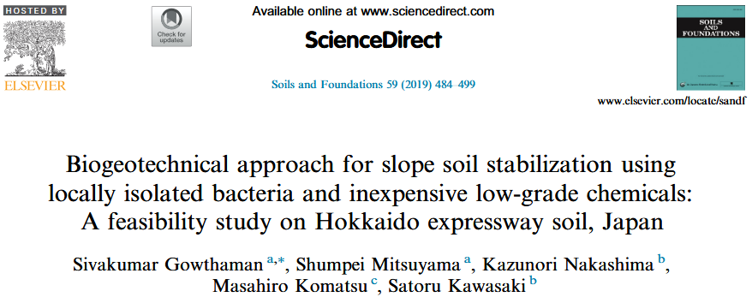
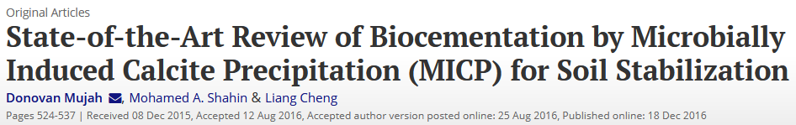
This process can improve shear strength to stabilize slopes in rivers, canal banks and natural hills.
It can reduce settlement on foundations by filling voids with calcite particles.
It can also increase the stiffness of soil to prevent liquefaction in seismic prone areas.

Slide 10



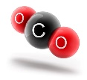

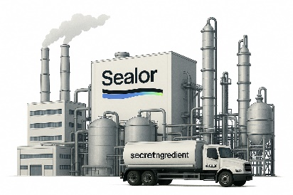

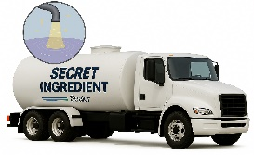
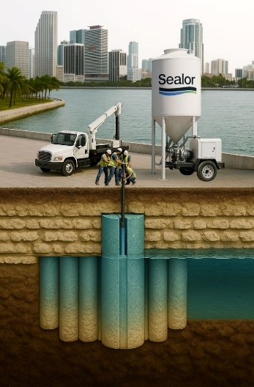
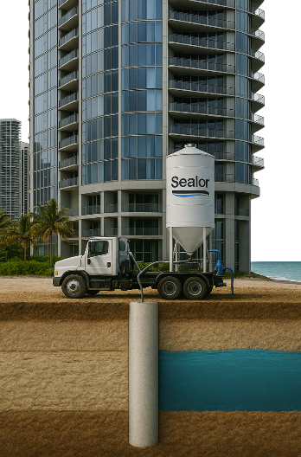
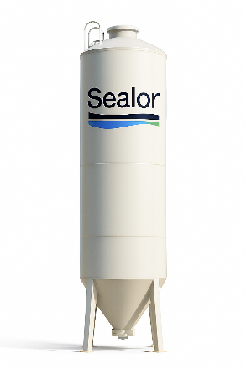
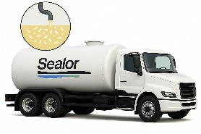
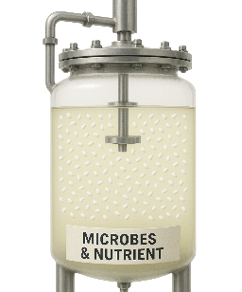

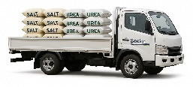
The Technology - Sealor
1. Microbe Production Facility
2. Transport All Ingredients to Site
3. Final Mixing On-Site
4. Inject Sealor into the Ground
5. Sealor Creates an Underground Impermeable Barrier with High Strength Properties
PATENTED TECHNOLOGY

Slide 11
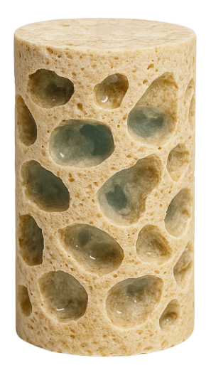
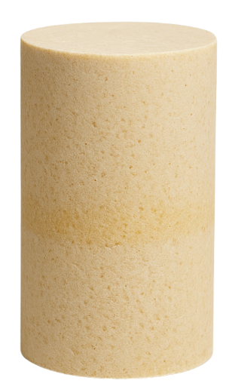
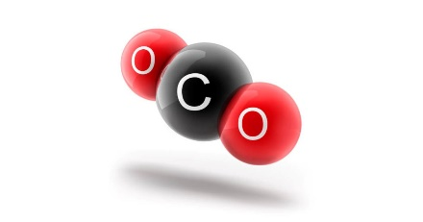
Potential Carbon Sequestation Impact
44% of Newly Formed Limestone is Sequestered CO₂ Locked in the Underground for Eternity
CaCO₃

Slide 12

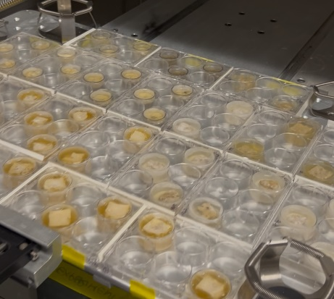
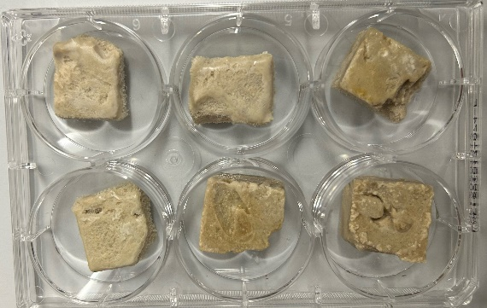

Phase 1 Proof of Concept
Control
Chips ✔️
1.5x1.5cm
Autoclaved
Cylindrical hole in center
Observed hole filling in
20% weight addition
10 days MICP
Completed
Cubes Set 1 ✔️
2x2x1cm
Autoclaved
Test different MICP cocktails
Observe forming CaCO3
30 days MICP ✔️
Measure weight addition
2x30 days MICP to go
Completed
Cubes Set 2
2x2x1cm
Non-Autoclaved
Test different MICP cocktails
Observe forming CaCO3
90 days MICP
Measure porosity change
Ongoing
MICP here used as Microbially Induced Carbonate precipitation

Slide 13
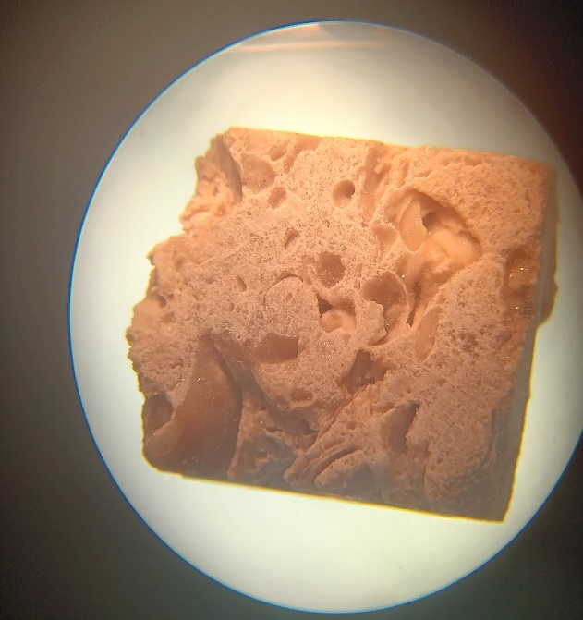
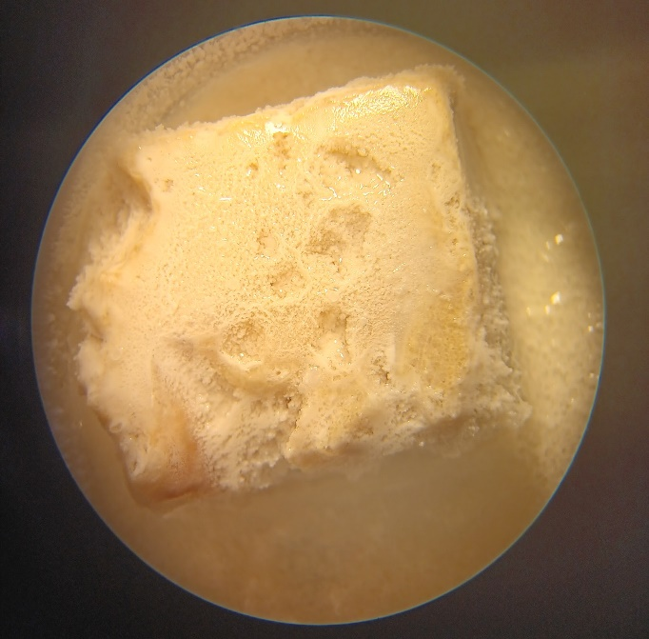
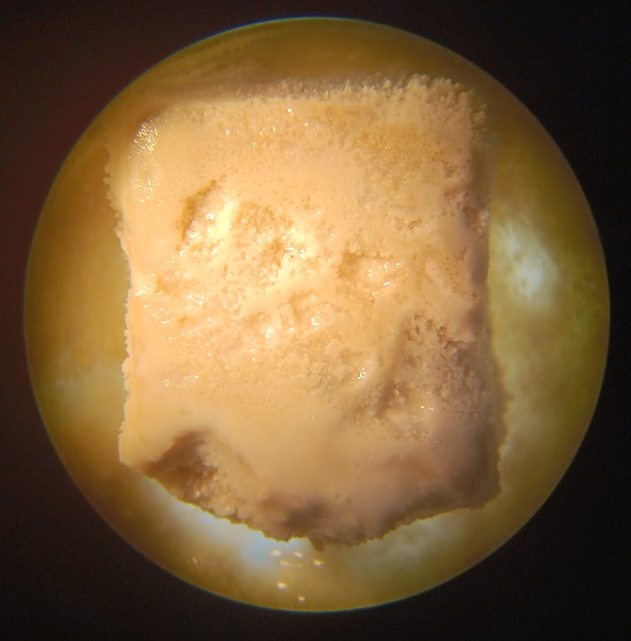
This is the same rock!
Initial Lab Results
+25% Weight in 30 days
06/24/25 07/03/25 07/27/25
9 days
24 days

Slide 14
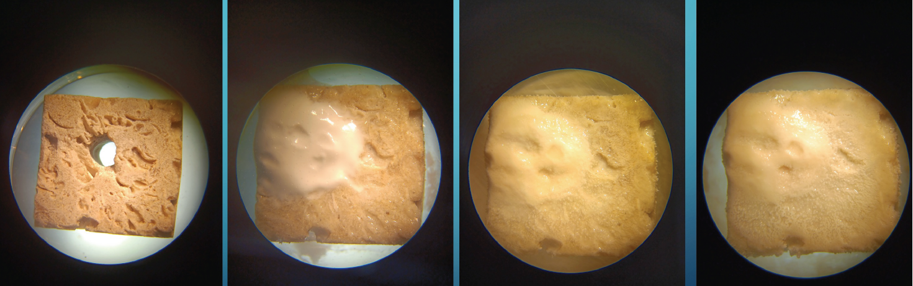
Testing of CO₂ & Microbially Induced Carbonate Precipitation
Dry Rock
CO₂ Induced
Carbonate Precipitation
1 week
CO₂ & Microbially Induced
Carbonate Precipitation
1 week + 1 week
CO₂ & Microbially Induced
Carbonate Precipitation
1 week + 2 week

Slide 15
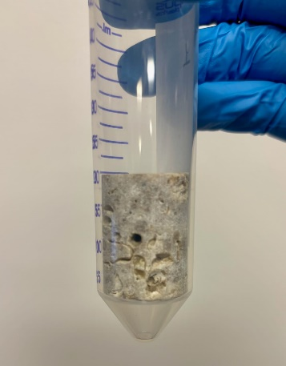
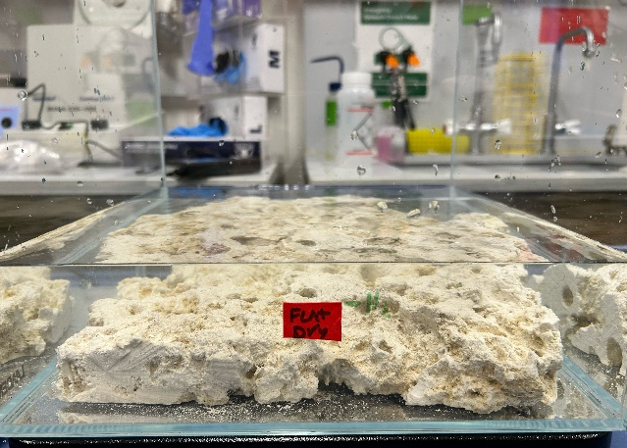
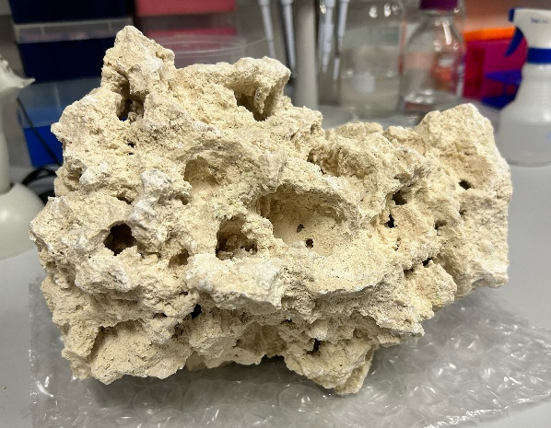
Phase 1 Proof of Concept
TRL 3
TRL 4
TRL 5
Plugs
1x2 inch
Autoclaved
Petrophysics impermeability
(University of Miami)
90 days MICP
Ongoing
Flat Rock
30x30x4cm
Autoclaved
Observe forming CaCO₃
Scaling up
Weight & Volume measurement
90 days MICP
Ongoing
Volumatic rock
20x20x25cm
Non-Autoclaved
Mimic field conditions
Observe forming CaCO₃
Weight & Volume measurement
90 days MICP
Planned

Slide 16
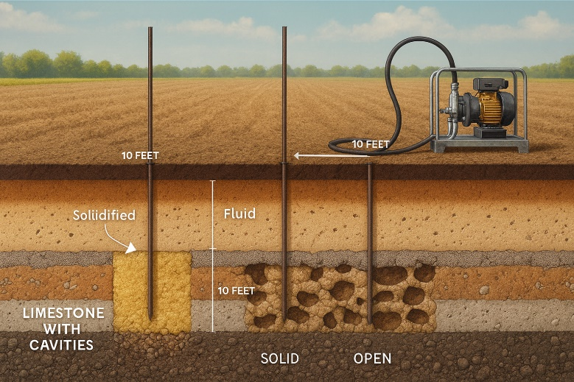
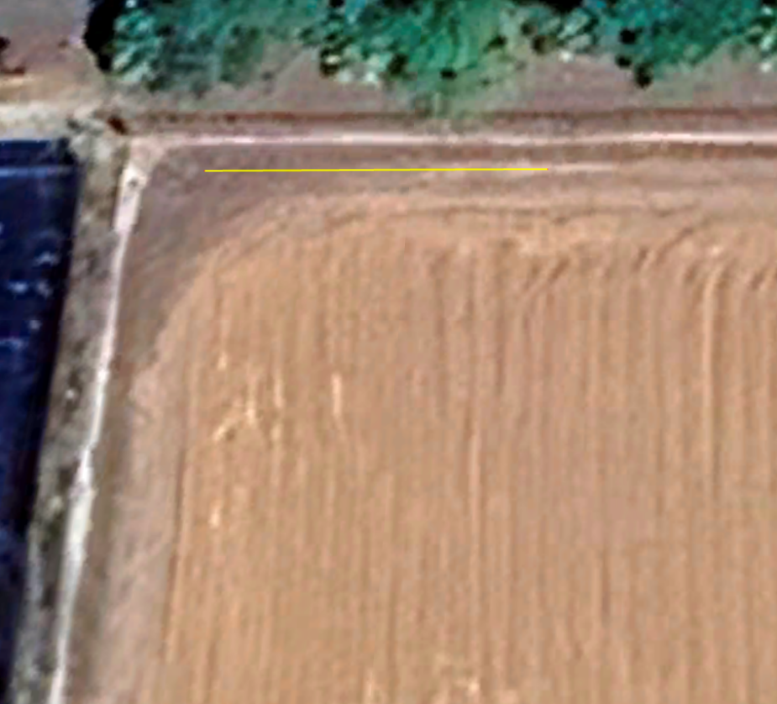
Phase 2: Field Test (TRL 6)
INJECTION 1: 15 FT DIAMATER CIRCLE
3x10 FT TRENCH
INJECTION 2: 3x (12.5x7.5 FT) OVALS
TEST LOCATION
60x60FT FENCED
3x10 FT TRENCH
INJECTION 3: 5x (10x5 FT) OVALS
Test Setup
3 injection points
10ft deep, expected 10-15ft radius spread
Summer 2026
3rd Party validations
Next step: pilots
WORK PACE: 60x60 FT FENCED

Slide 17
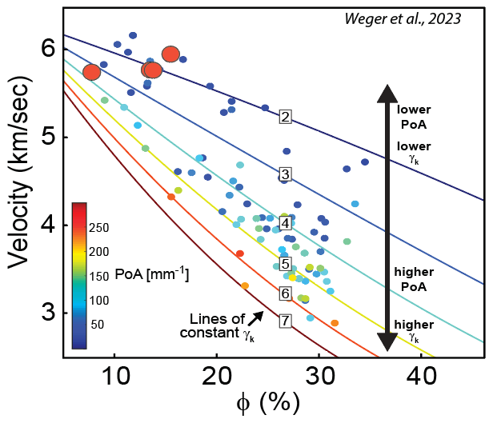
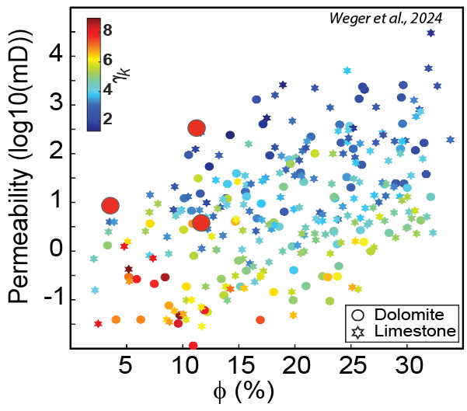

4
3
2
1
0.1
0.2
0.3
0.4
Ralf J. Weger, 2024

Slide 18
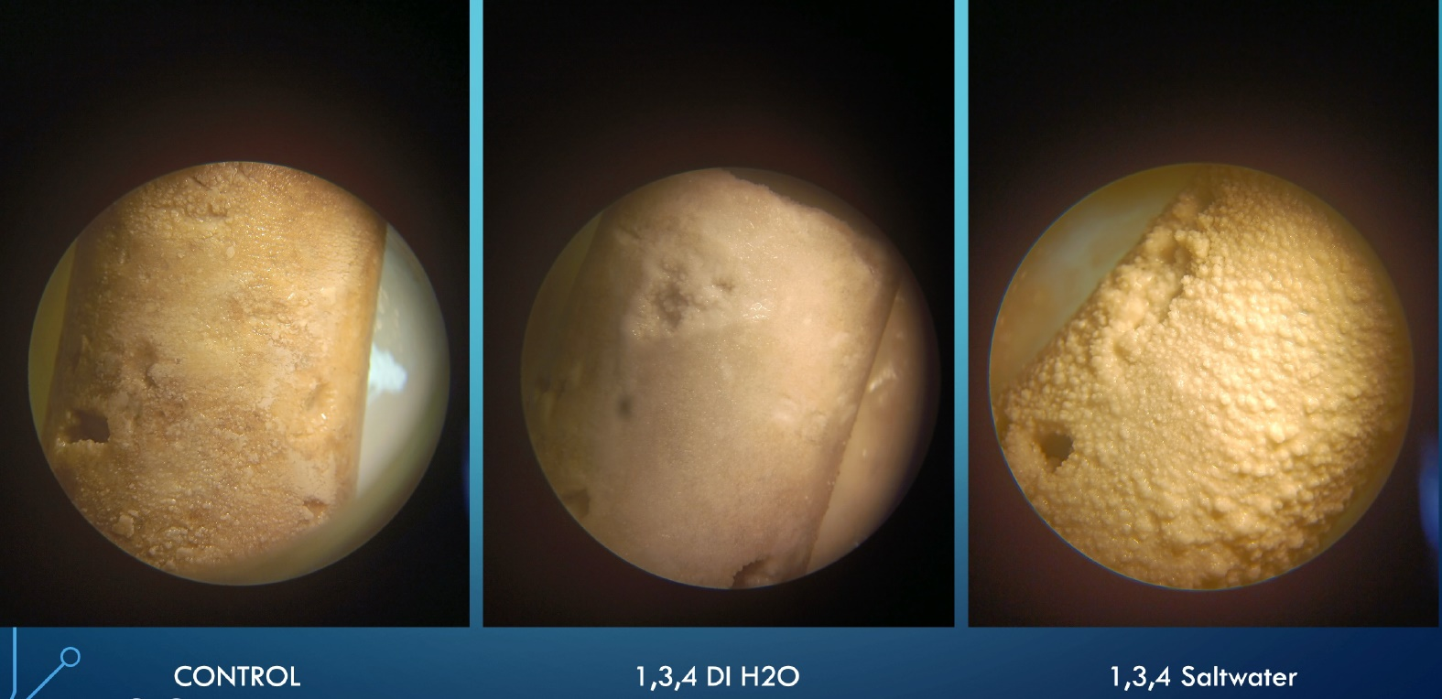
Testing Precipitation on Plug samples with both DI Water and Seawater

Slide 19
Key Points
Ralf J. Weger, 2024
“SEALOR” Technology uses Microbially Induced Carbonate Precipitation to create a subsurface barrier that strengthens the subsurface to reduce permeability and mitigate seawater infiltration and flooding.
  It aims to enhance coastal resilience by protecting infrastructure
  It acts as a carbon-negative solution, permanently sequestering CO₂ underground.
“SEALOR” can be used for both Infrastructure Protection & Carbon Sequestration.
This ongoing NSF-SBR uses over over 150 lab tests to confirm the method's effectiveness:
  a) calcium carbonate crystal formation,
  b) pore-space reduction, and
  c) significant consolidation of sediment samples
Quantification and large-scale field testing is still ongoing …

Slide 20
Questions?

