Slide 1
PERMEABILITY ESTIMATION THROUGH INTEGRATION OF VELOCITY, RESISTIVITY, AND PORE GEOMETRY
Ralf J. Weger and Gregor P. Eberli

Slide 2

Why should you care?
Ralf J. Weger, 2024
The relationships between velocity, resistivity, and porosity provide insight about pore geometry, connectivity, and permeability.
Direct permeability measurements (core plugs) are expensive, slow, spatially limited, and often unavailable.
Acoustic/Resistivity (EM) data can provide a continuous, indirect permeability estimate.
Utilizing existing (routinely acquired) logging data (sonic, resistivity) for permeability estimation is cheaper and faster than coring and core analysis.

Slide 3
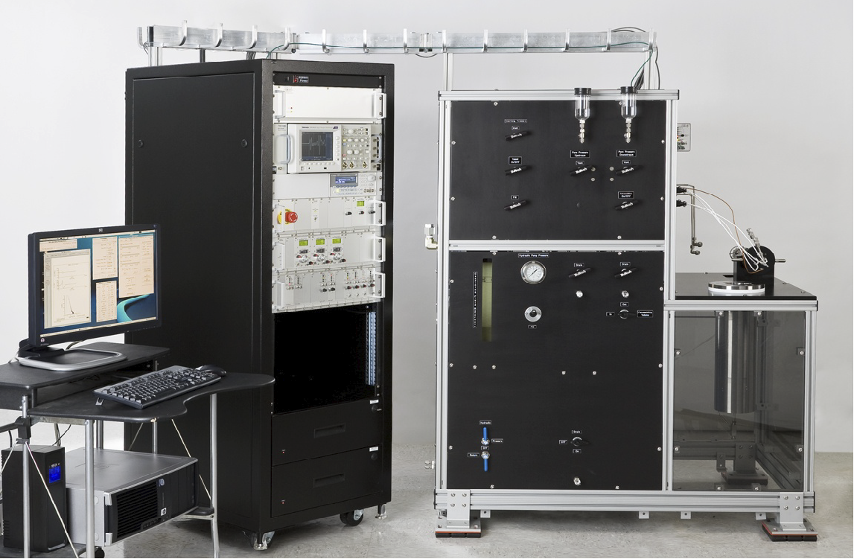
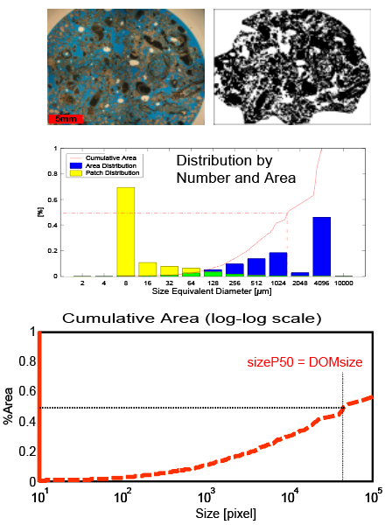
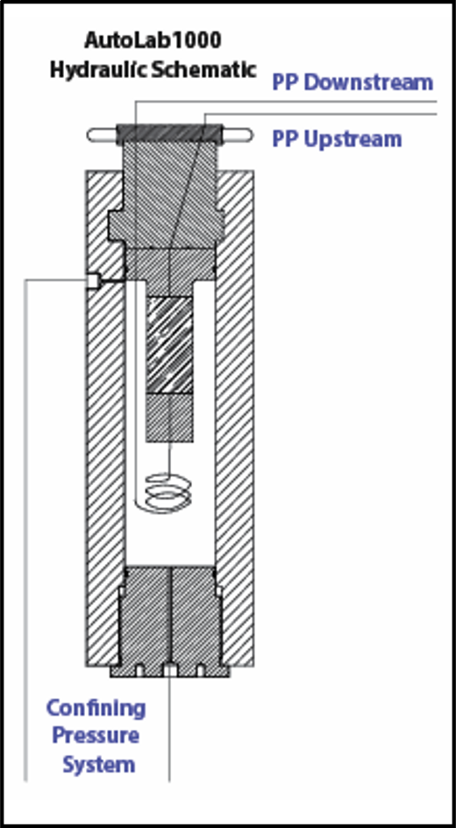
Acoustic Velocity, Electrical Resistivity, and Permeability

Slide 4
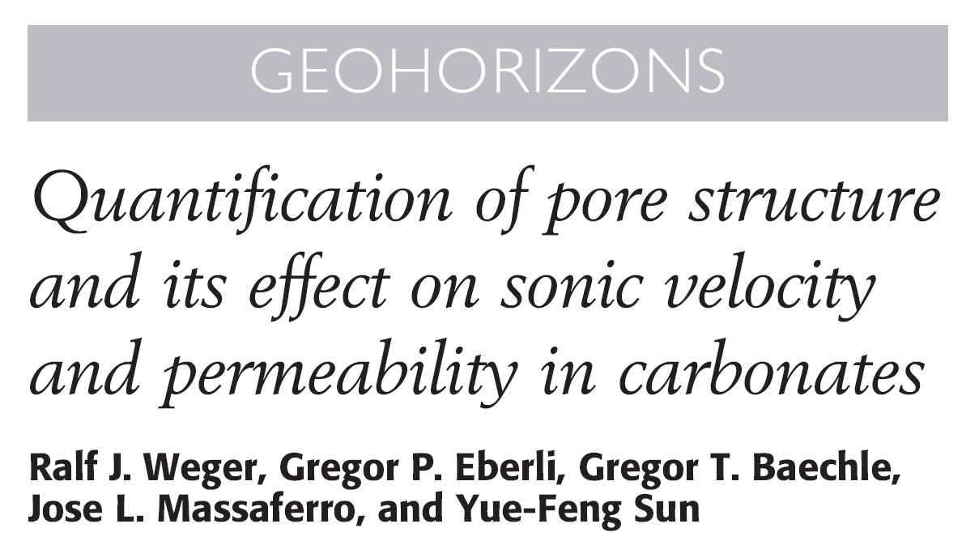
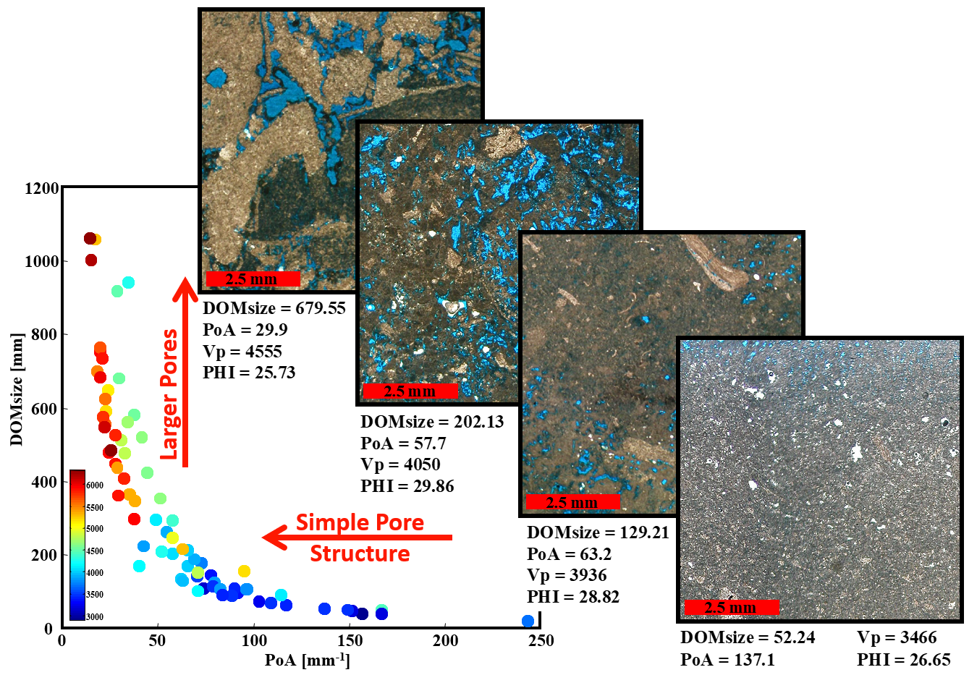
Quantification of Pore Structure
  Produce quantitative description of pore systems characteristics.
  Explain variation in elastic parameters using DIA parameters.

Slide 5
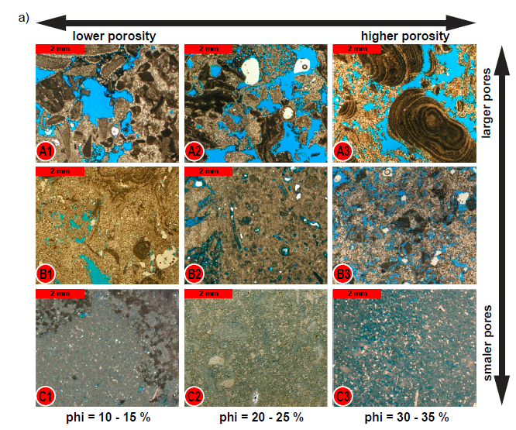
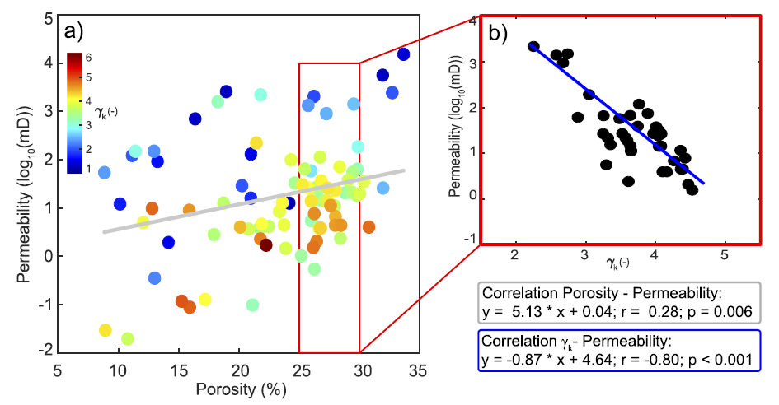

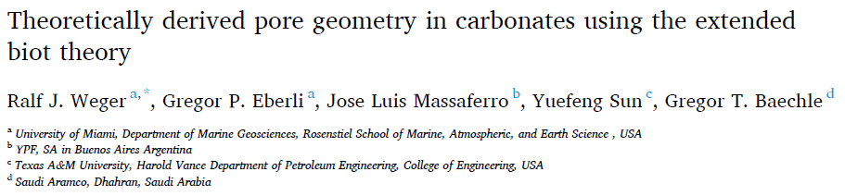
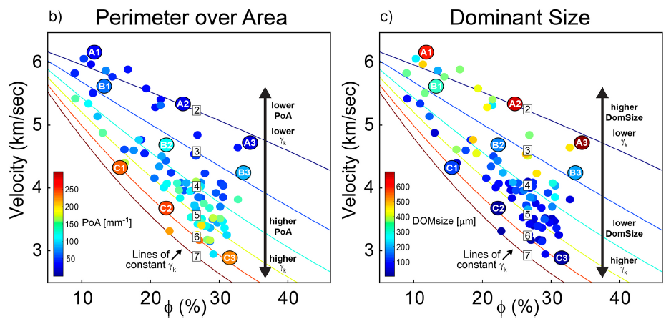
Linking Pore Structure and Frame Flexibility
Marine and Petroleum Geology 155 (2023) 106359

Slide 6
Key Points
Ralf J. Weger, 2024
Simple Pores = High Velocity/Permeability:
  Rocks with large pores and simple pore geometries have high acoustic velocity and generally high permeability.
Oomoldic/moldic pores (dissolved grains) are simple (e.g. high velocity) but isolated, causing low permeability.
Low-perm moldic rocks are rare in calcite (greenhouse times) but more common in aragonite (icehouse times).
Isolated moldic pores cause high resistivity (low conductivity), identifying low permeability.

Slide 7
Velocity-Porosity colored by Geometry
Cretaceous
Cretaceous
7000
Miocene
7000
Miocene
Mississippien
Mississippien
Neogene
Neogene
Permiam
Permiam
6000
6000
Velocity (m/s)
5000
Velocity (m/s)
5000
2.8
2.8
2.6
2.6
4000
2.4
4000
2.2
2.4
2
2.2
Log₁₀(PoA)
Log₁₀(DomSize)
1.8
2
3000
1.6
3000
1.8
1.4
1.6
1.2
1
1.4
0
5
10
15
20
25
30
35
0
5
10
15
20
25
30
35
Porosity (%)
Porosity (%)
from Weger et.al., 2024

Slide 8
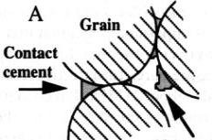
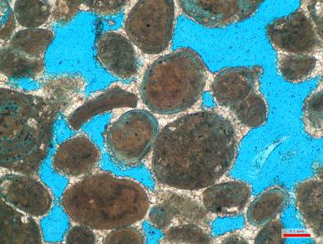
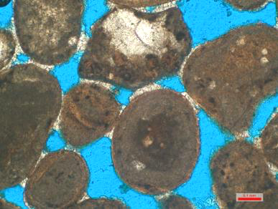
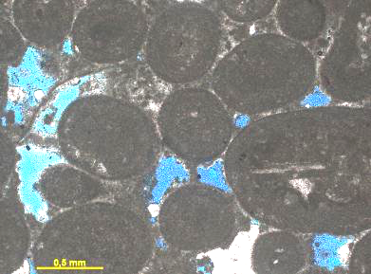
Contact Cements in Carbonates
In carbonates, contact cementation occurs as:
  meniscus cements derived from meteoric waters (Harris, 1978; Longman, 1980) or
  micritic bridging cements in the marine realm (Hillgärtner et al., 2001).
Generally producing
high-velocity
high-K rocks
Meteoric Meniscus Cement
Meniscus Cement
Marine Microbial Cement
Pleistocene Shoal Ocean Cay
Holocene Beach Rock, Shroud Cay
Cretaceous offshore Brazil

Slide 9
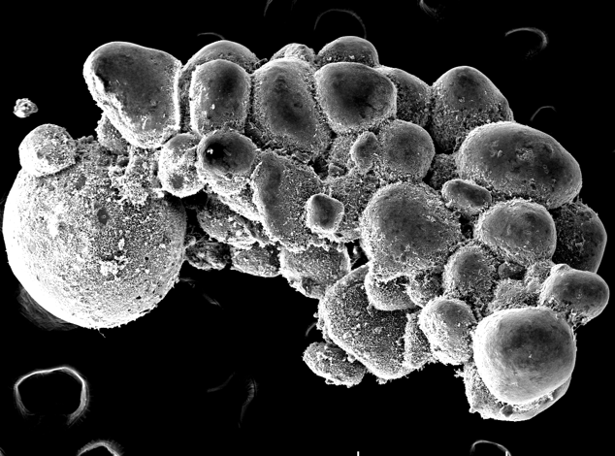
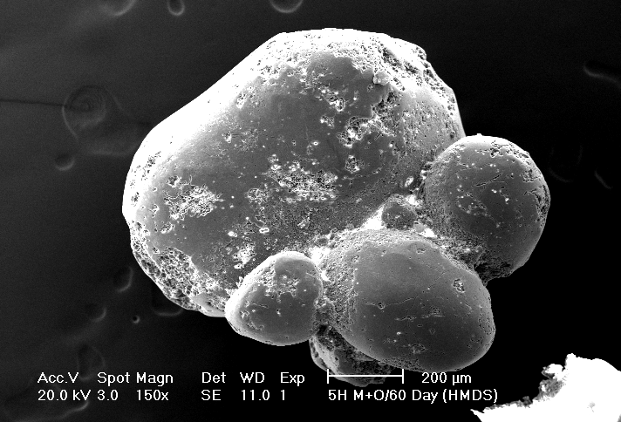
Precipitation of Contact Cements at Sea and in the Lab
Fused grains at Joulter Cays
In vitro fused 30 days
In vitro fused 60 days
500 µm
500 µm
400 µm
Synergetic effects of microbes and EPS as well as calcifying filaments trigger the precipitation of micrite cement in less than 30 days.
Diaz et al., 2022.

Slide 10
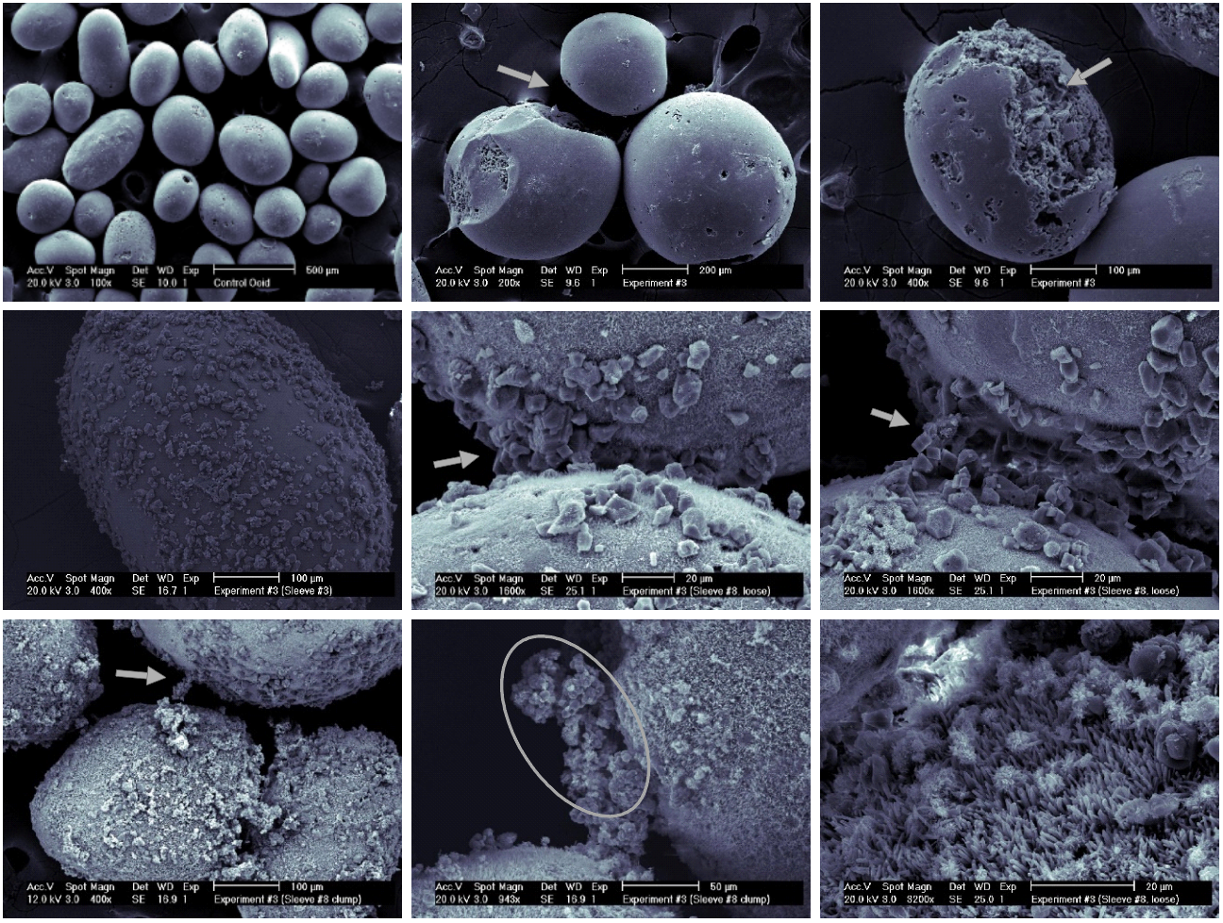
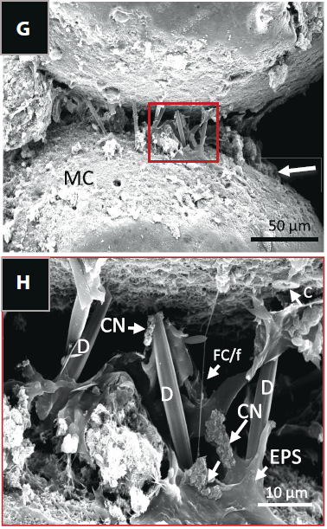

Observe Contact Cements Precipitation in the Lab
Ralf J. Weger, 2024

Slide 11
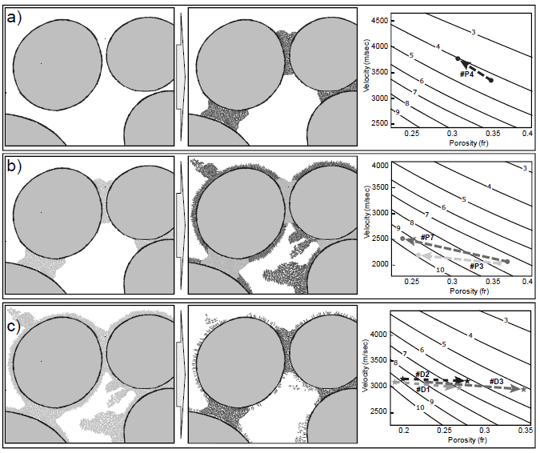
Precipitation at grain-to-grain contacts resulted in an increase in velocity comparable with model predictions from the EBT
Intrapore growth at grain surfaces and within pore spaces creates a softer, more complex framework resulting in smaller-than-expected velocity increases despite substantial porosity reduction
Selective removal of non-load-bearing particles during dissolution experiments
simplifies the pore network, increases porosity, but causes only modest velocity
changes
Weger et al., (in review)

Slide 12
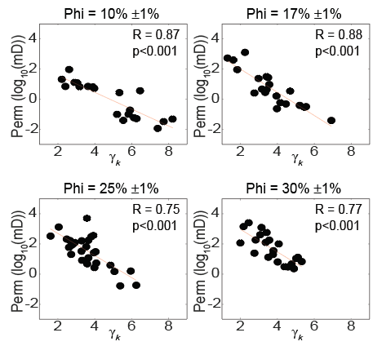
How does Geometry relate to Permeability
2.8
2.8
4
2.6
4
2.6
2.4
2.2
2.4
3
2
2.2
Log₁₀(PoA)
3
Log₁₀(DomSize)
1.8
2
1.6
1.8
2
1.4
2
1.6
1.2
1
1.4
Permeability (log₁₀(mD))
Permeability (log₁₀(mD))
1
1
0
0
-1
-1
Cretaceous
Cretaceous
-2
Miocene
-2
Miocene
Mississippien
Mississippien
Neogene
Neogene
Permiam
Permiam
0
5
10
15
20
25
30
35
0
5
10
15
20
25
30
35
Porosity (%)
Porosity (%)
from Weger et.al., 2024

Slide 13
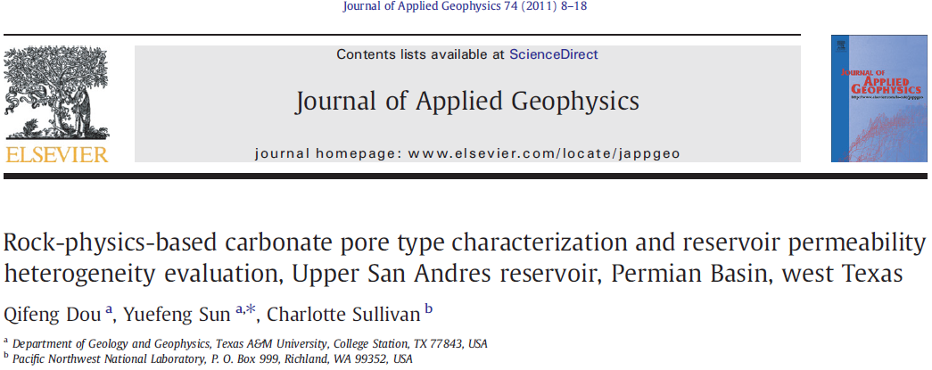
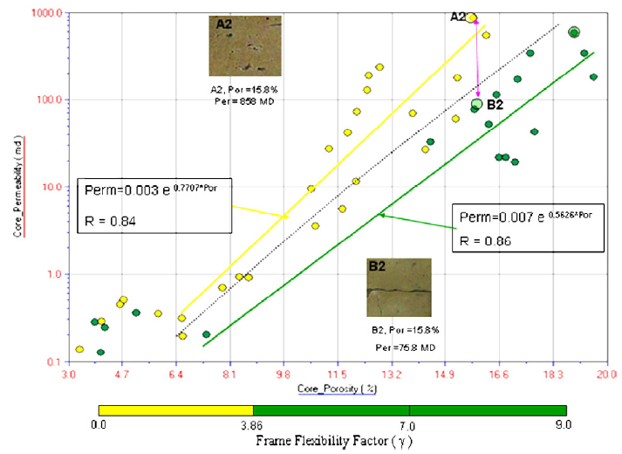
EBT on log scale
From well log sonic data to permeability estimates using Extended Biot Theory

Slide 14

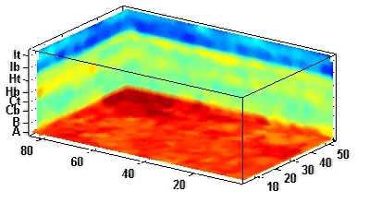
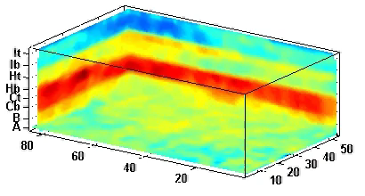

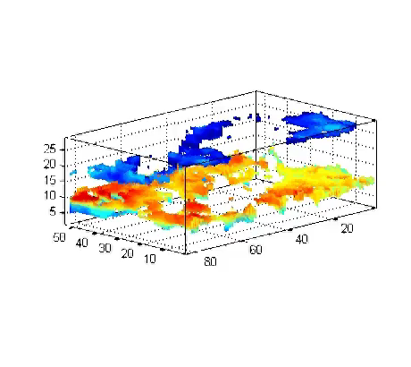

φ and Permeability Indicator from Seismic Data
γ_{k}
Porosity
Applying EBT to reservoir scale QI on high resolution Seismic data can be used to determine volumes and producibility.
Permeability
Indicator
Eberli, G. P., Massaferro, J.‐L., Weger, R. J., Sun, Y. F., Baechle, G. T., and Bracco Gartner, G.,
Permeability from Seismic in Carbonate Reservoirs, Part I: Dream or Reality?, in Proceedings AAPG Annual Convention 2006.
Bracco Gartner, G. L., Weger, R. J., Nasser, M., Leguijt, J., van der Kolk, K., Hillgaertner, H., Asyee, W., Eberli, G. P., Sun Y. F., and Wagner, P.,
Permeability from Seismic in Carbonate Reservoirs, Part II: The Field Example, in Proceedings AAPG Annual Convention 2006.
Notes:
This was used to characterize a reservoir, but the same tools allow for characterization of a potential CO2 container.
BUT, this is based on one-time, static snapshot of a reflection seismic cube

Slide 15
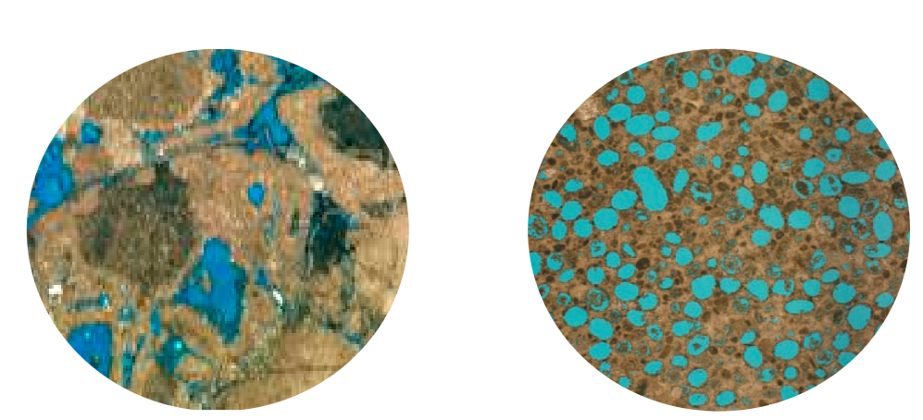
The Challenge:
Distinguish Simple Pore Space Geometries (stiff rocks) that have connected pore networks from those with unconnected pore networks
vs.
Both of these rocks have:
low PoA and high DOM size.
high velocities for their given porosity
low γ_{k}
Almost all rocks fitting this description have excellent flow properties,
But,
some oomoldic/moldic rocks have little to no Permeability

Slide 16
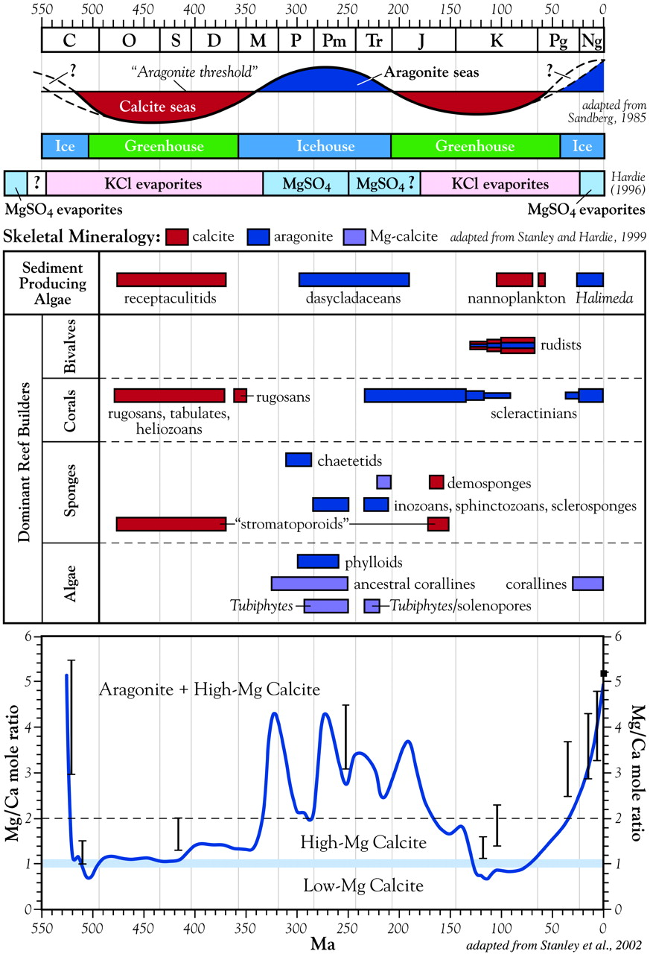
Aragonite vs calcite seas
Potential for
moldic rocks
Potential for
moldic rocks
Potential for
moldic rocks

Slide 17
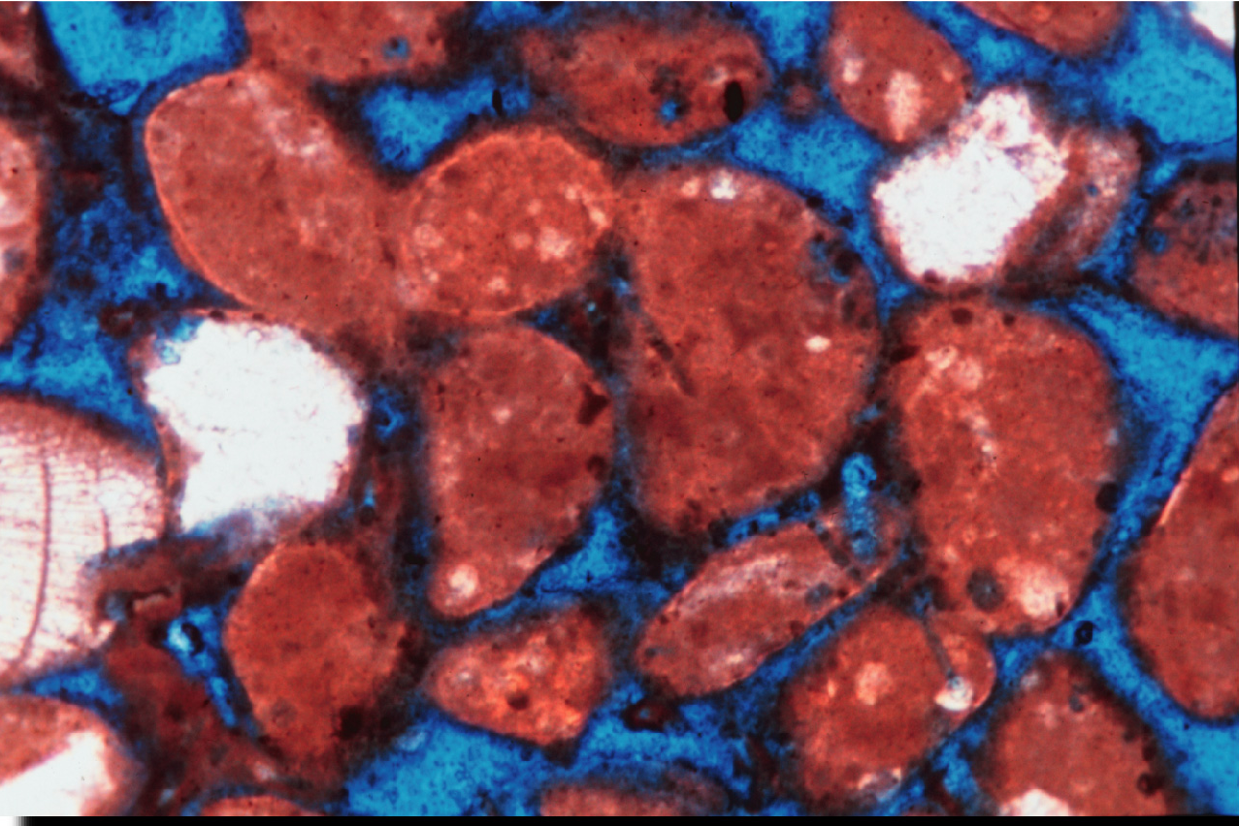
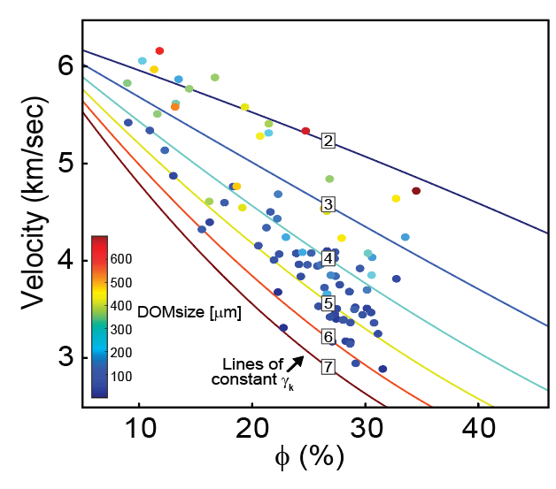

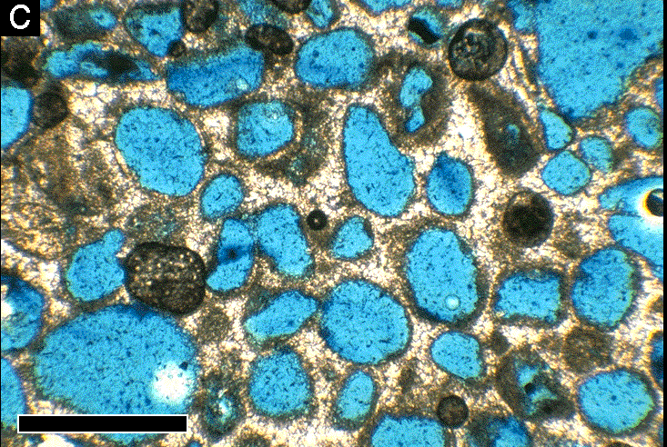
Same high velocity but different permeability
Interparticular porosity:
Cements on grain contacts
form rigid frame
4
3
log
2
10
1
High porosity
High velocity
High K
(K)
0
-1
lower
PoA
lower
γ_{k}
Moldic (separate vug) porosity: pore filling cements form stiff frame
higher
PoA
higher
γ_{k}
High porosity
High velocity
Low K

Slide 18
Same velocity but different permeability
Interparticular porosity:
Cements on grain contacts
form rigid frame
High porosity
High velocity
High K
Moldic (separate vug) porosity: pore filling cements form stiff frame
High porosity
High velocity
Low K

Slide 19
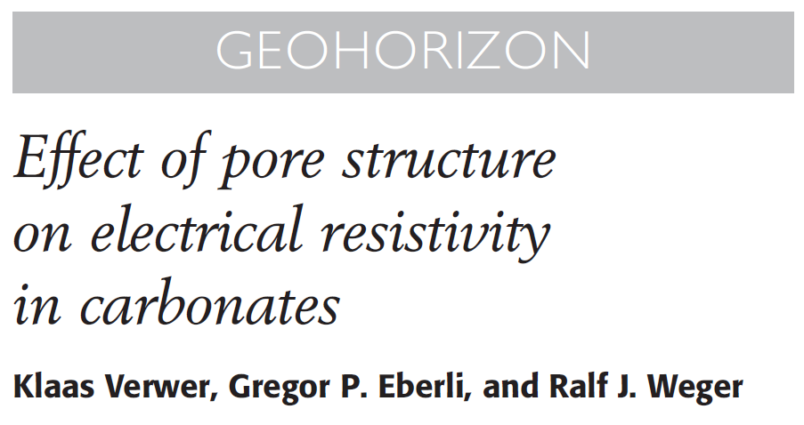
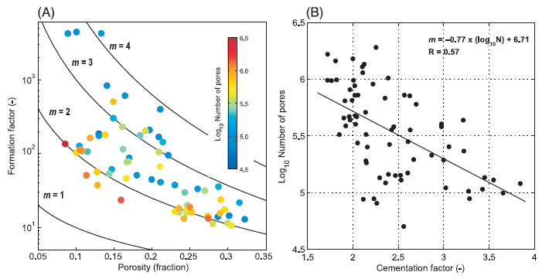
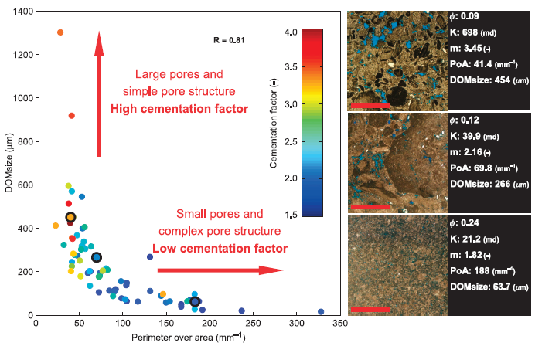
Linking Resistivity to Pore geometry
  Produce quantitative description of pore systems characteristics in the context of electrical resistivity.
  Explain variation in Archie’s cementation factor using DIA parameters and number of pores.

Slide 20
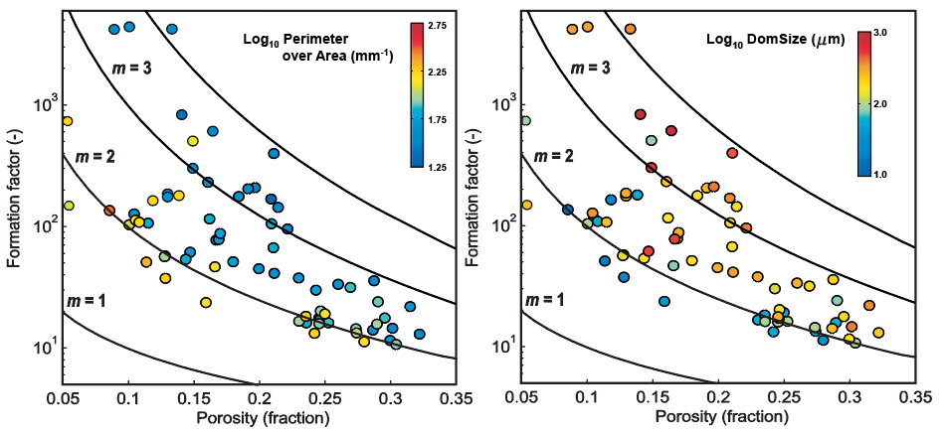
Pore Structure and Electrical Resistivity
Verwer et al., 2010

Slide 21
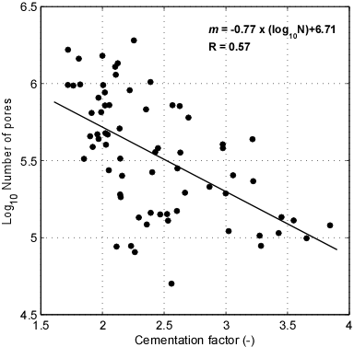
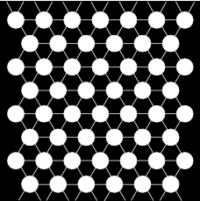
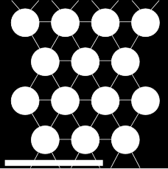
Cementation Factor, Pores & Pore Number
Phi
N_{PORES}
N_{THROATS}
DOMsize
PoA
34%
52
154
730 μm
5.8 mm⁻¹
Phi
N_{PORES}
N_{THROATS}
DOMsize
PoA
34%
14
39
1500 μm
3 mm⁻¹
More pores = less tortuous and higher surface conductivity

Slide 22
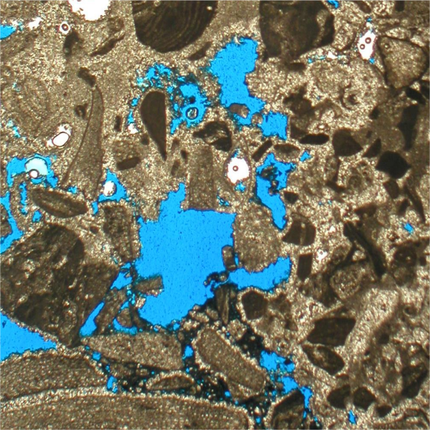
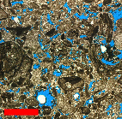
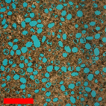
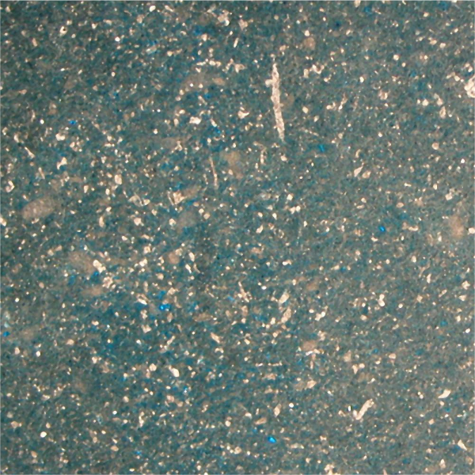
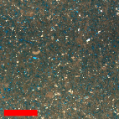
Velocity & Resistivity
(or γ_{k} & m)
Extended Biot Theory γ_{k}
Archie’s Cementation Factor m
m=3
m=4
m=5
5.0
6
4.5
4.0
3.5
m (-)
10⁴
m=2
3.0
2
2.5
2.0
1.5
5
1.0
3
10³
Velocity (km/s)
Formation Factor (-)
4
4
m=1
9
5
10²
8
γ_{k}
7
6
6
3
5
7
4
10¹
3
1
0
2
0
3
0
4
0
0.05
0.1
0.15
0.2
0.25
0.3
0.35
0.4
0.45
Porosity (%)
Porosity (fraction)

Slide 23
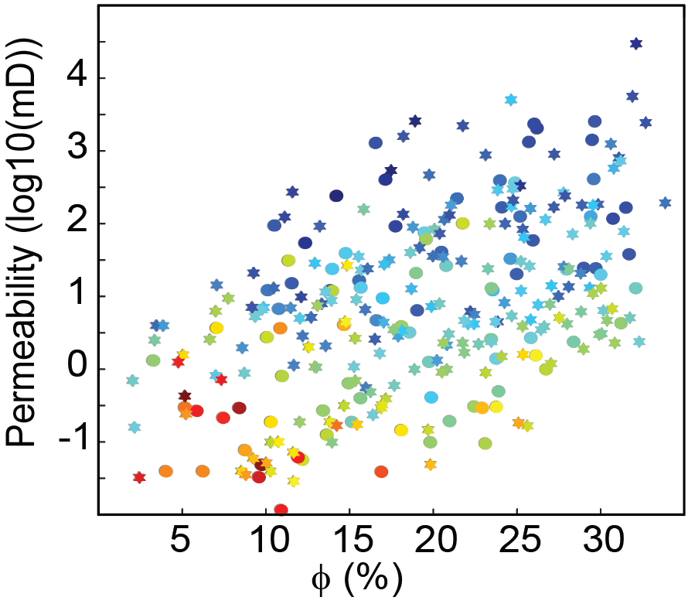
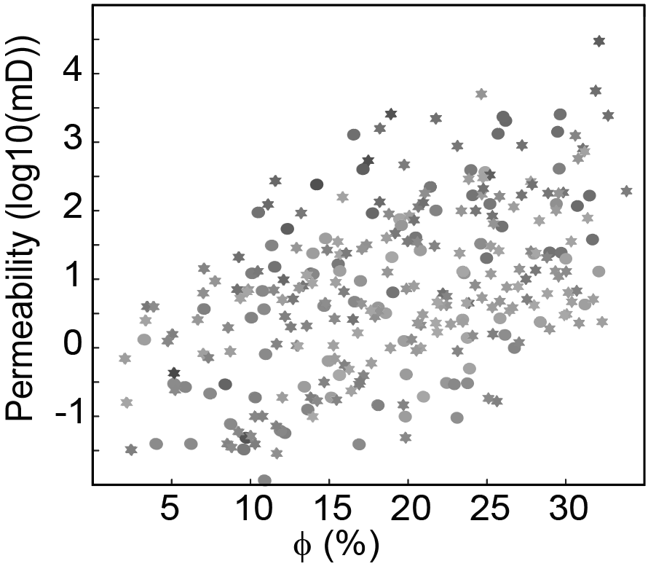
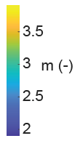

Permeability and Electrical Resistivity
Weger et al., 2024
Interparticular porosity:
Cements on grain contacts
alllow for large number of pores and pore connections
High porosity
High velocity
High conductivity
High K
Moldic (separate vug) porosity: pore filling cements form stiff frame with little to no pore connections
High porosity
High velocity
Low conductivity
Low K

Slide 24
Key Points
Ralf J. Weger, 2024
Simple Pores = High Velocity/Permeability:
  Rocks with large pores and simple pore geometries have high acoustic velocity and generally high permeability.
Oomoldic/moldic pores (dissolved grains) are simple (e.g. high velocity) but isolated, causing low permeability.
Low-perm moldic rocks are rare in calcite (greenhouse times) but more common in aragonite (icehouse times).
Isolated moldic pores cause high resistivity (low conductivity), identifying low permeability.

Slide 25
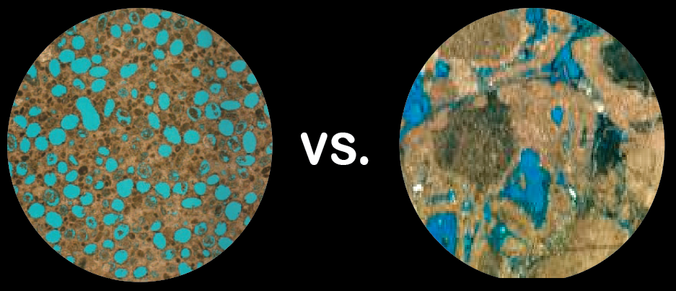
Questions?

Slide 26
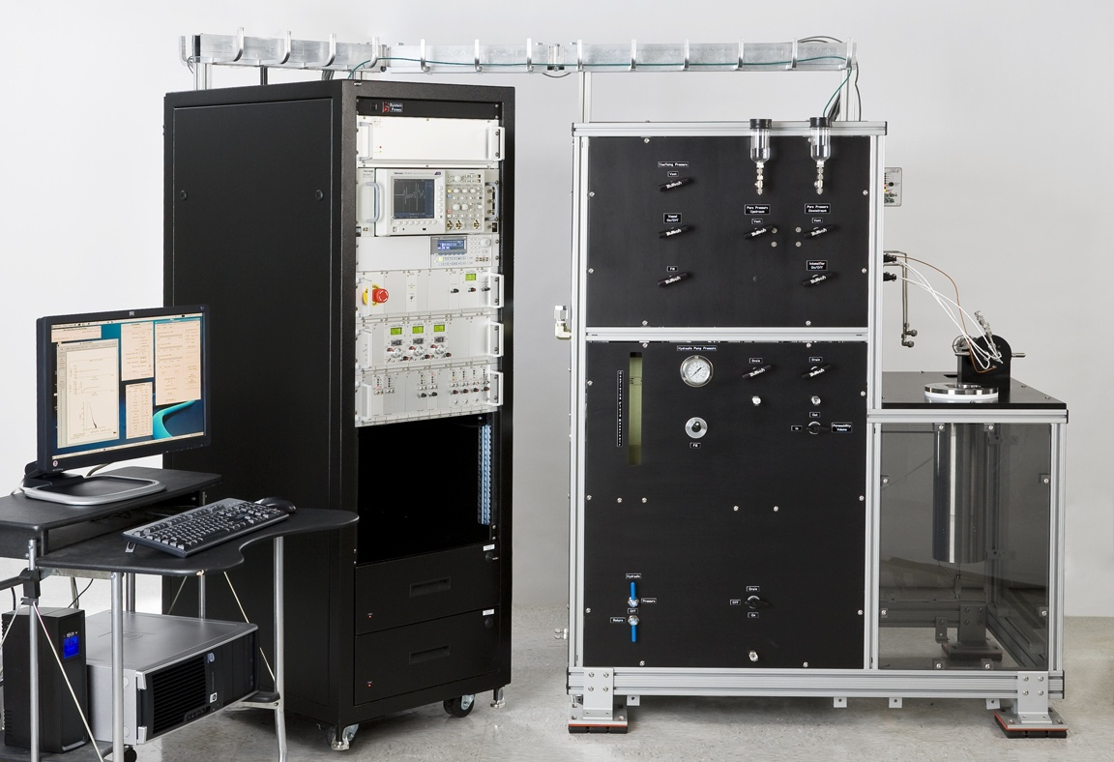
Resistivity Measurements
F=φ^{-m} where,
F=R_{o}/R_{w}
R_{o}= R_{t}/S_{w}^{-n}
φ = porosity
F = formation resistivity factor
R_{o} = resistivity of fully saturated rock
R_{t} = resistivity of partially saturated rock
R_{w} = resistivity of pore fluid
S_{w} = brine saturation
n = saturation exponent
m = cementation factor
m = −log(R_{o}/R_{w}) / log(φ)
AutoLab 1000
NER

Slide 27
Comparison of Data Sets
Kruskal-Wallis test
Klaas Verwer, Albertus Ditya, Ergin Karaca, Jan Norbisrath, Giovanna della Porta
5
4
Reefal Limest.
m=3
m=4
m=5
Hamelin Pool
Stromatolites
3
Tufa
m (-)
10⁴
m=2
MISS Dolo.
Travertine
2
LLL
VM
ET
10³
318 samples
1
+ 224 VM samples
= 542 samples
Reefal
Hamelin Pool
Strom.
Tufa
MISS
Dolomites
Travertine
LLL
VM
Formation Factor (-)
ET
 | Mean Phi | Median Phi | Mean FF | Median FF | Mean m | Median m | # of Sample
Reefal | 30.2 | 27.2 | 74 | 55 | 3.21 | 3.11 | 66
Hamelin Pool | 28.5 | 29.6 | 44 | 27 | 2.65 | 2.63 | 64
Stromatolites | 19.2 | 19.5 | 349 | 57 | 2.45 | 2.28 | 72
Tufa | 18.8 | 18.5 | 216 | 121 | 2.87 | 2.83 | 12
MISS Dolo. | 15.6 | 15.1 | 233 | 76 | 2.27 | 2.32 | 14
Travertine | 9.9 | 8.2 | 6597 | 3773 | 3.38 | 3.25 | 77
LLL | 6.3 | 6.8 | 392 | 371 | 2.06 | 2.14 | 13
VM | 6.6 | 5.3 | 651 | 342 | 1.94 | 1.93 | 166
ET | 7.7 | 8.0 | 580 | 355 | 2.20 | 2.25 | 58
10²
m=1
 | Mean Phi | Median Phi | Mean FF | Median FF | Mean m | Median m | # of Sample
Reefa | 30.2 | 27.2 | 74 | 55 | 3.21 | 3.11 | 66
Hamelin Pool | 28.5 | 29.6 | 44 | 27 | 2.65 | 2.63 | 64
Stromatolites | 19.2 | 19.5 | 349 | 57 | 2.45 | 2.28 | 72
Tufa | 18.8 | 18.5 | 216 | 121 | 2.87 | 2.83 | 12
MISS Dolo. | 15.6 | 15.1 | 233 | 76 | 2.27 | 2.32 | 14
Travertine | 9.9 | 8.2 | 6597 | 3773 | 3.38 | 3.25 | 77
LLL | 6.3 | 6.8 | 392 | 371 | 2.06 | 2.14 | 13
10¹
0.05
0.1
0.15
0.2
0.25
0.3
0.35
0.4
0.45
Porosity (fraction)

Slide 28
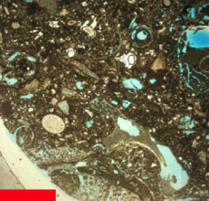
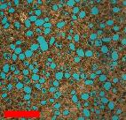
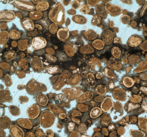
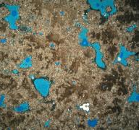


Comparing Cementation Factors
Reefal Limestones
(Ditia 2011)
Carbonates
(Verwer 2011)
Travertine
and Tufa
Crystalline Dolomite
(crystal sizes 30-300mm)
Stromatolites
VM Mudstone
m = 2.11 - 5.29
m = 1.7 - 4.14
m = 2.1 – 3.8
m = 1.9 - 5.8
m = 1.75 - 3.01
m = 1.13 - 2.96
Mudstones and Crystalline Dolomite have a narrow range and very low m
Crystalline Dolomite have a narrow range and still low m
Stromatolites have a narrow range and higher m
Travertine and Reefal Limestones have a wide range and often very high m

Slide 29

Stiff rock frames. What is it, and what creates it?
High velocity at a given porosity is possible if pore compressibility is low
Stiff frames occur in rocks with vugs or molds, but also in rocks with interparticle and intercrystalline porosity.
From the latter, stiff frames can be produced by contact cementation (Dvorkin and Nur, 1996)

Slide 30


Cementation Theory
cementation scheme 1, first and foremost, increases rock stiffness due to increased grain-to-grain contact strength
Grains interact through cement that strengthen the most compliant part of the pore space — the grain contacts.
The main practical conclusion is that high porosity — high velocity
indicates well cemented grain contacts and
a mechanically strong and stable potential reservoir rock.
Dvorkin & Nur, 1996

