Slide 1
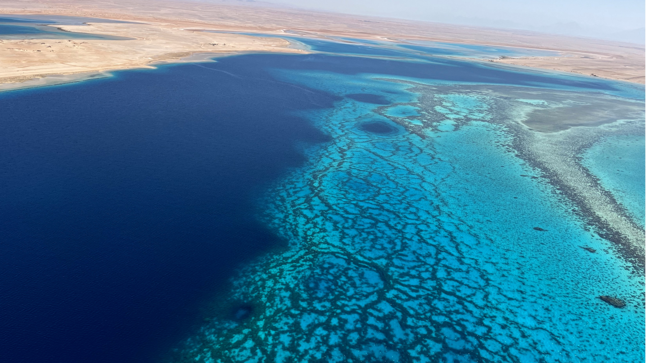

Fractals in the Fossil Record: Self-Organization of Carbonates
Sam Purkis (spurkis@earth.miami.edu)
Flora Beleznay (fxb522@miami.edu)

Slide 2
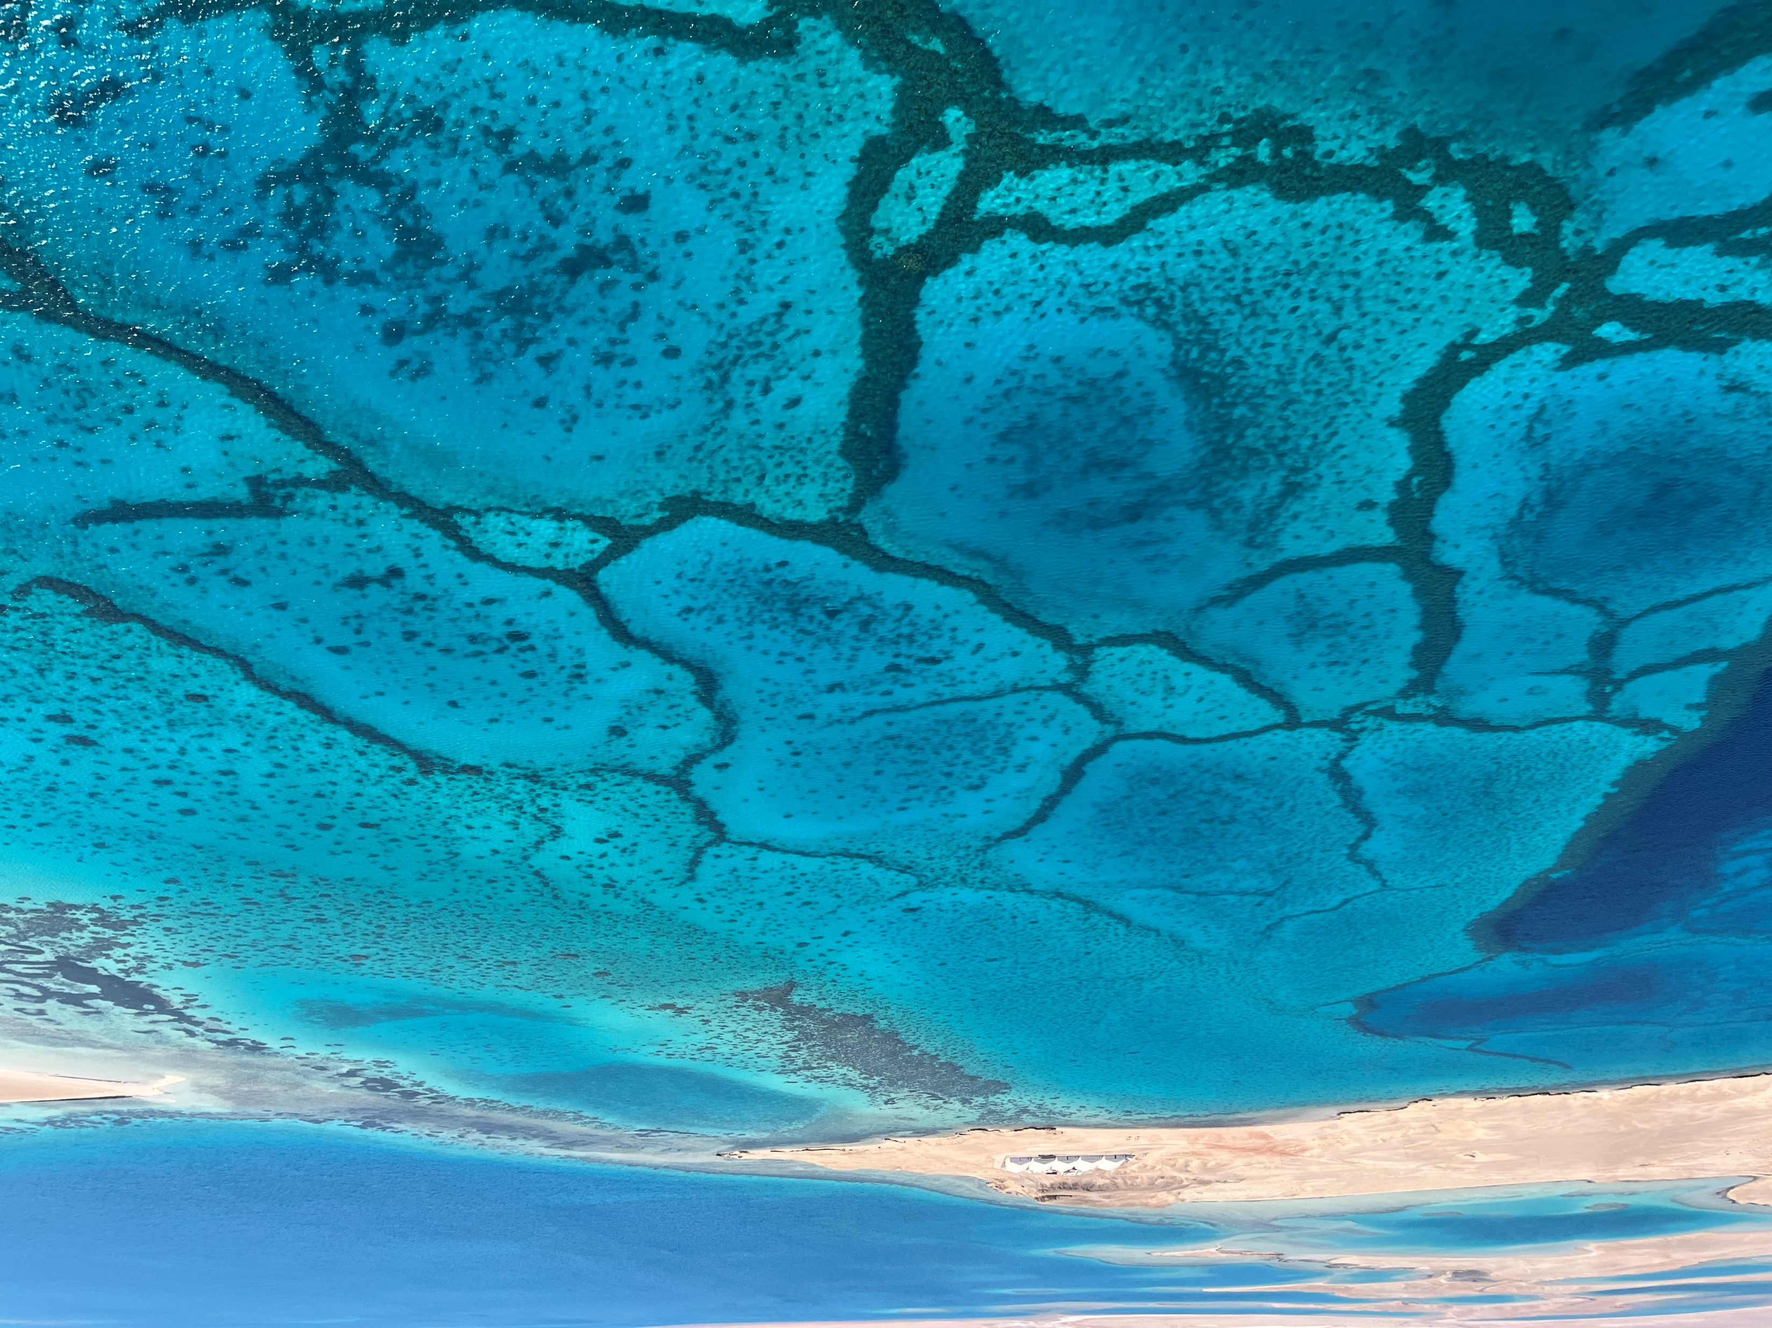

Slide 3

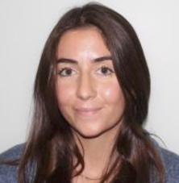
Flora Beleznay
Purkis et al., 2025
B.Sc. Environmental Science – FIU (2023-2024)
M.P.S. Environmental Geology – UM (2024-2025)
Ph.D. Purkis + Eberli – UM (2026 - ?)
Goals:
Revisit the concept of spatial self-organization in modern and ancient carbonates
Quantitative approaches – forward models
Fresh remote sensing approaches
Collate observations over a wide range of scales – cm – km
New insights into heterogeneity and predictability

Slide 4
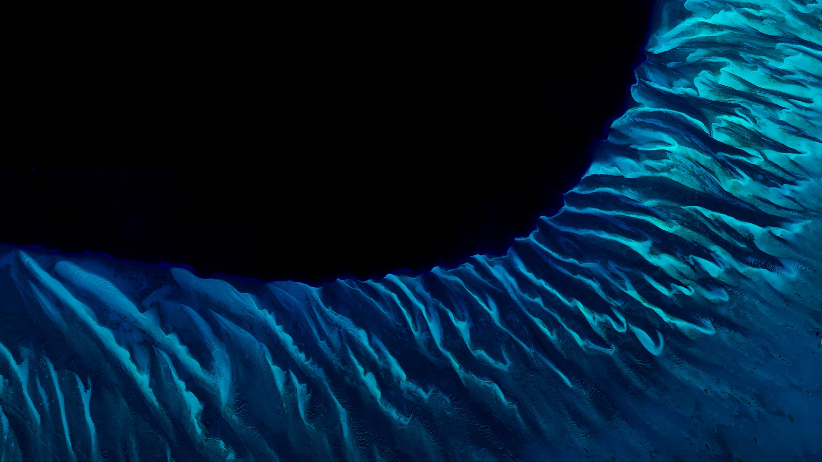
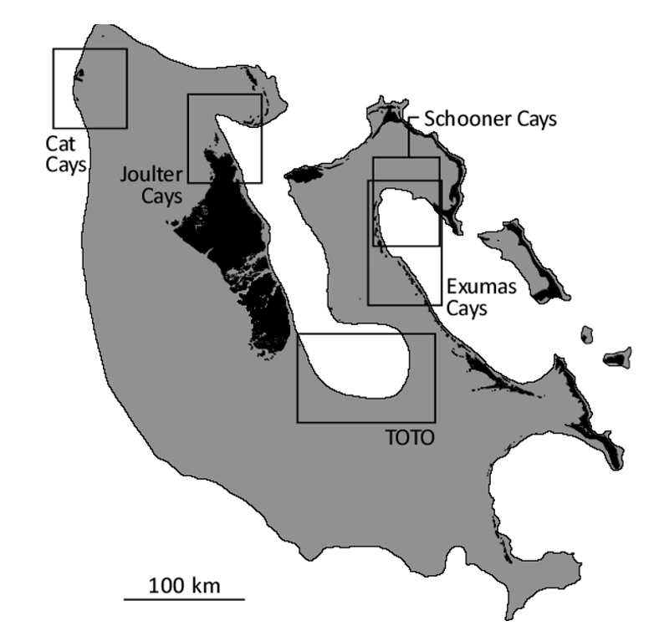
A Brief History of Miami Self-organization
Purkis et al., 2025
25 km

Slide 5
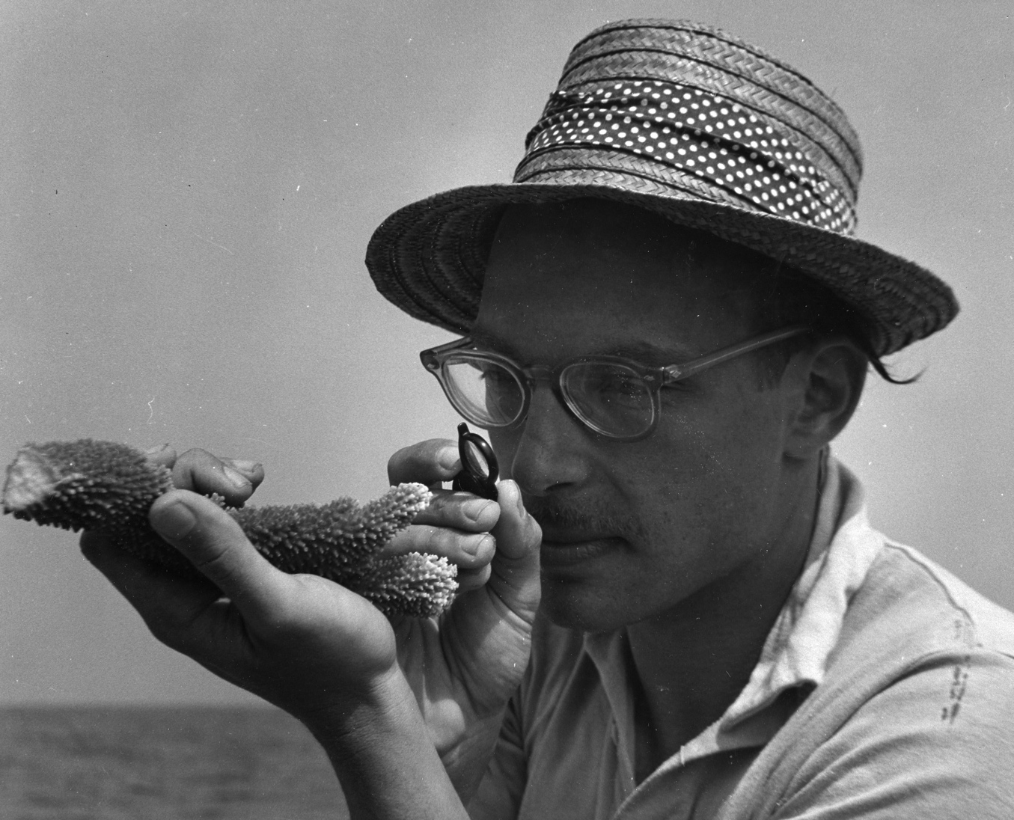
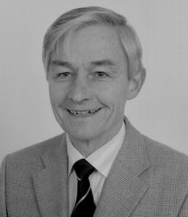

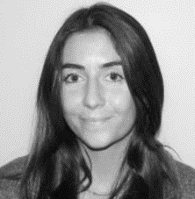
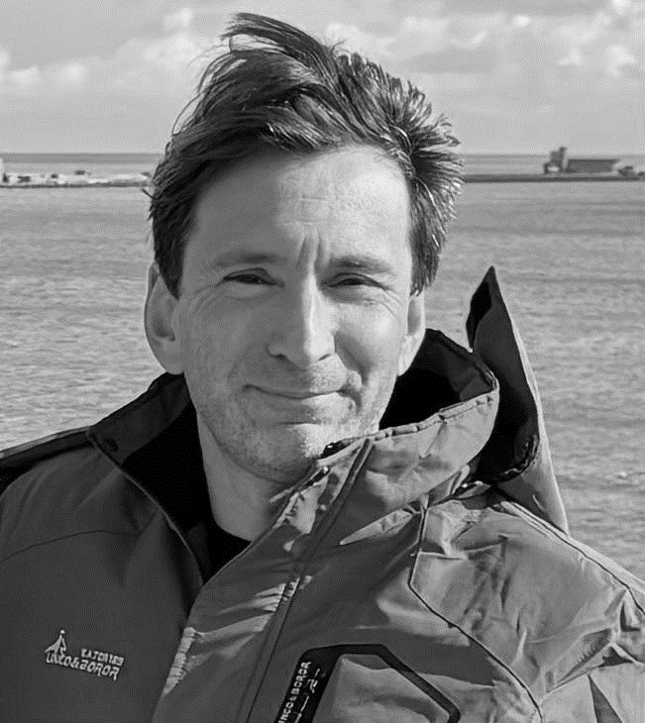
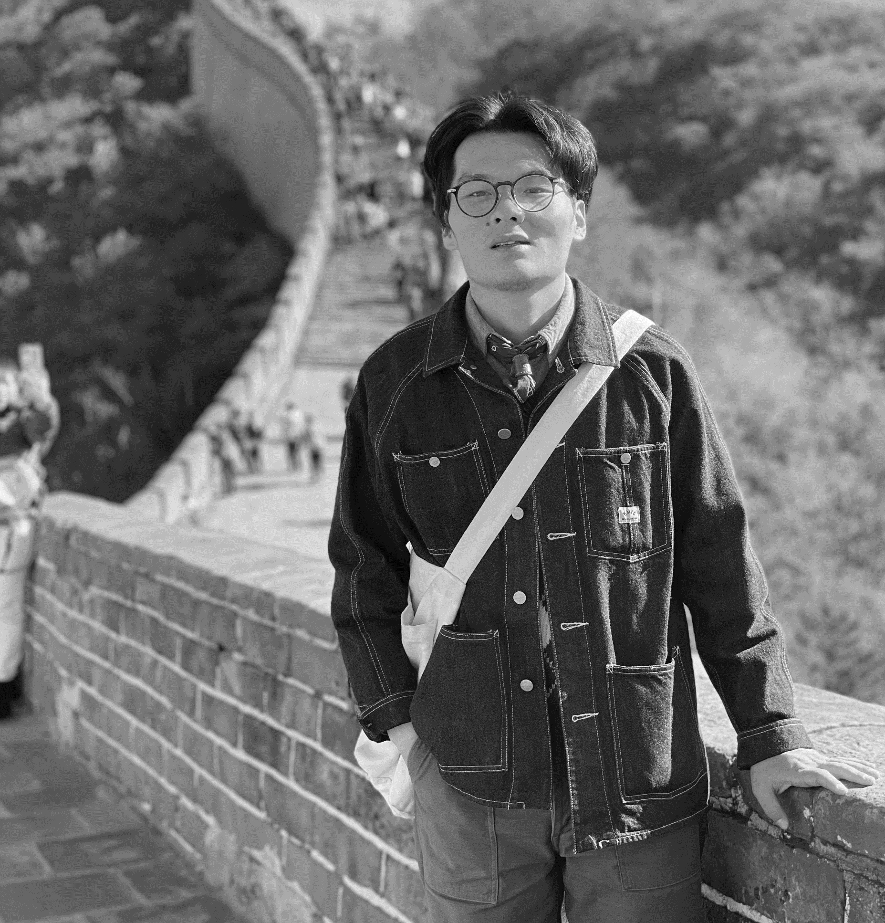
A Brief History of Miami Self-organization
Bob Ginsburg
Wolfgang Schlager
2022 - 2024
Fwd Modelling &
Remote Sensing
Flora Beleznay
1971 - Autocycles
+
Haiwei Xi
2025 -
All of the above !
Sam Purkis
2010 – 2015
Biological Self-organization
(BSO)
25 km

Slide 6
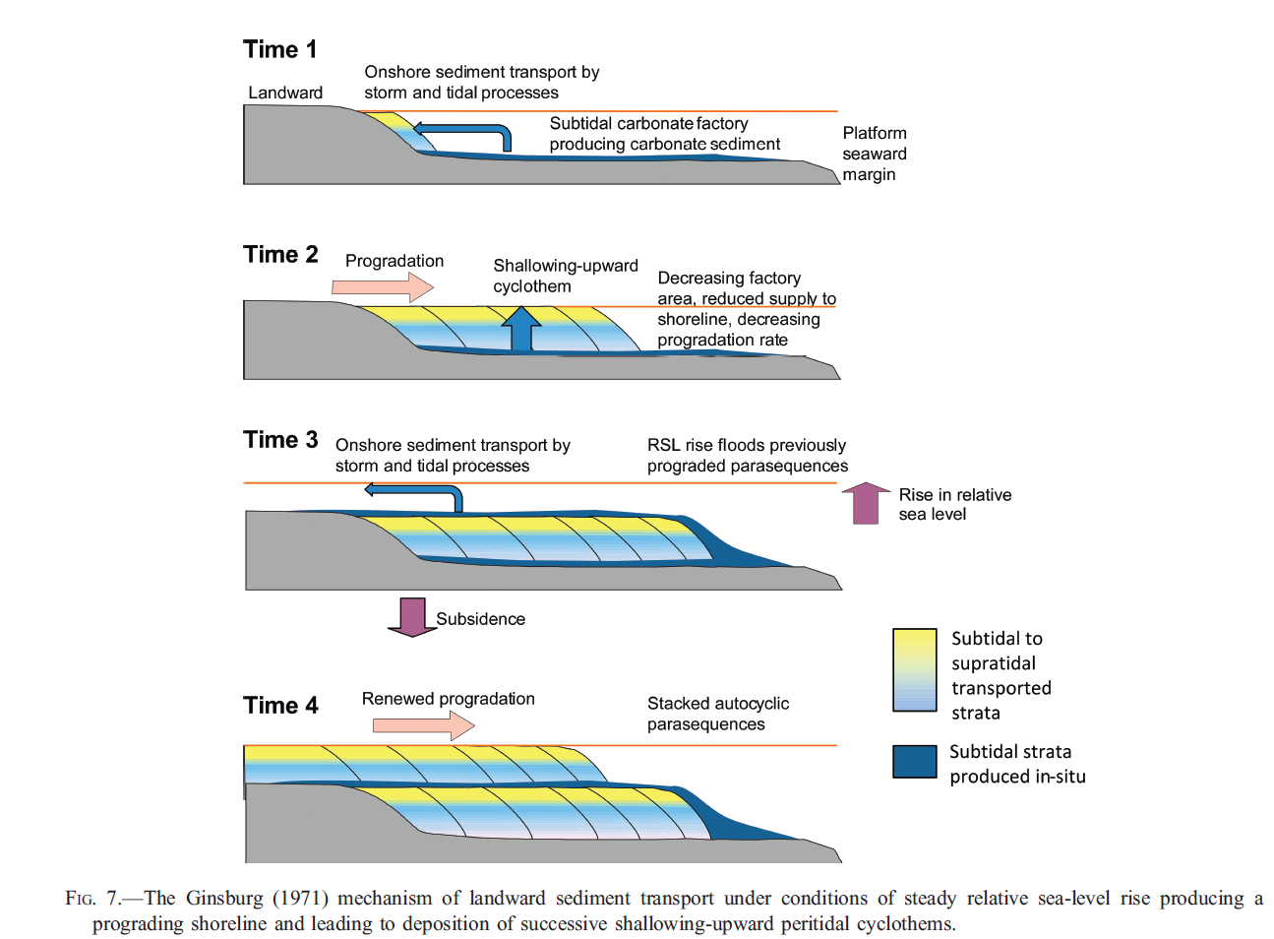
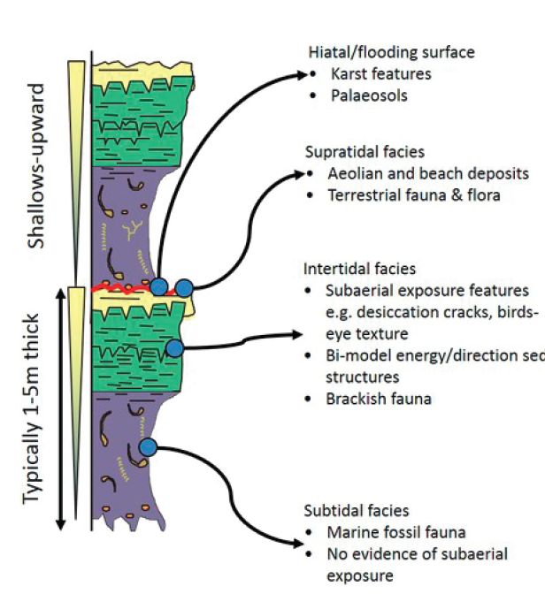
Ginsburg (1971) Autocycles – A Thought Experiment
Purkis et al., 2025
Ginsburg suggested that carbonate platforms have internal dynamics capable of generating repetitive stratigraphic patterns — what he termed autocycles
These cycles arise from the natural feedbacks between sedimentation and relative sea level on a platform, even under stable external conditions
Offshore carbonate mud drives shoreline progradation and shallowing-upward cycles (T1)
Progradation reduces factory size, slowing and halting sediment supply (T2–T3)
Reflooding reactivates production and transport, restarting the cycle (T4)
No GBB evidence!
Ginsburg

Slide 7
Purkis et al., 2025
[2] Emergent Behavior

Slide 8
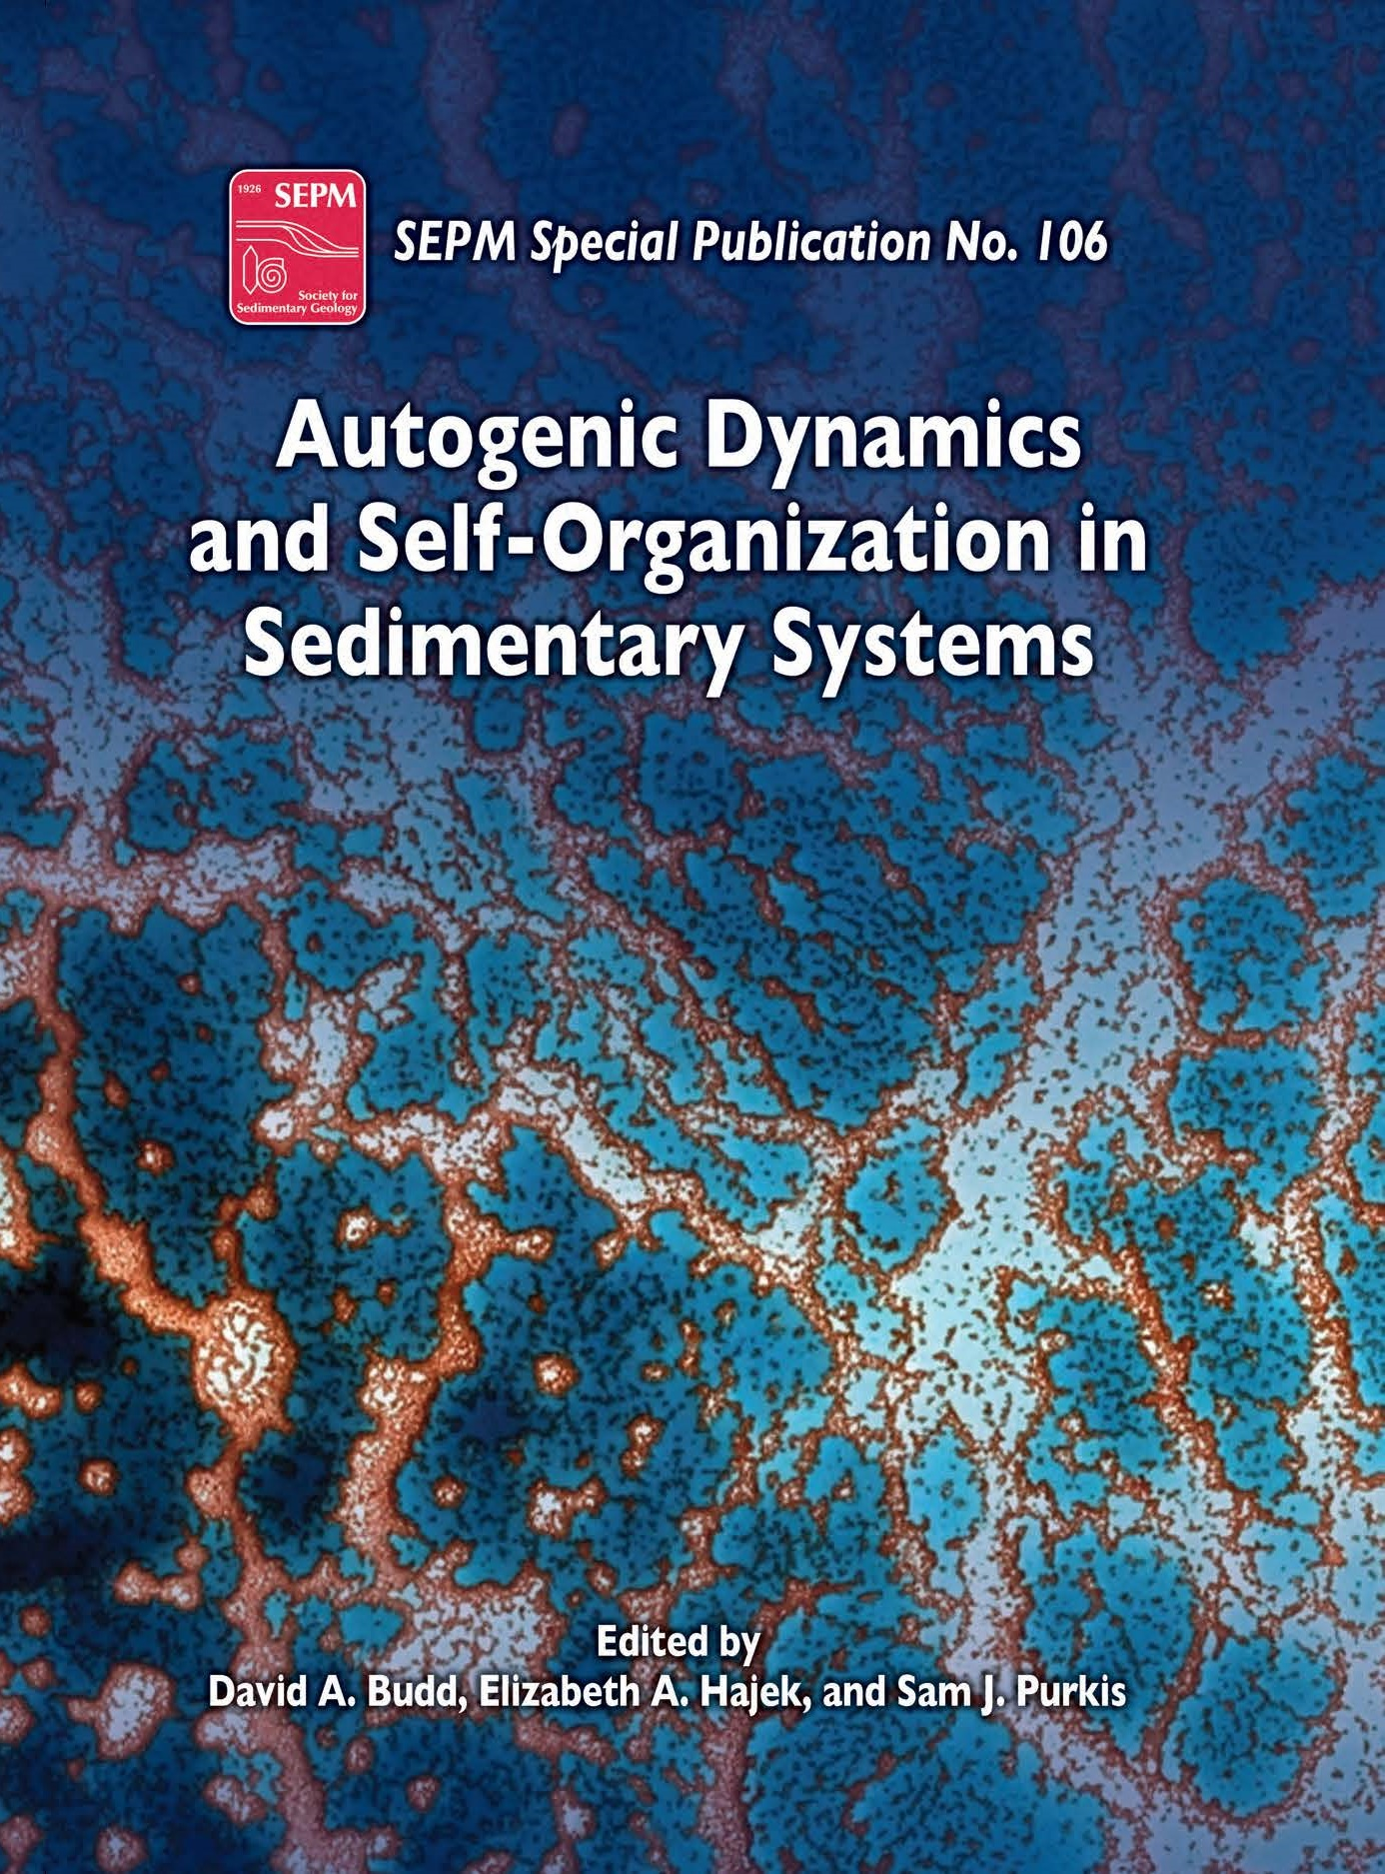
Global Reef Expedition – What do Big Data Reveal?
Purkis et al., 2025
The hallmarks of spatial self-organization
A universal characteristic of a complex system is that the whole is greater than, and often significantly different from, the simple linear sum of its parts
In many instances, the whole appears to act in a manner dissociated from the specific characteristics of its individual building blocks
This collective outcome is termed ‘emergent behavior’
A special case of emergent behavior is ‘self-organization’, where the constituents of a system agglomerate themselves to form the emergent whole – coherent patterning
The system gets organized

Slide 9
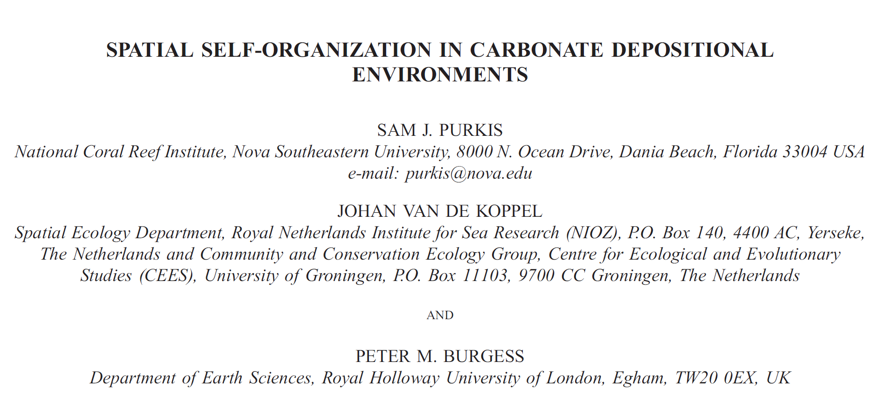
SEPM – Autogenic Dynamics
Purkis et al., 2025
2017

Slide 10
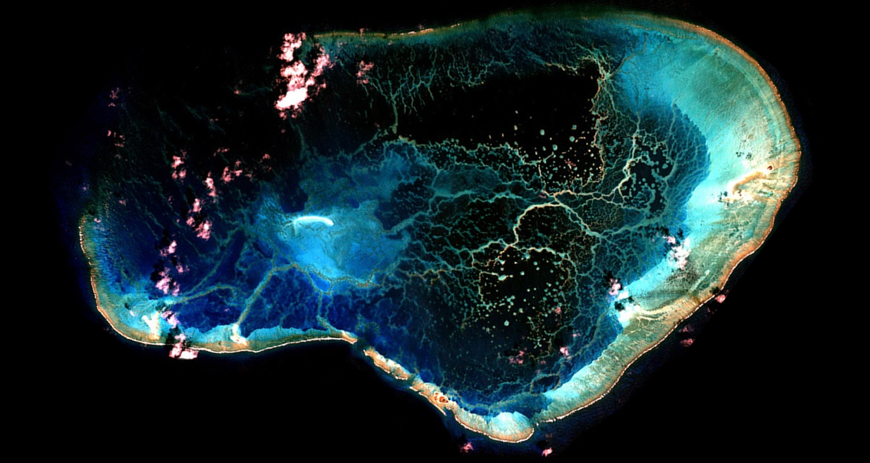
Coherent Patterning of Platform-Interior Reefs
Purkis et al., 2025
2 km
Pearl & Hermes Atoll, NW Hawaiian Isl.

Slide 11
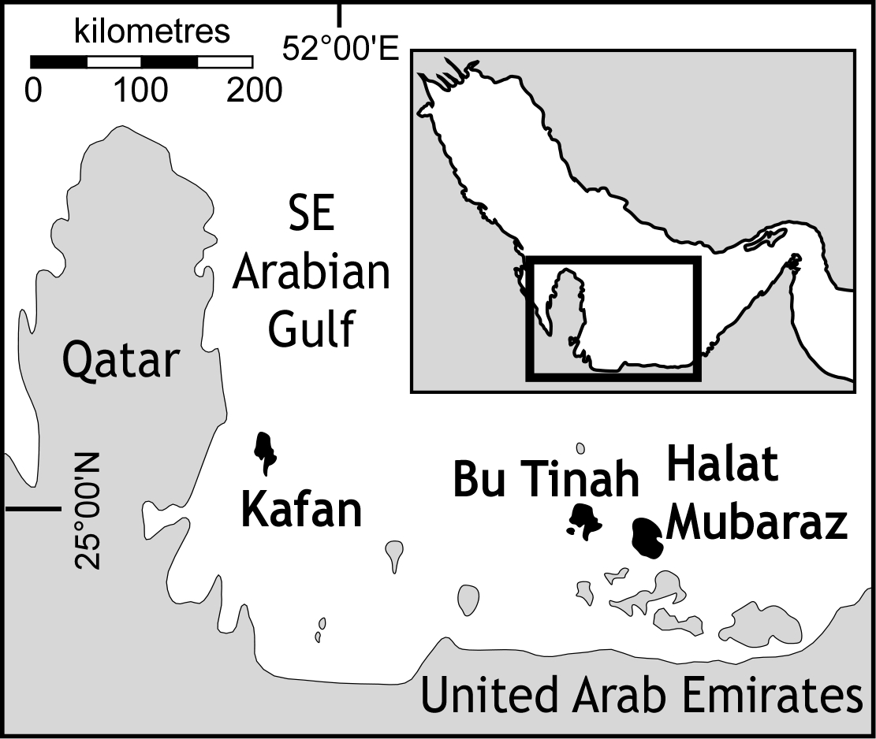
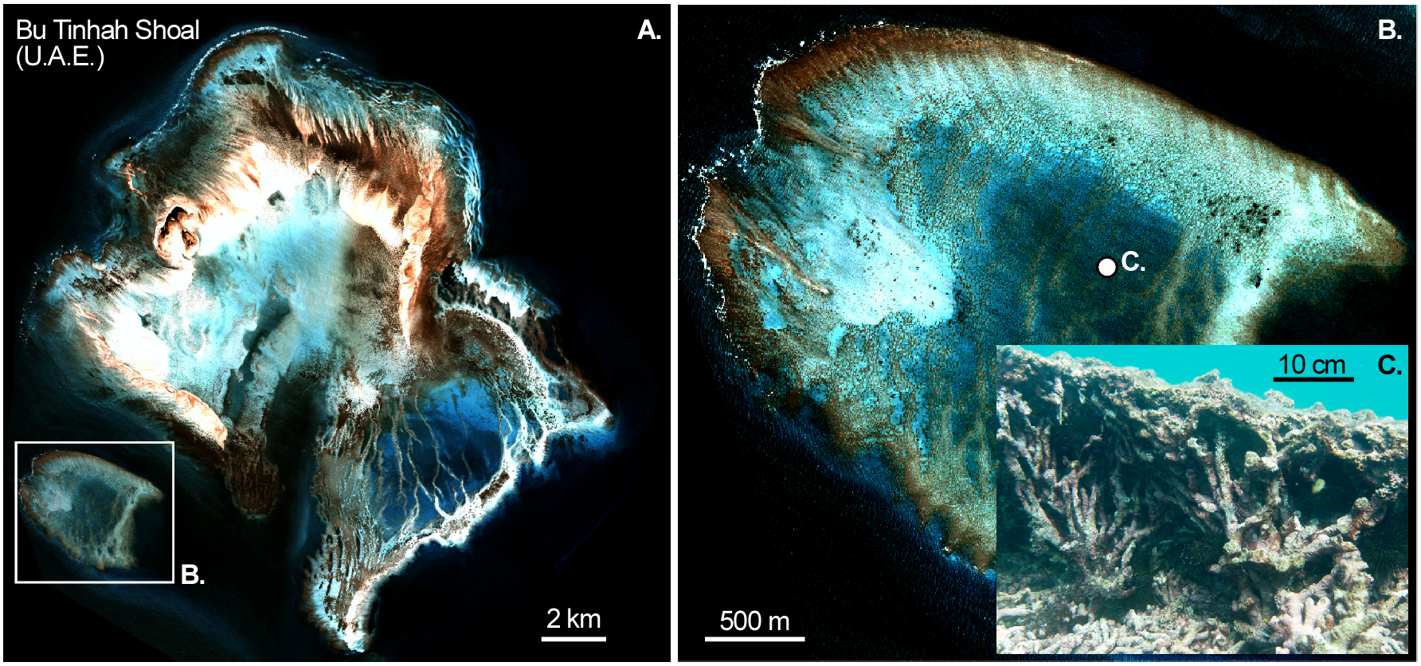
Coherent Patterning of Platform-Interior Reefs
Purkis et al., 2025

Slide 12
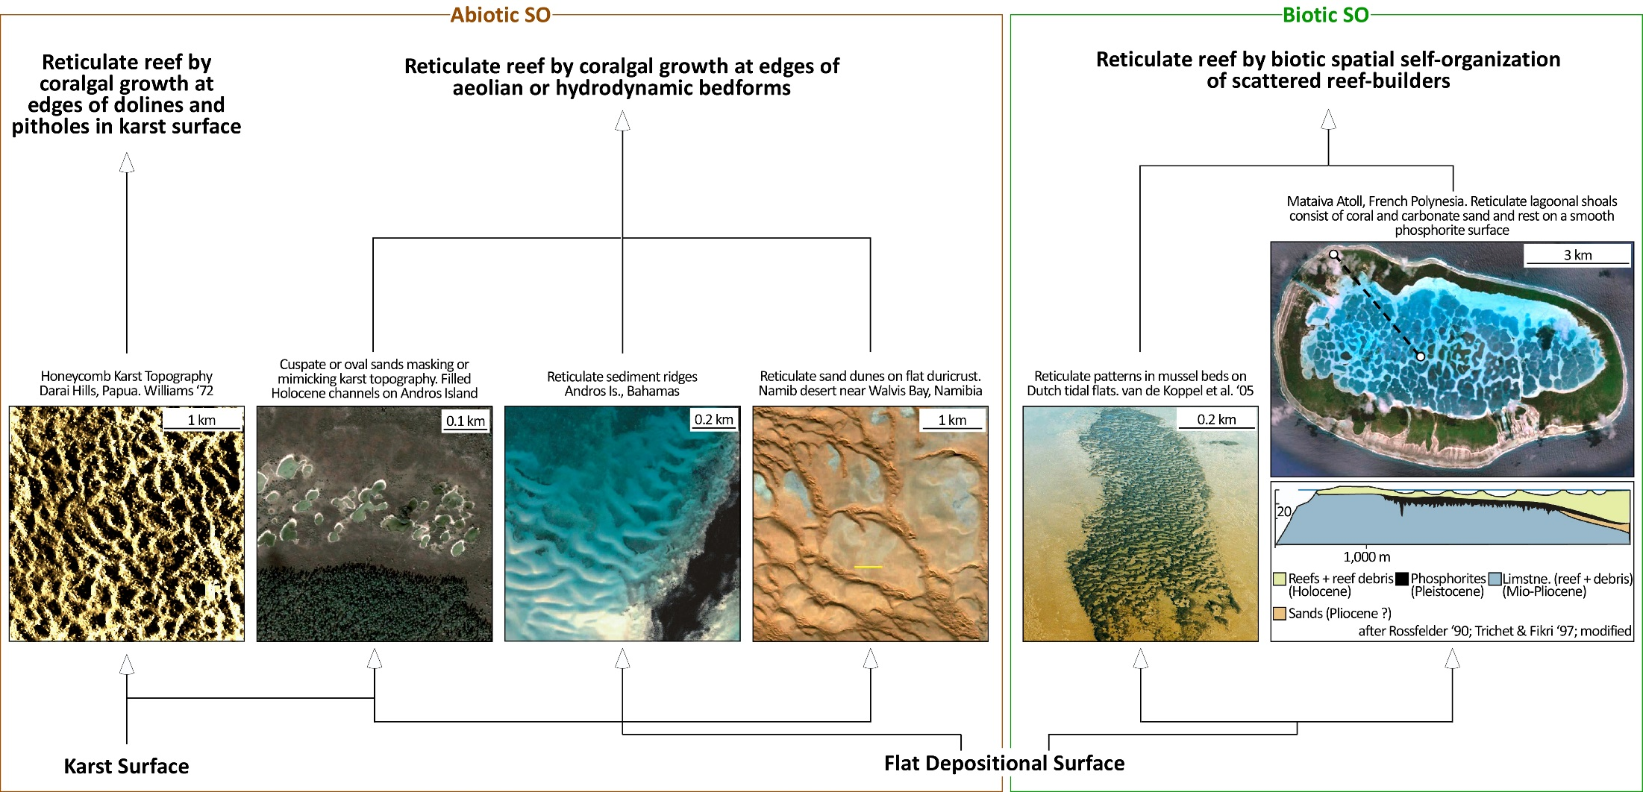
Why Coherent Patterning of Platform-Interior Reefs?
Purkis et al., 2025

Slide 13
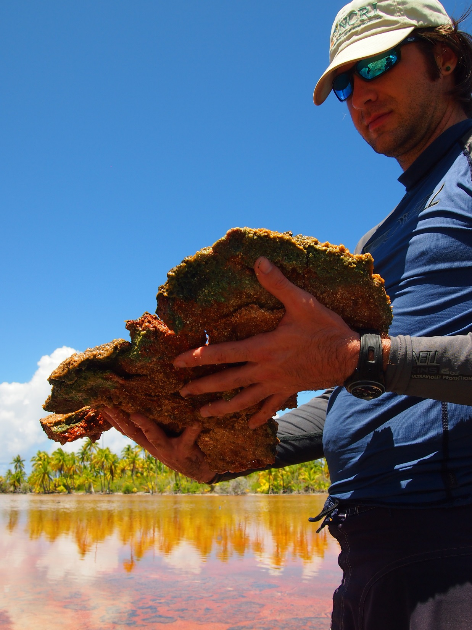
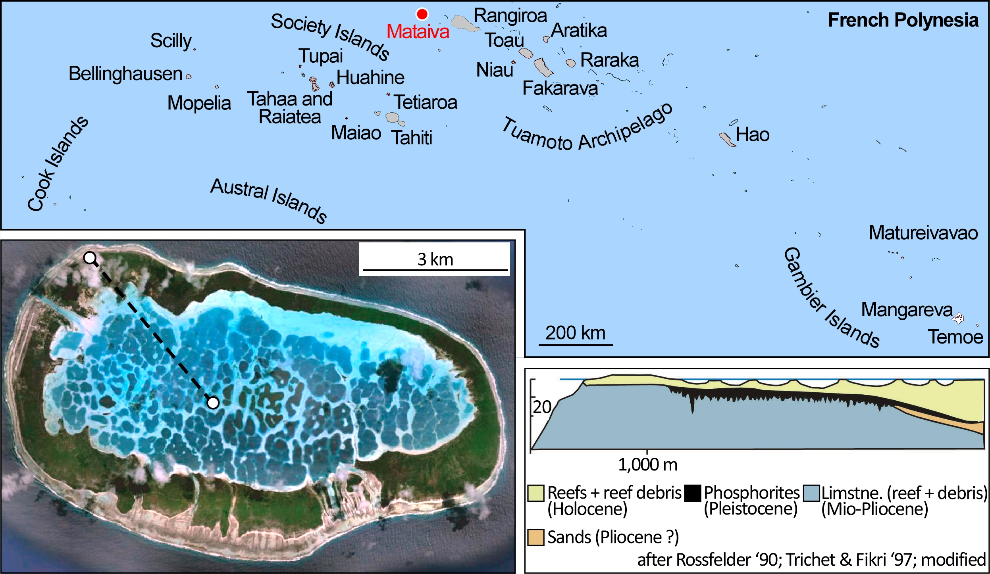
Coherent Patterning of Platform-Interior Reefs
Reticulate lagoonal shoals consist of coral and carbonate sand and rest on a smooth phosphorite surface
Pleistocene mega kopara ponds – thick stromatolitic cyano mats:
Phosphogenesis

Slide 14
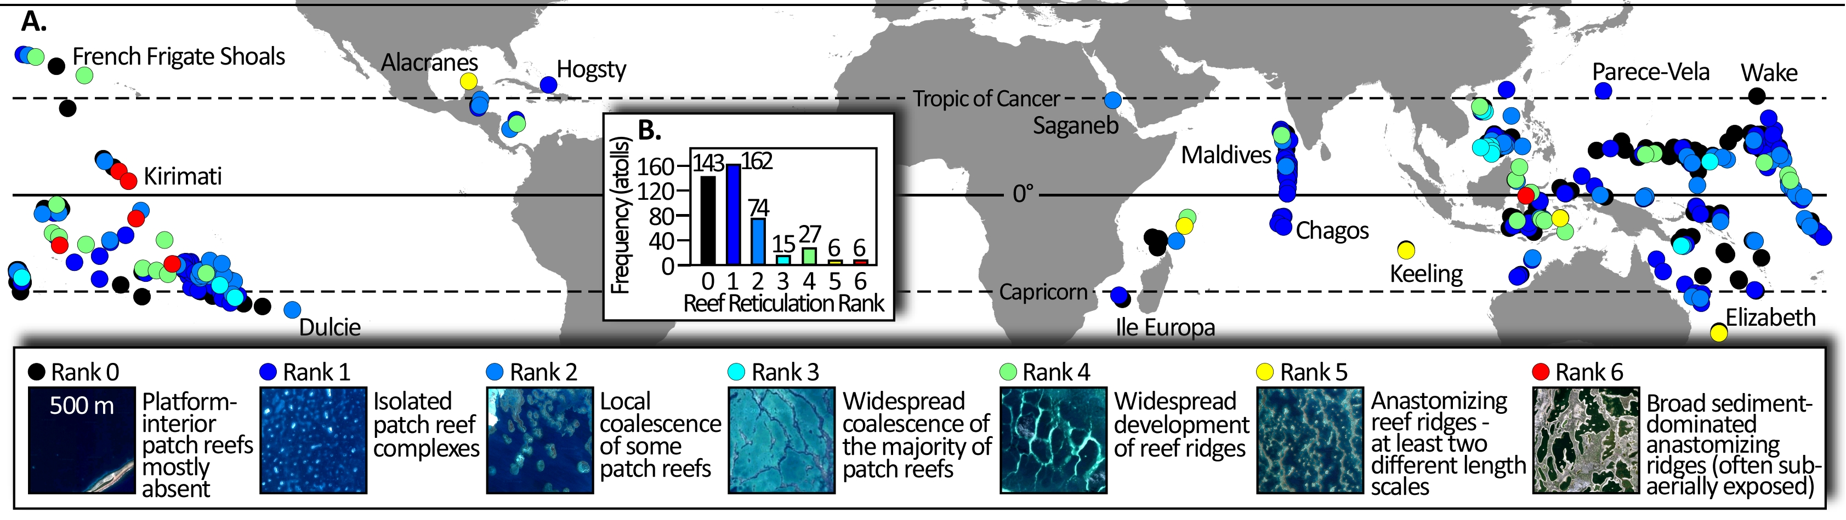
Widespread Reticulation
Purkis et al., 2025
Geographic and frequency distributions of reticulation ranks for †Goldberg’s 433 ‘Atolls of the World’
Globally, 30% of atoll lagoons contain reefs with some degree of reticulation
Note that atolls with high degrees of reef reticulation are spatially clustered
†Goldberg, W.M., 2016. Atolls of the world: Revisiting the original checklist. Atoll Res Bull, 610, pp.543-544.

Slide 15
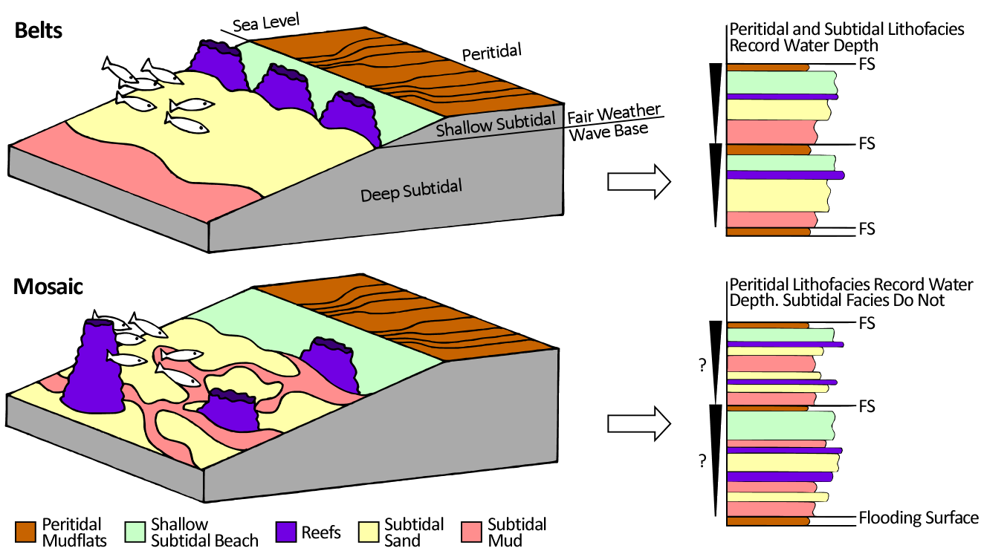
So What? Why Should We Care About Spatial Self-Organization
Bob Ginsburg
Sediments deposited with water-depth dependent attributes
Allogenic system
Autogenic system
Imparts autogenic control on stratigraphic anatomy
Yields stratigraphic complexity - mosaics, not belts (Wright & Burgess, 2005);
Can obscure or create cyclicity
Delivers surprising mathematical predictability
And, drastic ecological consequences – tipping points

Slide 16
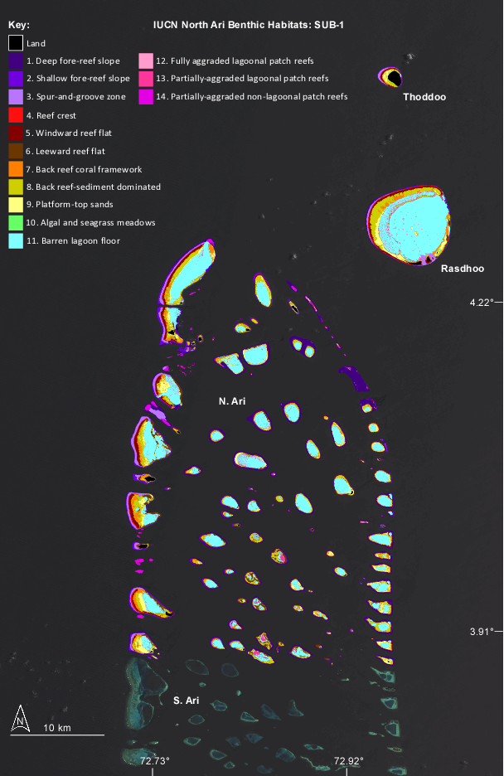
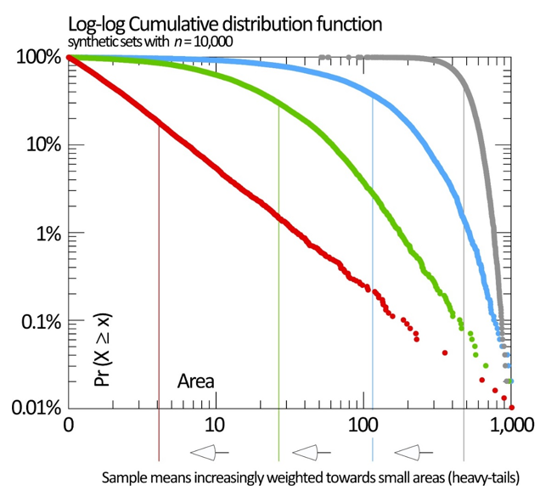
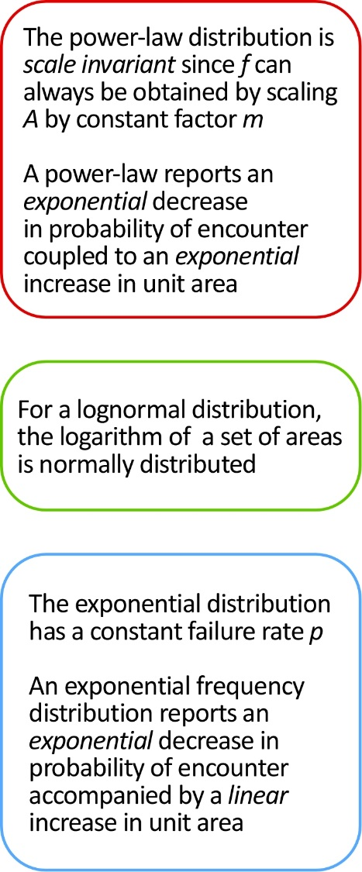
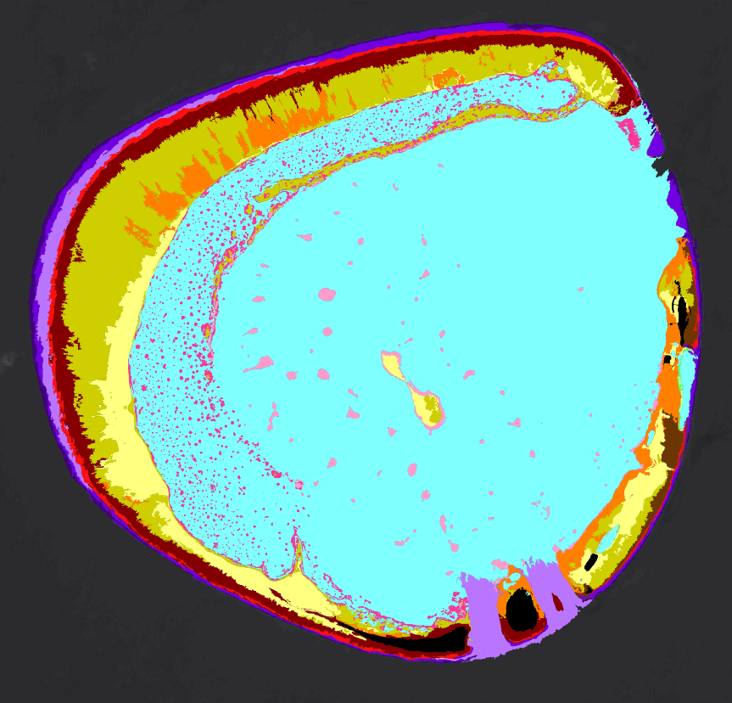
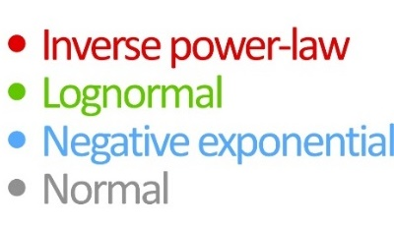
Carbonates are Often Fractal, Never Normal
Prediction Across Scale

Slide 17
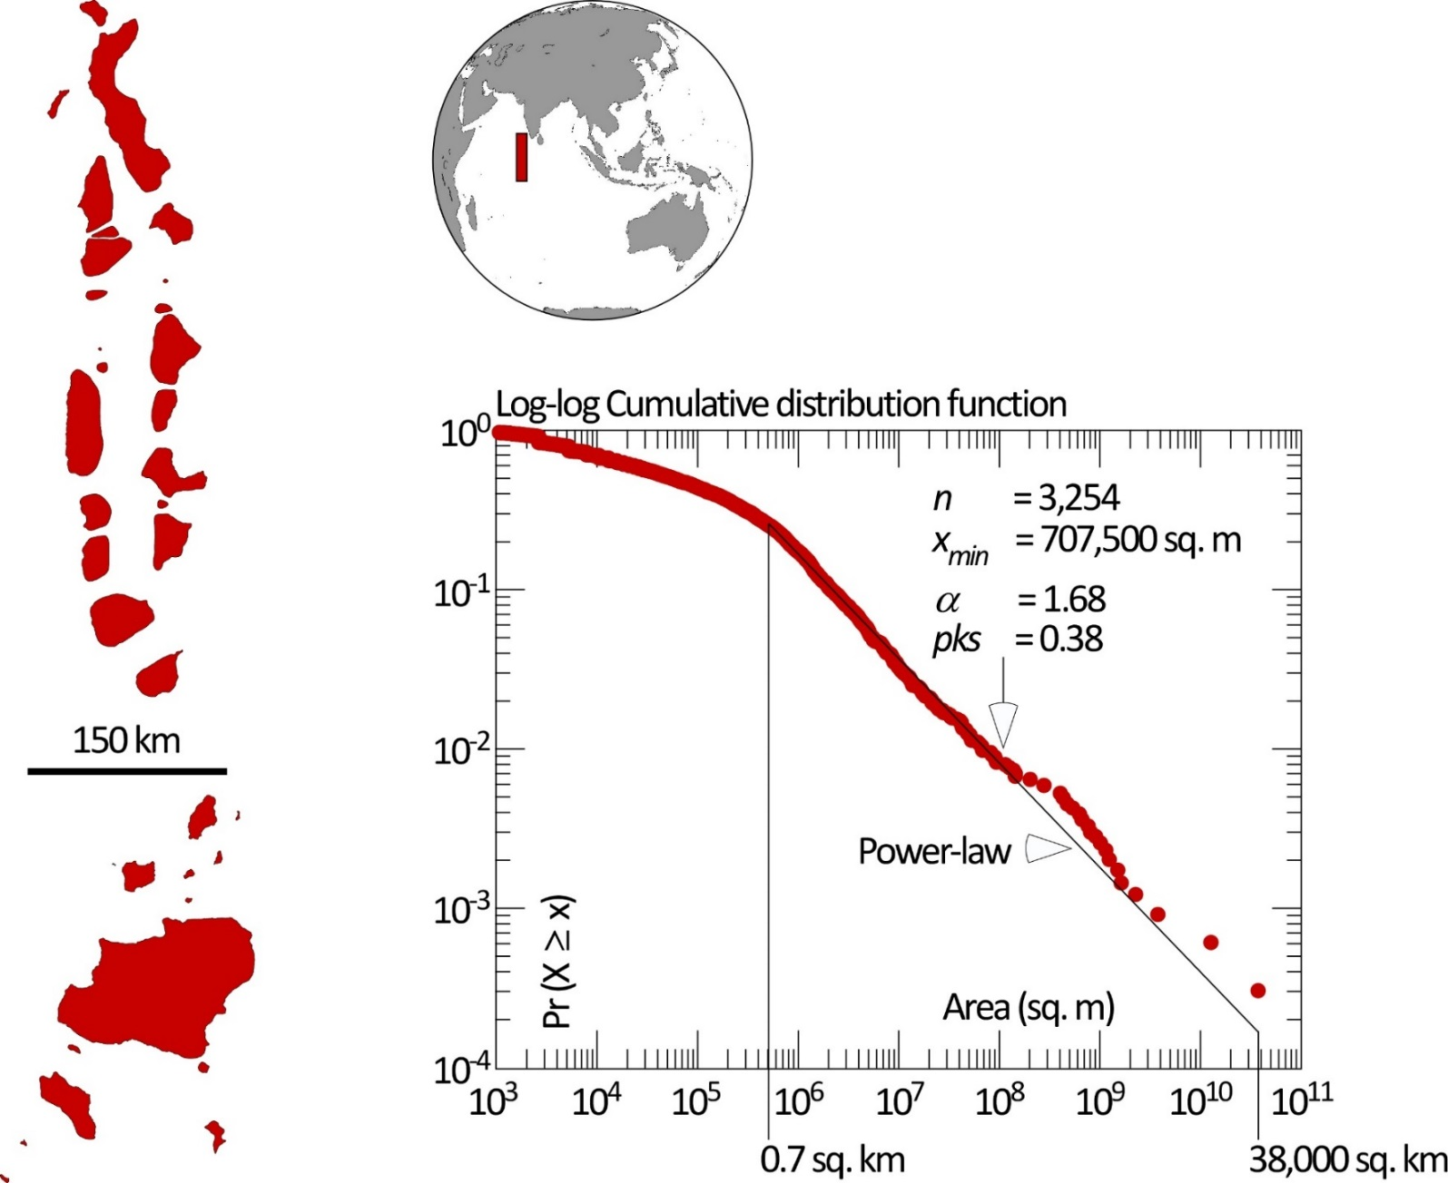
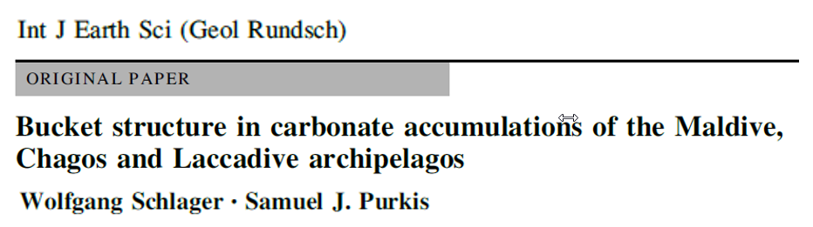
Carbonates are Often Fractal, Never Normal
Purkis et al., 2025
Reefal bodies scale with size in a remarkably universal, systematic, and predictable fashion
Wolfgang Schlager
Reefs that are one order of magnitude larger are 10× less abundant
2013

Slide 18
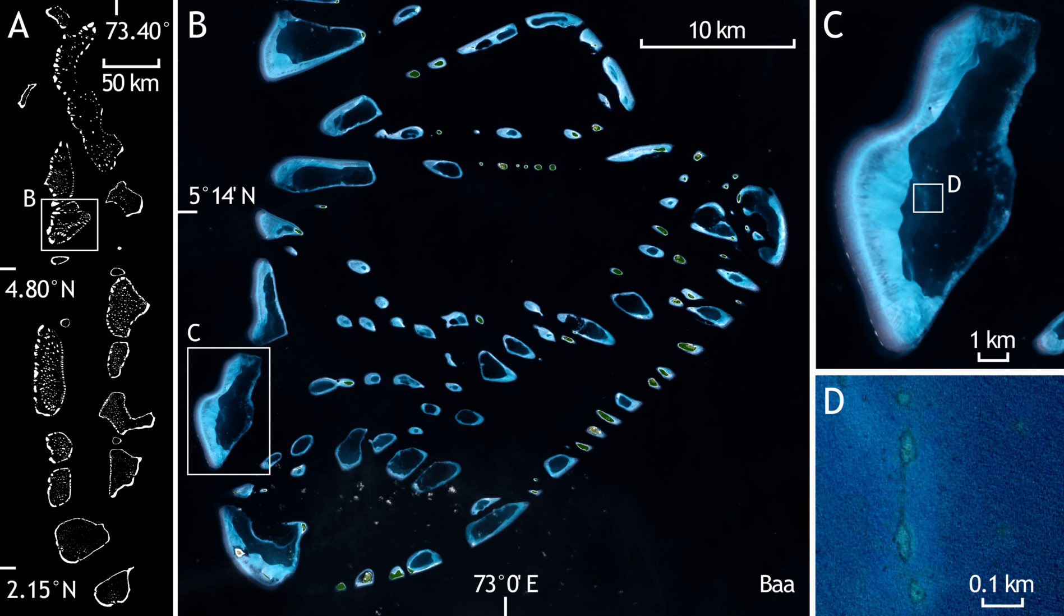

Slide 19
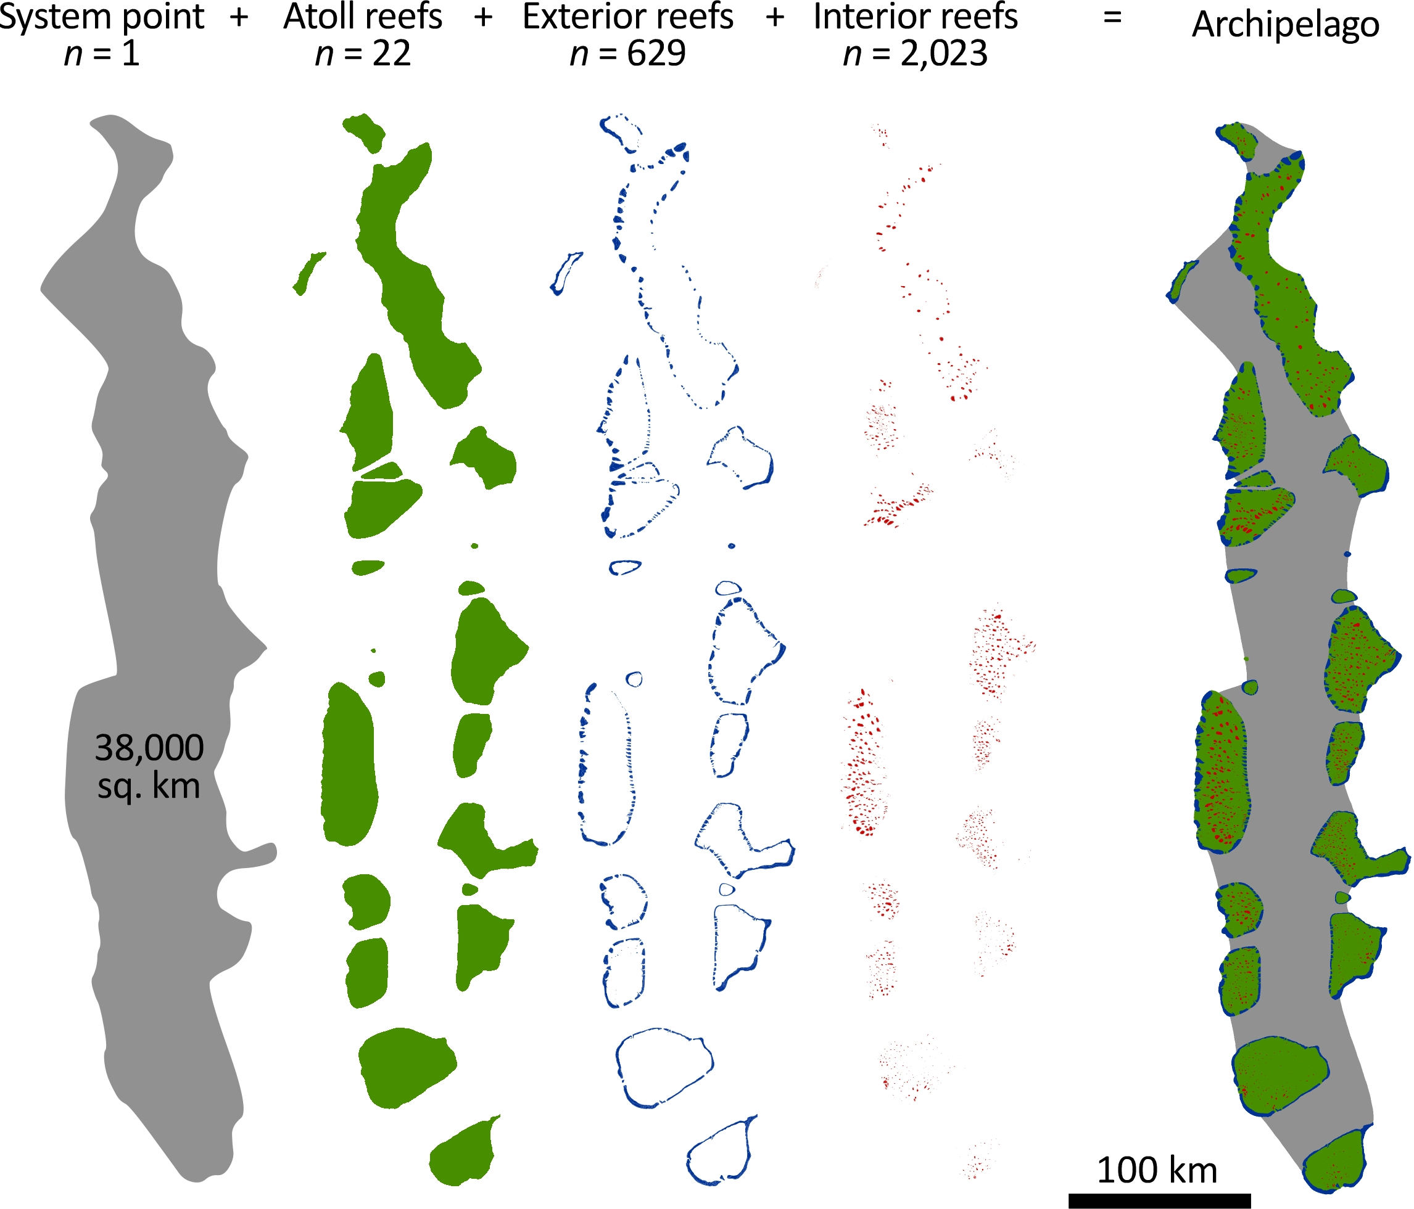
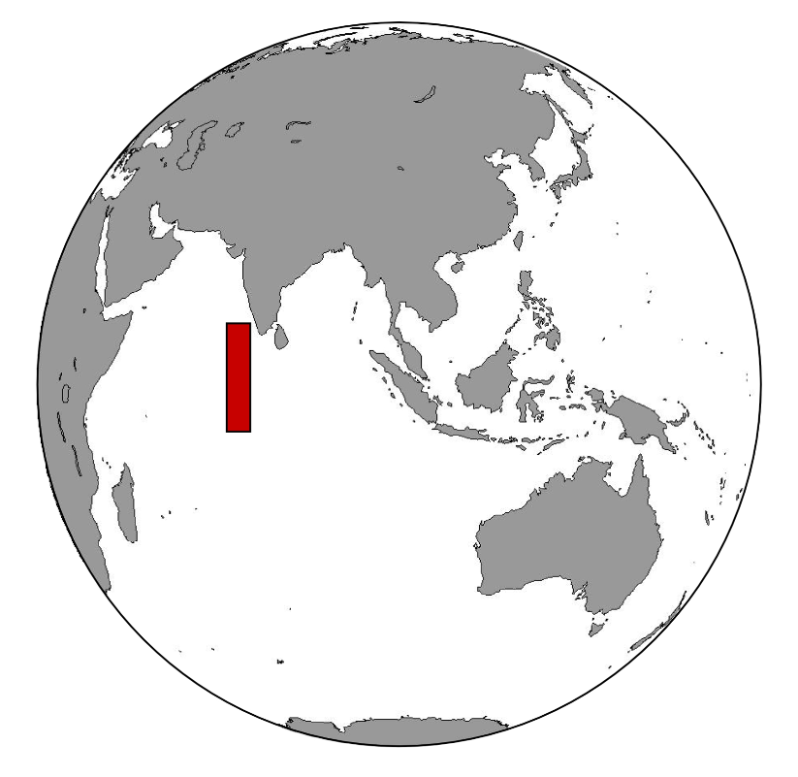
Construction Hierarchy of the Maldives
Purkis et al., 2025

Slide 20
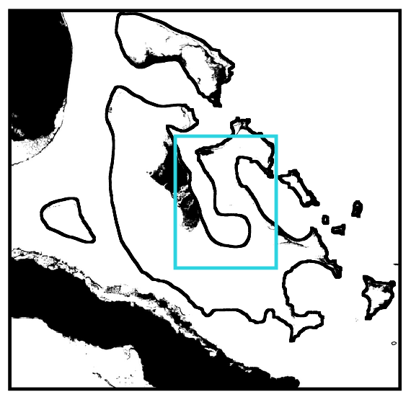
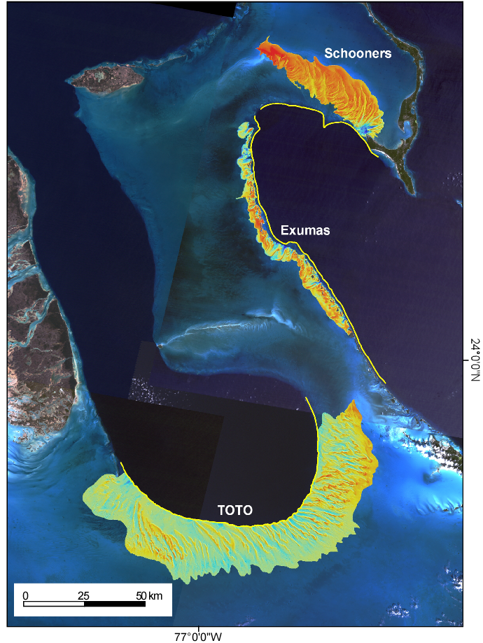
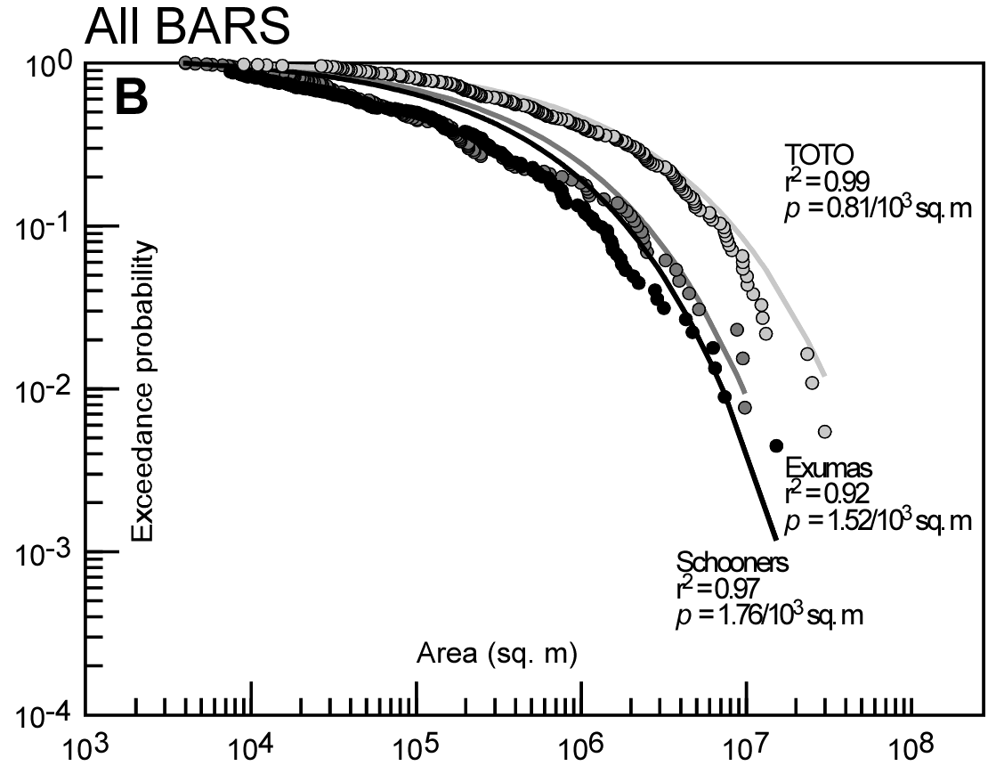

Carbonates are Often Fractal, Never Normal
Purkis et al., 2025

Slide 21
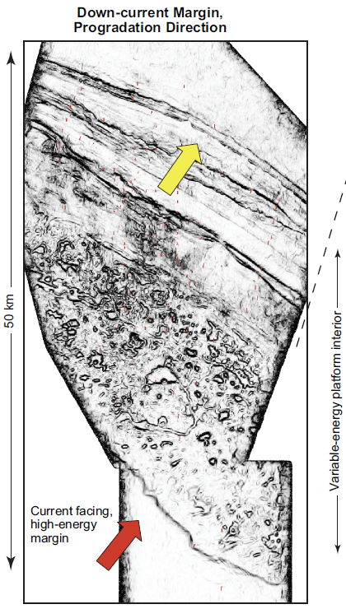

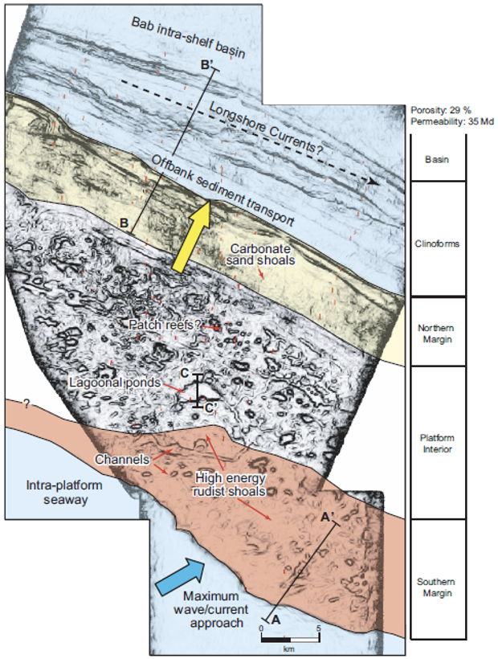
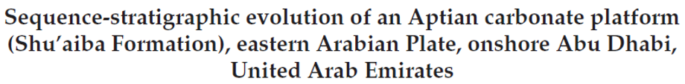
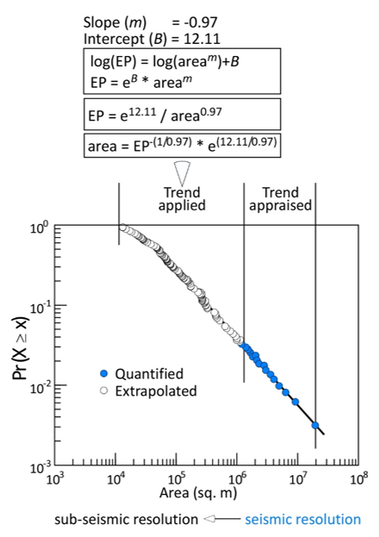
So What? Why Should We Care About Spatial Self-Organization

Slide 22
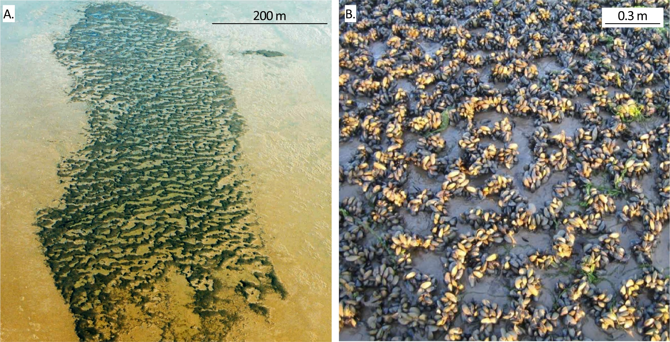
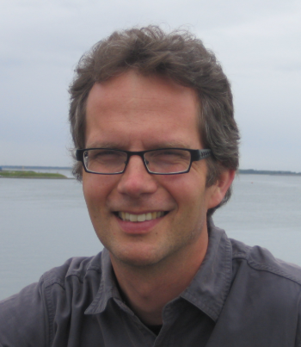
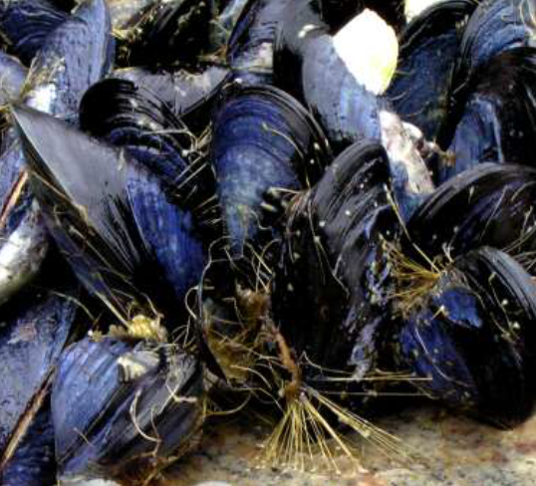
Spatial Self-Organization is Common in Carbonates – In Space and Time
Two scales of emergent patterning in mussel beds on Dutch tidal flats (from van de Koppel et al. 2005)
Purkis et al., 2025
m-scale: regular banded patterns orientated parallel to incoming tide
cm-scale: string-shaped aggregations that link up to produce a reticulate network

Slide 23
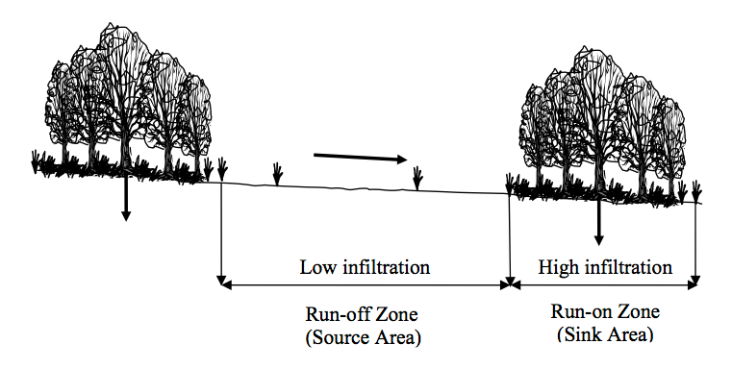
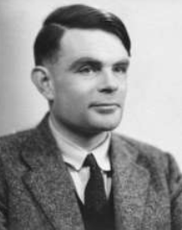
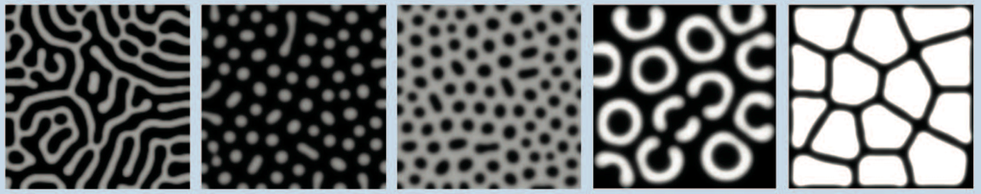
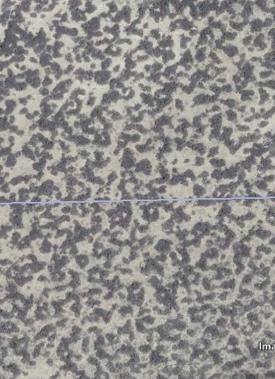
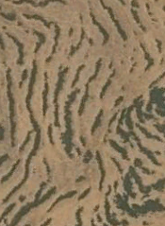
Spatial Self-Organization is Common in Carbonates – In Space and Time
Spatial self-organization – large-scale ordered spatial patterns that emerge through small-scale interactions
Key concept: spatial self-organization requires at least one set of coupled feedback loops (one positive and the other negative) operating at different spatial scales
“spots”
“tiger bands”
Turing ‘52
Turing Reaction-Diffusion Model
+
Short-distance positive feedback
+
Activator
Slow
diffusion
Distance
-
+
Net feedback strength
Inhibitor
Fast
diffusion
-
Long-distance negative feedback
250 m
250 m
Rietkerk & van de Koppel (2007)
Kondo and Miura (2010)

Slide 24
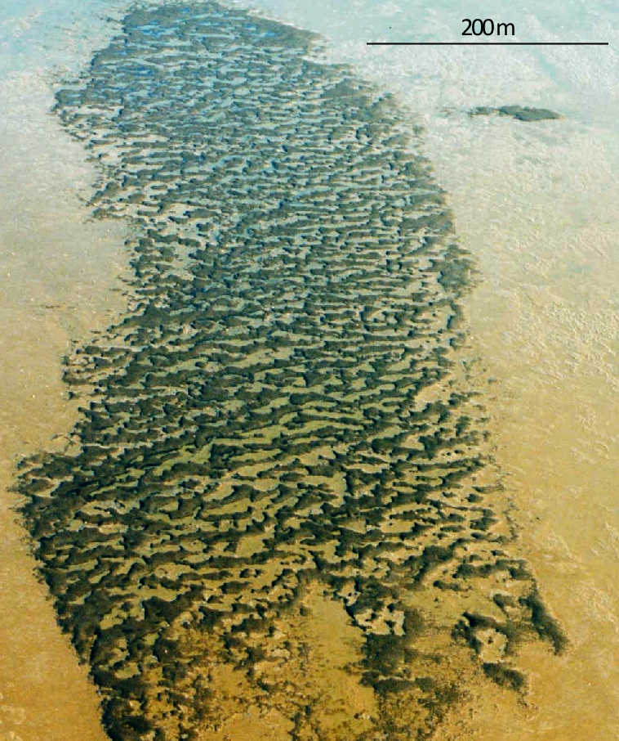
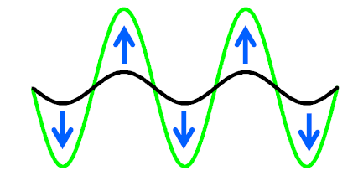
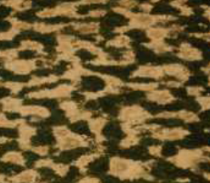



Spatial Self-Organization is Common in Carbonates – In Space and Time
Turing ‘52
Type 1
Growth-driven SO
(Activator-inhibitor principle)
Arid vegetation
Cahn ‘57
Short-range facilitation by mutual protection from waves and currents, vs. Long-range competition for resources (algae)
Type 2
Growth-driven SO
(Phase separation principle)
vd Koppel et al. (2005)
Purkis et al., 2025
Mussels

Slide 25







Halimeda bioherms of the northern Great Barrier Reef
Mardi McNeil & Jody Webster
(after McNeil et al. 2016, Coral Reefs)
Three bioherm morphology variants
Reticulate
Calcareous algal bioconstructor
Annulate
Queensland
Australia
Undulate
6095 km²

Slide 26

(www.deepreef.org)
Halimeda bioherm complex 25 m water depth
shallow coral reef (sea level)
~ I km
But What Happens When We Leave the Modern?

Slide 27
Purkis et al., 2025
[3] Emergent Behavior in the Geological Record

Slide 28




Mid-Mesozoic Bioherms - Romania
44.4767°, 28.4742°
Purkis et al., 2025
200 m

Slide 29





Purkis et al., 2025

Slide 30


Spatial Self-Organization is Common in Carbonates – In Space and Time
Study Areas – 50° of latitude and 300 Ma
Upper Carboniferous and Lower Permian
Cool water heterozoan
Warm water photozoan
Purkis et al., 2025

Slide 31




Alacranes Reef (GOM)
1 km

Slide 32


Power-law size-frequency dbn. of ponds 0.01 sq. km – 10 sq. km (~3 orders)
Trend well-characterized apart from ponds associated with structural lineaments (likely, faults)
N

Slide 33


Spatial Self-Organization is Common in Carbonates – In Space and Time
Seismic Expression of the Phylloid Algae Complexes Tubiphytes Build-ups Imaged and Penetrated by a Well
Purkis et al., 2025
Best imaged with RGB blended color schemes in flattened frequency decomposition cubes

Slide 34

Spatial Self-Organization is Common in Carbonates – In Space and Time
Systematic behavior across 300 Ma.
When considered at equal resolution, the size-freq. dbns. of ponds for Alacranes and the Barents are statistically inseparable – both are fractal
Purkis et al., 2025
Comparison of platform interior ponds at “Seismic” Resolution

Slide 35


Spatial Self-Organization is Common in Carbonates – In Space and Time
Hierarchies of Scale
Reticulated morphologies of the Upper Palaeozoic build-ups and the Modern scleractinian analog share dominant periodicities at length scales of 2 km and 4 km
The characteristic periodicities conform to breadth of “Major” and “Composite” ponds
The build-up patterns are statistically inseparable between the Upper Palaeozoic and the Modern
Why?
Purkis et al., 2025

Slide 36


NASA ROSES – The Marine Biodiversity and Scaling Project (Grant 20-BIODIV20-0108)
2022-2025
MarineVERSE – The Marine Biodiversity and Scaling Project
Dr. Haiwei Xi

Slide 37

Widespread Reticulation
Purkis et al., 2025

Slide 38


Reaction-Diffusion Model for Reef Pattern Formation
Purkis et al., 2025
Governing Equations
Hydrodynamics
$$∇\left(p_{f}U\right)+\frac{∂p_{f}}{∂t}=0$$
$$<u_{x}>w=\frac{∂ψ}{∂y} and <u_{y}>w=\frac{∂ψ}{∂x}$$
$$ψ_{(i,j)}=\left(jdh−\frac{idh}{tan⁡(θ)}\right)wsin(U_{0})$$
$$ψ_{\left(i,j\right)}=\frac{ψ_{\left(i+1,j\right)}\left(f_{\left(i+1,j\right)}+f_{\left(i,j\right)}\right)+ψ_{\left(i−1,j\right)}\left(f_{\left(i−1,j\right)}+f_{\left(i,j\right)}\right)+ψ_{\left(i,j+1\right)}\left(f_{\left(i,j+1\right)}+f_{\left(i,j\right)}\right)+ψ_{\left(i,j−1\right)}\left(f_{\left(i,j−1\right)}+f_{\left(i,j\right)}\right)}{{4f}_{\left(i,j\right)}+f_{\left(i+1,j\right)}+f_{\left(i−1,j\right)}+f_{\left(i,j+1\right)}+f_{\left(i,j−1\right)}}$$
$f_{\left(i,j\right)}=\frac{p_{f}k^{2}}{{(w_{i,j}\ln\left({w_{i,j}}/{z_{0}}\right)+w_{i,j}+z_{0})}^{2}}$
$${<u}_{x(i,j)}>=\frac{ψ_{\left(i,j−1\right)}−ψ_{\left(i,j+1\right)}}{2dx w_{i,j}} and {<u}_{y(i,j)}>=\frac{ψ_{\left(i−1,j\right)}−ψ_{\left(i+1,j\right)}}{2dy w_{i,j}}$$
$$<U_{(i,j)}> =\sqrt{{{<u}_{x(i,j)}>}^{2}+{{<u}_{y(i,j)}>}^{2}}$$
$u_{∗\left(i,j\right)}=\frac{<U_{(i,j)}>k }{ln\frac{w_{(i,j)}}{z_{0}}−1+\frac{z_{0}}{w_{(i,j)}}}$
Reef biomass production (B, t/m²)
$$\frac{∂B}{∂t}=rf_{B}\left(S,V\right)\frac{\left(K−B\right)}{K}B+D_{1}∗\left(\frac{∂^{2}B}{∂x^{2}}+\frac{∂^{2}B}{∂y^{2}}\right)$$
Sediment accumulation (S, m)
$$\frac{∂S}{∂t}=cBf_{S}\left(V\right)+D_{2}∗\left(\frac{∂^{2}S}{∂x^{2}}+\frac{∂^{2}S}{∂y^{2}}\right)$$
Elevation change (Z, m)
$$\frac{∂Z}{∂t}=γ\frac{∂B}{∂t}+\frac{∂S}{∂t}$$

Slide 39


Reaction-Diffusion Model for Reef Pattern Formation
Purkis et al., 2025
1 km

Slide 40


Model Validation
Purkis et al., 2025

Slide 41

Conclusions
Purkis et al., 2025
Spatial self-organization, the process where coherent spatial patterns emerge through internal interactions, is widely observed in modern and ancient natural systems
Despite a wide range of modern cases, the concept of self-organization and its potential effects on geological patterns have not yet been widely discussed by the geological community, especially in carbonate depositional systems
This new project aims to provide a firm understanding of the mechanisms that generate emergent patterning in carbonate deposystems

Slide 42

Purkis et al., 2025
Flora Beleznay
Questions

